Slide 1
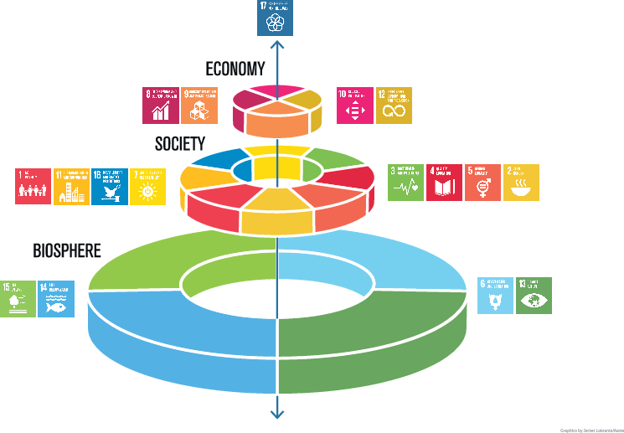
Addressing Sustainability In All Evaluation
Andy Rowe
Footprint Evaluation
Image from Stockholm Resilience Centre
Notes:
We were very pleased to see this image of the SDGs displayed in the cafeteria
The difference from the usual group photo of the SDGs is that here it is clear that natural systems are the foundation for all of the others, society and economy
This means that when addressing the social and economic SDGs there is a connection to those of the natural systems – to put it bluntly whatever we do on any of the SDGs affects natural systems – draws from them such as water for irrigation or WASH programs, and leaves deposits on them such as plastics, landfills, ocean and air pollution
Thus we need to consider natural systems in all evaluations, that includes those that do not have specific natural system outcomes.
Failing to do so means that we have excluded important direct effects of the intervention, and that will usually mean negative effects.
And one of the most systematic things one can observe about evaluation globally and nationally is that it ignores natural systems – we have two recent assessments one from UNEG and one from the Canadian Evaluation Society that clearly demonstrate this – we are talking around 4% of all federal evaluations in Canada consider natural along with human system outomes

Slide 2
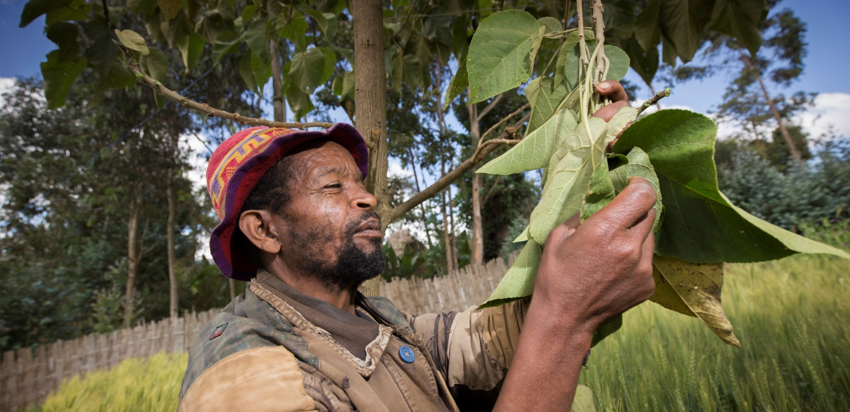
Thematic Evaluation of
IFAD's Support to Smallholder Farmers' Adaptation to Climate Change
Notes:
That means that evaluation globally gets the value of the evaluand wrong, likely systematically positive lean.
The implication is that we are encouraging replication of interventions that are harming natural systems
And as we all know and accept now, we can no longer afford to do so – the 2030 Paris agreement thresholds are looming before us and as we have heard several times already in this conference, on most natural system fronts we continue to harm and burden natural systems instead of reaching DNH or restoring
A recent Thematic Evaluation of IFAD demonstrates that evaluation can incorporate environmental systainability into evaluaitons of interventions that focus on human systems
I want to briefly show how this worked – and communicate to you that it shows proof of concept – that IF we decided to address environmental sustainability we have the technical, process and other capacities needed for this. So my main message is – let’s get going incorporating sustainability into all evaluations
The evaluation was …

Slide 3
Sources of Evidence for the Evaluation
20 (35 projects – 14% of IFAD climate portfolio, stratified purposive sampling)
Knowledge Management, Scaling Up, Human-Natural systems nexus, Rapid Evidence Assessment - secondary evidence from published literature)
Feedback from IFAD and Project Staff (227 responses)
HQ Stakeholders (EB, IFAD staff)
Project, Country and Corporate level documents and data analysis; IOE Evaluations; Analysis of GIS data
Case Studies
Learning Theme Studies
E-Surveys
HQ Interviews
Document Review
TE of IFAD’s Support for Smallholder Farmers’ Adaptation to Climate Change
Learning Event
19th May 2022
Notes:
A quick snapshot of the evaluation – the core was systematic document review, and incorporating natural systems questions into interviews and case studies
I want to point to the case studies – these were really country case studies – 20 is a pretty robust sample

Slide 4
Assessing overall environmental sustainability
Restorative Restores the natural environment so that it thrives
No Net Harm to the Natural System Practices cause no harm OR restoration offsets any harm
Sustainability-Aware Practice Sustainability-aware practices limit environmental damage
Plunders the Natural System Extractive and damaging practices cause serious harm
beneficial
neutral
harmful
destructive
Notes:
What do we mean by sustainable and how do we operationalize this for evaluation?
'Sustainable' development means development that meets the needs of the present without compromising the ability of future generations to meet their own needs.​
IPCC (2018) defines sustainability as a dynamic process that guarantees the persistence of natural and human systems in an equitable manner. ​
In other words, sustainability is about pursuing goals for the human system (such as equity, food security) while preserving (or restoring degraded) natural systems.
The figure you see is the typology we developed and which is now a core element in Footprint Evaluation

Slide 5
Impact of CCA: Ecosystem – Human System Nexus
Likely to be Harmful to ecosystems
Neutral or beneficial to ecosystems
Number of Country Case Studies (N=20)
Successful projects pursued integrated approaches with nature-based solutions
Failure to ‘Do No Harm’ is likely to lead to low sustainability of benefits of IFAD interventions
A strong subset of IFAD climate projects were performing at or beyond doing no harm
TE of IFAD’s Support for Smallholder Farmers’ Adaptation to Climate Change
Learning Event
19th May 2022
Notes:
Use of typology identified some key elements as you can see in the slide
IFAD demonstrated proof of concept and importance of use-seeking processes
Next steps to develop rubrics so that typology can be used to assess the overall environmental sustainability of all interventions
Especially evaluations where intervention does not have specific environmental goals, small(er) budget evaluations
Subsequent reviews by IFAD IOE, IFAD operations and management did not seriously challenge the approach

Slide 6
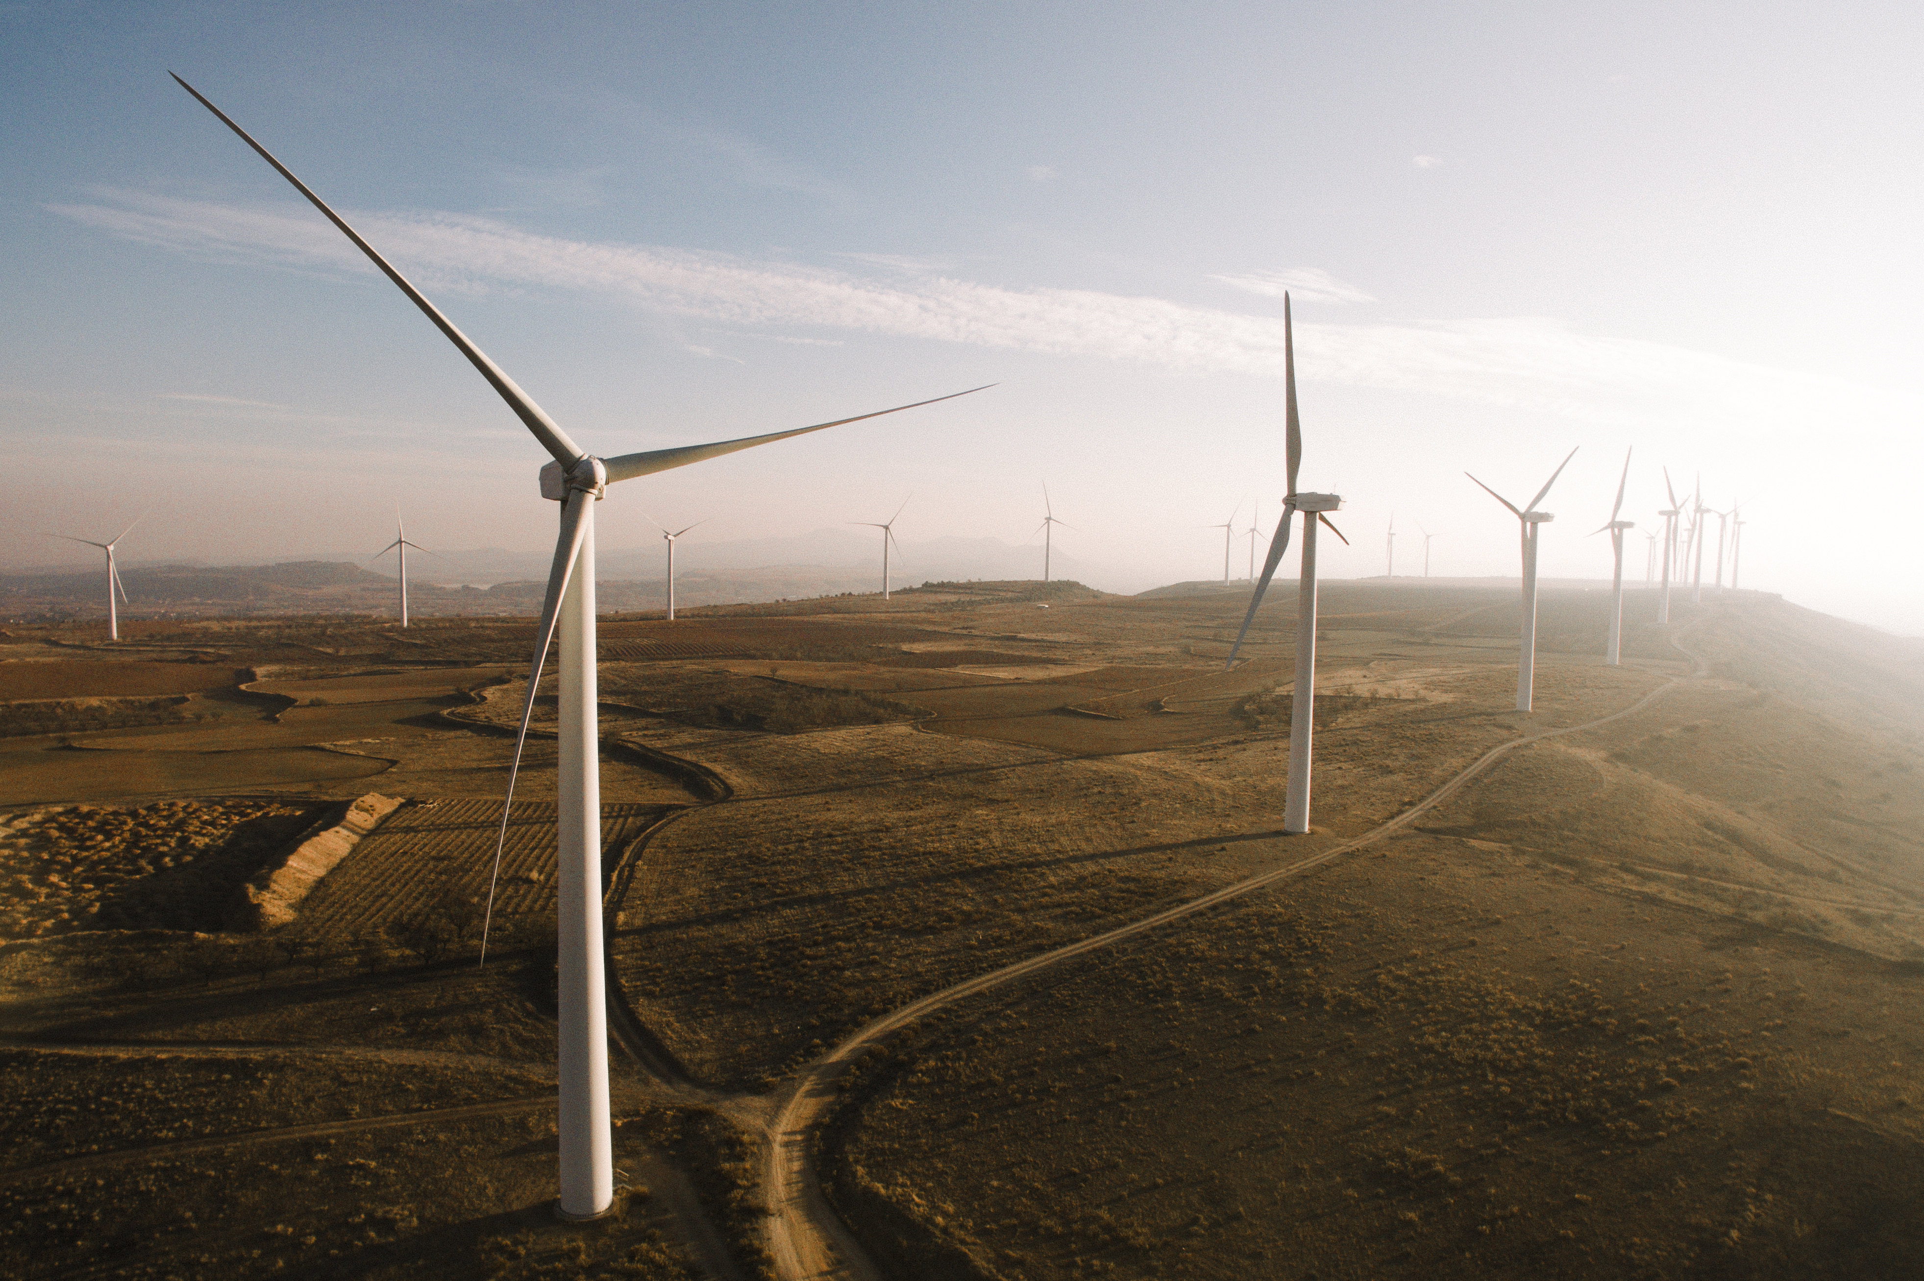
Yes. EVERY evaluation needs to address this.
Every single policy, programme, project, and intervention couples with natural systems in some way
Notes:
JANE
Part of getting this right is being very clear that environmental sustainability is not just about preserving the natural environment or minimising any further harm.
We now have an extremely damaged natural system that needs to be restored.
Right now, in 2022, everything we do has to help restore the natural environment and put the systems and structures in place that stop the harm from occurring.
This is the same logic we apply when we design evaluation to be in service of equity.
Equitable policies and programs don’t just stop harming marginalised groups; they address and repair past harm as much as possible, and they dismantle the systems and structures that were causing harm in the first place.

Slide 7
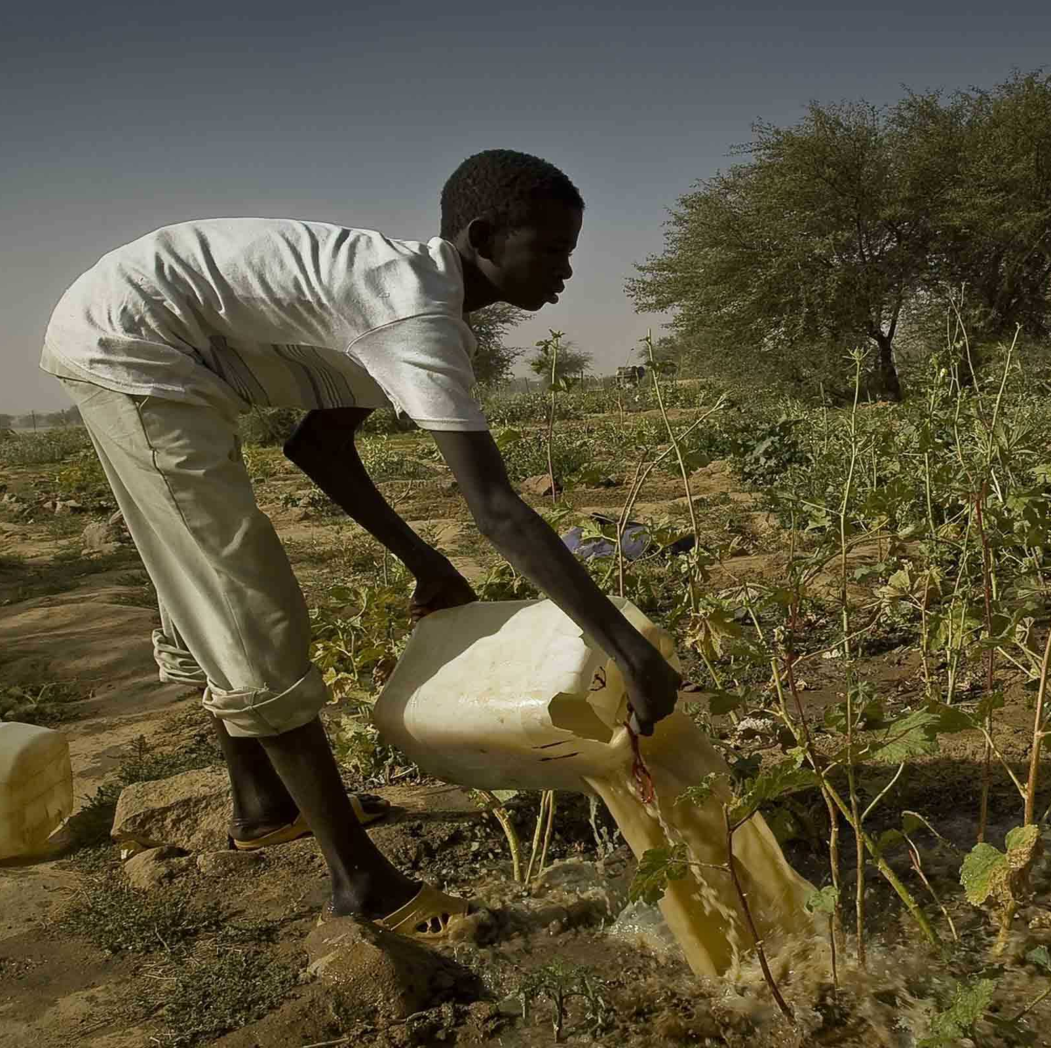
What does sustainable and equitable design look like?
Addresses the root causes and systemic drivers of environmental damage and of inequitable outcomes.
Informed by the expertise/perspectives of affected communities, especially Indigenous groups – via culturally appropriate consultation.
Restorative, addressing and repairing past harm to people and the environment, not just “do no more harm”.
Adapted and improved over time to respond to emerging conditions and learning.
Notes:
Equity and Sustainability are intertwined and inseperable

Slide 8
What does sustainable and equitable implementation look like?
Prioritized and managed so that the right natural system elements and the right people received what was most needed at the right times and places and in the right ways.
Appropriately balanced implementation fidelity with responsive adaptation/tailoring to context, landscapes, and changing local priorities.
Upholds and enhances the rights, dignity, self-determination and sovereignty of the traditional custodians of the land, including their responsibilities for stewardship of natural systems.
Notes:
Sustainability can also be applied to implementation.
A few things you might ask here include:
How well prioritization and management got the right support to the right parts of the natural system at the times it was most needed.
How well the implementation balanced the need to tailor to the local context and landscapes vs. “fidelity to design”.
How well the implementation enhanced the rights, dignity, self-determination and sovereignty of the traditional custodians of the land.

Slide 9
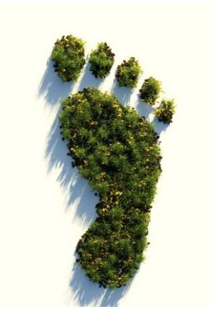
Emerging principles for footprint evaluation
1. Value both human and natural systems
Intrinsic value of natural systems, not only their value to human systems
Address equity throughout
Crafting win-win solutions rather than zero-sum game
3. Expand the scope
Spatially – downstream, downwind
Temporally - intergenerational
4. Draw on multiple sources of evidence and expertise
Natural systems science
Local and Indigenous knowledge
2
2. Know the place
Observe and engage - literally, virtually or vicariously
Purposeful sampling
3
5. Use systems thinking
Feedback loops, tipping points, fractals, boundary critique
4
1
5
6
6. Focus on the big issues
Significant impacts not just what is easily measurable or achievable
Notes:
In addition to the typology and forthcoming rubrics Footprint Evaluation has and is developing other normative or knowledge products such as guidance on how to incorporate sustainability into all evaluation

Slide 10
Footprint Evaluation can use existing evaluative criteria
How well does the intervention align with policies and commitments to protect and restore the natural system?
Is the intervention doing the right things with respect to both the human and natural systems?
What resources are being used – not only those directly paid for by the implementing organisation?
What difference does the intervention make to both human and natural systems?
How resilient and well sustained are the benefits in the face of emerging environmental changes?
Notes:
Annotation of OECD DAC criteria incorporating environmental sustainability

Slide 11
Footprint Evaluation : Key Evaluation Questions
1. Relevance & coherence | How relevant is the evaluand to the issues facing the population/sector and the natural environment – and how well does it complement other related efforts in the context?
2. Design & adaptation | How well does the design address the strengths, needs, and aspirations of both human and natural systems – in ways that are equitable, restorative, and enable both to thrive?
3. Implementation | How well has the evaluand been implemented so that the right people and natural system elements receive what is most needed at the right times and places and in the right ways?
4. Outcomes & impacts | How good, valuable, and important are the outcomes and impacts on both human and natural systems, particularly where equity and/or previous harm needed to be addressed?
5. Patterns, outliers & links | How did the evaluand influence change – and then how did that change continue to unfold – in the relevant coupled human and natural systems? Where, when, for whom, and under what conditions did we see the most and least valuable outcomes? Why?
6. Durability | How resilient and durable are the changes that the evaluand has contributed to, and how well are they likely to last in the face of emerging environmental and other changes?
7. Overall value | How good, valuable, or worthwhile is the evaluand overall, given its relevance and coherence, design and implementation, the value of its outcomes and impacts, their durability, and what it cost to achieve them?
Notes:
A set of key evaluation questions to elaborate criteria such as OECD DAC or others, or on their own
This list of KEQs has been designed so that it can apply in any sector, type of evaluand, level of analysis, etc. As such, the language is deliberately generic; each evaluation team will need to rewrite/interpret the questions for the particular population or community, context, culture, sector, evaluand, and evaluation audience, using whatever wording that makes sense to them.
If you’re commissioning an evaluation, you could rewrite these questions and drop them into the Terms of Reference.
If you’re an evaluator, you can adapt them to use as a high-level framework to guide any evaluation.
You can also use these KEQs to inform sustainability-ready design, implementation, monitoring, and adaptation.

Slide 12
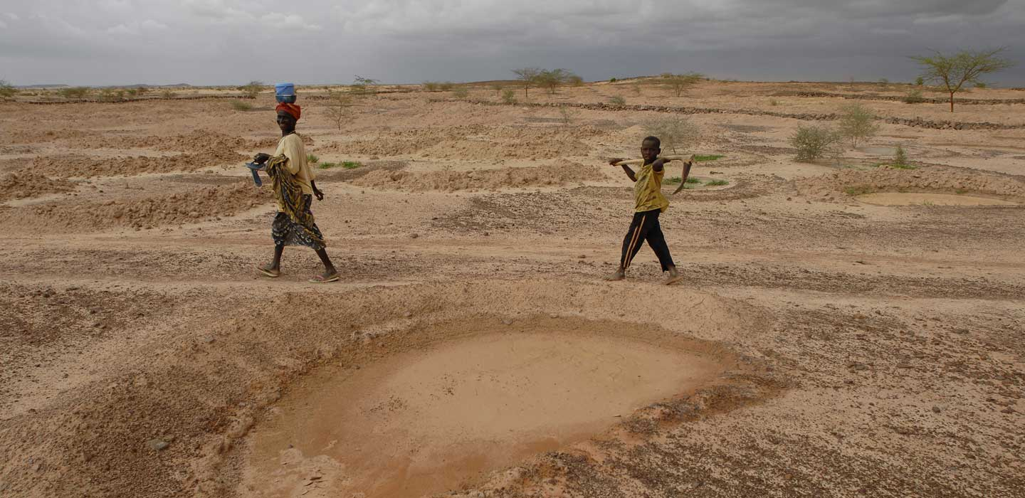
Thank You!
Notes:
All of these can be found on the Better Evaluation Footprint Evaluation website where you can also join the discussion group as well as access other supportive material such as our experience conducting Thought Experiments and some case studies. The rubrics I mentioned earlier will also be posted there.

