Slide 1
Workshop:
What does good look like? Intro to Criteria & USE
Megan kennedy-Chouane & Jenna Smith-kouassi

Slide 2
Velayuthan Sivagnanasothy
Memorial Workshop: International Evaluation Norms and Criteria in National Evaluation Contexts

Slide 3
After today you will:
Fully understand how each criterion is defined and what it means in different contexts relevant to your day-to-day work.
Explain the evaluation criteria – relevance, coherence, effectiveness, efficiency, impact and sustainability – using either plain language or technical language to help different audiences understand the role of evaluation.
Use the criteria in your work and feel comfortable distinguishing between evaluation criteria and formulating good evaluation questions.
Be more effective in evaluating interventions and communicating about evaluations to support learning and accountability in their own context.

Slide 4
Today’s Agenda
9:00 – 10:30 What are the criteria?
How are the six concepts defined?
Exercises: Developing example (individual)
Refreshment break
11:00 – 12:30 How are they used at country level?
What are common challenges and how can these be overcome?
Lunch
14:00 – 15:30 An exercise for participants: Deepening understanding and applying knowledge (small group work on COVID)
Break
16:00 – 17:00 Wrap up and closing: Sharing of lessons

Slide 5
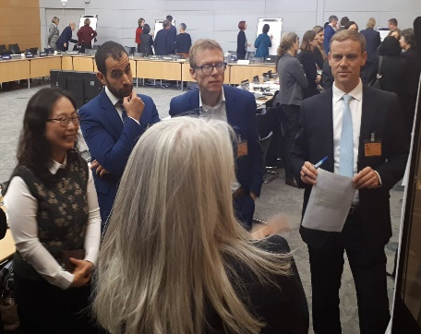
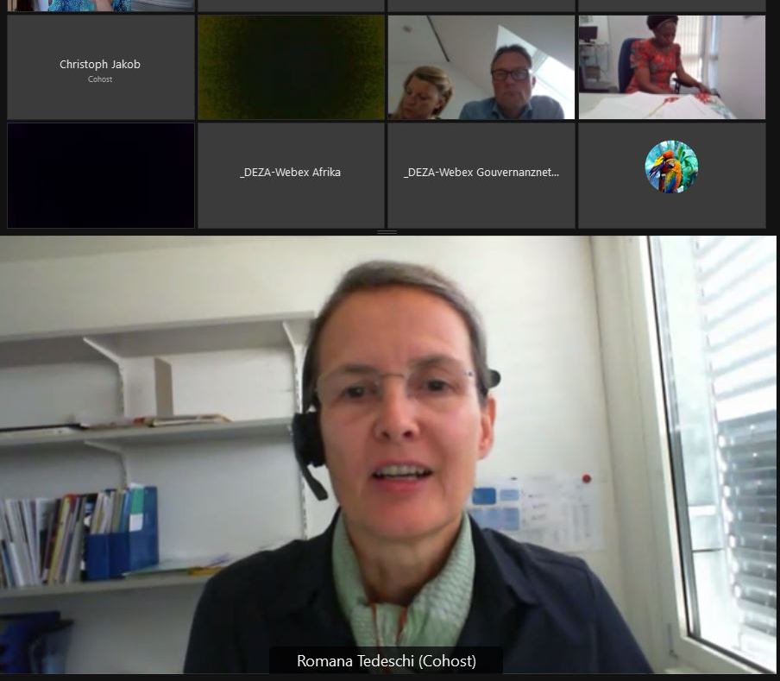
Who is EvalNet?
OECD DAC EvalNet is made up of the central and independent evaluation units of DAC countries + regional development banks, the World Bank IEG, the IMF, and the UNDP IEO.
Long history of partner engagement and capacity support for national evaluation systems.
Notes:
EvalNet members drive resources and evaluation demand.
While they have mandates for development assistance lots of work in of course inter connected with partner systems….
used on development co-opeariton, they are allies ….

Slide 6
Evaluation contributes to better development results for all people, by providing credible evidence and insights for accountability and for learning.
Strong evaluations provide evidence on the merit and value of an intervention, its effectiveness and results.
Evidence and insights about what works, for whom, why, and under what circumstances
Increases accountability and learning that improves results and processes, for example by adjusting how a programme is implemented, or scaling up a policy that works well.
Evaluation contributes to accelerate and deepen progress towards the Agenda 2030 vision of Sustainable Development for all.

Slide 7
Key takeaways
The criteria describe what “good” looks like.
The criteria help us ask the right questions, promoting useful evaluation.
Anyone can use the criteria : when designing policies, programmes or projects, and when monitoring and evaluating them.
The criteria should be adapted to the context and used thoughtfully.
Equity, synergies and potential trade-offs are important cross cutting elements for analysis for each criterion.
Notes:
: if it doesn’t add value don’t do it!

Slide 8
What is public policy evaluation?
OECD definition refers to the structured and evidence-based assessment of the design, implementation and results of a planned, ongoing or completed public intervention.
It assesses the relevance, coherence, efficiency, effectiveness, impact and/or sustainability.
Notes:
https://legalinstruments.oecd.org/en/instruments/OECD-LEGAL-0478

Slide 9
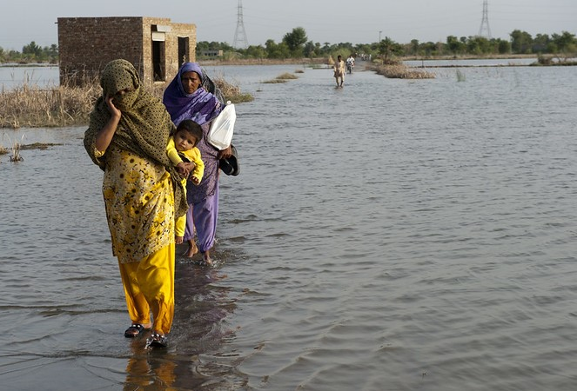
Imperatives of the moment
In this decade of action, accountability is everything
We do not have time to waste money on things that don’t work, speed is critical and we need to learn faster and better
As with any transformational change process, there are a lot of unknowns high risk of unintended effects
Pay attention to knowing: what we know, what is acted upon/not
Notes:
People everywhere beyond commitments or effort to actions and impact

Slide 10
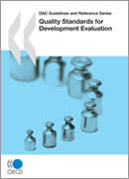
Criteria are part of norms, along with evaluation principles & quality standards
Impartiality and independence
Credibility
Usefulness
Participation
Co-operation (Harmonisation)
Programming (Coverage)
+ evaluation methodologies, approaches
Notes:
Criteria are part of a broader set of evaluation norms and standards, including the evaluation principles and quality standards, and they should be understood in this context.
Also sector—specific guidance, etc.

Slide 11
What are the evaluation criteria?
The criteria encourage a focus on effectiveness and results, looking beyond inputs and activities.
Definition: “A principle or standard by which something may be judged or decided” - Oxford Living Dictionary.
The criteria support critical thinking, help us ask the right questions. Not a methodology, standards, process etc.
Best when used throughout the project cycle - beyond evaluation.
Notes:
Though originally developed for use in the context of development co-operation, now widely used and referenced, including for national and south-south co-operation.
Adopted by the OECD Development Assistance Committee (DAC) in 1991, updated in 2019.
Examples: Kenya, Nepal, Phillipines
The criteria help us focus on results (instead of only looking at inputs and activities)
Broad guides to help us think about and explain changes occurring because of an intervention: what changed, how and why?
Criteria are normative: they describe the desired attributes of an intervention
One of the DAC’s most widely known and influential products!
Criterion:
“A principle or standard by which something may be judged or decided”
Oxford Living Dictionary
“A condition or fact used as a standard by which something can be judged or considered”
Cambridge Dictionary
From Greek “kritèrion” – “means of judging”

Slide 12
Why do criteria matter?
“If they can get you asking the wrong questions, they don't have to worry about answers.”
- Thomas Pynchon
Notes:
American novelist
Because they are fundamental to defining success

Slide 13
Principles: Use the criteria to support critical thinking, to add value
THINK FIRST
NO STRAIGHT JACKET
The criteria should be applied thoughtfully to support high quality, useful evaluation.
They should be contextualized to the individual evaluation, the action being evaluated, and the stakeholders involved.
Use of the criteria depends on the purpose of the evaluation.
Covered according to the needs of the relevant stakeholders and the context of the evaluation. More or less time and resources may be devoted to each criterion
Notes:
Purpose is the guide!

Slide 14
Examples of the principles being used
THINK FIRST
NO STRAIGHT JACKET
COVID-19 response evaluations
An example you have?
Notes:
Purpose is the guide!

Slide 15
Examples of use
For individual evaluations
For evaluation programme / plans or national learning agenda
Evaluation policies
Evaluation manuals or guidance

Slide 16
POINTS ON LANGUAGE
Intervention used to refer to the object (topic/evaluand) of the evaluation. Could be a project, programme, policy, strategy, thematic area, financing mechanism, etc. Criteria are used across Agenda 2030 (humanitarian, climate etc.)
Beneficiaries has specific meaning: “the individuals, groups, or organisations, whether targeted or not, that benefit directly or indirectly, from the development intervention." Other terms, such as rights holders or affected people, also used. Does not assume that people do benefit (these are questions for evaluation to answer). Actual beneficiaries may not be the stated/intended beneficiaries.

Slide 17
Each criteria is a lens, giving a different perspective on the intervention – both the implementation process & the results…
Notes:
Image: UNHCR Afghanistan

Slide 18
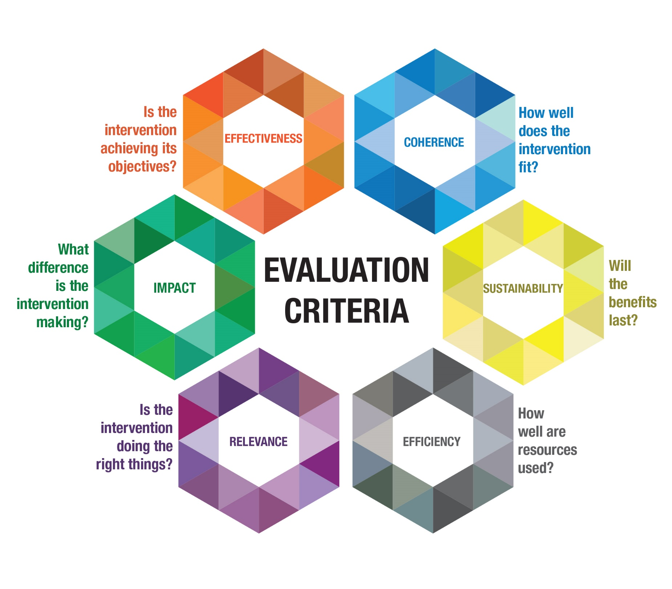
EFFECTIVENESS
COHERENCE
IMPACT
SUSTAINABILITY
RELEVANCE
EFFICIENCY
Notes:
Recap of key changes:
Relevance – add time dimension, emphasis beneficiaries + priorities, potential conflict
Coherence – new criteria
Effectiveness – add results and differential results
Efficiency – operational efficiency and timeliness added, full results chain covered
Impact – focus on higher level changes, transformative/scope/time scale
Sustainability – focus on benefits, not external funding, multidimensional
New emphasis on intended use- understand that definitions are not sufficient.

Slide 19
…together, they provide a more complete picture.
Notes:
This integrated perspective reflects agenda 2030 and the need for holistic, transformational approaches…

Slide 20
RELEVANCE
Is the intervention doing the right things?
Notes:
The extent to which the intervention objectives and design respond to beneficiaries’, global, country, and partner/institution needs, policies, and priorities, and continue to do so if circumstances change.
Note: “Respond to” means that the objectives and design of the intervention are sensitive to the economic, environmental, equity, social, political economy, and capacity conditions in which it takes place. “Partner/institution” includes government (national, regional, local), civil society organisations, private entities and international bodies involved in funding, implementing and/or overseeing the intervention. Relevance assessment involves looking at differences and trade-offs between different priorities or needs. It requires analysing any changes in the context to assess the extent to which the intervention can be (or has been) adapted to remain relevant.

Slide 21
RELEVANCE
The extent to which the intervention objectives and design respond to beneficiaries’, global, country, and partner/institution needs, policies, and priorities, and continue to do so if circumstances change.
Note: “Respond to” means that the objectives and design of the intervention are sensitive to the economic, environmental, equity, social, political economy, and capacity conditions in which it takes place. “Partner/institution” includes government (national, regional, local), civil society organisations, private entities and international bodies involved in funding, implementing and/or overseeing the intervention. Relevance assessment involves looking at differences and trade-offs between different priorities or needs. It requires analysing any changes in the context to assess the extent to which the intervention can be (or has been) adapted to remain relevant.
Notes:
Adding ‘design’ and ‘implementation’ to capture other elements related to the quality of the intervention (not only objectives)
Making time dimension more explicit: While relevance is generally evaluated looking at the point of time before the intervention starts, the ongoing relevance should also be evaluated. This is now included in the definition

Slide 22
COHERENCE
How well does the intervention fit?
Notes:
The compatibility of the intervention with other interventions in a country, sector or institution.
Note: The extent to which other interventions (particularly policies) support or undermine the intervention, and vice versa.
Internal coherence addresses the synergies and interlinkages between the intervention and other interventions carried out by the same institution/government, as well as the consistency of the intervention with the relevant international norms and standards to which that institution/government adheres.
External coherence considers the consistency of the intervention with other actors’ interventions in the same context. This includes complementarity, harmonisation and co-ordination with others, and the extent to which the intervention is adding value while avoiding duplication of effort.

Slide 23
COHERENCE
The compatibility of the intervention with other interventions in a country, sector or institution.
Note: The extent to which other interventions (particularly policies) support or undermine the intervention, and vice versa.
Internal coherence addresses the synergies and interlinkages between the intervention and other interventions carried out by the same institution/government, as well as the consistency of the intervention with the relevant international norms and standards to which that institution/government adheres.
External coherence considers the consistency of the intervention with other actors’ interventions in the same context. This includes complementarity, harmonisation and co-ordination with others, and the extent to which the intervention is adding value while avoiding duplication of effort.
Notes:
Capturing a perspective not covered previously
Promoting understanding of the role of an intervention within a particular system
Responding to the need for greater attention to complexity and competing agendas
Encouraging analysis of consistency with commitments under international law or agreements – example evaluation of a national roads strategies, extent to which it aligns with Paris commitments.

Slide 24
EFFECTIVENESS
Is the intervention achieving its objectives?
Notes:
The extent to which the intervention achieved, or is expected to achieve, its objectives, and its results, including any differential results across groups.
Note: Analysis of effectiveness involves taking account of the relative importance of the objectives or results.

Slide 25
EFFECTIVENESS
The extent to which the intervention achieved, or is expected to achieve, its objectives, and its results, including any differential results across groups.
Note: Analysis of effectiveness involves taking account of the relative importance of the objectives or results.
Notes:
Enquiring about the distribution of results across different groups to encourage more thoughtful analysis, attention to equity

Slide 26
EFFICIENCY
How well are resources used?

Slide 27
EFFICIENCY
The extent to which the intervention delivers, or is likely to deliver, results in an economic and timely way.
Note: “Economic” is the conversion of inputs (funds, expertise, natural resources, time, etc.) into outputs, outcomes and impacts, in the most cost-effective way possible, as compared to feasible alternatives in the context. “Timely” delivery is within the intended timeframe, or a timeframe reasonably adjusted to the demands of the evolving context. This may include assessing operational efficiency (how well the intervention was managed).
Notes:
Looking at inputs relative to the entire results chain, but also allowing flexibility to focus analysis on the most relevant part of the results chain
Valid cost-benefit analysis requires comparing the value of the intervention with pertinent counterfactuals
Reference to operational efficiency (important area, often focus)
Implementation issues are of great interest to evaluation stakeholders.
(competing understandings)

Slide 28
IMPACT
What difference is the intervention making?
Notes:
The extent to which the intervention has generated or is expected to generate significant positive or negative, intended or unintended, higher-level effects.
Note: Impact addresses the ultimate significance and potentially transformative effects of the intervention.
It seeks to identify social, environmental and economic effects of the intervention that are longer term or broader in scope than those already captured under the effectiveness criterion. Beyond the immediate results, this criterion seeks to capture the indirect, secondary and potential consequences of the intervention. It does so by examining the holistic and enduring changes in systems or norms, and potential effects on people’s well-being, human rights, gender equality, and the environment.

Slide 29
IMPACT
The extent to which the intervention has generated or is expected to generate significant positive or negative, intended or unintended, higher-level effects.
Note: Impact addresses the ultimate significance and potentially transformative effects of the intervention. It seeks to identify social, environmental and economic effects of the intervention that are longer term or broader in scope than those already captured under the effectiveness criterion. Beyond the immediate results, this criterion seeks to capture the indirect, secondary and potential consequences of the intervention. It does so by examining the holistic and enduring changes in systems or norms, and potential effects on people’s well-being, human rights, gender equality, and the environment.
Notes:
Perhaps the most changed definition (in language)
Emphasis on the significance and transformational nature of the effects, not a narrow (attribution-focused) definition
Common understanding of the term and its meaning
Distinguish between Effectiveness and Impact
Critical importance of unintended impacts
Transformative: holistic and enduring

Slide 30
SUSTAINABILITY
Will the benefits last?
Notes:
The extent to which the net benefits of the intervention continue, or are likely to continue.
Note: Includes an examination of the financial, economic, social, environmental, and institutional capacities of the systems needed to sustain net benefits over time. Involves analyses of resilience, risks and potential trade-offs. Depending on the timing of the evaluation, this may involve analysing the actual flow of net benefits or estimating the likelihood of net benefits continuing over the medium and long-term.

Slide 31
SUSTAINABILITY
The extent to which the net benefits of the intervention continue, or are likely to continue.
Note: Includes an examination of the financial, economic, social, environmental, and institutional capacities of the systems needed to sustain net benefits over time. Involves analyses of resilience, risks and potential trade-offs. Depending on the timing of the evaluation, this may involve analysing the actual flow of net benefits or estimating the likelihood of net benefits continuing over the medium and long-term.
Notes:
Original definition too donor centric and focusing only on external funding – now focus on the benefits (not the continuation of the activity/intervention)
Current definition showing that sustainability has various dimensions
Encouraging analysis of potential trade-offs, and of the resilience of capacities/systems underlying the continuation of benefits
Retaining the term “net benefits” to focus on the overall value, taking into account the costs of producing and maintaining benefits

Slide 32
Common challenges
Too many criteria + too many questions
Flexibility vs. comparability
Interlinkages between criteria
Power dynamics and different views
Lack of knowledge or lack of action?
Scoring and weighting of criteria
Knock out criteria → overall conclusion?
(many more not listed!)

Slide 33
Tips: See guidance for more! oe.cd/criteria
Integrate throughout lifecycle: Business cases should address each criterion (with evidence)
Focus on value add: what do you need to know?
Less is more: what will change behaviour?
Be a translator: listen and mirror what people want to know, what they are interested in (might use different words)
Provide operational guidance for your institution
→ Coherence: where to focus?
If you add criteria, be sure to define and keep concepts clear
Human rights & gender equality: new guidance coming soon!

Slide 34
Exercise 1.
Write down the name of the project/intervention, and its primary objective(s) (2 minute)
Discuss key stakeholders: Who wants or needs an evaluation and what? Write down your primary evaluation purpose (10 minutes)
Go through each criteria and come up with 1-2 evaluative questions
Present an elevator pitch of your evaluation & questions

Slide 35
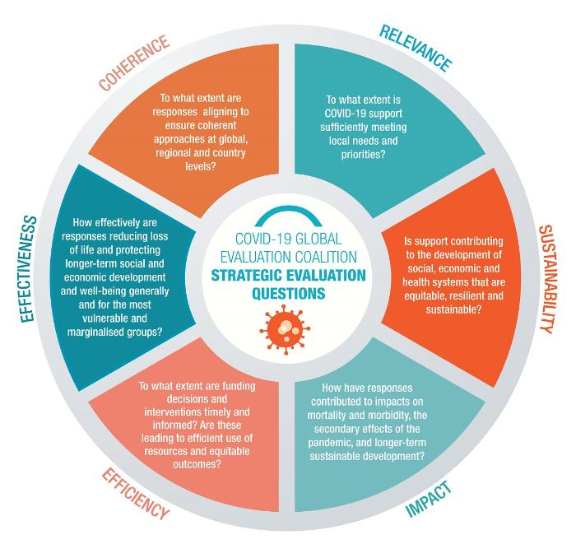
Exercise 2. Common framework of the COVID-19 Evaluation Coalition
Notes:
An independent collaborative project, made up of the evaluation units of countries, United Nations organisations and multilateral institutions.
The Coalition provides credible evidence to inform responses to and recovery from the COVID-19 pandemic - helping to ensure that lessons are learned and that the global development community delivers on its promises.

Slide 36
Join us!
Open to any country interested in evaluating COVID-related efforts to respond to the direct and indirect impacts of the pandemic.
COVID19evaluation@oecd.org
www.covid19-evaluation-coalition.org
Notes:
COVID pandemic confirming the universality of evidence and evaluation challenges faced by all governments, all people.
Evaluation systems as part of good governance, democratic process.

Slide 37
New! Urdu, Pashto & Dari
Arabic
مقاييس أفضل من أجل تقييم أفض
Chinese
采用更好的准则实现更优质的评估
French
Définitions adaptées et principes d’utilisation
Russian
Улучшенные критерии для улучшенной оценки
Spanish
Mejores criterios para una mejor evaluación
Dutch
Betere criteria voor betere evaluatie
Dari
معیارهای بهتر برای ارزیابی بهتر
Pashto
د غوره ارزونې لپاره غــوره معــيارونـه
Urdu
بہتر تشخیص کے لیے بہتر معیار
Coming soon: Ukrainian…

Slide 38
Thank you!
Read more and download the guidance: oe.cd/criteria

