Slide 1
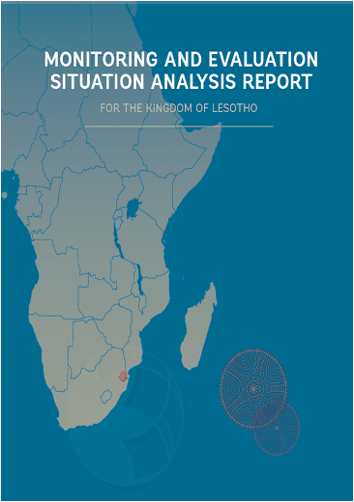

Slide 2
Approach
•Research process to diagnose the situation of M&E in the country and identify areas which would make sense to focus capacity strengthening efforts, building collective agreement of stakeholders in the process
•The MESA is intended to be flexible when applied in different contexts.
•The MESA could be used with a view to improving an entire M&E system or only some elements of it; it could also be applied and customized to countries, regions, states, or line ministries. At the heart of each MESA are two overarching questions:
•What does the country’s M&E ecosystem already have in place?
•Based on good practice, as well as a strong understanding of country needs and preferences, what are the opportunities to further strengthen the M&E ecosystem?

Slide 3
Principles for the MESA
•Country ownership - Sustainable M&E systems are about country ownership, where countries decide what they want to do to implement M&E systems, partnering with external support agencies as needed. Building effective M&E systems is a long-term process and the partnership may need to be long-term.
•Listening and learning about what happens in the country, informed by local contexts and cultural preferences so working with local partners who understand the context. Meet the country where it is. How are things working in the country in terms of decision-making, what is working well or less well, how can systems and practices be strengthened?
•Objective and credible - informed by local context and global good practice, so that national and international external stakeholders see the exercise as valid and worthwhile and are prepared to invest in following up on the outcomes of the MESA.
•Flexible - applying the MESA will depend on context, including resources and timing and should be customized to the needs of each country/region and GEI partner.
•Forward-looking - there is greater interest in diagnostics when follow-on action is envisaged from the outset.

Slide 4
Structure Summary
1.Introduction to the MESA
2.Country background
3.Overview of planning, budgeting, and M&E systems (PBM&E)
4.Monitoring and reporting systems
5.Evaluation systems
6.Overall findings, conclusions, and recommendations

Slide 5
1 Introduction to the MESA
Introduction to the MESA
Objective of the MESA
Methodology and process
Structure of the MESA report
2 Country background
Country profile
Structure of government
Political economy and link to M&E
Organizational culture of government and implications for M&E
Level of interest in M&E at the beginning of the MESA

Slide 6
3 Overview of planning, budgeting, and M&E systems (PBM&E)
1.Legal and policy basis for the PBM&E systems
2.Roles of key actors in the PBM&E systems
3.Overview of the planning and budgeting systems
4.Overview of the M&E systems
5.Role of other stakeholders in relation to M&E
6.Statistical and administrative data
7.Resources for M&E
8.Communication of M&E evidence
9.M&E capacity-development initiatives
10.Equity and gender considerations in the PBM&E systems
11.Climate and environmental sustainability considerations in the PBM&E systems

Slide 7
4 Monitoring and reporting systems
1.Systems for government monitoring and reporting at the national level
2.Systems for government monitoring and reporting in line ministries and at subnational levels
3.Monitoring of government by parliament
4.Capacity in government to undertake monitoring and reporting
5.Role of civil society in the government monitoring system
6.Systems/incentives for acting on monitoring
7.Use of monitoring information by government

Slide 8
5 Evaluation systems
1.Evaluation systems at the national level
2.Evaluation systems at line ministry and subnational levels
3.Government capacity to manage, commission, and undertake evaluations
4.Government capacity to manage and coordinate an evaluation system
5.Capacity to undertake evaluations in civil society/academia/the private sector
6.Systems for ensuring that evaluation is acted upon
7.Use of evaluations by government
8.Use of evaluations by parliament
9.Use of evaluations by civil society and the media
10.Role of civil society in government evaluation systems

Slide 9
Conclusions
1.Overview of the M&E system and how it functions
2.Areas that are working well and areas that are working less well
3.Recommendations for interventions that can trigger wider system change and development outcomes
•Build on this for the M&E capacity development plan
4.Conclusions

Slide 10
Deciding what to include/not in the MESA
Is evaluation conducted in the country – if so section 5 (Evaluation systems) is needed, if not then may not be needed
May feel that the overview section 3 is enough, don’t need the detail on monitoring
Important to agree the structure of the MESA you want, as the methodology depends on the questions you want to answer

Slide 11
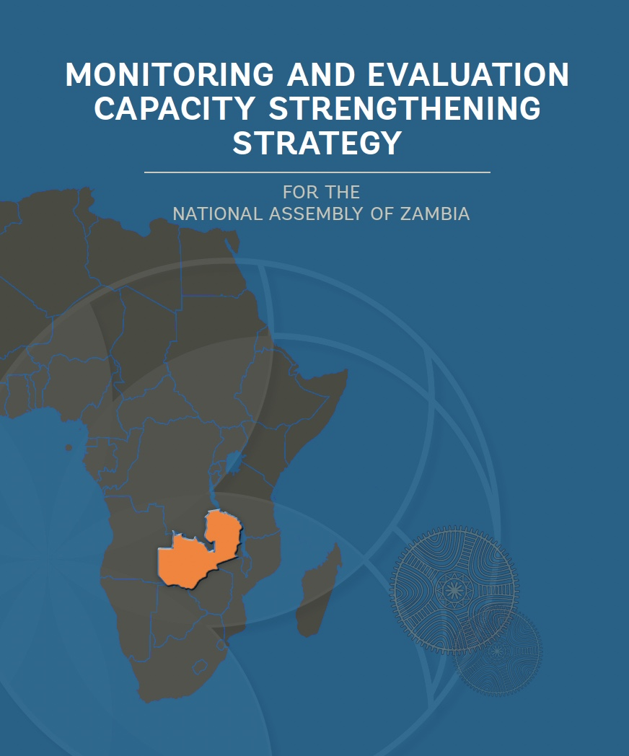
What does the MESA lead to?
Monitoring and Evaluation Capacity Strengthening Strategy
results that need to be achieved for the country to be able to improve its M&E performance are clearly listed
along with the specific approaches to be followed for delivering those results)
An accompanying M&E Capacity Strengthening Plan that provides
details on the results proposed in the strategy,
indicating who will do what,
when and
what resources will be required and where these will come from

Slide 12
Implementing MESA

Slide 13
12 steps suggested
Making initial contact
Coming to a common understanding on the MESA
Formalizing the understanding
Identifying relevant stakeholders and formulating agreements
Establishing structures to increase and embed country ownership
Establishing the team for undertaking the MESA
Building capacity to undertake diagnostic work and the MESA
Launching the MESA assessment – ensuring transparency
Undertaking the MESA (Chapter 4 of the MESA Guideline)
Keeping stakeholders informed during the process
Validating the MESA
Overseeing a peer review of the report
Designing a contextually relevant response program
Preparing for the MESA research phase
Undertaking the MESA
Writing up the MESA report

Slide 14
1 Initial contact
You have already had initial contacts, but included in this step would be:
initial scoping meetings to explore what the country is looking to do with its M&E system and what kind of support it is seeking.
desk review to assemble existing diagnostic information
holding discussions with a few stakeholders who know the country’s M&E ecosystem, and to anticipate areas where collaboration may be fruitful. The guiding questions in section 2 can help with the desk review.

Slide 15
2 Coming to a common understanding on the MESA
Mutual understanding/building a strong relationship of trust with the country partner
Initial scoping mission
Get an overview of:
M&E stakeholders;
M&E practices in the country – formal and informal;
Individual and institutional capacities for M&E and the use of evidence from M&E;
Opportunities and options for strengthening those capacities.
Building initial partnerships by starting a dialogue with national players
Clarifying the purpose of the MESA
Developing a roadmap for the MESA

Slide 16
2 Coming to a common understanding on the MESA

Slide 17
3 Formalising the understanding
Agreeing the plan/terms of reference for what needs to be done
Signing an agreement
4 Identifying the stakeholders
Which stakeholders are the official clients of the MESA?
Which stakeholders have the power to facilitate or block the process?
Which stakeholders are most actively involved in the MESA process?
Which stakeholders will be the end-users of the diagnosis?
Who are M&E champions?

Slide 18
5 Establishing structures to increase and embed country ownership
A local oversight structure(s) to oversee the MESA process (existing or new structure)
Advisable to have two levels of structures: technical and institutional/political.
Example: CLEAR FA in Madagascar:
a National Steering Committee (Government +Parliament led)
a Technical Committee
Agree objectives and functions of the structures.
Inception report

Slide 19
6 Establishing the team
Internal Team (these are people who work within the government e.g. staff from the institution that provides coordination and oversight of M&E system)
Brings the benefit of being familiar with government M&E system and its history, and are invested in the results of the system, thereby increasing the likelihood of learning about the system
External Team (people not employed by government)
Can also be from outside the country, where local consultancies may be scarce or not have the skills
External evaluators from outside the country may be hired for transparency, and impartiality
Joint Team (involves both internal and external staff working together)
The advantage is that there both internal and external staff can complement and substitute skills set
Coaching, and just-in-time technical advice can also happen
Terms for Reference for each team need to be developed with clearly stated timelines, responsibilities.

Slide 20
6 Establishing the team
Madagascar
Presidency
Ministry of Economy of finance
VOPEs
Parliament
CLEAR Expert + National Consultant
UNICEF Country office focal point
UNICEF Regional Office focal point
UNDP Country focal point

Slide 21
7 Building capacity to undertake the MESA
Examples of training topics
Results-based M&E, National Evaluation System, Research skills: document reviews, interviews, and focus groups, and how to analyze the data.
Who to be trained
Government staff in MESA teams, Policy champions, other Team members
Objectives
to strengthen ownership and capacities
to refine the structure of the report to be prepared
to understand how the research tools will be used.

Slide 23
8 Launching the MESA assessment – ensuring transparency from the outset
An open MESA process has the following benefits:
Makes sure that all stakeholders informed about the process.
Not seen as the initiative of a single institution.
Avoids bypassing an important player
CLEAR-FA in Madagascar: a launch event with the Steering Committee, chaired by the General Secretary of the Government.
CLEAR-LAC: launch events in every country and every regional institution with whom it was doing diagnostics.

Slide 24
Preparing for the research
Collecting basic background documents based on desk research to get an overview of the system;
Deciding on the MESA report structure (see annex 2) and which sections will be included;
Deciding on the research design and identifying the detailed questions to be asked and how these questions will be answered; (the table in annex 2 can be adapted.)
Developing the detailed methodology: Survey instrument.; Checklists for semi-structured interviews, identifying people to be interviewed; Planning for any workshops, including selecting dates;
Doing a detailed activity-based plan and budget for the MESA process;

Slide 25
Undertaking the assessment
Desk research: Review existing literature and relevant country information to inform the specific country MESA approach and design.
Interviews: These may well be in pairs of external support agency and a government staff member.
Focus groups: Possibly with several staff members – for example, from the M&E champion.
Regular meetings: of the team every two to three days to reflect on the emerging picture and do detailed planning.
Initial findings: These would need to be identified, agreed, and articulated in writing.
Validation workshop: On the initial findings and recommendations.
How does geography influence?

Slide 26
Writing up the report
Analyzing qualitative and quantitative information received about the country M&E systems and processes.
Allocated people writing specific sections for the report in line with the interviews they conducted ideally, including government team members.
The analysis and findings may be drafted by an independent MESA team, or may be done jointly.

Slide 27
9 Keeping stakeholders informed during the process
1. Taking good minutes in every meeting, especially about decisions, which are shared with all those participating in the meeting.
2. Keeping track of the planned timeline, checking progress and any corrections needed.
3. Summarizing the emerging M&E diagnostic findings at least every fortnight, and giving feedback, for example through the steering committee.
4. Keeping track of challenges in undertaking the MESA and potential solutions.
5. Having regular meetings with main stakeholders – every fortnight – to inform on all the above.
Example: Periodic meetings, whatsapp, emails

Slide 28
10 Validating the MESA
Validate the findings from the MESA research process,
Receive feedback from stakeholders.
Make sure that recommendations are relevant, implementable, and action oriented.
Help stakeholders enrich their picture of the M&E ecosystem,
Give stakeholders an opportunity to express their views
Increase trust and the credibility of the exercise
Strengthen ownership over the results,
Lays a strong foundation for the way forward.
The workshop with stakeholders can be hold before or after the report is written

Slide 29
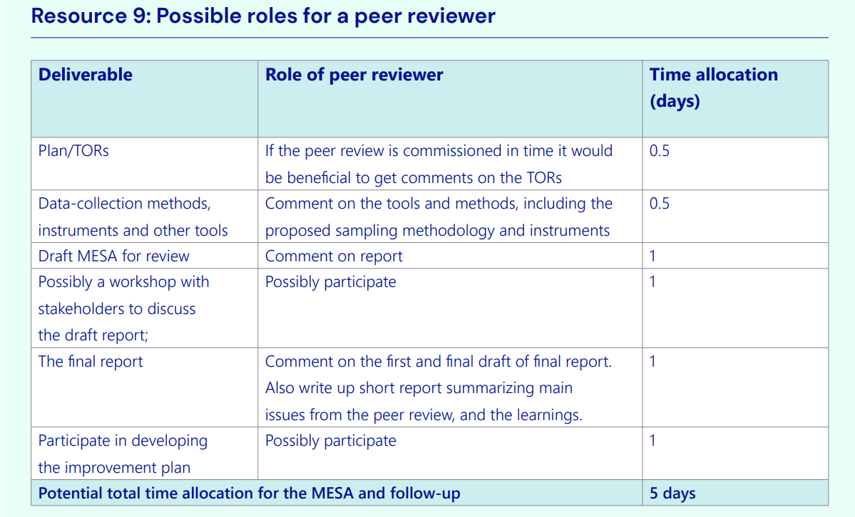
11 Overseeing a peer review of the MESA report

Slide 30
Implementation challenges
Aligning the diagnostic with national priority
Dealing with political instability, ministerial reshuffle
Involving civil society actors and other political actors
Getting approval for the data sources
Building a national ownership : leadership, political instability,
Gaining legitimacy for the process
Documentary review
Lack of institutional memory/ knowledge management
Time and budget

