Slide 1
Global Evaluation Initiative’s Monitoring and Evaluation Systems Analysis (MESA) tool: a step toward a resilient national M&E Ecosystem Edoe Djimitri Agbodjan – CLEAR FA/GEI Lycia Lima – CLEAR LAB/GEI Taku Chirau – CLEAR AA/GEI

Slide 2
Agenda
9 :00 - 9 :10 | Introduction
9 :10 - 9 :40 | Discussion
9 :40 - 10 :20 | Presentation of GEI/CLEAR. What is a M&E System/Ecosytem - why does GEI promote it ?
10 :20 – 10h30 | What is the MESA ?
10 :30-11 :15 | Coffee Break
11h15-11h50 | Why do we conduct the MESA? What are its components?
11 :50-12 :30 | The process of the MESA. What are the implementation challenges?
12 :30-14 :00 | Lunch
14 :00 – 15 :15 | Group work : Country case study
15h15-15h45 | Coffee Break
15h45-16h45 | Group presentation and discussion
16h45-17h00 | Conclusions and Wrap up
Notes:
9:10-9:40

Slide 3
Introduction
Introduction of facilitators
What is your name, where are you from and where do you work?
What are your expectations? Please answer key words only on the link link or QRD: https://www.menti.com/al3f25qbpgwr
Notes:
9:10-9:40

Slide 4
Learning objectives
By the end of the session participants would be able to:
Define the components of a M&E ecosystem/system;
Explain the strategical framework of the GEI to strenghtening national M&E systems;
Explain what a MESA is about;
Decide when undertaking MESA is appropriate for M&E system strenghtening;
Explain steps involved in undertaking a MESA;
Apply the MESA tool to analyze a system.

Slide 5
Discussion
What is a national evaluation system ? What are the components of an M&E System?
What are the pros and cons of having a system versus isolated evaluations ?
Notes:
9:10-9:40

Slide 6
Global Evaluation Initiative
An inclusive partnership responding to the global demand for better Monitoring & Evaluation
10 June 2022, European Evaluation Society Conference
Notes:
Lycia 9:40- 10:20

Slide 7
THE GAP
Today in many developing countries the capacities and systems for measuring progress in policy implementation and assessing the impact of public policies are limited and need strengthening.

Slide 8
THE RESPONSE
In November 2020, the World Bank Independent Evaluation Group and the UNDP Independent Evaluation Office joined forces to launch the

Slide 9
THE RESPONSE
GEI seeks to plays a crucial role in improving the global field of monitoring and evaluation:
GEI works with partners to help developing countries improve the systems and capacities that enable them to measure progress and robustly assess programs and projects.
GEI nurtures a governance culture that uses evidence and data to improve policies, implementation, and, ultimately, the lives of citizens.
GEI ensures that knowledge generated in one country is made available to others.

Slide 10
VISION
Better Evidence.
Better Policies.
Better lives.
Notes:
Ultimately, the GEI helps to create a world where evidence is used to increase transparency and make better decisions to improve lives.

Slide 11
Bilateral and Multilateral Organizations
Academic Institutions and Think Thanks
Evaluation Capacity Development (ECD)
Providers
Civil Society
M&E Associations
Governments from Developing Countries
THE NETWORK
Private Sector
Evaluation Practitioners
Notes:
GEI brings together governments, citizens, and experts to support countries in strengthening evaluation and monitoring systems and capacities GEI will operate as a catalyzer and convener of gLOCAL partnerships to provide high quality M&E systems development support to governments and other target groups around the world​ ​ Build & leverage local capacity​ Strengthen sustainable country systems ​ Ensure local ownership​ Tailor services to local contexts​

Slide 12
CORE
IMPLEMENTING
ASSOCIATE

Slide 13
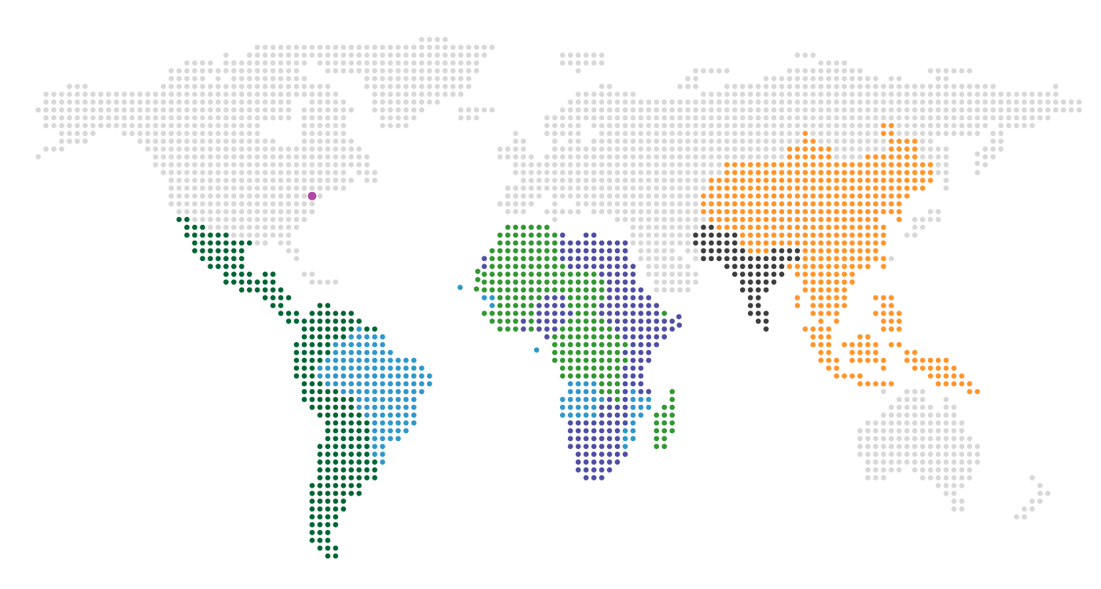
Clear Centers – Implementing Partners of GEI
CLEAR- FA:
Francophone Africa
Senegal
CLEAR- EA:
East Asia
China
CLEAR- SA:
South Asia
India
Clear LAB:
Brazil & Lusophone Africa
São Paulo – Brazil
CLEAR- AA:
Anglophone Africa
Johannesburg

Slide 14
What do we do?
Country-level engagements to strengthen the M&E ecosystem
Training and professional development
Knowledge generation and sharing

Slide 15
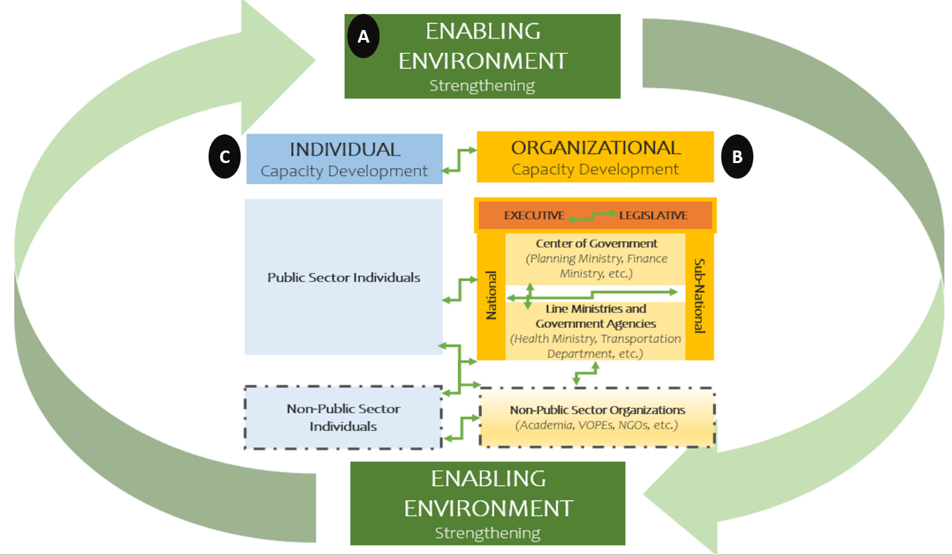
Stakeholders of a Country M&E Ecosystem
What do we mean by capacity development?
Individuals
Higher Education & Research Institutions
Civil Society & Media
Development partners:
agencies, philanthropy
VOPEs
Private sector: investors, vendors
Governments
Legislative
Legislative
Judiciary
Notes:
NSG – National School of Government
PSC - Public Service Commission

Slide 16
How do we work?
GEI liaises with and convenes M&E stakeholders
Government requests support to strengthen its M&E systems
Advocacy strategy
Better understanding of the role of M&E
Better evidence
National Evaluation Policy / legislation
Increased capacity for coordinating M&E
Evidence use
Evaluation unit
Improved regulatory and policy environment for M&E
Better policies
GEI & gov’t assess the current state of the national M&E system
“MESA”
Tools and processes: evaluation plan, guidelines, standards
GEI supports preparation of an M&E capacity development plan or strategy
Improved M&E frameworks, processes and systems
Better programmes
Pilot evaluations
Increased capacity for implementing and using M&E
Better lives
Tailored training

Slide 17
M&E Systems: evidence-based decision making
It is a set of norms, guidelines and activities to guide evidence-based decision making
It allows the generation of valuable information through the use of monitoring and evaluation tools to measure and guide government actions on a regular and systematic basis throughout the public policy cycle
Notes:
Ultimately, the GEI helps to create a world where evidence is used to increase transparency and make better decisions to improve lives.

Slide 18
Our approach to support building M&E system:
5.
Hold meetings and workshops to design the M&E System
7.
Provide support to build the legal framework
1.
Undertake the Diagnostic Tool for a Monitoring and Evaluation Systems Analysis (MESA)
3.
Develop a work plan to design and implement the M&E System
4.
Research case studies on M&E Systems, according to the context
2.
Create a Working Group with the Government
6.
Provide technical assistance for pilot evaluations, courses, and guidelines
Notes:
Passo a passo - breve complementação ao que está explicado no slide:
Passo 1: MESA é estratégico e ajuda entender o contexto, as lacunas e as capacidades existentes
Passo 2: Os grupos contam com participação de diferentes departamentos. Isso gera ownership
Passo 3: Primeira atividade do grupo de trabalho é traçar um planejamento
Passo 4: Levantamentos de experiências de outros sistemas que pode ajudar o contexto do governo que estamos apoiando (em alguns casos entregamos um documento com sistematização das experiências)
Passo 5: Organização de reuniões e workshops semanais ou quinzenais para desenhar os componentes do sistema. E as vezes aproveitamos essas reuniões para trocas entre governo. Exemplo no grupo de trabalho de Moçambique, levamos Cabo Verde para apresentar a experiencia deles. Isso gerou uma repercussão muito positiva e incentivo Moçambique a avançar mais. Nesta reuniões levamos perguntas que ajudam a orientar as discussões. Tbm fazemos oficinas ampliadas com participação de governo, sociedade civil, universidade e donors.
Passo 6 e Passo 7: Inicio de pilotos e atividades de capacitação etc enquanto a parte legal tramita (ela é bem demorada)

Slide 19
M&E System Building Blocks
Knowledge generation and sharing
Objectives
Demand
Supply
Training and Manuals
Key Alliances
Measure government performance
Improve the design and implementation of public policies
Assist in the decision on budget allocation
Promote accountability and transparency
Who are the potential users?
High-level officials
Policy analysts
Program managers
Civil society
Universities
M&E Tools
Quality of M&A information
Who runs:
Independent body
External consultant
Hybrid execution
Sectoral Departments
1. Training (for which audiences and at which levels)
2. Who offers the training on an ongoing basis
3. How to support the institutionalization of the M&E System and disseminate M&E culture
Key government authorities
M&E champions
Legislative branch
Promote adoption of recommendations
Influence policies
Engagement and governance
4. Civil Society
5. Universities

Slide 20
Example:
Development of an M&E Ecosystem in Mozambique
MESA informed the M&E Capacity Development Plan
Technical Assistance
Training
Conducting courses to support capacity building in the country.
Development of strategies to build capacities, support in the design of the M&E System
Building Mozambique’s National M&E System
Evaluations
Guides
Assistance in one or more evaluation pilots, to support public policy improvement, internal learning processes, the planning of a first evaluation cycle under a National Evaluation System, and the development of knowledge and research.
Development of public policy M&E guides, with methodological orientations on evaluating policies/programs Government-wide.
Evidence-based decision making

Slide 21
M&E Systems: evidence-based decision making
EXAMPLES FROM THE AUDIENCE
Notes:
Ultimately, the GEI helps to create a world where evidence is used to increase transparency and make better decisions to improve lives.

Slide 22
What is MESA about?
https://www.globalevaluationinitiative.org/publications/mesa-diagnostic-tool
Go to Updates then publications to download the tool

Slide 23
Why is M&E important?
•Effective policy making builds on a culture of evidence-based decision making
•This relies on a country’s M&E systems
•For countries to strengthen their M&E systems, need to understand the current situation of these systems in a country – formal and informal – and the prevailing economic, political, and social environment and how this affects the context for M&E
•There also needs to be a good understanding of how policy makers view national M&E practices with respect to decision making.
•Gaining a solid understanding of a country’s M&E ecosystem is an important first step to understanding needs, priorities, and potential pathways for strengthening those systems.
•Conducting a MESA allows governments and civil society and its development partners to build a mutual understanding of how the national M&E system functions and to identify opportunities to further strengthen capacities.

Slide 24
Why do you think carrying a MESA is important?

Slide 25
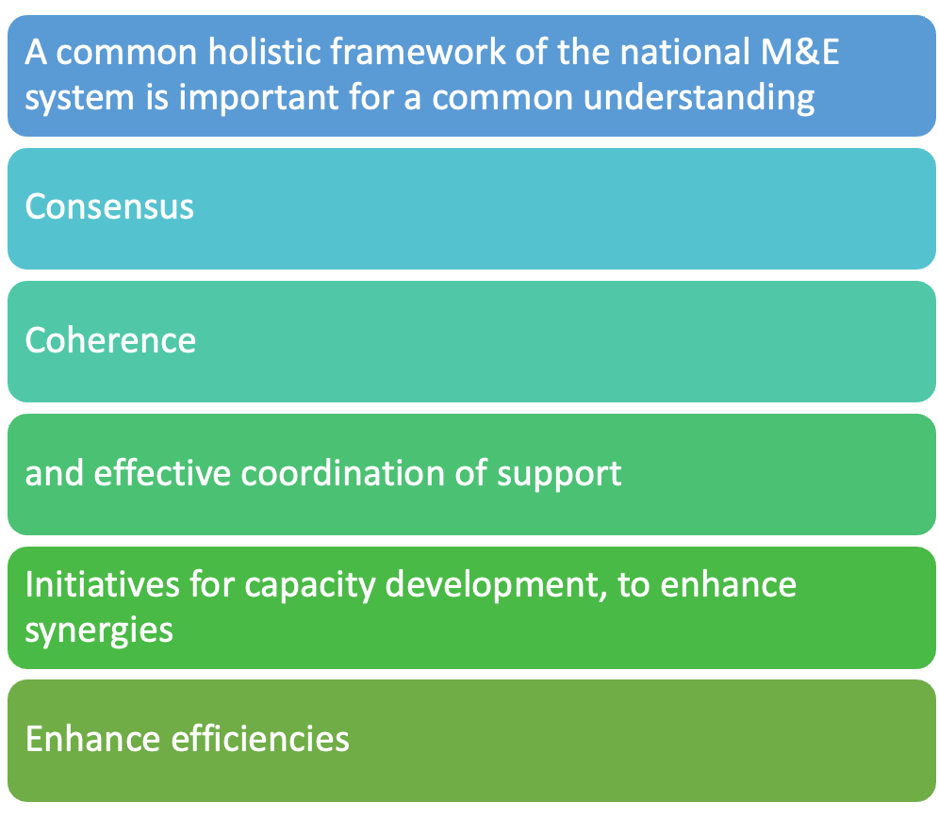
Why is the MESA important

