Slide 1
A systematic review of youth employment interventions
Workshop 6. Measuring employment-related outcomes of development interventions: Employment impact assessment National Evaluation Capacities (NEC) Conference
Slide credits:
-Jonas Bausch, ILO
-Susana Puerto, ILO

Slide 2
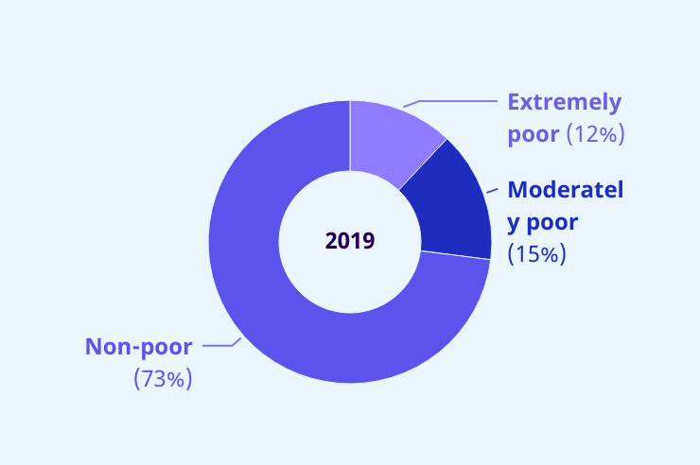
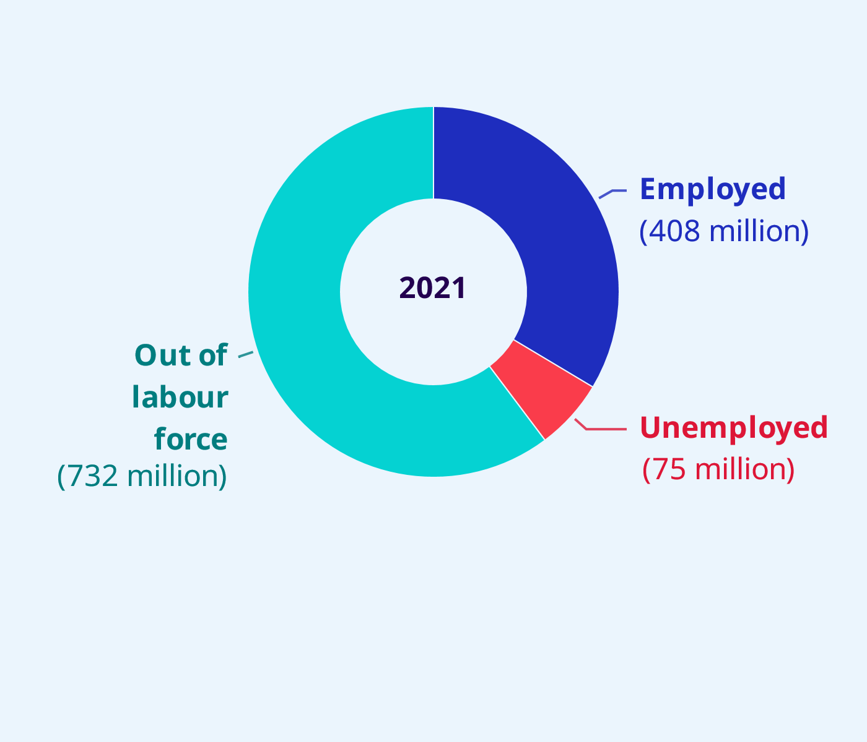
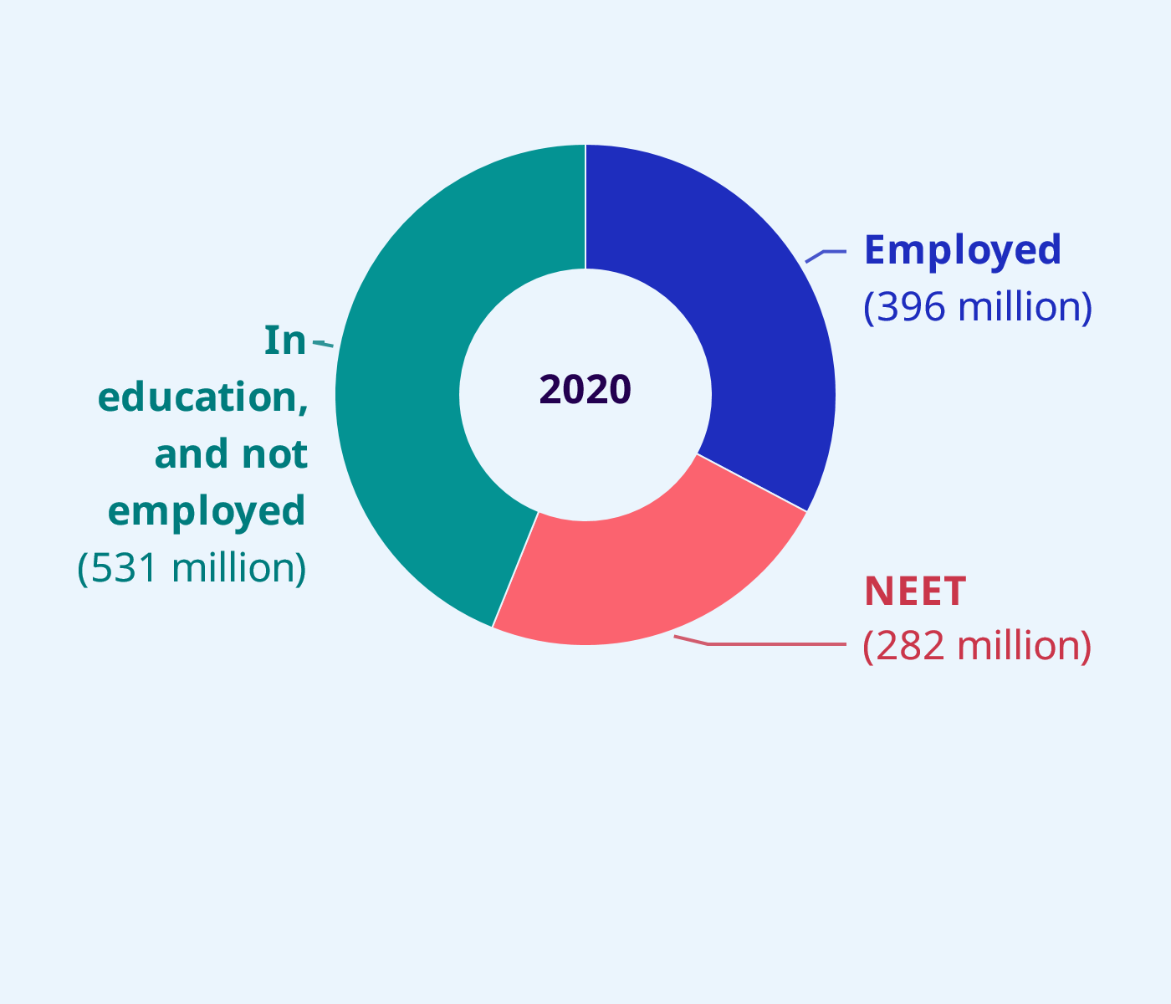
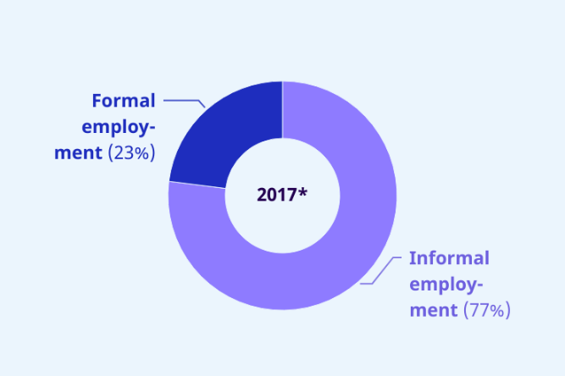
Youth employment trends
Global key figures

Slide 3
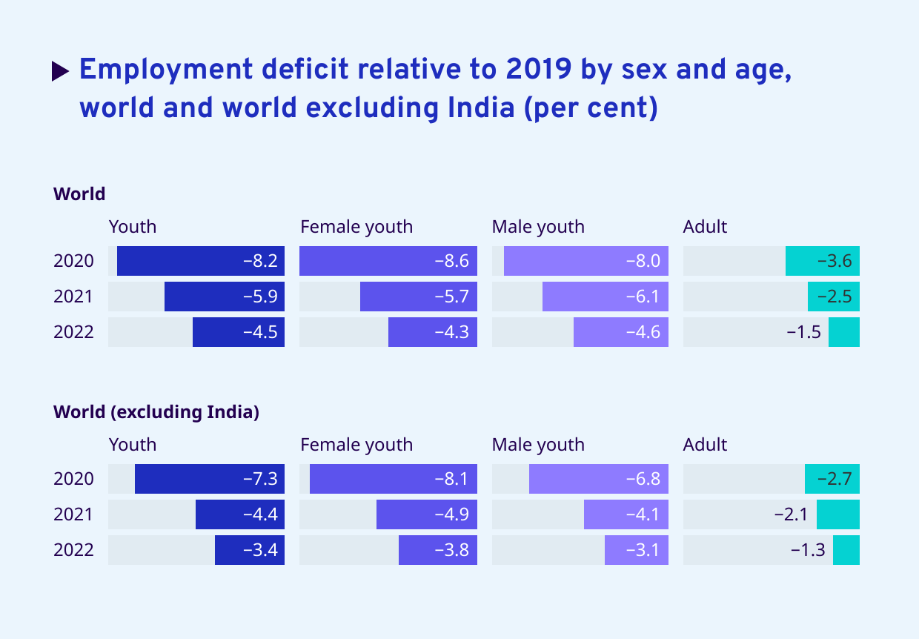
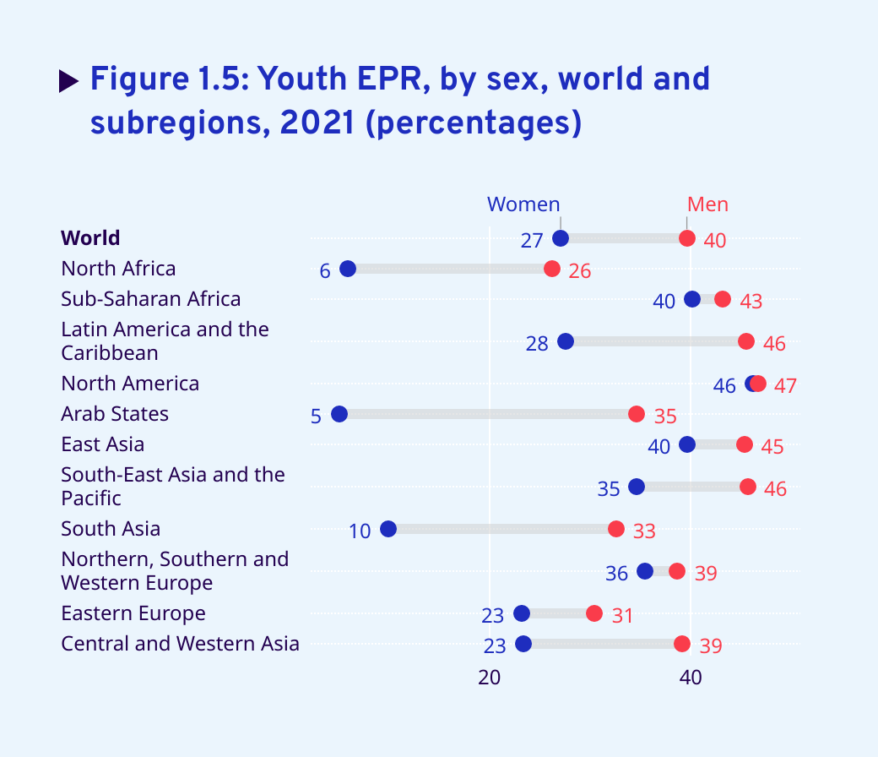
Comparative Employment trends
Covid-19 impacts
Note: The employment deficit shows the (cumulative) difference between the employment growth and the population growth. It represents by how much employment is lower, relative to employment in 2019, because the employment-to-population ratio is below its 2019 level.

Slide 4
Starting point: The impact of active labour market programmes on youth
Youth labour market challenge is persisting in many countries across the globe: COVID-19 has exacerbated pre-existing inequalities
Active labour market programmes (ALMPs) have been promoted as a key component of COVID-19 recovery plans
Since policymakers place a great focus on policies and programmes to accelerate the COVID-19 recovery up-to-date evidence on what works in youth employment can help steer investments and maximise impacts

Slide 5
Why a systematic review?
Goal: Provide an unbiased assessment of what works through systematic identification, assessment and synthesis of relevant research.
Existing reviews on youth employment are either not systematic, not youth focused, analyse a limited set of studies, or do not use empirical methods.
Key components of this systematic review:
Transparent and replicable: peer-reviewed protocol publicly available
Clear theory of change underlying the review question
Comprehensive search, incl. grey literature
Explicit study inclusion and exclusion criteria
Coding of study characteristics and empirical results
Quantitative and qualitative synthesis

Slide 6
Impact evaluation: One concept, many methods
Learning objectives
What is the impact of our program on outcomes of interest?
Type of evaluation
Impact evaluation
Type of evaluation method
I. Experimental
II. Quasi-Experimental
III. Non-Experimental
Randomized Control Trial (RCT)
Matching
Difference-in-difference
Regression discontinuity design
Instrumental variables
Before & after comparison;
Participants vs. non-participants
Examples
Notes:
We have just learned that selecting a good comparison group is essential for a solid and reliable impact evaluation.
However, we have not talked much about the concrete methods and techniques that help us accomplishing this. In fact,

Slide 7
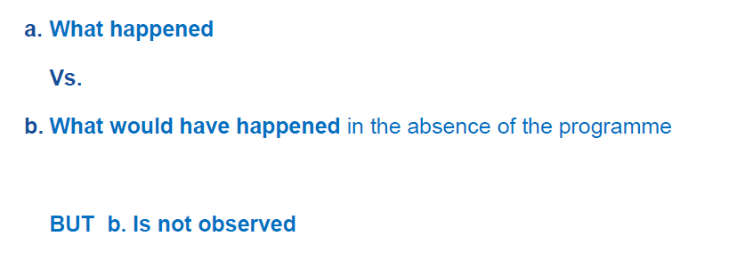
Impact evaluations estimate the causal effect of programmes
Counterfactual
Notes:
We have just learned that selecting a good comparison group is essential for a solid and reliable impact evaluation.
However, we have not talked much about the concrete methods and techniques that help us accomplishing this. In fact,

Slide 8
Scope of the Systematic Review
Questions | What is the impact of (different) youth employment interventions on labour market outcomes of youth? What is the role of context and programme design?
Inclusion criteria | Programmes : Youth (15-35) targeted Active Labour Market Programmes (ALMP) Methods: (Quasi-)Experimental counterfactual impact evaluations Sources: Peer-reviewed & grey literature/working papers;1990 – 2022 Outcomes categories: Employment, earnings, business performance

Slide 9
Active Labour Market Interventions
Training and Skills Development
Basic skills and employability, equipping youth with skills with in-classroom and on-the-job combinations
Entrepreneurship Promotion
Provide entrepreneurial skills as well as physical, financial and social capital for self-employment
Employment Services
Job-search assistance, mentoring; often complemented by job placement services
Subsidized Employment
Wage subsidies + public works (EIIP) → to subsidized the cost of labour, compensate for low productivity, and/or provide (short-term) employment and on-the-job experience

Slide 10
Step 1: Search & selection process
A.
Search in 38 sources using search terms results in 88,097 records
B.
Initial screening: check for duplicates and removal of “unlikely matches”: 21,560 records
C.
Title and abstract screening: 875 records left
D.
Full text review of 876 records and initial selection of 220 studies
Total number of studies included in the SR: 232
E.
Comparing with initial SR (Kluve et al. 2017) results in 12 added records

Slide 11
Step 2: Coding
Data extraction (coding) follows a strict protocol guided by a coding manual
The coding process builds a database where the unit of observation is the effect size: an impact estimate for…
Further information are collected at the study-level (e.g. research methods) and intervention level (e.g. type of implementer)
Database containing 5,146 effect sizes (observations)
Type of variable | Example
Intervention | Skills development training
Outcome category | Probability of employment
Sub-group | Young women with higher levels of education
.....

Slide 12
Step 3: Analysis & methods
To be able to compare impact estimate across intervention types and outcome categories we compute the standardised mean difference* (SMD):
$$SMD=\frac{{\overline{Y}}_{t}−{\overline{Y}}_{c}}{S_{p}}$$
Where ${\overline{Y}}_{t}$ is the average in the treatment group and ${\overline{Y}}_{c}$ the average in the control group (post-treatment). $S_{p}$ is the pooled standard deviation of the outcome after treatment
SMDs capture the relative magnitude of treatment effects in a dimensionless way making them comparable across outcomes and studies.
*: simplified, a correction term is used to account for small sample biases (not shown here)

Slide 13
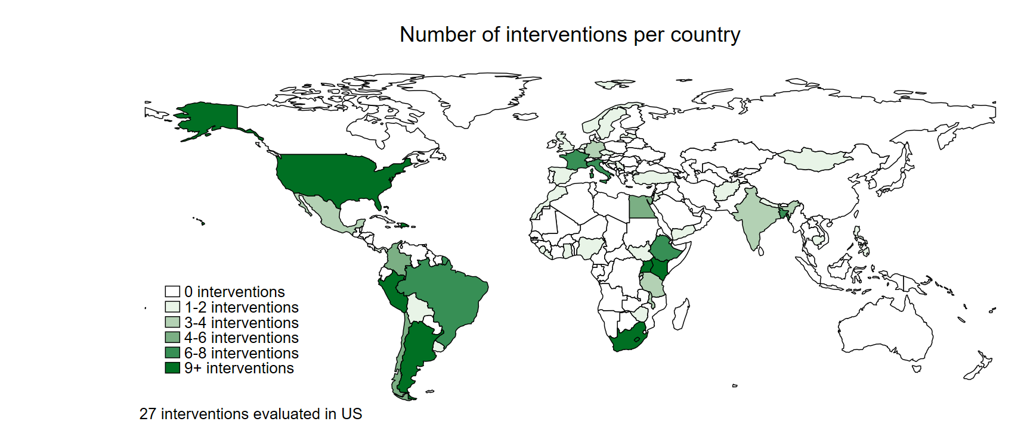
Geographic coverage (prel.)

Slide 14
Results from 2017 systematic review

Slide 15
Study Characteristics
Notes:
Extensive search effort seems successful in identifying unpublished studies
Only around one-third of the studies are from peer-reviewed journals (generally lower)
detection of grey literature is one of the strength of this review
account for publication status in the later analysis & test for publication bias
Recent surge of evidence
Almost 50% published after 2010, with 21 studies published in 2014 alone
Better evidence base
In particular in low-income countries
2014, 12 out of 15 RCTs included in this review were from non-OECD countries, mainly Sub-Saharan Africa (
large share of (randomized) experimental studies
Three quarter of the studies (N= 86) in the sample report results for several different outcomes

Slide 16
Study Characteristics
Notes:
Extensive search effort seems successful in identifying unpublished studies
Only around one-third of the studies are from peer-reviewed journals (generally lower)
detection of grey literature is one of the strength of this review
account for publication status in the later analysis & test for publication bias
Recent surge of evidence
Almost 50% published after 2010, with 21 studies published in 2014 alone
Better evidence base
In particular in low-income countries
2014, 12 out of 15 RCTs included in this review were from non-OECD countries, mainly Sub-Saharan Africa (
large share of (randomized) experimental studies
Three quarter of the studies (N= 86) in the sample report results for several different outcomes

Slide 17
Descriptive Overview
 |  | PSS |  |  |  | SMD
 |  | Mean | Total # Effect Sizes | # Effect Sizes indep. groups |  | Mean | Total # Effect Sizes | # Effect Sizes indep. groups
(a) Type of outcome:
Employment |  | 0.36 | 1983 | 299 |  | 0.11 | 937 | 216
Earnings |  | 0.33 | 944 | 239 |  | 0.09 | 305 | 113
Business Performance |  | 0.34 | 173 | 50 |  | 0.08 | 160 | 45
(b) Follow-up timing
Less than on year |  | 0.34 | 1058 | 247 |  | 0.07 | 487 | 165
Longer than one year |  | 0.37 | 1430 | 315 |  | 0.14 | 674 | 209
(b) Main Intervention Cat.
Skills training |  | 0.36 | 2031 | 372 |  | 0.10 | 933 | 250
Entrepreneurship Promotion |  | 0.35 | 262 | 95 |  | 0.15 | 214 | 68
Employment Services |  | 0.18 | 171 | 26 |  | 0.03 | 90 | 15
Subsidized Employment |  | 0.41 | 461 | 49 |  | 0.10 | 116 | 28
Comprehensive |  | 0.29 | 175 | 46 |  | 0.11 | 49 | 13
Total |  | 0.35 | 3100 | 588 |  | 0.10 | 1402 | 374
Note: Individual effect sizes are computed across independent studies (i.e. samples). Means for PSS and SMDs weighted such that each study contributes in equal proportions. The number of effect sizes represents the number of different effect sizes (with respect to outcomes) derived from independent groups. One group may contribute multiple effect sizes such as reporting outcomes for earnings, hourly wage, probability of employment, and hours worked per week.
Overall positive and statistically significant impact of youth ALMP
…
but overall magnitude is rather small.
Notes:
initial 3,582 treatment effects reported in the 115 primary studies
PSS dummy variable for a total of 3,107 effect sizes (87%).
compute standardized mean differences N=1391 or 39%)
but higher than in many other systematic reviews.
intensive efforts to acquire missing information from authors
primary studies only provided the required information to compute SMDs for roughly 13%
averages are computed across independent samples for each intervention in order to account for dependencies within studies due to overlap of the study population across effect estimates
Overall, evaluations of youth employment report a statistically significant, albeit very small effect on youth employment outcomes
Outcomes
Average effect size for employment outcomes > income
But power is generally higher for detecting binary outcomes than for detecting changes in rather continuous variables
Business outcomes negative, driven by evaluations of non-business related interventions
For entrepreneurship programs, find large efffects on business outcomes and labor market outcomes
Duration
Generally, effectiveness increases with medium-term -> indication that outcomes take time to materialize

Slide 18
Descriptive Overview
 |  | PSS |  |  |  | SMD
 |  | Mean | Total # Effect Sizes | # Effect Sizes indep. groups |  | Mean | Total # Effect Sizes | # Effect Sizes indep. groups
(a) Type of outcome:
Employment |  | 0.36 | 1983 | 299 |  | 0.11 | 937 | 216
Earnings |  | 0.33 | 944 | 239 |  | 0.09 | 305 | 113
Business Performance |  | 0.34 | 173 | 50 |  | 0.08 | 160 | 45
(b) Follow-up timing
Less than on year |  | 0.34 | 1058 | 247 |  | 0.07 | 487 | 165
Longer than one year |  | 0.37 | 1430 | 315 |  | 0.14 | 674 | 209
(b) Main Intervention Cat.
Skills training |  | 0.36 | 2031 | 372 |  | 0.10 | 933 | 250
Entrepreneurship Promotion |  | 0.35 | 262 | 95 |  | 0.15 | 214 | 68
Employment Services |  | 0.18 | 171 | 26 |  | 0.03 | 90 | 15
Subsidized Employment |  | 0.41 | 461 | 49 |  | 0.10 | 116 | 28
Comprehensive |  | 0.29 | 175 | 46 |  | 0.11 | 49 | 13
Total |  | 0.35 | 3100 | 588 |  | 0.10 | 1402 | 374
Note: Individual effect sizes are computed across independent studies (i.e. samples). Means for PSS and SMDs weighted such that each study contributes in equal proportions. The number of effect sizes represents the number of different effect sizes (with respect to outcomes) derived from independent groups. One group may contribute multiple effect sizes such as reporting outcomes for earnings, hourly wage, probability of employment, and hours worked per week.
… easier to impact employment than income.
Notes:
initial 3,582 treatment effects reported in the 115 primary studies
PSS dummy variable for a total of 3,107 effect sizes (87%).
compute standardized mean differences N=1391 or 39%)
but higher than in many other systematic reviews.
intensive efforts to acquire missing information from authors
primary studies only provided the required information to compute SMDs for roughly 13%
averages are computed across independent samples for each intervention in order to account for dependencies within studies due to overlap of the study population across effect estimates
Overall, evaluations of youth employment report a statistically significant, albeit very small effect on youth employment outcomes
Outcomes
Average effect size for employment outcomes > income
But power is generally higher for detecting binary outcomes than for detecting changes in rather continuous variables
Business outcomes negative, driven by evaluations of non-business related interventions
For entrepreneurship programs, find large efffects on business outcomes and labor market outcomes
Duration
Generally, effectiveness increases with medium-term -> indication that outcomes take time to materialize

Slide 19
Descriptive Overview
 |  | PSS |  |  |  | SMD
 |  | Mean | Total # Effect Sizes | # Effect Sizes indep. groups |  | Mean | Total # Effect Sizes | # Effect Sizes indep. groups
(a) Type of outcome:
Employment |  | 0.36 | 1983 | 299 |  | 0.11 | 937 | 216
Earnings |  | 0.33 | 944 | 239 |  | 0.09 | 305 | 113
Business Performance |  | 0.34 | 173 | 50 |  | 0.08 | 160 | 45
(b) Follow-up timing
Less than on year |  | 0.34 | 1058 | 247 |  | 0.07 | 487 | 165
Longer than one year |  | 0.37 | 1430 | 315 |  | 0.14 | 674 | 209
(b) Main Intervention Cat.
Skills training |  | 0.36 | 2031 | 372 |  | 0.10 | 933 | 250
Entrepreneurship Promotion |  | 0.35 | 262 | 95 |  | 0.15 | 214 | 68
Employment Services |  | 0.18 | 171 | 26 |  | 0.03 | 90 | 15
Subsidized Employment |  | 0.41 | 461 | 49 |  | 0.10 | 116 | 28
Comprehensive |  | 0.29 | 175 | 46 |  | 0.11 | 49 | 13
Total |  | 0.35 | 3100 | 588 |  | 0.10 | 1402 | 374
Note: Individual effect sizes are computed across independent studies (i.e. samples). Means for PSS and SMDs weighted such that each study contributes in equal proportions. The number of effect sizes represents the number of different effect sizes (with respect to outcomes) derived from independent groups. One group may contribute multiple effect sizes such as reporting outcomes for earnings, hourly wage, probability of employment, and hours worked per week.
… impact often only materializes in the long-term.
Notes:
initial 3,582 treatment effects reported in the 115 primary studies
PSS dummy variable for a total of 3,107 effect sizes (87%).
compute standardized mean differences N=1391 or 39%)
but higher than in many other systematic reviews.
intensive efforts to acquire missing information from authors
primary studies only provided the required information to compute SMDs for roughly 13%
averages are computed across independent samples for each intervention in order to account for dependencies within studies due to overlap of the study population across effect estimates
Overall, evaluations of youth employment report a statistically significant, albeit very small effect on youth employment outcomes
Outcomes
Average effect size for employment outcomes > income
But power is generally higher for detecting binary outcomes than for detecting changes in rather continuous variables
Business outcomes negative, driven by evaluations of non-business related interventions
For entrepreneurship programs, find large efffects on business outcomes and labor market outcomes
Duration
Generally, effectiveness increases with medium-term -> indication that outcomes take time to materialize

Slide 20
Descriptive Overview
 |  | PSS |  |  |  | SMD
 |  | Mean | Total # Effect Sizes | # Effect Sizes indep. groups |  | Mean | Total # Effect Sizes | # Effect Sizes indep. groups
(a) Type of outcome:
Employment |  | 0.36 | 1983 | 299 |  | 0.11 | 937 | 216
Earnings |  | 0.33 | 944 | 239 |  | 0.09 | 305 | 113
Business Performance |  | 0.34 | 173 | 50 |  | 0.08 | 160 | 45
(b) Follow-up timing
Less than on year |  | 0.34 | 1058 | 247 |  | 0.07 | 487 | 165
Longer than one year |  | 0.37 | 1430 | 315 |  | 0.14 | 674 | 209
(b) Main Intervention Cat.
Skills training |  | 0.36 | 2031 | 372 |  | 0.10 | 933 | 250
Entrepreneurship Promotion |  | 0.35 | 262 | 95 |  | 0.15 | 214 | 68
Employment Services |  | 0.18 | 171 | 26 |  | 0.03 | 90 | 15
Subsidized Employment |  | 0.41 | 461 | 49 |  | 0.10 | 116 | 28
Comprehensive |  | 0.29 | 175 | 46 |  | 0.11 | 49 | 13
Total |  | 0.35 | 3100 | 588 |  | 0.10 | 1402 | 374
Note: Individual effect sizes are computed across independent studies (i.e. samples). Means for PSS and SMDs weighted such that each study contributes in equal proportions. The number of effect sizes represents the number of different effect sizes (with respect to outcomes) derived from independent groups. One group may contribute multiple effect sizes such as reporting outcomes for earnings, hourly wage, probability of employment, and hours worked per week.
… wide variation across intervention types.
Notes:
initial 3,582 treatment effects reported in the 115 primary studies
PSS dummy variable for a total of 3,107 effect sizes (87%).
compute standardized mean differences N=1391 or 39%)
but higher than in many other systematic reviews.
intensive efforts to acquire missing information from authors
primary studies only provided the required information to compute SMDs for roughly 13%
averages are computed across independent samples for each intervention in order to account for dependencies within studies due to overlap of the study population across effect estimates
Overall, evaluations of youth employment report a statistically significant, albeit very small effect on youth employment outcomes
Outcomes
Average effect size for employment outcomes > income
But power is generally higher for detecting binary outcomes than for detecting changes in rather continuous variables
Business outcomes negative, driven by evaluations of non-business related interventions
For entrepreneurship programs, find large efffects on business outcomes and labor market outcomes
Duration
Generally, effectiveness increases with medium-term -> indication that outcomes take time to materialize

Slide 21
Step 5: Interpretation - What works? And where?
Investments in young people pay off: employment interventions are effective in improving labour market outcomes of young women and men; on average effect sizes are medium.
Labour market programmes in LMICs are more effective: which appears to be driven through earning outcomes – could be as ALMPs in LMIC target income over employment effects
Entrepreneurship promotion programmes show higher effect sizes – driven entirely by interventions in LMIC.
Multiple programme components are more effective and – again – particularly in LMICs
Participant characteristics: young people from disadvantaged based (in particular in LMICs) appear to benefit more; similar tendency for young women in LMIC
Timing of follow-up: No indication that effects grow over time (when measures more than 1 year after the intervention).

