Slide 1


LESSONS LEARNED FROM UNDP SUPPORT TO E-GOVERNANCE:
RAPID EVIDENCE ASSESSMENT OF EVALUATIONS FROM THE LAST DECADE

Slide 2

Context
E-Governance can improve transparency & accountability, expand service coverage and accessibility, and engage citizens
COVID-19 highlighted the use of e-governance tools
Digital divide can exacerbate inequalities
Needs for e-governance remain largely unmet
UNDP’s support to digital transformation emphasizes the whole-of-society approach, connecting people, business, government, regulation, and infrastructure.

Slide 3
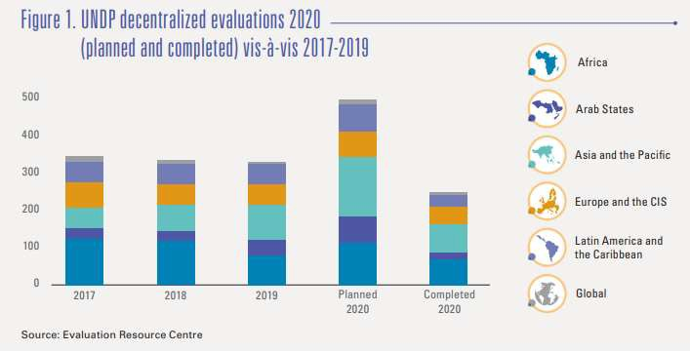
Evaluation at UNDP
Evaluations conducted in accordance with UN Evaluation Group Standards and Norms & the UNDP Evaluation Policy
Around 300 project evaluations per year managed by regional bureau and country offices
Independent country programme, thematic, and corporate evaluations managed by IEO

Slide 4
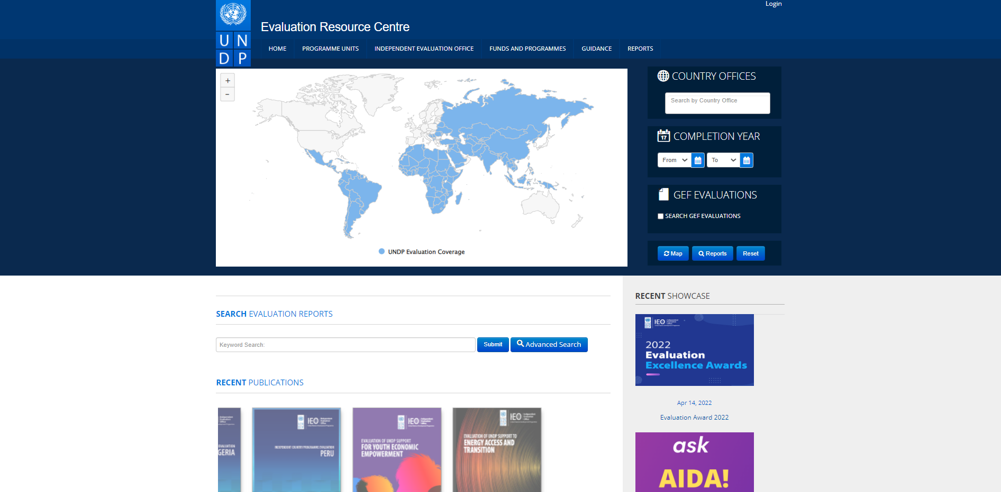
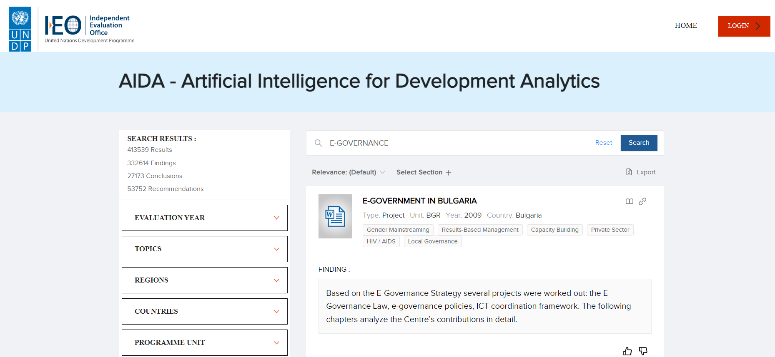
Evaluation at UNDP
Evaluations are publicly accessible on the UNDP Evaluation Resource Centre (ERC)
Artificial Intelligence for Development Analytics (AIDA) was launched in February 2022 to search and retrieve evidence from ERC
Open database with more than 5,000 evaluation reports since 2002
About 300 new evaluation reports added annually
Use artificial intelligence and machine learning to extract evaluation evidence and generate evaluation insights and lessons

Slide 5



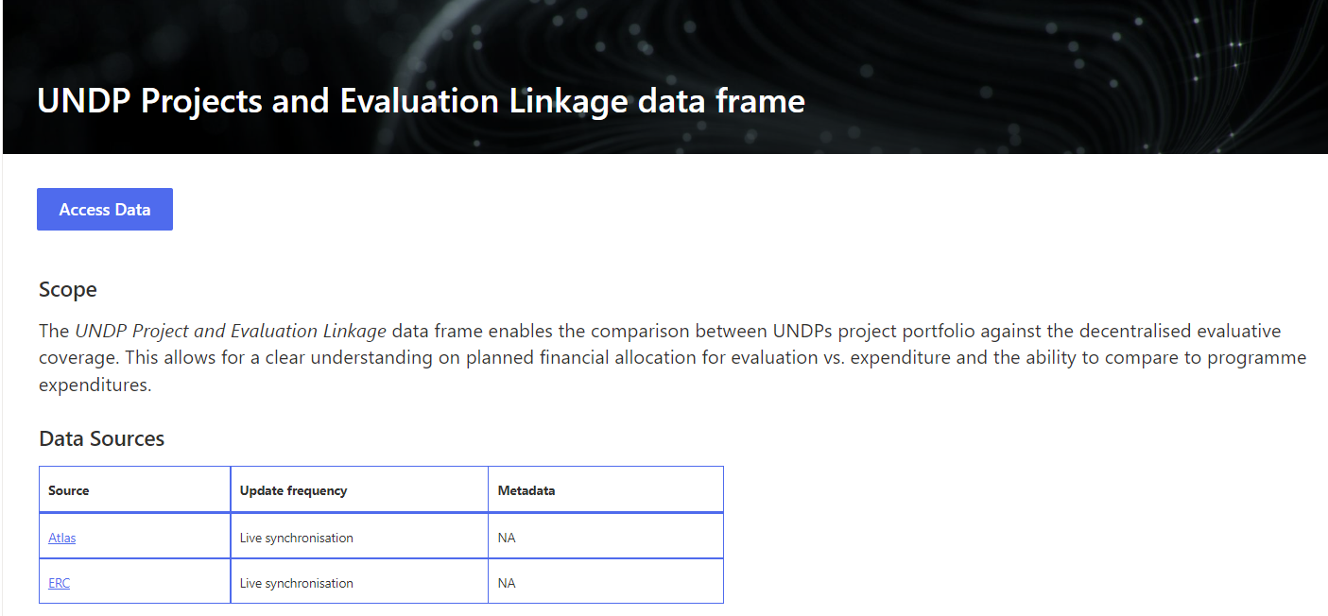
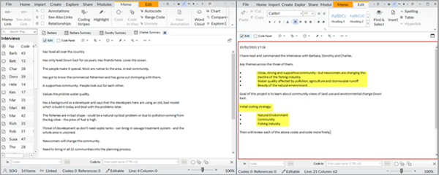


Methodology
Keywords list
Search in project-evaluation linkage database
Search in AIDA & ERC
Deductive & Inductive Coding on NVIVO
Coding result
AIDA
Rapid Evidence Assessment
Shortlisting
Filtering & Shortlisting
Sampling
Additional Sampling
Coding
Analysis

Slide 6
Methodology
Sample: 98 UNDP evaluation reports (2012-2022) in English, French and Spanish

Slide 7
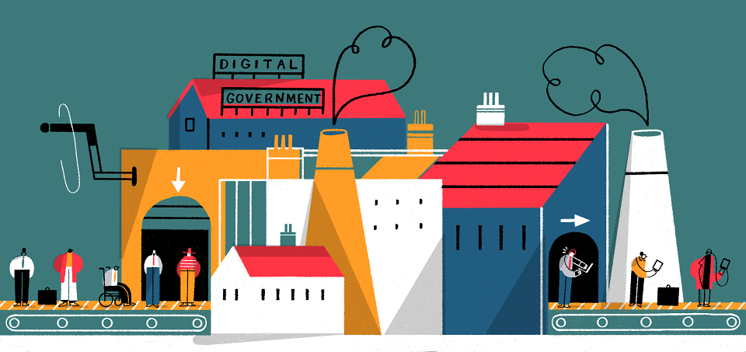
Lessons Learned
Inclusive e-services
Lesson 1 E-governance solutions can enhance interoperability and efficiency of public service delivery and promote service continuity as evidenced during the COVID-19 pandemic.
Lesson 2 Making digital public services accessible and inclusive for vulnerable and underserved populations requires targeted interventions adapted to their specific needs and capacities.
Lesson 3 One-stop-shops, combining digital technology with human/physical interface, can reduce time and cost and reinforce localized public service delivery in rural and remote areas.
Public administration reform
Lesson 4 Transforming public administration requires both modernization and reform, where introduction of technology and capacity is accompanied by updated regulation and changes in the work culture.
Lesson 5 Digital tools can promote open government initiatives and facilitate citizens’ participation in the decision making process.

Slide 8
Interoperability, efficiency and continuity: public service delivery
Digital registry
Improve interoperability and efficiency
Support Covid-19 emergency responses
Country examples: Montenegro, Argentina, Malawi, Tajikistan, Bosnia and Herzegovina
E-records and documentation management system
Improve efficiency and transparency
Country examples: Bangladesh, Tajikistan, Uzbekistan, Moldova
Technology (e.g. Zoom license, APPs)
Ensure business continuity during COVID-19
Country examples: Nepal, Peru, Zambia, Uganda, South Sudan

Slide 9

Accessibility and e-inclusion: adapt to specific needs and capacities
Unequal access to e-services
Groups lacking digital literacy
Persons with disabilities
Rural and remote communities
Good practices
Accessibility mapping (e.g. Kazakhstan)
Apps with features for persons with hearing/speech and/or visual disabilities during Covid-19 (e.g. Egypt, Belarus)
Call centres /local agents for groups and communities lacking digital literacy (e.g. Serbia, Pacific islands)

Slide 10


One-stop-shops
One-stop-shops, combining digital technology with human/physical interface, can reduce time and cost and reinforce localized public service delivery in rural and remote areas.
Country examples: Bangladesh, Georgia, Serbia, Bhutan, Moldova, Laos
Lack of information
Low confidence
Limited usage
Unsatisfactory revenue generation
Sustainability at risk
Challenges

Slide 11
E-governance for public administration reform
Transforming public administration requires both modernization and reform, where introduction of technology and capacity is accompanied by updated regulation and changes in the work culture.
Laws and regulations to set up data sharing and protection requirements and procedures (e.g. Montenegro, Serbia), or MoUs (e.g. Malawi)
Cultural change (e.g. Moldova, Bangladesh)

Slide 12




E-participation
Digital tools can promote open government initiatives and facilitate citizens’ participation in the decision-making process.
Local governance: planning, budgeting, public service (e.g. Ukraine, Bosnia and Herzegovina)
Legislation: e-parliament (e.g. Bhutan, Armenia, Ukraine, Serbia)
Election: voter registration system, voter engagement (e.g. Haiti)
Citizen engagement: feedback on public service and transparency (e.g. Moldova, Georgia, Uzbekistan)

Slide 13


Twofold implications for NES
1st, national monitoring and evaluation systems need to take into consideration the advancements and trends in e-governance, and develop adequate approaches and processes for them.
2nd, (digitalized) M&E system can also be part of the e-governance architecture of a country, and therefore should also consider how systems can facilitate the access, inclusion and participation – three key issues of citizen engagement - as highlighted in the lessons.
Participation
Interoperability
Data privacy
Accessibility
Inclusivity
……
Inclusion
Access

Slide 14

Thank You
Xiaoling.zhang@undp.org
www.undp.org/ieo

