Slide 1
What can we learn from Sectoral Evaluation systems?
7th International Conference on National Evaluation Capacities (NEC 2022)
Dr Shabnum Sarfraz
Senior Social Sector Development Professional
Former Member Social Sector & Devolution,
Ministry of Planning, Development and Special Initiatives
Government of Pakistan

Slide 2
Outline
CONTEXT - What was the initial situation in your sectoral evaluation system? What needed to be improved?
INTERVENTION – What did u do? What were the achievements?
OBSTACLES – What were the key challenges & how will they be addressed?
NETWORK – Who were the main external partners and how did they support?
REFLECTION – What would you have done differently?
NEC FORUM – How can NEC initiative support you?

Slide 3
Evidence Guided High Level Sectoral Reviews
Forums of mutual learning and collective decision making rather than policing
Notes:
While working very closely with sectors and ministries on streamlining their quarterly reviews, we have invested in smart, target oriented monitoring. The objective is not to pinpoint gaps but sit together and identify areas where mitigating measures and better coordination for intended impact can be achieved.

Slide 4
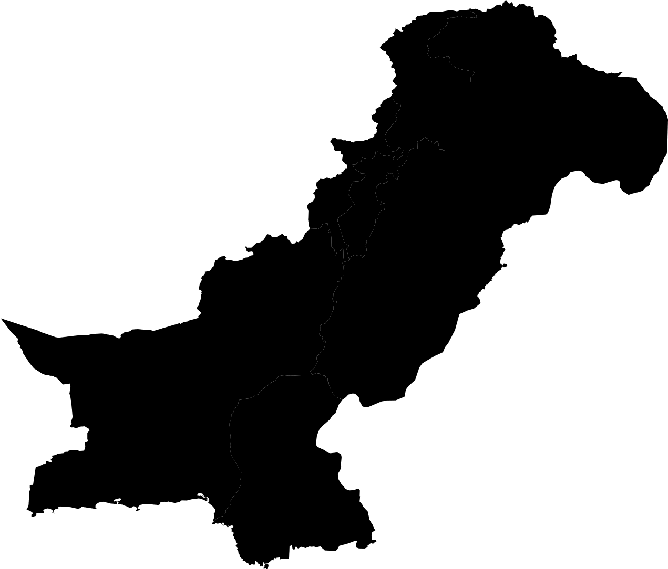
Using Evidence to Align Financing to Sectoral Needs
Mobilized funding through development partners, repurposed existing financing streams for sustainable development | Gap? | Increasing the economic, social and environmental impact of investment in SDGs
MOBILISATION | ALIGNMENT | IMPACT
Repurposed Govt Financing
Project Financing
Grants
PSDP
Budgetary Support
Notes:
Efforts are made to use the trend lines, variances and projections to guide investment decisions

Slide 5
SDG 3 – National Performance Gap to meet SDG2030 commitments
SDG 3 – Key Indicators 2019 and 2030 Targets
Monitoring Health for SDGs , PDHS 2017-18, PSLM 2019-20, NHA 2017-18 NNS, NTP-MIS, PES 2019
Notes:
Taking example of health sector reviews, we monitor the SDG3 at the national level while keeping a close eye on the sub indicators and where we need to invest more to meet the gap.

Slide 6
Universal Health Coverage – Performance Gap
Provincial UHC Indices – Indicator Breakdown for 2019
UHC Indicators | Punjab | Sindh | KP | Balochistan | ICT | GB | AJK | National
Family Planning satisfied with modern methods (%) | 50.3 | 50.2 | 45.1 | 33.8 | 55.1 | 46.4 | 38.5 | 48.6
Anti-natal care -4+ visits | 56.2 | 54.1 | 44.6 | 23.1 | 80.2 | 34.9 | 46.5 | 51.4
Child Immunization (Penta 3) (%) | 89 | 59.3 | 64.9 | 37.3 | 34 | 61.1 | 84.3 | 75.4
Care-seekig behaviour for child pneumonia (%) | 86.1 | 85.4 | 84.3 | 62.2 | 83.6 | 76.2 | 80.8 | 84.5
RMNCH Aggregate Score | 68.22 | 60.87 | 57.6 | 36.69 | 74.64 | 52.42 | 29.09 | 63.11
Tuberclosis Effective Treatment (%) | 59.5 | 54.4 | 54.9 | 30.7 | 39.3 | 62.8 | 43.7 | 54.9
HIV Treatment (%) | 12 | 12 | 12 | 12 | 12 | 12 | 12 | 12
At least basic sanitation (%) | 87 | 70 | 83 | 41 | 80 | 80 | 80 | 80
CD Aggregate Score | 39.61 | 35.75 | 37.95 | 24.72 | 33.54 | 39.2 | 34.75 | 37.49
Prevalence of Normal Blood Pressure (%) | 40 | 63 | 63 | 63 | 63 | 63 | 63 | 63
Normal blood sugar (%) | 63 | 63 | 63 | 63 | 63 | 63 | 63 | 63
Tobacco non-smoking (%) | 60.4 | 60.4 | 60.4 | 60.4 | 60.4 | 60.4 | 60.4 | 60.4
NCD Aggregate Score | 53.39 | 53.39 | 53.39 | 53.39 | 53.39 | 53.39 | 53.39 | 53.39
Hospital beds per 10,000 population against threshold (%) | 28.9 | 42.8 | 36.1 | 33 | 67.8 | 45.5 | 50.1 | 34.4
(Physicians*Surgeons) density against threshold (%) | 32.8 | 41.5 | 28.5 | 90.6 | 32 | 90.6 | 39.6 | 33.3
International Health Regulations core capacity index (%) | 53 | 53 | 53 | 53 | 53 | 53 | 53 | 53
SAC Aggregate Score | 36.88 | 45.48 | 37.93 | 32.48 | 48.64 | 36.15 | 47.2 | 39.34
UHC Index | 48.03 | 47.95 | 45.87 | 35.41 | 50.49 | 44.63 | 47.7 | 47.21
MoNHSR&C for UHC Index
Notes:
The national health indicators are disaggregated to evaluate progress at sub national level

Slide 7
SDG-3 Provincial Performance Parameters
Provincial Performance on SDGs (2019)
 | Punjab | Sindh | KP (FATA) | Balochistan | GB | AJK | Pak | Bangladesh | Iran | India | Sri Lanka
3.1.1 Maternal Mortality Ratio* | 157 | 224 | 165 | 298 | 157 | 104 | 186 | 176 | 25 | 174 | 30
3.1.2 Skilled Birth Attendance* | 71.3 | 74.8 | 67.4 (52.1) | 38.2 | 64.4 | 64.1 | 69.3 | 49.8 | 50.5 | 81.4 | 99
3.2.1 Under 5 Mortality Rate* | 85 | 77 | 64 (33) | 78 | 76 | 53 | 74 | 37 | 15 | 47 | 9
3.2.2 Neonatal Mortality Rate* | 51 | 38 | 42 | 34 | 47 | 30 | 42 | 19.06 | 8.58 | 21.66 | 4.27
3.7.1 FP demand satisfied with modern methods* | 50.3 | 50.2 | 45.1 (35.3) | 33.8 | 46.4 | 38.5 | 48.6 | 70.3 | 68.5 | 61.7 | 74.3
3.8.1 Universal Health Coverage Index | 48.03 | 47.95 | 45.87 | 35.41 | 44.63 | 47.70 | 47.21 | 46 | 65 | 56 | 62
3.c.1 Essential Health Workforce Density | 1.45 | 2.02 | 1.2 | 0.63 | Pb | Pb | 1.65
Penta3 Immunization coverage* | 89 | 59.2 | 64.9 (42.6) | 37.3 | 61.1 | 84.3 | 75.4 | 94 | 98 | 87 | 99
Tuberculosis effective treatment | 59.5 | 54.4 | 54.9 | 30.7 | 62.8 | 43.7 | 54.9 | 94 | 86 | 82 | 85
Hospital Beds Density per 10000 | 28.9 | 42.8 | 36.1 | 33 | 45.5 | 50.1 | 5.78 | 7.9 | 15.6 | 5.3 | 41.5
Stunting* | 36.4 | 45.5 | 40 (48.3) | 46.6 | 46.6 | 39.30 | 40.2 | 28 | 6.8 | 34.7 | 17.3
Wasting* | 15.3 | 23.3 | 15 (23.1) | 18.9 | 9.4 | 16.1 | 17.7 | 9.8 | 4 | 20.8 | 15.1
Government Health Spending (US$) |  |  |  |  |  |  | 9.91 | 5.79 | 197.5 | 15.1 | 65.92
 | Punjab | Sindh | KP (FATA) | Balochistan | GB | AJK | Pak
3.1.1 Maternal Mortality Ratio* | 157 | 224 | 165 | 298 | 157 | 104 | 186
3.1.2 Skilled Birth Attendance* | 71.3 | 74.8 | 67.4 (52.1) | 38.2 | 64.4 | 64.1 | 69.3
3.2.1 Under 5 Mortality Rate* | 85 | 77 | 64 (33) | 78 | 76 | 53 | 74
3.2.2 Neonatal Mortality Rate* | 51 | 38 | 42 | 34 | 47 | 30 | 42
3.7.1 FP demand satisfied with modern methods* | 50.3 | 50.2 | 45.1 (35.3) | 33.8 | 46.4 | 38.5 | 48.6
3.8.1 Universal Health Coverage Index | 48.03 | 47.95 | 45.87 | 35.41 | 44.63 | 47.70 | 47.21
3.c.1 Essential Health Workforce Density | 1.45 | 2.02 | 1.2 | 0.63 | 0.46 | 0.51 | 1.65
Penta3 Immunization coverage* | 89 | 59.2 | 64.9 (42.6) | 37.3 | 61.1 | 84.3 | 75.4
Tuberculosis effective treatment | 59.5 | 54.4 | 54.9 | 30.7 | 62.8 | 43.7 | 54.9/93
Hospital Beds Density per 1000 | 2.89 | 7.7 | 6.5 | 5.94 | 0.82 | 3.77 | 5.28
Stunting* | 36.4 | 45.5 | 40 (48.3) | 46.6 | 46.6 | 39.30 | 40.2
Wasting* | 15.3 | 23.3 | 15 (23.1) | 18.9 | 9.4 | 16.1 | 17.7
Government Health Spending (US$) | 16.56 | 20.1 | 18.2 | 15.4 | 4.5 | 17.7 | 9.91
Source: PDHS, PMMS, PSLM, NNS, NTP-MIS
Notes:
The sub national performance is evaluated to identify the lagging regions and is also compared with regional countries

Slide 8
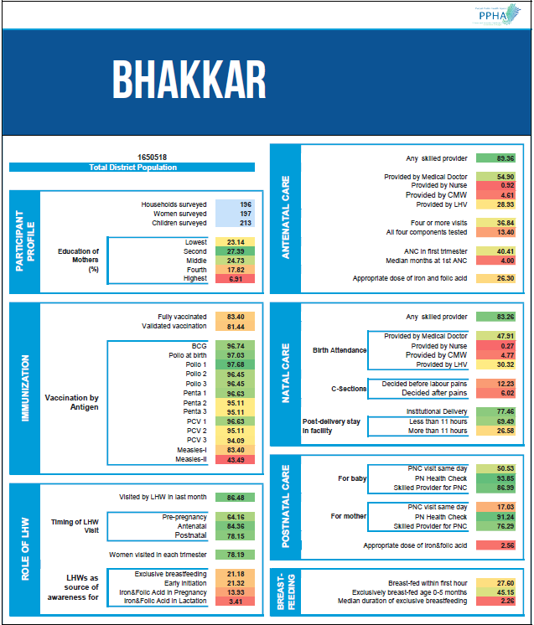
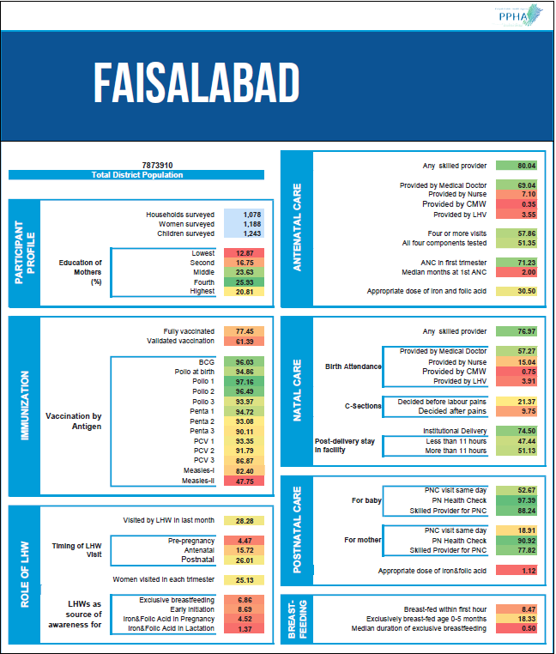
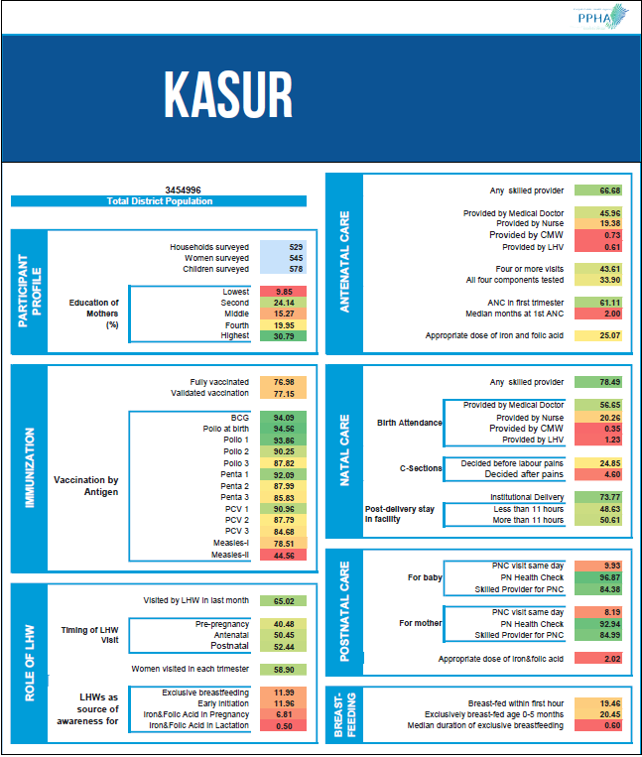
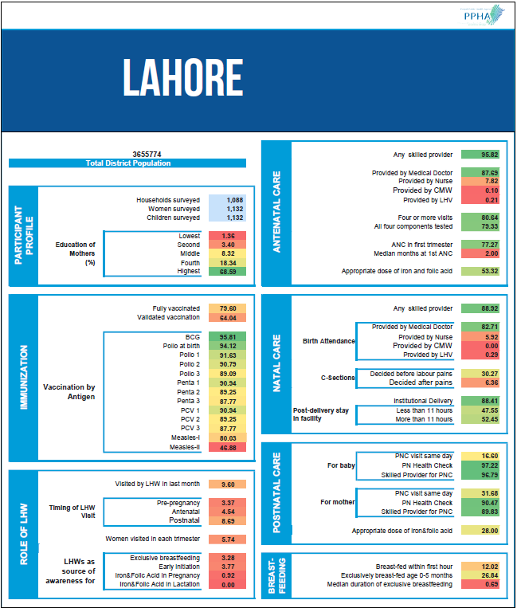
Tracking sub national data for focused interventions
Plotting progress and improvement across districts
Generation of District Dashboards
District | Antenatal Care Coverage | Skilled Birth Attendance | Institutional Delivery | Postnatal Care for New born | Postnatal Care for Mother | Geometric Average | Improvement from 2014
Bahawalpur | 72 | 73 | 67 | 98 | 93 | 79 | 18
Kasur | 67 | 78 | 74 | 97 | 93 | 81 | 18
Bhakkar | 89 | 83 | 77 | 94 | 91 | 87 | 17
Rajanpur | 72 | 44 | 42 | 96 | 97 | 66 | 16
Attock | 94 | 87 | 82 | 97 | 95 | 91 | 15
Layyah | 68 | 69 | 55 | 89 | 93 | 73 | 14
RY Khan | 61 | 76 | 74 | 89 | 80 | 76 | 14
Mandi Bahauddin | 86 | 75 | 72 | 87 | 95 | 82 | 13
Khanewal | 92 | 78 | 76 | 96 | 91 | 86 | 13
Okara | 79 | 73 | 73 | 93 | 92 | 82 | 13
Sahiwal | 96 | 87 | 86 | 94 | 93 | 91 | 12
Muzaffargarh | 94 | 50 | 48 | 96 | 73 | 69 | 12
Rawalpindi | 96 | 94 | 93 | 96 | 95 | 95 | 10
Bahawalnagar | 56 | 70 | 65 | 91 | 93 | 73 | 10
Narowal | 97 | 85 | 78 | 75 | 95 | 86 | 10
Lodhran | 72 | 67 | 63 | 96 | 85 | 76 | 9
Mianwali | 96 | 80 | 79 | 97 | 94 | 89 | 9
DG Khan | 77 | 43 | 40 | 84 | 67 | 60 | 9
Pakpattan | 85 | 82 | 79 | 87 | 87 | 84 | 8
Vehari | 80 | 75 | 72 | 97 | 94 | 83 | 7
Jhang | 86 | 75 | 74 | 97 | 77 | 81 | 7
Lahore | 96 | 89 | 88 | 97 | 90 | 92 | 6
Punjab | 79 | 79 | 76 | 87 | 84 | 81 | 6
Jhelum | 94 | 93 | 92 | 94 | 91 | 93 | 6
Gujranwala | 76 | 91 | 87 | 94 | 93 | 88 | 5
Gujrat | 97 | 93 | 91 | 94 | 93 | 94 | 4
Khushab | 90 | 71 | 68 | 97 | 86 | 82 | 4
Chakwal | 91 | 88 | 85 | 88 | 92 | 89 | 4
Multan | 92 | 71 | 69 | 89 | 75 | 79 | 3
Nankana Sahib | 76 | 88 | 82 | 89 | 92 | 85 | 2
Faisalabad | 80 | 77 | 75 | 97 | 91 | 84 | 0
TT Singh | 45 | 85 | 83 | 88 | 87 | 75 | -1
Chiniot | 77 | 81 | 79 | 96 | 87 | 84 | -1
Hafizabad | 70 | 79 | 75 | 93 | 95 | 82 | -2
Sheikhupura | 54 | 79 | 78 | 84 | 87 | 75 | -2
Sialkot | 45 | 97 | 94 | 94 | 91 | 81 | -4
Sargodha | 62 | 71 | 69 | 75 | 76 | 70 | -7
Notes:
The sub national data is further disaggregated as reflected here. Each province is a composite of number of districts. Heat maps indicate the low performing districts, targets are set and performance is internally monitored monthly and high level reviews organized every quarter

Slide 9
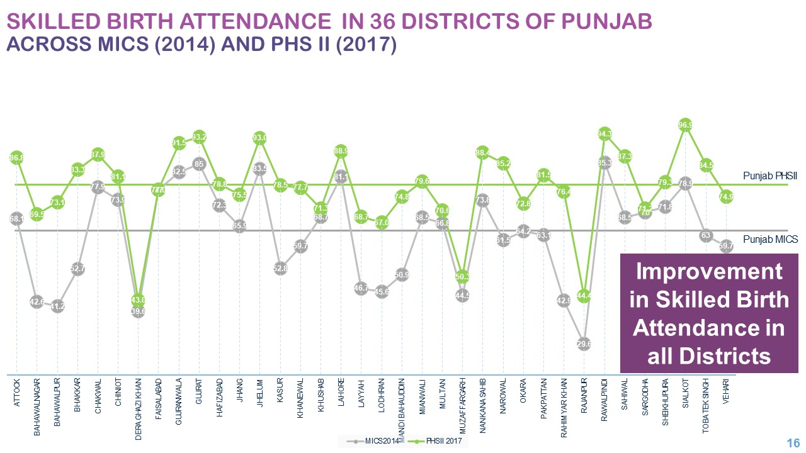
Notes:
Periodic surveys help in evaluating progress and identifies outliers

Slide 10
Triangulating Survey Data with Services Data and Live Tracking
Data Driving Success
1 million cases transferred between 2017 and 2019
Over 900 % Increase in Institutional Deliveries
Polygon Tracking of Vaccinators for Coverage
Notes:
Survey data is routinely triangulated with operational service delivery data. Here u can see polygon live tracking of vaccinators for monitoring their coverage

Slide 11
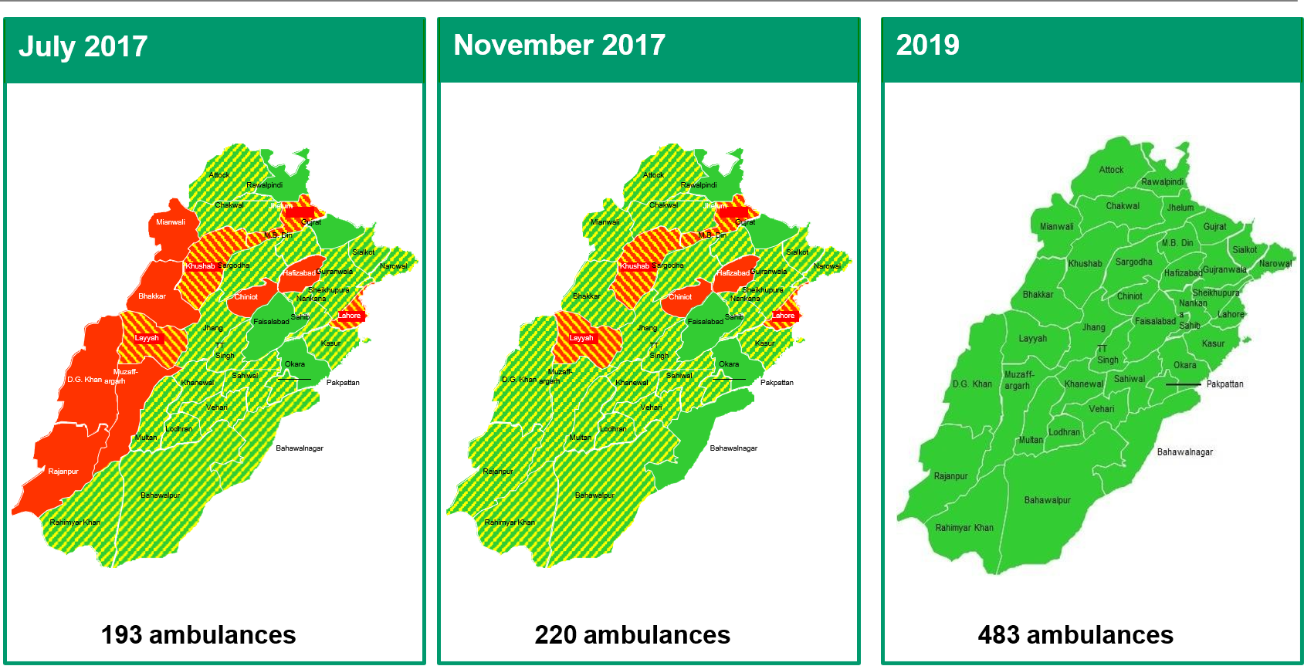
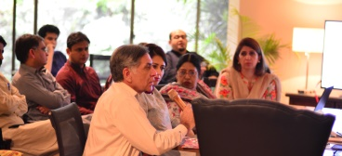
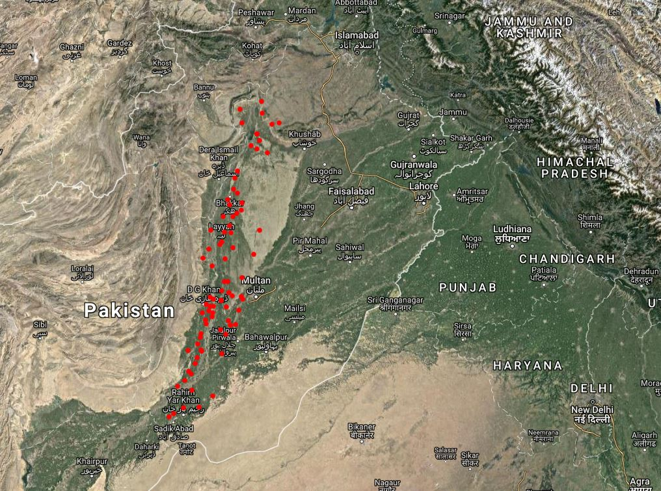
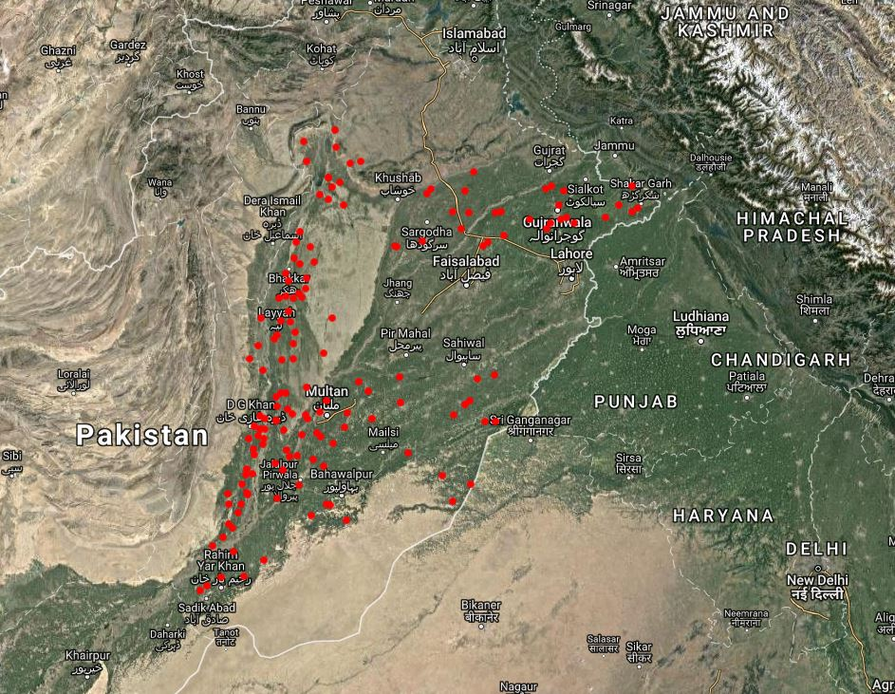
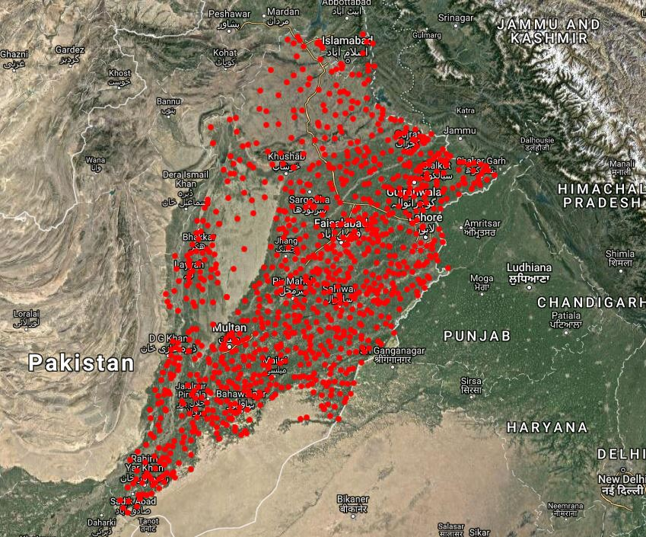
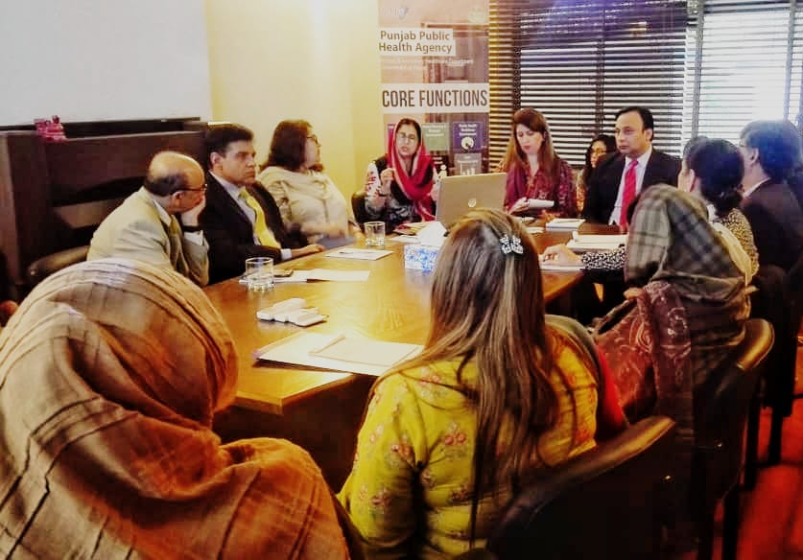
Utilizing Operational Data and Geospatial Mapping
Data Driven Interventions
Ambulance Coverage
Monthly Monitoring Reviews with Policy-Makers
24/7 Health Facilities Upgrading
Notes:
Geospatial mapping is used for evaluating coverage

Slide 12
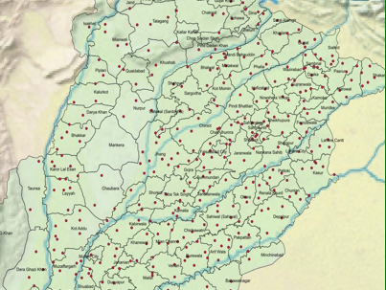
Monitoring coverage
Improving Skilled Birth Attendance
Ambulance Coverage radius
Example of over-concentration of service
per month
GIS maps of ambulance coverage
Example of under-coverage of a remote tehsil
Notes:
GIS mapping helps in identifying under served areas and guides data guided expansion of services

Slide 13
Generating Data to highlight Gaps & Inform Program Design
Notes:
Whereas the production of short and long term statistics was negatively affected in the LMICs, we had some successes as we adopted innovative techniques to fulfil data demands during the COVID19 recovery and response planning and to achieve the SDGs.
What you see here are snippets from our national health facility assessment which was carried out across the 144 districts of Pakistan to serve as baseline for allocation of health funding post COVID19.

Slide 14
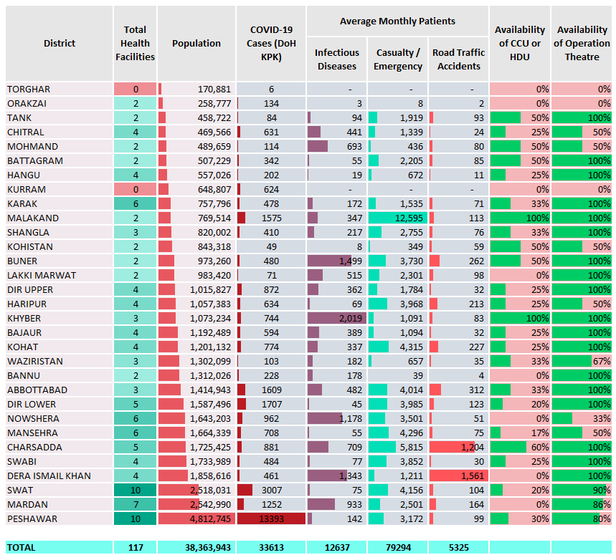
Patient Loads at the 117 health facilities
Three districts
With no Opertaion Theatre
(Torghar, Orakzai and Kurram)
Lakki Marwat
WITHOUT
a CCU or HDU in place.
KPK Rapid Health Facility Assessment
Nowshera
WITHOUT
a CCU or HDU in place and only 2 hospitals having OTs out of 6.
Notes:
It helped guide investments where there were larger gaps

Slide 15
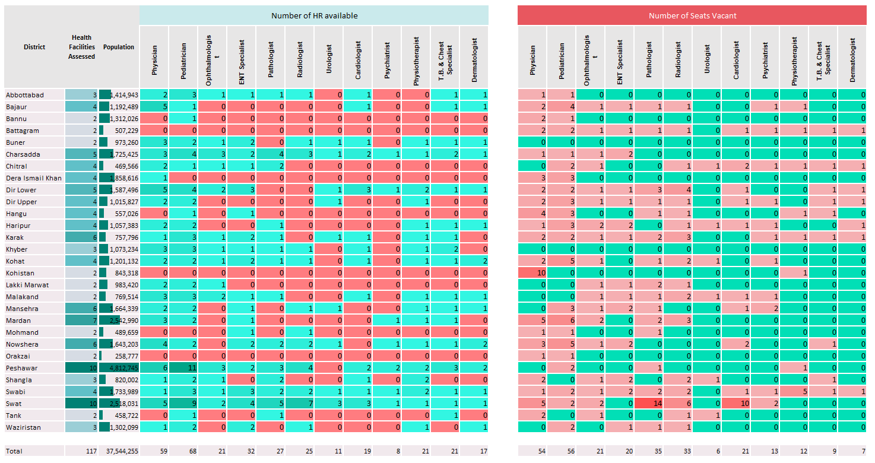
HR Availability and Gaps- Medicine and Allied Specialties
KPK Rapid Health Facility Assessment
Notes:
And also bring to the attention of the implementers the bottlenecks i.e. shortage of critical HR to deliver the program for the intended impact

Slide 16
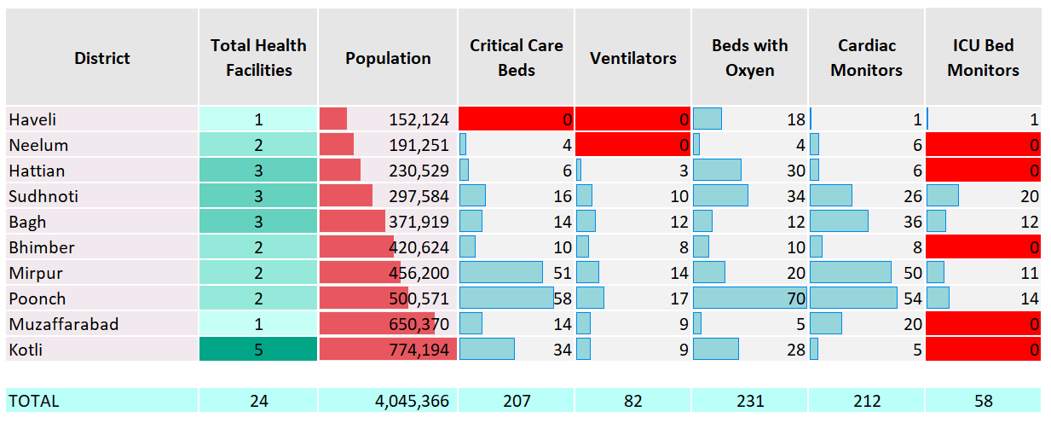
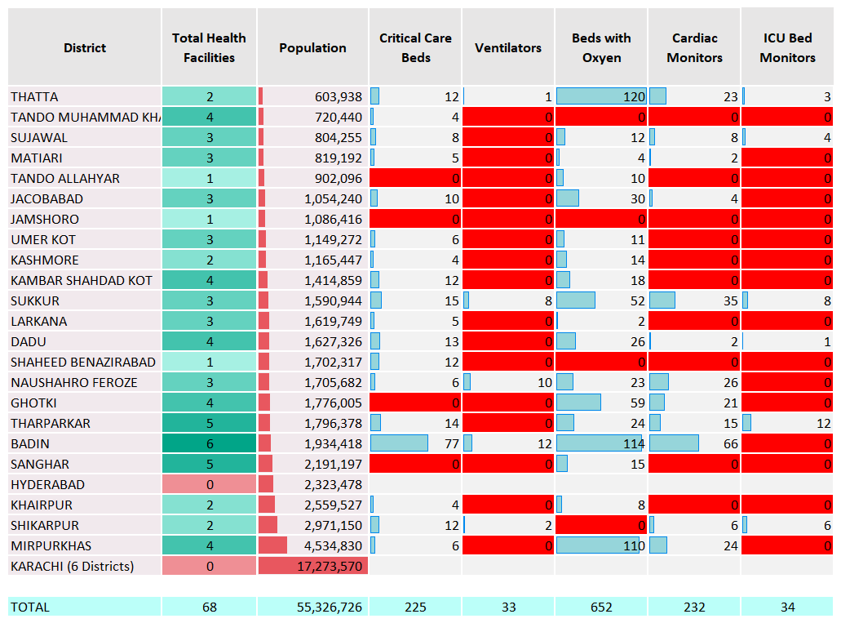
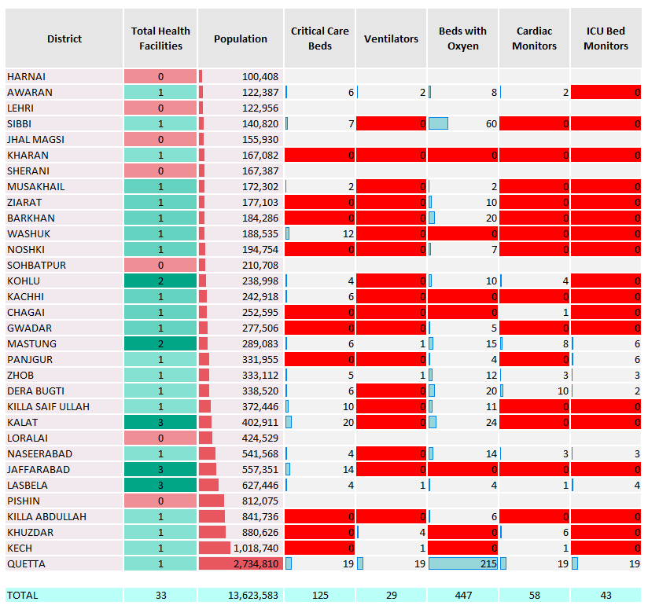
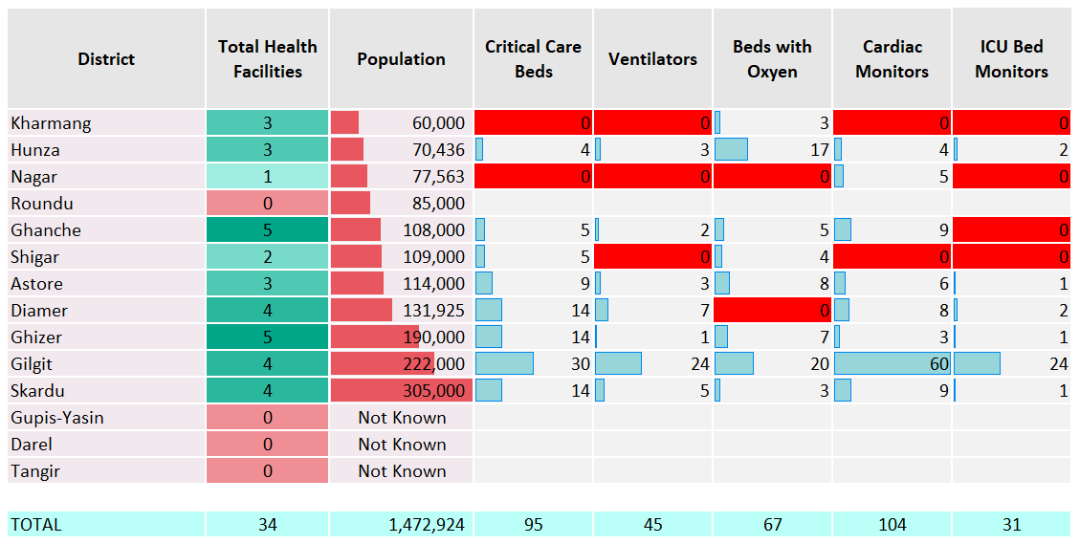
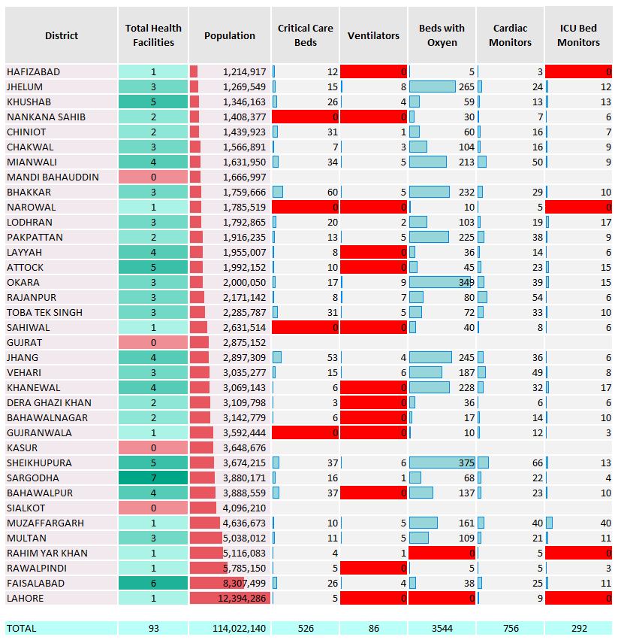
Should we be optimizing the existing health infrastructures first or building new ones?
BUIDLING COMPELLING NARRATIVES
Notes:
We have been using data strategically to build compelling narratives and designing investment cases by placing before these insights before the decision makers

Slide 17
Data guiding district prioritization for SDG investment
Notes:
Sub national rankings help prirotize districts where investments are needed most to meet the SDG national targets

Slide 18
Selecting Indicators and establishing baselines to facilitate target setting
Notes:
Indicators are proposed using strong rationale for investment and baselines are provided to facilitate target setting for subsequent monitoring and evaluation forums

Slide 19
Strengthening Partner Coordination & Data Ecosystem
PLANNING COMMISSION
Notes:
All this has come into effect through strengthening of coordination mechanisms and data ecosystems
Federal SDG Unit at the Planning Commission serves as the conduit between the ministries, departments, UN partners, Donors and Development agencies for coordinating donors’ assistance and strengthening collaborative partnerships.
This has been critical in instituting SDG data reporting and monitoring mechanisms to allow for effective coordination, implementation and monitoring of SDG interventions
We started our journey with SDG data reporting on 21 indicators in 2015 and have reached to160 today

Slide 20
COVID-19 Secretariat
Int’l Experts
CERP
National Academic and Research Institutions
Data Collation, Analysis and Reviews
Harvard Global Health Institute
Indepth Analysis by UN Partners in relevant thematic areas
International Think Tanks
Level 1– Review by COVID19 Secretariat
World Bank
Level 2– Review by Intl/Nl experts
ADB
Harvard Kennedy School
Level 3 – Review by Ministries
PIDE
Notes:
During COVID 19, the Planning Commission served as the secretariat which provided a platform for working along the entire continuum of SDGs with not only government counterparts, but also development partners, national academia and research institutes, policy think tanks both nationally and internationally.

Slide 21
Notes:
This arrangements has proved to be pivotal in aligning ourselves for multiple SDG policy and program initiatives; exploiting nationally and internationally available subject expertise and accessing critical technical backstopping for analyzing data and developing rapid critical insights for use in corrective policy and program design
Engagement with a wide group of key stakeholders while using a snow flake model, and using this systematic approach has enabled us to access data repositories, arrange for national and international expertise to facilitate designing of evidence-informed interventions for government’s economic and social response to achieving the SDGs;

Slide 22
Digitized surveys for inclusion of youth voices
Notes:
The country uses innovative digitized tools for including voices from under represented segments and collecting data where it does not exist using existing networks

Slide 23
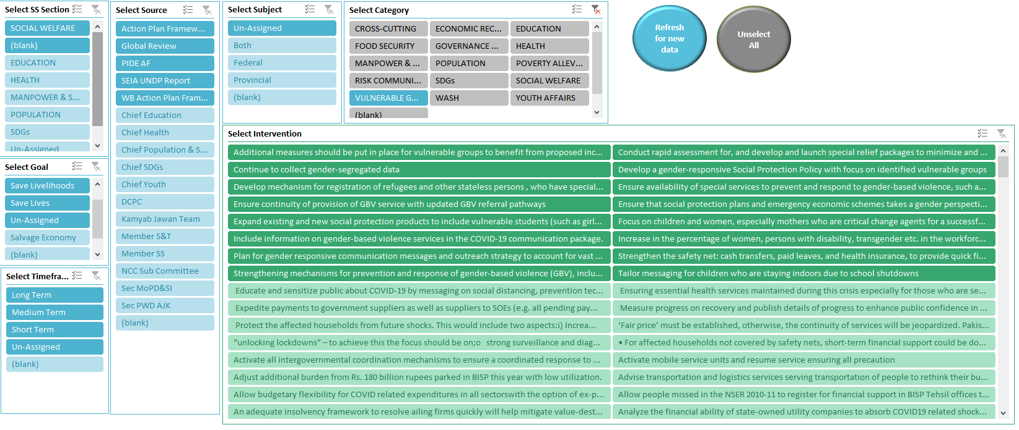
Strategies Dashboard by Themes, Contributors, Sectors & SDG Goals
Notes:
Regular leaning forums and policy roundtables allow for using evidence to guide discussion and consensus building. The stakeholder consultations are categorized and archived in a strategies dashboard and is pivotal for generating reports and policy briefs.

Slide 24
Key Challenges
Political instability
Bureaucratic transitions
Technocratic ability to pursue continuity of good work
Weak institutional capacities and limited local capacities
Access to data
Missing links between monitoring, planning and programming
Realigning narrative to evolving context
Multi sectoral coordination
Notes:
Our biggest challenge to strengthening the NES has been the resistance at all levels
Political resistance
Bureaucratic selection of smart indicators
Teams resistant due to the uncertainty and new ways of working
Focus on budget utilisation
Access to data
Weak integration of monitoring with planing, policy
Image of policing tool rather than aid to robust and targeted decision making
Weak institutional capacities and limited local evaluators

Slide 25
Moving Forward
Strategic utilization of comparative advantage of partners to address country specific challenges
Reform system from within rather than trying to import a contextually irrelevant model
Strengthen analytic abilities for building compelling SDG investment cases to help prioritize SDG financing
Collaboration with other countries on pattern of Pakistan- Sri Lanka twinning program for optimizing on existing tools, programs, lessons learnt
Continue to strengthen accountability forums by careful weaving of the same within the existing national evaluation systems
Adopt a collaborative, participatory approach to gain ownership and reduce resistance
Notes:
Collaborative approach
Culture of M&E needs to be embedded within the system
Context relevant culturally appropriate
Strengthening ability to evaluate our programs
You need to reform system from within rather than import from outside
Use the structure you have

