Slide 1
Digital Innovation in evaluation
Application of Geographic Information Systems in impact evaluation and geospatial portfolio analysis of transport projects
Toshiyuki Yokota, PhD
Principal Evaluation Specialist
Independent Evaluation Department
Asian Development Bank

Slide 2
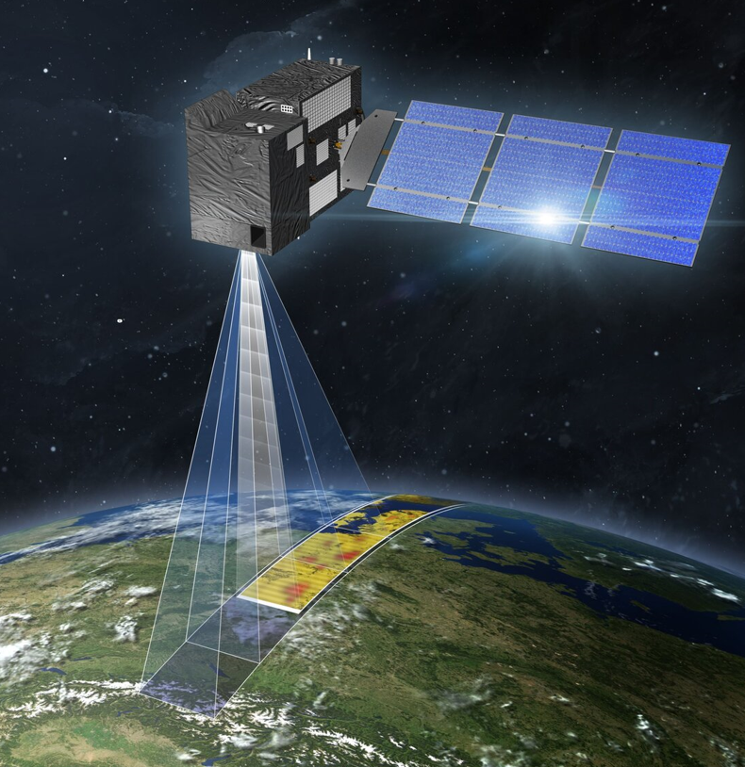
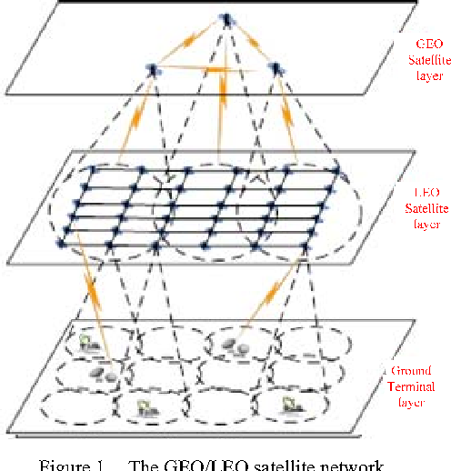
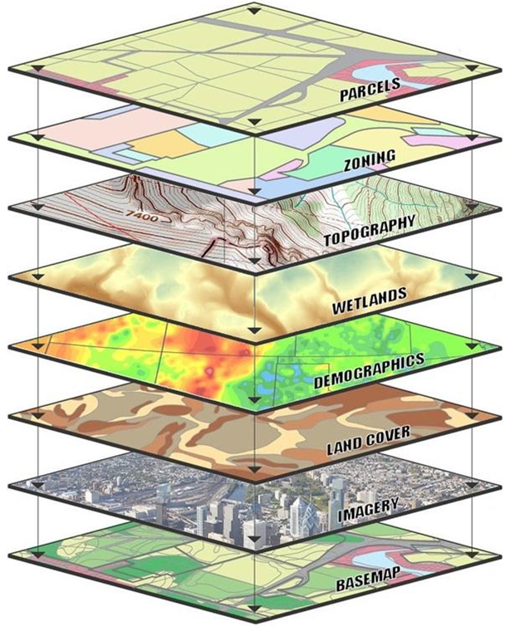
Geospatial data
Sensing
Data Mapping
Application
Layers of GIS

Slide 3
#1 Geospatial Portfolio analysis

Slide 4
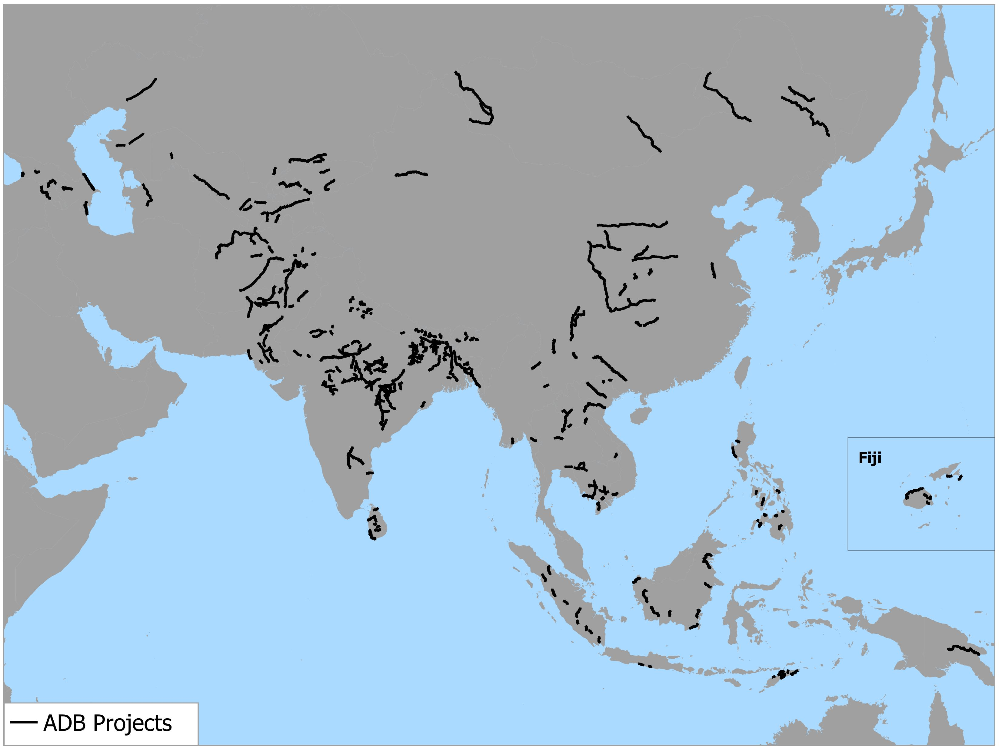
Step 1: Digitize projects
Example: ADB financed 163 projects in 10 years
Figure 1: Locations of 163 Projects
Note: This presentation does not show any borderlines.

Slide 5
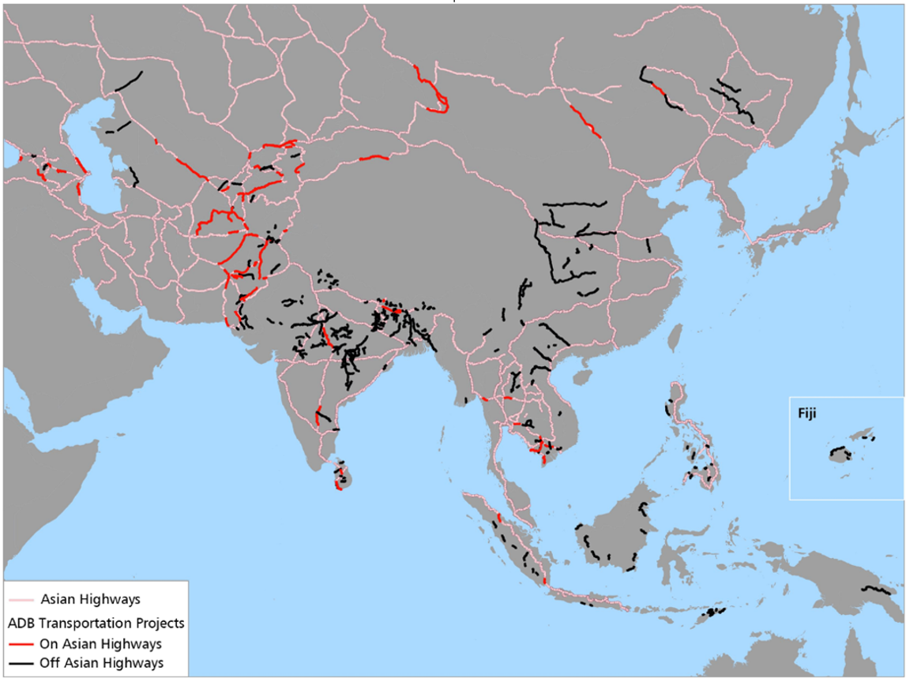
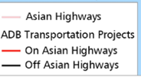
Step 2: Overlap with other values
Example: 163 Projects and the Asian Highways
Figure 2: Asian Highways and Project Locations
Note: This presentation does not show any borderlines.

Slide 6
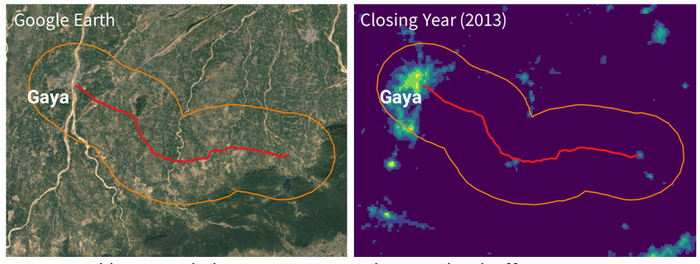
Step 3: Set a Buffer zone
Example: Road Project
Buffer zones can be set freely in size and shape.
Value in buffer zones can be measured if geospatial data are available.
Figure 3: 10-kilometer Buffer Zone (Daytime and Nighttime)

Slide 7
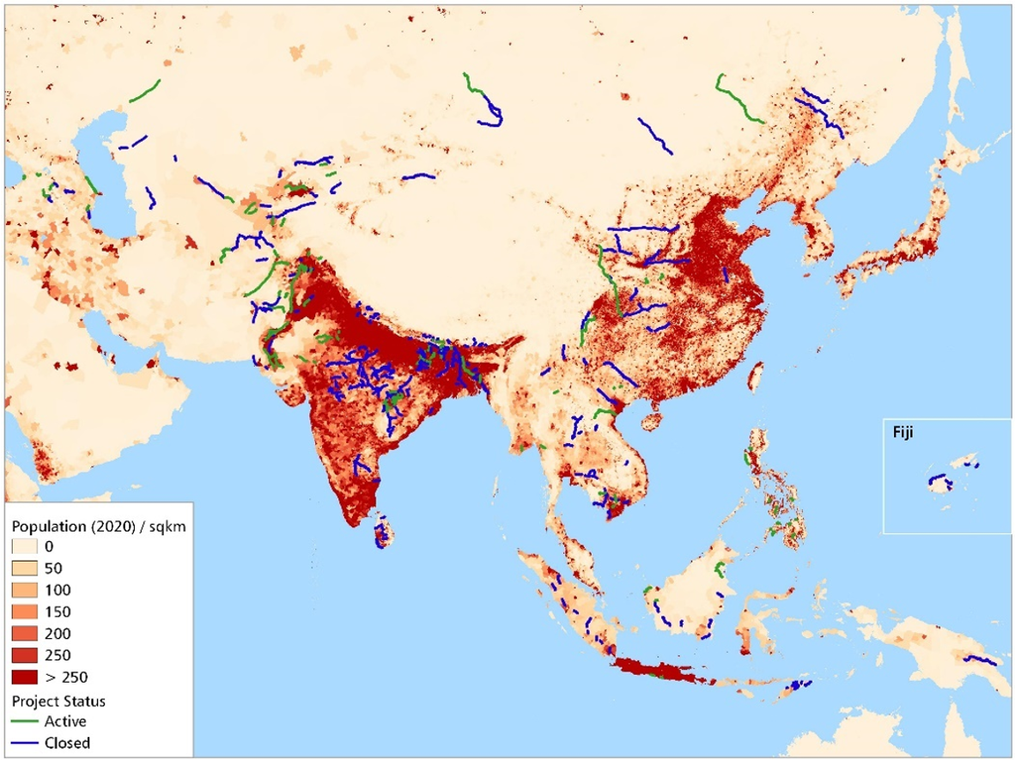
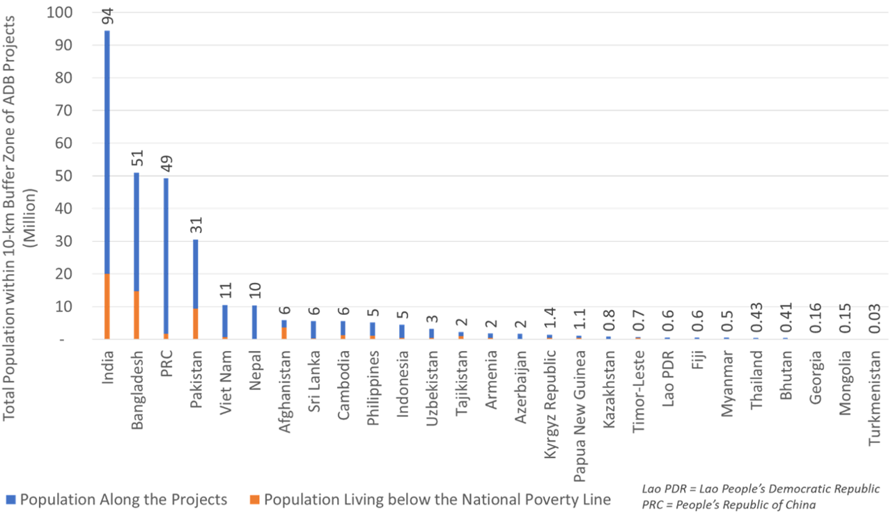
Measuring Population
Figure 5: Population in Buffer Zones by Country
Figure 4: Population in 2020 and Project Locations

Slide 8
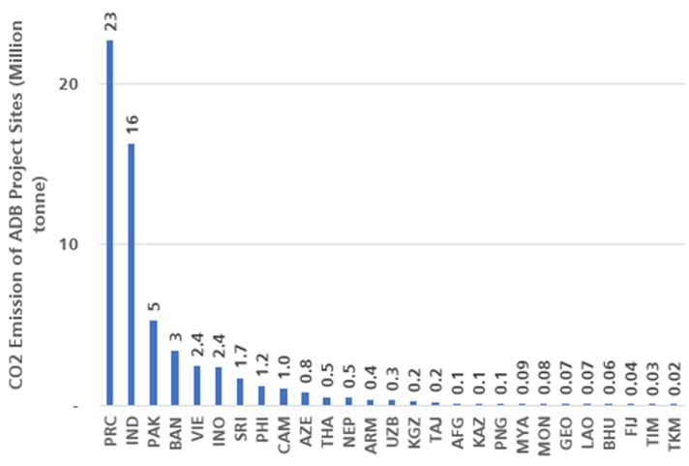
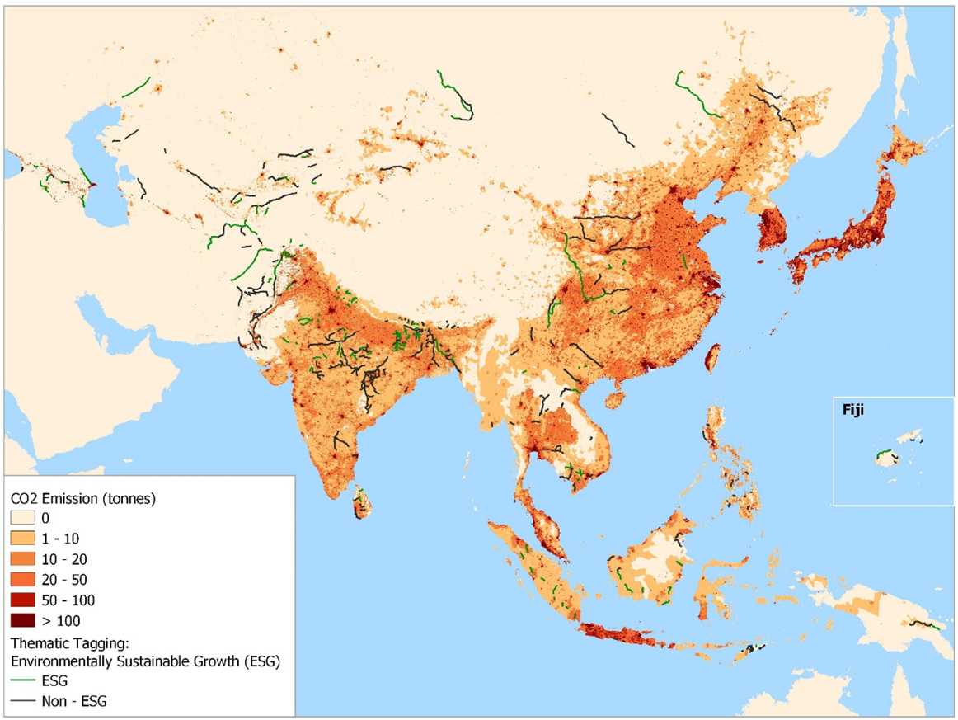
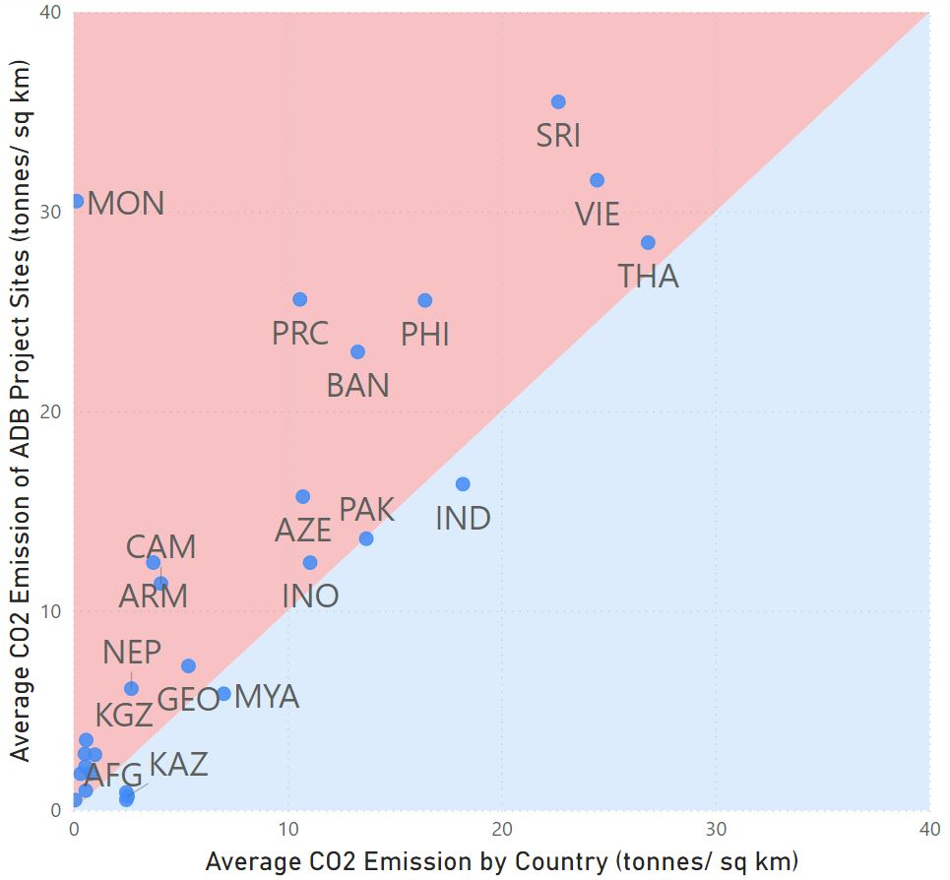
Co₂
Figure 7: CO₂ in Buffer Zones by Country
Project average
Country average
Figure 6: CO₂ Emission from Transport and Project Locations
Figure 8: CO₂ Density in Project Areas vs. Country Average

Slide 9
#2 Impact analysis with Nighttime Light

Slide 10
Difference In Differences = A–B
With Project
DID originated in the field of econometrics.
DID is typically used to estimate the effect of a specific intervention or treatment by comparing the changes in outcomes over time between the intervention group and a control group.
A
Without Project
B
Pre-intervention
Post-intervention
Figure 9: Difference of Difference

Slide 11
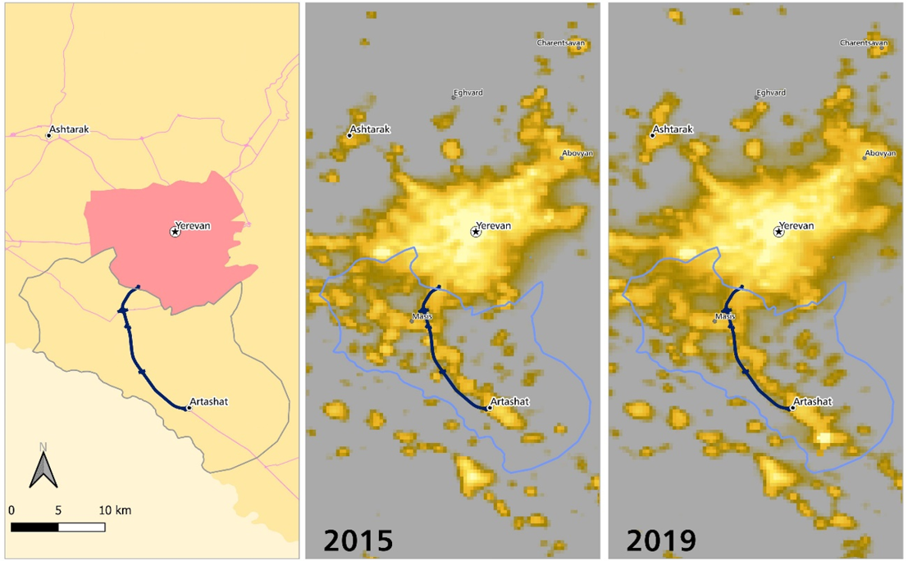
project
North–South Road Corridor in Armenia
Figure 10: Nighttime Light in 2015 and 2019

Slide 12
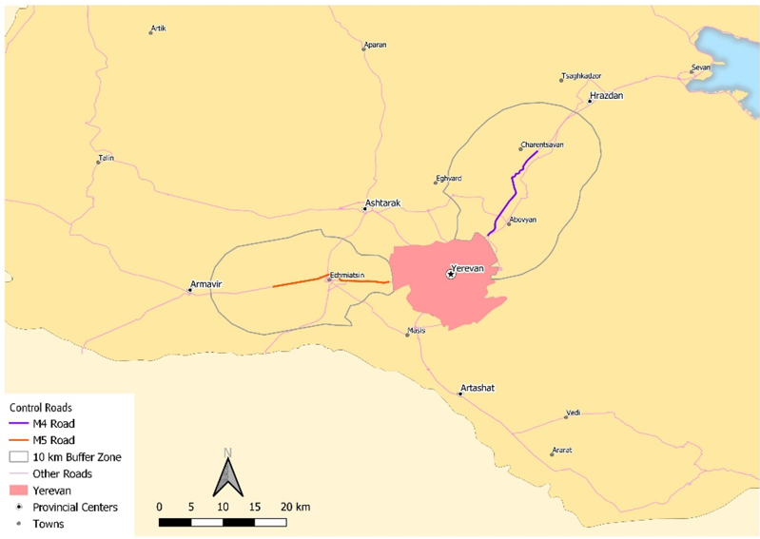
Control Groups (Without project)
Control Road 1
Control Road 2
Figure 11: Two Control Groups

Slide 13
Impact of Economic Development
Table 2: Growth Rate and DID
With Project | Without Project | DID
9.8% | 6.0% | 3.8%
DID = difference-in-difference.

Slide 14
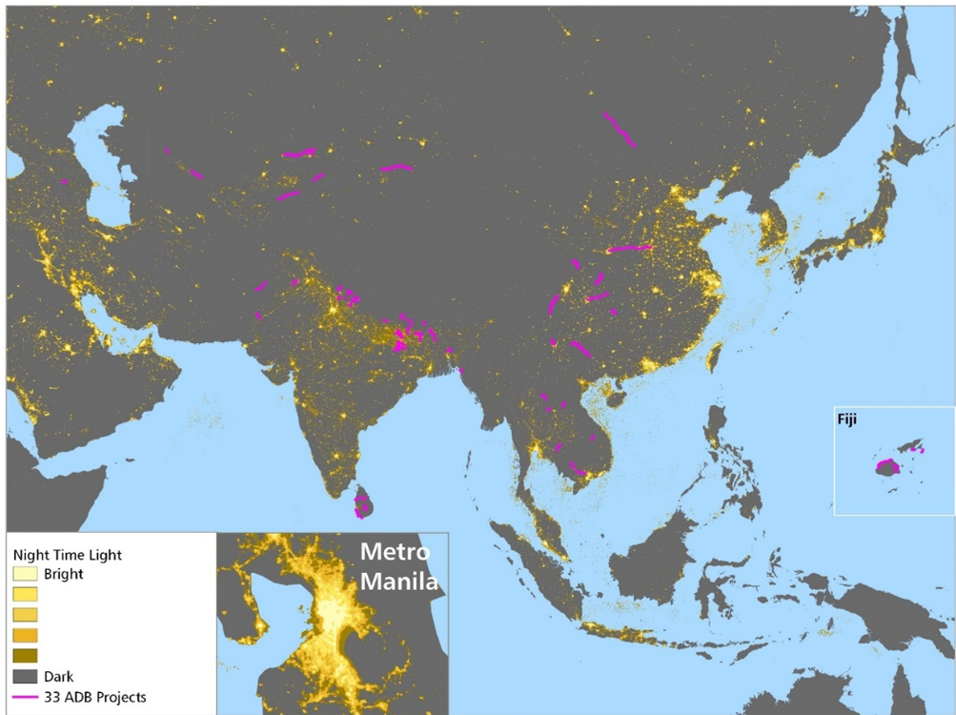
Impact assessment of 33 Completed Projects
Figure 12: Locations of 33 Projects

Slide 15
Impact of Economic Development
Table 3: Average Annual Growth Rates of Nighttime Light of
33 Projects in Two Periods
With Project | Without Project | DID
11% | 6% | 5%
DID = difference-in-difference

Slide 16
#3 Validation
-triangulation-

Slide 17
#1 With qualitative analysis
Document Review
  Manual
  AI
People’s Voice
  Beneficiary Survey
  e.g., North-South Road Corridor in Armenia
    Increased their access to markets and social service institutions
    Created employment opportunities
    Generated gender benefits (many women were engaged in agriculture activities or small or medium-sized agro-industries)

Slide 18
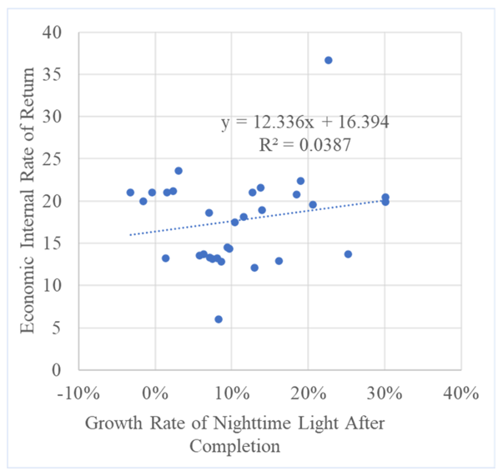
#2 With quantitative analysis
e.g., economic analysis (EIRR)
Positive correlation was observed, while it was not statistically significant yet.
NTL measures socioeconomic activities in areas
(Local people)
EIRR measures benefits of travelers including time saving, vehicle cost saving, and reduction of accidents (Road users)
Figure 13: Correlation between Growth Rate of NTL and EIRR

Slide 19
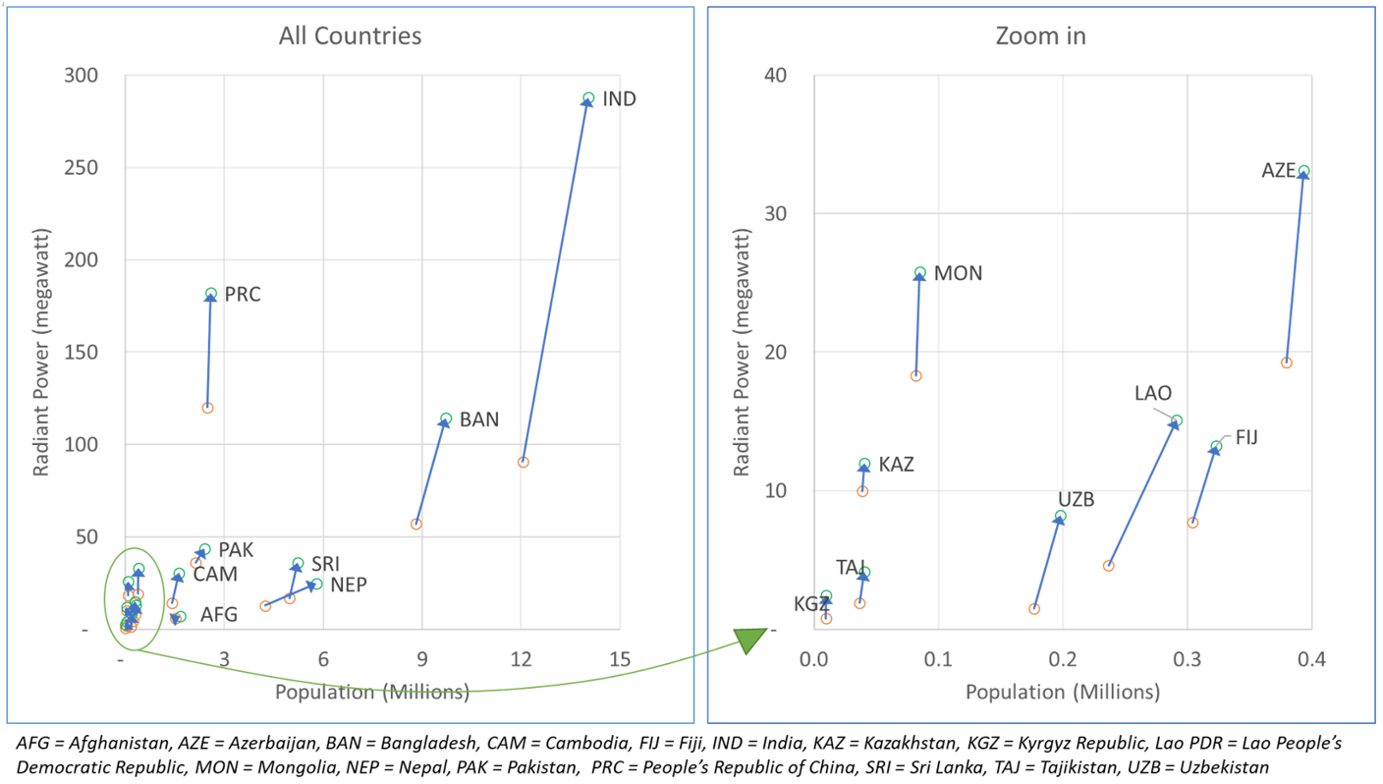
#3 with other GIS data
e.g., Nighttime light VS. Population
All Countries
Zoom in
Figure 14: Increase in Nighttime Light and Population by Country

Slide 20
Conclusion
Performance
  Monitoring. Helping us monitor key socioeconomic indicators for SDGs such as economic growth, population, and CO₂
  Impact evaluation. Help us measure attribution to local economic growth, and complementing the existing economic analysis
Advantage
  Evidence-base and Transparent
  Handy and real-time (Most data are free)
  Remotely and retrospectively accessible
  Comparable across countries as data quality and standards are same
Requirements
  Knowledge of GIS software like QGIS (Free app)
  GIS Data

Slide 21
Thank you
https://journals.sagepub.com/doi/10.1177/03611981221092007

Slide 22
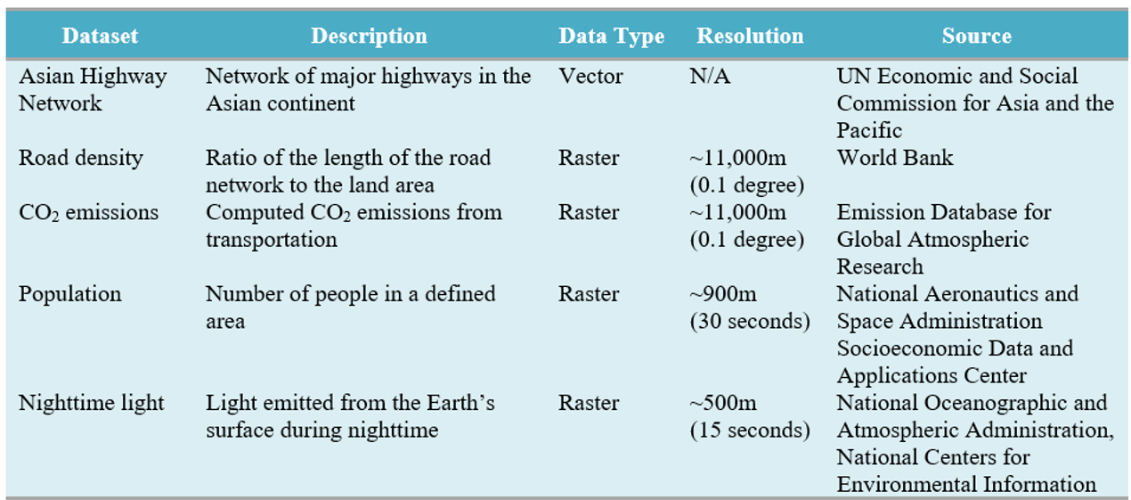
Geospatial Datasets used
Table A: Geospatial Datasets Used

Slide 23
case 1: DID = A-B
Same time frame but different location
DID originated in the field of econometrics and uses a quasi-experimental design that makes use of data from treatment and control groups to obtain an appropriate counterfactual to estimate a causal effect.
Growth of the Project area
A
Growth of the Control group
B
Pre-intervention
Post-intervention
4 years
Figure A: Difference of Difference (Case 1)

Slide 24
Case 2: DID = A-B
Same location but different time frame
Growth after the project completion
A
Growth before Project intervention
B
Pre-intervention
Post-intervention
Figure B: Difference of Difference (Case 2)

