Slide 1
Grounding ECD in Systems Theory
Sarah Klier
DEval

Slide 2
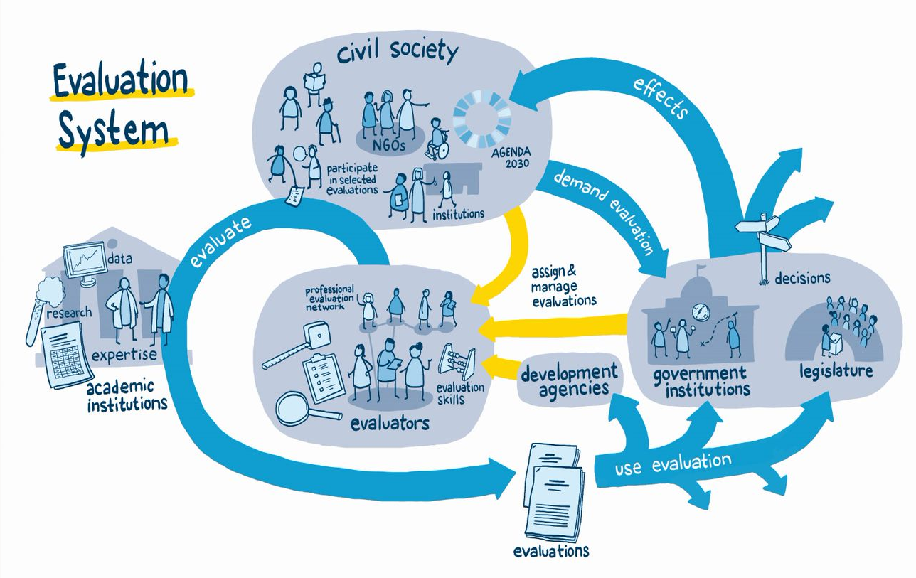
TITLE…

Slide 3
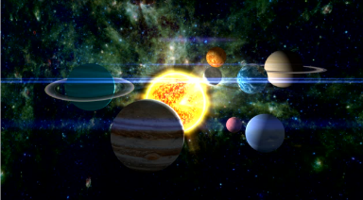
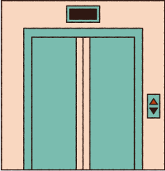
Systems

Slide 4
Charachteristics of systems

Slide 5
Complementarity
Each new perspective on a system adds important information. However, it can be challenging to accept the existence of different and potentially conflicting “truths.”

Slide 6
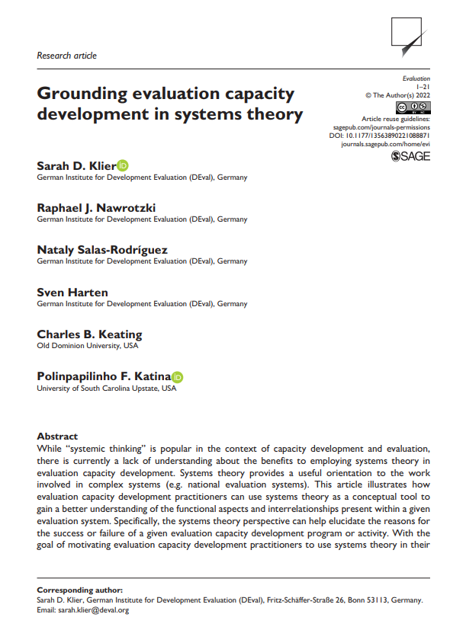

Slide 7
THANK YOU

