Slide 1
Indian Experience in Building MEL Ecosystem
Alok Mishra, Addl DG, Government of India

Slide 2
Layout of Presentation
Institutionalization of Monitoring & Evaluation
Sectoral Reviews
Data Governance Quality Index
Evaluation of Government Schemes
Institutionalization of Evaluation
Capacity Building & Partnerships
Institutional Change & support to Provinces

Slide 3
Output-Outcome Monitoring Framework
Tabled in Parliament along with Union Budget for four consecutive years
Financial Rules make OOMF an integral process for M/Ds
67 Ministries/Departments; 500+ Development Schemes; 5000+ Output and outcome indicators tracked
USD 130 billion Annual budget outlay
Annual and quarterly monitoring of outcome and output indicators on OOMF Dashboard,
Performance reviews for Ministries/Departments under the Chairmanship of Vice Chairperson & Members, NITI Aayog
Finance Ministry includes log frame at scheme proposal stage for identifying performance indicators
67 Ministries / Departments | Around 501 Schemes Approx INR 11 Lakh Crore Aggregate Outlay

Slide 4
Sector Reviews by Hon’ble PM (
Sector Reviews have been regularly held by the Hon'ble Prime Minister for enabling Sector Reforms
Sector reviews on infrastructure and social sectors
Annual target set for and metrics tracked for 12 sectors
300+ indicators being tracked quarterly on dashboard

Slide 5
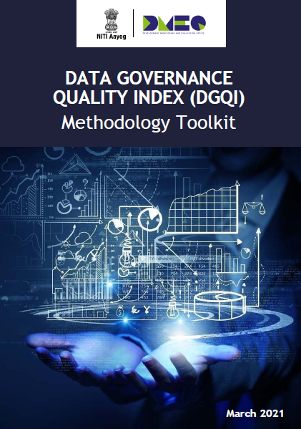
Data Governance and Quality Index (DGQI) Themes & Weightages
Data Governance Quality Index
Case Studies
(15%)
Data Security & HR Capacity
(10%)
Data Analysis, Use & Dissemination
(30%)
Data Quality
(15%)
Data Generation
(20%)
Use of Technology
(10%)

Slide 6
Evaluation of Centrally Sponsored Schemes – FY20-21
Sector and scheme evaluations for programme harmonization
126 Centrally Sponsored Schemes
Agriculture
Women & Child Development
Human Resource Development
17 Ministries across 10 sectors
Urban Transformation
Rural Development
Drinking Water & Sanitation
USD 30 billion Annual Budget Outlay
Health
Jobs & Skills
Water Resources, Environment & Forest
Best Practices Compendium shared with Chief Secretaries, States
Social Inclusion, Law & Order and Justice Delivery
Sector reports available on the DMEO website
Details

Slide 7
Evaluation of Centrally Sponsored Schemes - Framework
Schemes assessed on REESI + E Framework (Relevance, Effectiveness, Efficiency, Sustainability, Impact + Equity)
Extensive consultations with all stakeholders - officials in M/Ds, domain experts - at each stage in the evaluations: Inception, Mid term, Draft & Finalization
Cross-Sectional themes
Accountability & Transparency
Use of IT & Technology
Convergence
Gender
Social Inclusion
Regulatory Framework
Jobs & Economy
Climate Change
Behaviour Change
Improving Survey Methodology
R&D
Private Sector Participation
*CSS – Centrally Sponsored Schemes

Slide 8
Flagship and DoE Evaluations
Scheme Evaluation for Programme Harmonization
Medium term plan to cover all Central Sector & Centrally Sponsored Schemes
Development Evaluation Advisory Committee constituted
Evaluations of other schemes/ initiatives
Evaluations requested by Finance Ministry
Flagship Evaluations
15 Sample Surveys Evaluation
Large Survey based Evaluations – 2 such surveys being launched
Infrastructure – Connectivity Institutional Evaluation Studies

Slide 9
Enhancing M&E Capacities in the Ecosystem
M&E trainings on IGOT
Needs Diagnosis at National/State level:
- Institutional
- Knowledge
M&E trainings on IGOT
Needs Diagnosis at National/State level:
- Institutional
- Knowledge
Needs Diagnosis at National/State level:
- Institutional
- Knowledge
Needs Diagnosis at National/State level:
- Institutional
- Knowledge
Development of M&E curriculum aligned to competencies for both pre-service & in-service officers
Training of Central and State government officers on M&E through Central & state ATIs
Development of M&E curriculum aligned to competencies for both pre-service & in-service officers
Development of M&E curriculum aligned to competencies for both pre-service & in-service officers
Training of Central and State government officers on M&E through Central & state ATIs**
Development of M&E curriculum aligned to competencies for both pre-service & in-service officers
Enhanced capacity to undertake M&E exercises
Enhanced capacity to undertake M&E exercises
Identifying essential M&E competencies for Govt. Officers
Certificate & Diploma courses through M&E CoE in Academic institutions
Certificate & Diploma courses through M&E CoE in Academic institutions
Consultation with Central M/Ds, States & Other Stakeholders
*IGOT: Integrated Govt Online Training
**ATI : Administrative Training Institution

Slide 10
Engagement with States
Building Stronger Institutions for Monitoring & Evaluation
Technical assistance on key projects
Assessment of Evaluation Capacities in States:
30 states covered in the diagnostic exercise being undertaken to assess capacity of evaluation systems so far.
System capability assessment & development
Monthly State Webinars:
11 sessions organized and 12 more planned for facilitating M&E knowledge exchange among government stakeholders.
Institutional capacity building
Support to AP, HR, J&K, MP, Raj, Meghalaya, TN:
Development of Output Outcome Monitoring Framework, Setting up of procurement systems, Trainings on M&E fundamentals to state officers and Technical Assistance.
Exchange of knowledge resources, toolkits
Knowledge Repository on DMEO Website:
Toolkits and reports shared on DMEO website to provide, Government officials access to M&E tools and knowledge.
Access to global network of domain experts

Slide 11
Partnerships FY21-22
Vision: To support development of a strong M&E ecosystem through synergic partnerships with key stakeholders
Signed
With UN organisations
With Think Tank/ Int’l Development Institutions/
Network organizations
*SOIs signed/ in-progress till March 2022
With Academic Institutions
*SOI – Statement of Intent
With State Governments
Details

Slide 12
THANK YOU

