Slide 1
Evaluating Synergies & Trade-offs in Social-Ecological Interventions
JUHA UITTO
Director, GEF Independent Evaluation Office

Slide 2
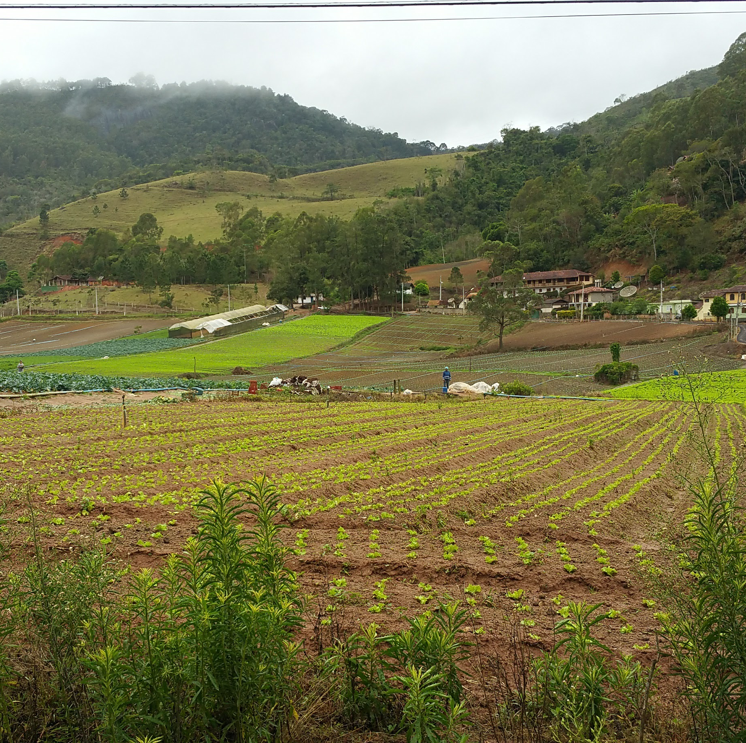
The Rio Rural Project in Brazil
Notes:
Photo by Jeneen R. Garcia, GEF IEO

Slide 3
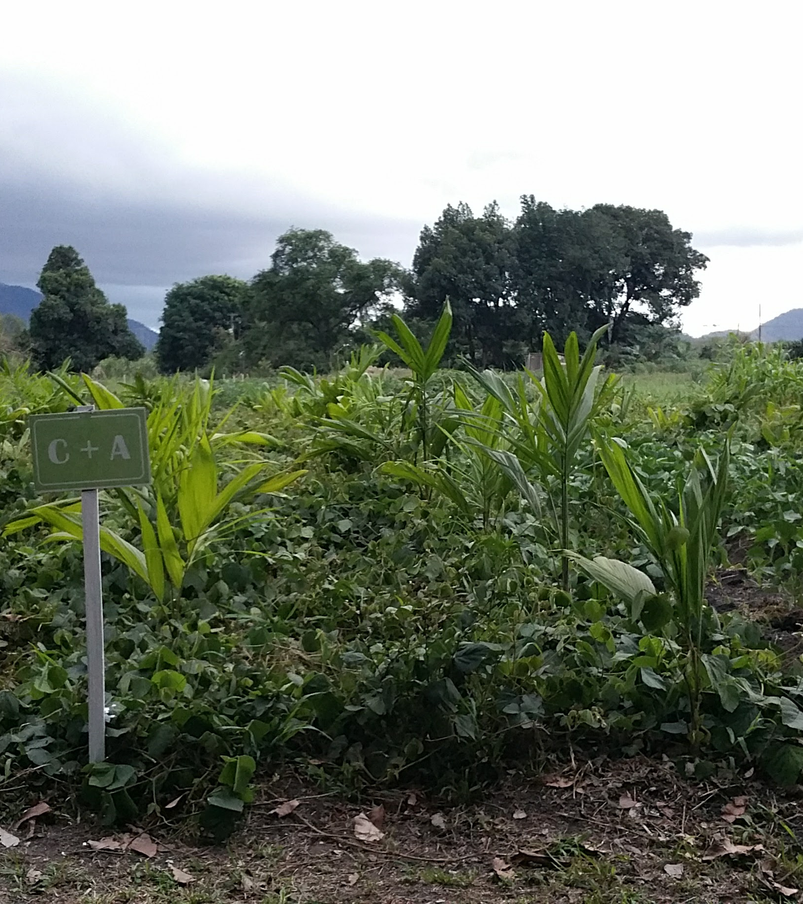
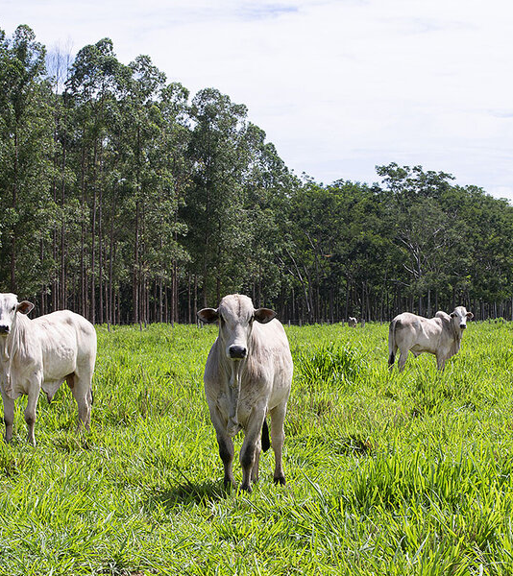
Mitigating Trade-offs
COMPENSATION
COMPROMISE
Notes:
Photo on left by Jeneen R. Garcia, GEF IEO
Photo on right from https://www.csmonitor.com/Environment/2020/0304/Saving-the-Amazon-How-cattle-ranchers-can-halt-deforestation

Slide 4
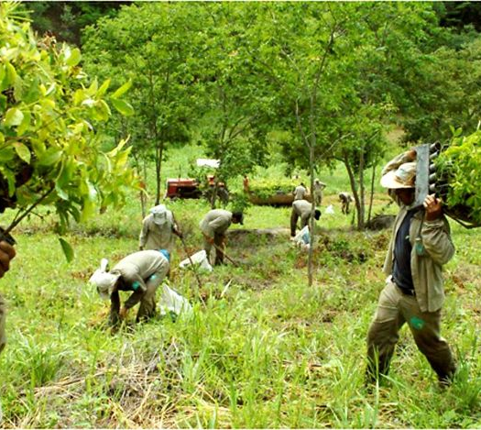
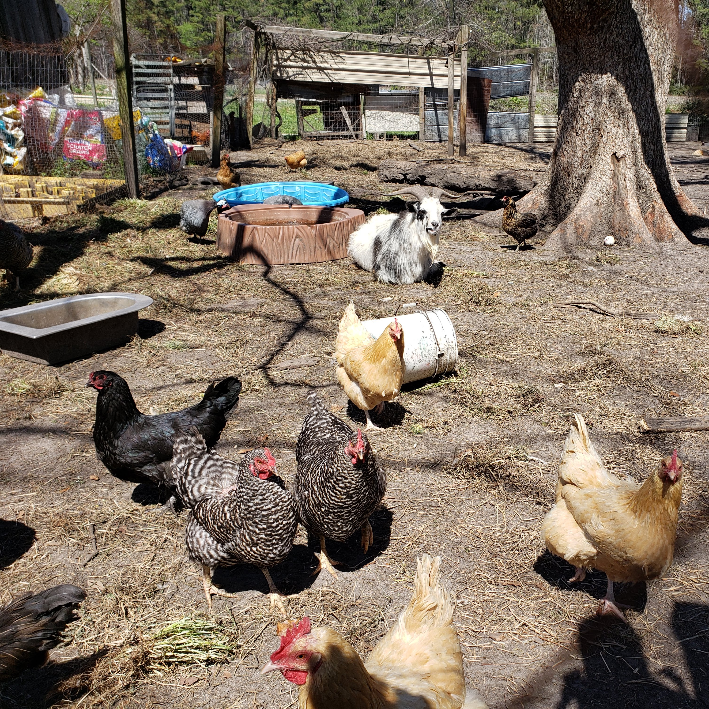
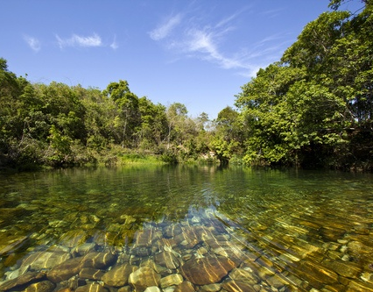
Seeking Synergies
Notes:
Photo on top right from https://www.boredpanda.com/brazilian-couple-recreated-forest-sebastiao-leila-salgado-reforestation/?utm_source=google&utm_medium=organic&utm_campaign=organic
Photo at bottom from Tapira, Brazil; photographer unknown

Slide 5
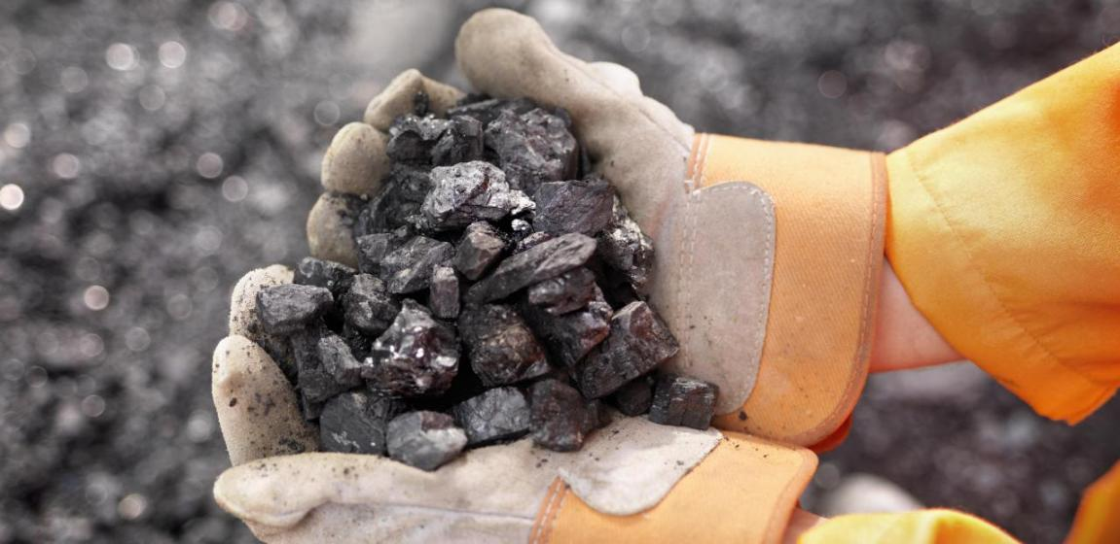
Where to look for potential synergies and areas to mitigate trade-offs?
Do no harm or create environmental benefits
Environmental root causes
Environmental extraction or alteration
Notes:
Photo credits, from left to right:
https://www.dreamstime.com/illustration/planet-roots.html
https://financialtribune.com/articles/economy-business-and-markets/24498/raw-material-exports-causes-and-consequences
https://www.westcoastdecal.com/product/recycle-arrows/

Slide 6
Why integrate social and ecological M&E?
More streamlined
activities
Higher transactional
COSTS
More HOLISTIC
problem-solving
Coordinate stakeholders from multiple sectors & disciplines
Catalyze ideas for SYNERGY
Mainstream mechanisms for regular
INTERSECTORAL INTERACTION

Slide 7
THANK YOU
juitto@thegef.org
https://www.gefieo.org/

