Slide 1
INSTITUTIONALIZING EVIDENCE IN DECISION MAKING THROUGH EVALUATIONS;
A CASE OF COUNTY GOVERNMENTS IN KENYA.
BY
HALIMA IBRAHIM KHALLA
HEAD OF PLANNING & BUDGETING, COUNTY GOVERNMENT OF ISIOLO, KENYA

Slide 2
1.0 BACKGROUND
The Journey of M & E in Kenya started
Year | Plan | Acton
1983 | District Focus for Rural Development | the first proposal for M&E
2000 | Poverty Reduction Strategy Paper (PRSP) | M&E was integrated in planning processes
2004 | Economic Recovery Strategy | the National Integrated Monitoring and Evaluation System (NIMES) was created alongside the creation of the Monitoring and Evaluation Directorate (MED) responsible for coordinating M&E activities.
Subtitle
Notes:
The journey of Kenya in M&E started in 1983 in the District Focus for Rural Development in which was the first proposal for M&E. In the 2000 Poverty Reduction Strategy Paper (PRSP), M&E was integrated in planning processes although much of the focus was at national level with little emphasis on tracking sub- national project/programme interventions. It is until the Economic Recovery Strategy of 2004 (and later Kenya Vision 2030) that the National Integrated Monitoring and Evaluation System (NIMES) was created alongside the creation of the Monitoring and Evaluation Directorate (MED) responsible for coordinating M&E activities.

Slide 3
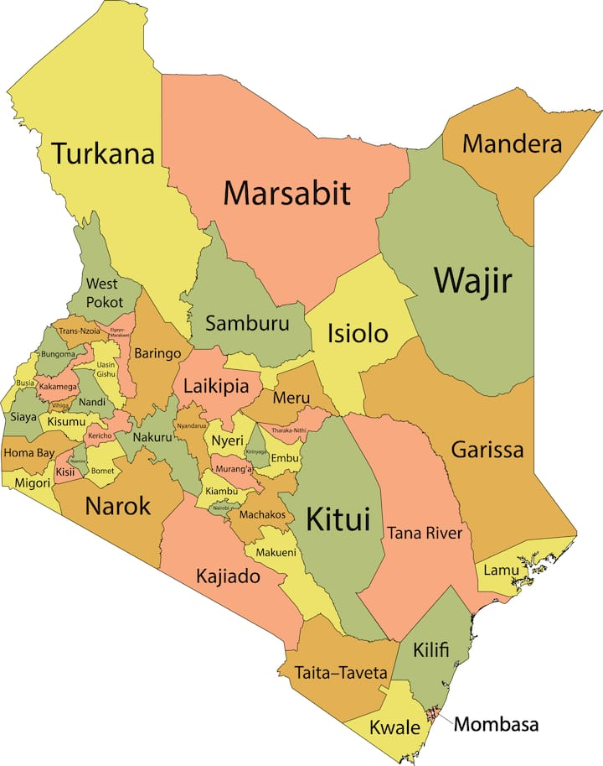
1.1 COUNTY GOVERNMENTS
Notes:
The promulgation of the Constitution of Kenya 2010 created two distinct and interdependent levels of governments: the National government and 47 county governments.
A maximum of 70% of this money is allocated to RE and a minimum of 30 % for DE
.

Slide 4
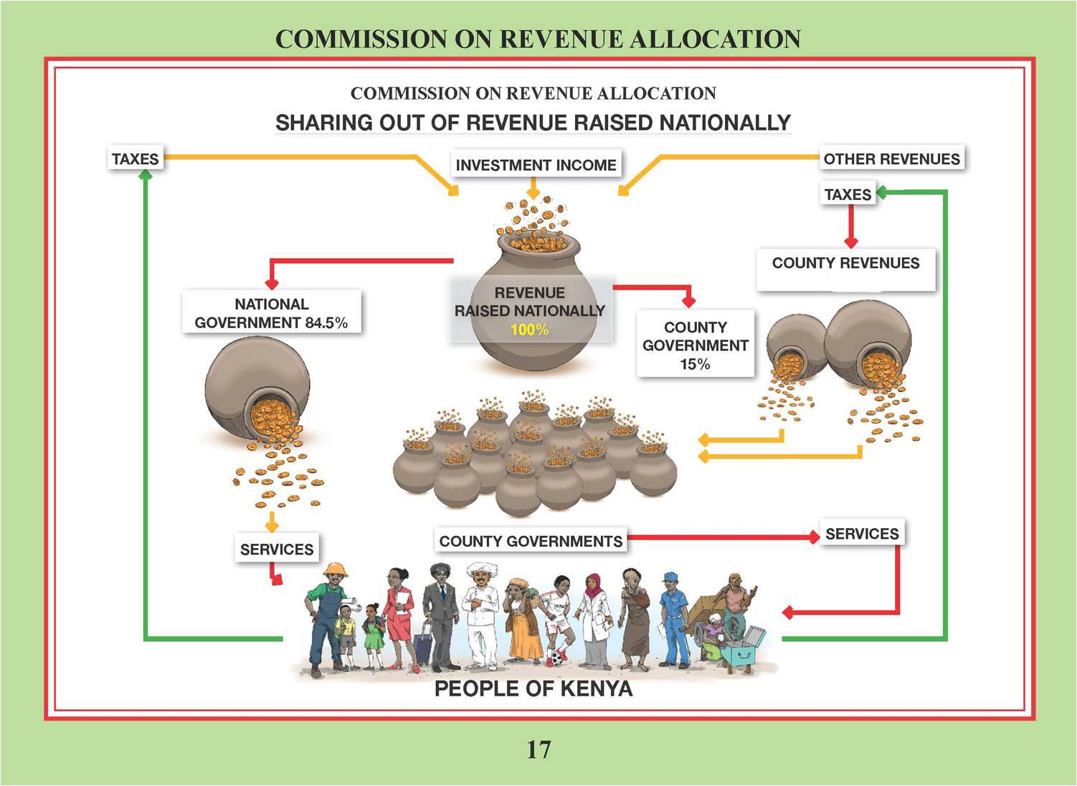
1.2 SHARING OF REVENUE RAISED NATIONALLY
4
Notes:
Criteria for revenue sharing
84.5% NG
15% CG
0.5% EF

Slide 5

1.3 COUNTY GOVERNMENTS SOURCES OF REVENUE
COUNTY REVENUES
PROPERTY TAXES
ENTERTAINMENT TAXES
LOCAL FEES
ANY OTHER TAX AUTHORISEDBY PARLIAMENT
NATIONALLYEQUITABLE SHARE OF REVENUE RAISED
CONDITIONAL OR UNCONDITIONAL ALLOCATION FROM NATIONAL GOVERNMENT
LOANS FOR CAPITAL PROJECTS GUARANTEED BY NATIONAL GOVERNMENT
ANY ALLOCATION FROM EQUALIZATION FUND
RESIDENTS VOLUNTARY CONTRIBUTIONS
DIRECT DONOR GRANTS
TOTAL COUNTY REVENUES
5
Notes:
County Governments revenues consist of transfers from the National Government, proceeds from loans and grants from development partners, and county own source revenues.
Counties developed the first generation of the 5-year County Integrated Development Plans.
And consecutive 1year plans (ADPS) from it.
With support from UNDP, NIMES was, therefore, adapted to provide for the County Integrated Monitoring and Evaluation System (CIMES). The electronic dashboard from NIMES, was also reconfigured to accommodate e-CIMES.
For devolution to succeed, county governments recognize that performance monitoring and evaluation is a necessary developmental and service delivery tool.
Evaluation evidence makes a key contribution to organizational learning and ensuring that policies, plans, programmes, and strategies are evidence-based

Slide 6
1.4 M & E SYSTEMS
NIMES, ENIMES
CIMES, ECIMES
Notes:
NIMES was established to provide a mechanism to track implementation of projects and programmes contained in the Kenya Vision 2030, the Big Four Agenda, SDGs and other international obligations.
To address the prevailing challenges of effective data management component critical to supporting its operations., the State Department for Planning in collaboration with stakeholders developed an electronic NIMES / CIMES (e-NIMES / e-CIMES) as a Performance Management tool for Results (PMfR) platform that will support and strengthen NIMES/CIMES.
The electronic system will provide a real-time, on screen reporting system for performance monitoring and evaluation of key priority programmes and projects. The system shall also provide a suitable platform preferably, a traffic light dashboard for reporting results on real time. The information generated is used for planning, policy and budget formulation process and evidence-based decision making.

Slide 7
2.0 SUCCESSES
Greater improvements in service delivery
Increased accountability
Improved ownership of projects
There will be participation in devolved governance and public confidence in government.
Notes:
Evidence strongly suggests that where M&E systems are robust and functional in public service, greater improvements in service delivery and accountability have been reported. Other benefits include ownership, participation in devolved governance and public confidence in government

Slide 8
3.0 CHALLENGES
1) Weak and underfunded M & E units
2) Low demand and value for M & E
3) Inadequate support from top leadership
4)Fragmented data collection, analysis and visualization systems
5) Inadequate policy and environment in supporting M & E
Notes:
In the ten years since CIMES was rolled out, county governments continue to face various challenges in setting up functional M&E systems. These include weak and under-funded M&E unit
s, low demand and value for M&E, little support for M&E from top leadership, weak and/or fragmented data collection, analysis and visualization systems, and inadequate policy and legal environment in support of M&E.
There is generally a very low level of awareness and knowledge of evaluations and how they are carried out within the organisations, and for this reason, most evaluations are not so effective.
Evaluation in development cooperation is focused on vertical use of findings with very little learning by field staff and middle management.

Slide 9
4.0 LESSONS LEARNT
Their is need to sustain a strong legal and policy framework for M&E
Secure support from top leadership, provide sufficient budgets, tools and equipment for M&E, and strengthen partnerships for M&E.
The political incentive for policy-makers to take evaluation results onboard must be well understood to ensure that findings are adopted.
At each level, communication processes are essential.
Influence and acceptability of findings might be stronger from an inside unit, whilst independence and objectivity from an outside organisation can be seen as preferable in terms of accountability and transparency
We appreciate the role of technology in M&E
Notes:
To secure the benefits of strong M&E systems, county governments need to sustain a strong legal and policy framework for M&E
Wider communication in the design and dissemination phase of evaluations helps democratise the process and encourages a culture of transparency into the “evaluation ideology” of expert-led assessment and advice.

Slide 10

THANK YOU

