Slide 1
PUBLIC PROGRAMS EVALUATION AND MONITORING SYSTEM: WHY IT IS IMPORTANT TO EVALUATE
Evaluating for decision-making purposes, the Chilean case

Slide 2
PUBLIC OFFER EVALUATION AND MONITORING SYSTEM
MAIN
OBJECTIVE
Contribute to improve the quality of public programs, giving information, executive and conclusive inputs for people involved in decision making.
Notes:
Since 80´s decade, Chile has been constructing and perfecting an Evaluation and Monitoring System for public policy, plans and programs. This system established a paradigm of results measure from outside the organizations and public services that execute the offer. Chilean State directs its efforts to the installation of an evidence-based information governance model that takes care of design quality of programs, complementarity opportunities, performance and results in the short, medium and long term.
The system establishes key incentives for institutions to generate programmatic proposals and budget based on appropriate and detailed information, promoting a better assignation and use of resources.

Slide 3
EVALUATING FOR DECISION MAKING: THE SYSTEM EVOLUTION
2008
2012
2022
In 2008 initiate de Ex-Ante Evaluation of Public Programs. This process allows to have relevant information about programs design to give feedback in order to improve the Budgetary Formulation Process and contribute to public invest transparency.
Chilean State Law create Social Development and Family Ministry (MDSF) and designated it, among others, the function of evaluate and give a recommendation about new and reformulated programs. Also, MDSF must collaborate with the follow up of the implementation of them.
The Monitoring process started as a pilot of Budget Management Chilean Office in 2012. This process allows to follow the execution of social programs, knowing their level of progress.
In November 2021, Finance Ministry approved the N°1510 regulation that Creates Evaluation and Productivity National Advisory Committee.
In March 2022 MDSF approved regulation that establishes criteria and procedure for determination of programs that will be part of social public invest and regulates the evaluation and recommendation reports of social programs.
In March 2022, Finance Ministry approves the regulation for Evaluation of Public Programs and Institution System.
Notes:
In addition to this institutional changes, Chilean State has made some arrangements in methodology process for evaluation and the budgetary calendar. The objective is to give quality and analyzed information to give data for appropriate budgetary decision.

Slide 4
PUBLIC PROGRAMS EVALUATION AND MONITORING SYSTEM: HOW IS THE INFORMATION USED?
Evaluation and monitoring of EXISTING public programs
Correct structural weakness
Design
Execution
(Mid Term)
Execution
(Long Term)
Correct findings
Correct repeated findings
Ex Ante
Evaluation
Ex Dure
Monitoring
Ex Post
Evaluation
Formalize committed adjustments
Yearly agenda defined by Economy Ministry, DIPRES and SES, in concordance with long term agenda that defines Evaluation and Productivity National Committee.
Budget Management Office (DIPRES)
Social Evaluation Undersecretary (SES)
Public Services
Notes:
Ex Ante Evaluation
The ex-ante evaluation process is intended to make recommendations regarding the design of new or significantly reformulated programs. Broadly speaking, this evaluation is based on the Logical Framework methodology and observes three aspects of the design of the offer: its relevance to solve the identified problem and with respect to the objectives of the proposing institution; its coherence with respect to the objectives, populations and intervention strategy proposed; and its consistency in relation to a proposal of performance indicators and the requested budget. Based on the critical judgment of these criteria, evaluation reports are prepared with the rating of each program (which may be Lack of Information, Technically Objected or Favorably Recommended). This rating constitutes a relevant input for the budget discussion that serves as a basis for the preparation of the annual Budget Law proposal.
Ex Dure Evaluation: Monitoring
The monitoring process is carried out between January and March with respect to what happened with the programmatic offer during the previous year. The information gathered during this process refers to aspects such as: population served, level of activity, level of effective expenditure and measurement of results, among others. The analysis of this information allows us to identify positive and negative aspects of program performance. When detected in a timely manner, these findings can be reviewed in greater depth and eventually be used to condition or reallocate resources in the state budgeting process. To this end, monitoring work involves assessing and making judgments regarding program performance in three main areas: targeting, efficiency and effectiveness. In terms of targeting, the relevance of the criteria by which programs characterize their target population and the prioritization criteria that determine the effective allocation of their benefits to the population served are evaluated. Additionally, the quantification of beneficiaries and the effective coverage that the programs are achieving are evaluated. In relation to effectiveness, monitoring seeks to ensure that the programs comply with solving the problems that motivate their implementation, through the analysis of performance indicators both at the level of compliance with the purpose and components of the program. Regarding efficiency, the objective is to ensure that programs are implemented at the minimum cost for the optimal use of public resources. To this end, expenditure per beneficiary compared to previous years, budget execution, estimated administrative costs and the persistence of budget under-execution, if any, are observed. In addition to being a relevant input for the budget formulation process, supply monitoring is accompanied by a process of training and technical assistance. Thus, in addition to contributing to making budgetary decisions based on evidence of programmatic performance, it is a strategic tool for the continuous improvement of the quality of services provided by the State to the people. Likewise, in line with the political priorities of the State of Chile, the different ex ante and ex dure evaluation processes seek to safeguard the protection of certain principles. In particular, the current administration has sought to strengthen the monitoring of the inclusion of a rights-based approach both in programmatic designs and in their implementation.
Ex Post Evaluation
Ex post evaluations began to be implemented in Chile in 1997 with the Evaluation of Government Programs (EPG). Since then, different lines of evaluation have been incorporated, which have expanded the coverage and diversity of instruments to measure the performance of public programs in terms of their results. There are currently five lines of ex post evaluation: the EPG, the Impact Evaluation (EI), the Institutional Expenditure Evaluation (EGI), the Focused Area Evaluation (EFA) and the Sector Evaluation (ES). Impact Evaluation is the only one of these that empirically seeks to measure the causal effect of a public program in solving the problem it proposes to address. Regarding the other evaluations, the Institutional Expenditure Evaluation (IEE) aims to analyze the overall expenditure of an institution in the provision of goods and services, in accordance with its strategic objectives, identifying alternatives for improvement. In turn, the Focused Area Evaluation (FEA) analyzes specific aspects of programs related to design and/or implementation in order to determine the correct use of public resources.
The Sector Evaluation (SE) is the newest of these evaluations and is focused on analyzing public policy areas comprising programs with similar objectives in an integrated manner. The analysis places special emphasis on complementarities and duplications at the level of the strategies of the different programs, in order to identify opportunities for improvement and coordination. The first of these evaluations was published in January of this year: Sectoral Evaluation of Job Training for Women, as a pilot designed in a collaboration between Dipres and SES. This example is very relevant for the system, insofar as it is, on the one hand, a methodological innovation, and on the other, it considers the inclusion of gender issues, a very relevant issue in the advancement and improvement of evaluation systems. Through this pilot program, the design of different programs that contribute to job training was evaluated in detail, as well as their performance and possibilities for coordination and complementarity.
The final reports of each ex-post evaluation must be sent to the Permanent Budget Commission of the National Congress and to the public institutions with responsibilities for decision making that affect the respective program or institution, within 60 days of its completion. Additionally, the evaluated institutions have the obligation to establish institutional commitments to improve the evaluated programs. This implies that, based on the results of each evaluation, the Dipres may establish specific requirements to be followed up directly or considered in the redesign and monitoring processes, which in some cases translates into commitments to enter other evaluation processes, such as Ex Ante Evaluation, through a reformulation of program elements.

Slide 5
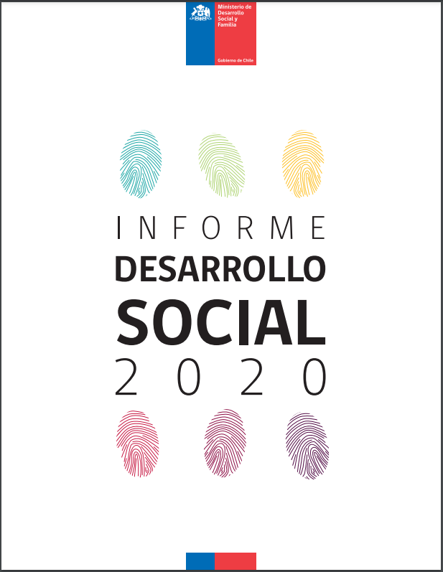
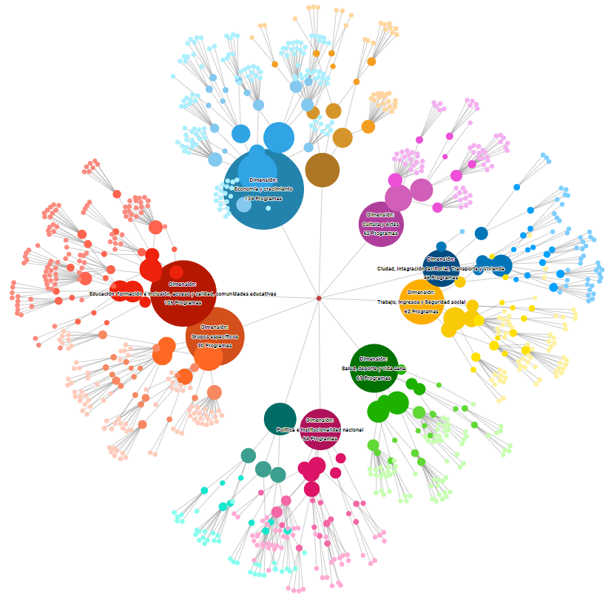
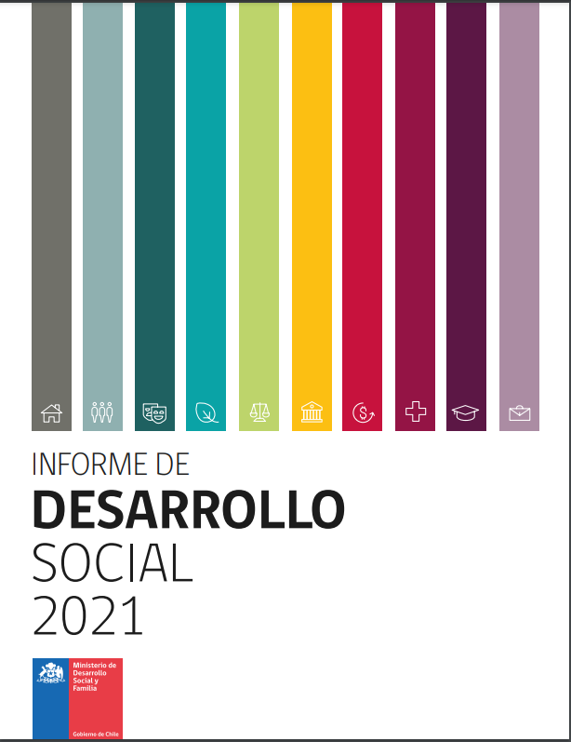
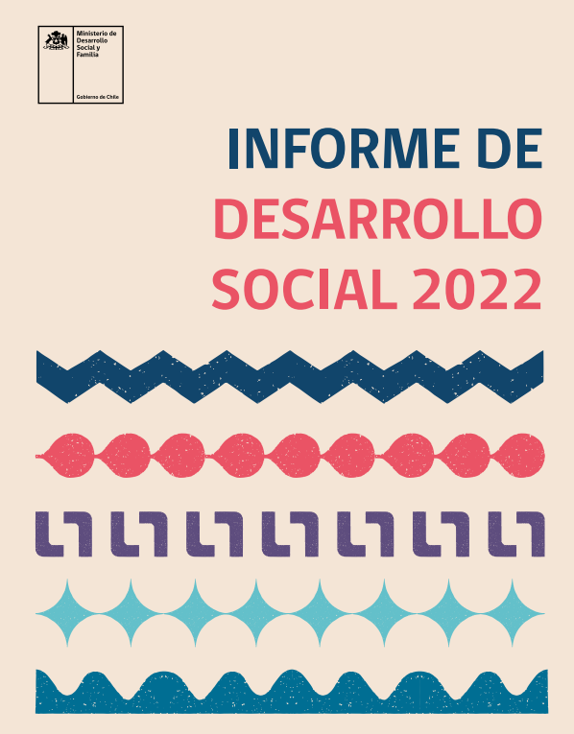
ANALYSIS TOOLS: MAPPING PUBLIC PROGRAMS
DATA SOCIAL PLATFORM
https://datasocial.ministeriodesarrollosocial.gob.cl/programas/dimensiones
https://www.desarrollosocialyfamilia.gob.cl/informacion-social/informes-de-desarrollo-social
Map of public programs by number of programs, budget and thematic dimensions
Social Development Report
10 dimensions
46 main problems
170 specific problems
Notes:
Working on the 2021 update and that we are improving the social data to generate new filters in the visualizations, and that the data of the filters created can be downloaded.
Mapping of the Programmatic Offering
Corresponds to the integrated and multidimensional analysis of the programmatic offer, which aims to open spaces and strengthen instances of articulation, collaboration and coordination of public policy.
This methodology is carried out since 2018 jointly by the SES, the Dipres and the United Nations Development Program (UNDP) and moves towards an analysis of the offer focused on the interactions between programs. This innovation seeks to build the existing network of interconnections around dimensions of problems or challenges to be addressed by public policy that affect the population and the public programs that address them.
The graph shows how the Economy and Growth dimension is the one with the largest current offer, with 134 programs, followed by Education, with 105.
See methodological annex for the dimensions and their definitions.
The programmatic offer was created to address specific situations that directly or indirectly affect the welfare of a given population and that cannot be solved by those affected. According to the supply mapping methodology, the problems identified are grouped into dimensions, which allows for differentiated analysis between different aspects of public policy and, in turn, disaggregate them into main and specific problems. For more information, go to: https://datasocial.ministeriodesarrollosocial.gob.cl
As a result of this methodology, 10 dimensions, 46 main problems and 170 specific problems were identified.
In terms of total self-reported executed budget, it is important to mention that in 2021 there was a great difference given by the Emergency Family Income Program (IFE) of the Undersecretariat of Social Services, which amounted to Th$17,011,443,187, influencing the Work, Income and Social Security dimension to rank first in the execution of resources with a total of Th$23,555,120,427. In second place was the Education dimension (training and inclusion, access and quality, and educational communities) executed a total of ThCh$11,454,269,067. Then, in third place, City, Territorial Integration and Transportation and Housing executed a total of Th$3,265,429,429.49, while Economy and Growth executed a total of Th$1,415,551,823.

Slide 6
EVALUATION SYSTEM CHALLENGES
Strengthen the integration of different lines of evaluation under a systemic view of the Evaluation and Monitoring cycle.
Strengthen the institutional framework of the system, promoting coordination among the different actors that compose it.
To make progress in assuring the quality of the information that makes up the Monitoring and Evaluation System.
To advance in the mainstreaming of the human rights approach in the different lines of evaluation.
Encourage the use of the results of the Evaluation System, so that Public Managers and Authorities have information that allows them to make decisions, making progress in improving the performance of their programs and using this information as a management tool.
Notes:
There are a series of challenges that the evaluation system has had to face and must continue to address in order to improve and contribute to the public policy decision-making process. One of the efforts that have been made to improve the quality of this system is its linkage and coordination with the development of the budget cycle. As of 2021, the evaluation stage of the cycle was moved from March to June-July, that is, after the preparation of the Base Budget, the proposal of the services and the review work of the Dipres and the formulating services (Technical Commissions). This change made it possible to have closed performance information, revised and with a higher level of analysis in order to adequately inform budgetary decisions.
Another challenge currently faced by the evaluation system has to do with the integration of ex ante, ex dure and ex post processes. Although changes in evaluation timeframes have allowed linking ex post performance results with commitments to be fulfilled by institutions in terms of design and execution, progress must be made in developing a connected evaluation process that ensures that the results of an evaluation stage can be followed up in subsequent stages.
On the other hand, a major challenge facing the system in general is to strengthen evidence-based decision making at the national level. In relation to the budget cycle, this is an area in which there has been great progress, the task is to extend this to other areas of action, ensuring that the results of the various evaluations are inputs for the design of inclusive, effective and efficient policies.
Today there is a regulation that establishes the criteria and procedures for the determination of the programs to be classified within public social spending and that regulates the evaluations and recommendation and follow-up reports on social programs, in addition to the evaluation plan.
The regulation establishes that within five years, all social programs must have undergone a design evaluation. For this purpose, the Undersecretariat for Social Evaluation shall consider as prioritization criteria those programs to which the greatest number of resources are allocated, the number of social programs incorporated per institution, their coverage or their complexity.

Slide 7
PUBLIC PROGRAMS EVALUATION AND MONITORING SYSTEM: WHY IT IS IMPORTANT TO EVALUATE
THANK YOU

