Slide 1
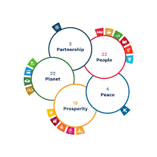

Global Coalition on Evaluative Evidence for the SDGs
The 5 P syntheses
Notes:
Good morning ladies and gentlemen, colleagues.
It is my pleasure to present to you the Global Coalition on Evaluative Evidence spearhead by the UNDP Independent Evaluation Office (IEO) and Global Affairs Canada to promote joint syntheses of evaluative evidence organized around the five SDG pillars of people, planet, prosperity, peace and partnership.

Slide 2
Global Coalition on Evaluative Evidence for the 5 Ps
28 United Nations agencies
6 bilateral partners: Canada, Germany, Ireland, Korea, the Netherlands and Spain
Evaluation community: United Nations Evaluation Group (UNEG); Network on Development Evaluations (EvalNet); Evaluation Cooperation Group (ECG); IDEAS, and other specialized evaluation networks.
Notes:
The Global Coalition on Evaluation Evidence so far counts with 28 United Nations entities as well as the engagement of bilateral partners such as Canada, Germany, Ireland, Korea, the Netherlands and Spain, This Global coalition is also working with networks such as (UNEG), IDEAS, (EvalNet) and members of the Evaluation Cooperation Group (ECG) such as the World Bank, and IMF and other specialized evaluation networks. Each network and office bring their knowledge, resources, innovations and ideas, and the groups effectively act as the voice of the community, collating and synthesizing members’ contributions. Aand the door is open for more partners.

Slide 3
Turning point in international development
Rapidly approaching transition beyond SDGs in 2030.
Opportunity to provide evaluative evidence for countries to get back on track, accelerate results towards the goals and build back forward and beyond 2030.
The MDGs were not fully evaluated, when the international community transitioned to the SDGs – lost potential learning
The evaluation community has an important role ensuring the potential for learning from the SDG experience is harnessed, for future benefits.
Global Coalition on Evaluative Evidence
  syntheses of evaluative evidence around the five SDG pillars
  Utility based structure to store and generate synthesis as needed at different times and formats for decision making at different levels
Notes:
We are at a turning point in the international development agenda as we rapidly approach the time when decisions will have to be made about the transition beyond the Sustainable Development Goals (SDGs) in 2030.
These coming years will be key for the evaluation community to take the opportunity to provide decision makers with evaluative evidence to think of the work needed to get back on track after the massive regressions due to the multiple crises faced in the past couple of year, accelerate results towards the goals and build back forward and beyond 2030.
When the international community made the transition from the Millennium Development Goals (MDGs) to the SDGs, the MDGs were not fully evaluated, either in terms of progress or impact. The potential for learning from this great endeavour was lost.
The evaluation community has an important role to play in ensuring that the potential for learning from the SDG experience is harnessed, for future benefits.
UNDP and Global affairs Canada is promoting the Global Coalition on Evaluative Evidence to generate five syntheses of evaluative evidence organized around the five SDG pillars of people, planet, prosperity, peace and partnership together with a utility based structure that will be built in the process of developing these syntheses to store and generate synthesis of evaluative evidence with AI technology that in the future can be accessed at different times and formats as needed for decision making at different levels

Slide 4

Key Objectives and purpose of this Global Coalition on evaluative evidence
Synthesize existing evaluative data on what has worked and not, why and where in key areas under the SDG’s 5 Pillars
To provide insights and analysis towards the key barriers and enabler to accelerate SDG achievements
To identify evidence gaps for future evaluations
Provide policy recommendations to achieve the goals in the last five years before 2030.
Purpose - provide decision makers with lessons learned and recommendations for the achievement of the SDGs in the years remaining until 2030 and inform deliberations on the post-SDG development agenda
Notes:
The key objective of the Global Coalition on evaluative evidence is to synthesize existing evaluative data on what has worked and not, why and where in key areas under the 5 SDG’s Pillars
To provide substantive insights on key barriers and enablers to accelerate SDG achievements
To identify evidence gaps that future evaluations could help fill
Provide policy recommendations to achieve the goals in the last five years before 2030, and beyond.
The purpose of the joint evaluative synthesis is to provide decision makers with lessons learned and recommendations for the achievement of the SDGs in the years remaining until 2030, organized around the five SDG pillars.
We hope the recommendations will be useful to inform the deliberations on the post-SDG development agenda, with synthesized evaluative evidence

Slide 5

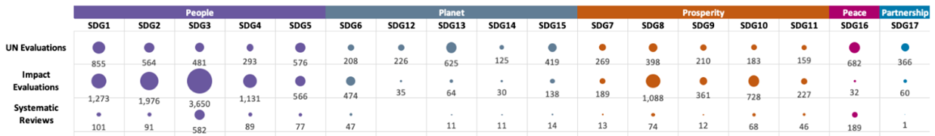
Preliminary “state of the evidence” assessment
the evidence base
8501
Performance Evaluations
10,440
Impact evaluations
947
Systematic reviews
176 (since 2016)
Voluntary National Reviews
Total evaluations identified as of May 2022: 19,888
evidence distribution by SDGs
Total evaluations tagged to SDGs as of May 2022: 10,154
what data do we already have, and what can we do with it?
(Sources: UNEG Database; UNDP Evaluation Resource Centre, 3ie’s Development Evidence Portal, UNDESA, Agency databases)
Notes:
A preliminary analysis of the amount of evidence we can work with indicates the following numbers you can see in the slide.
This ambitious proposal hopes to synthesize data from impact evaluations, systematic reviews, VNRs and UN performance evaluation reports – each treated differently given its level of methodological and results quality, credibility and independence.

Slide 6
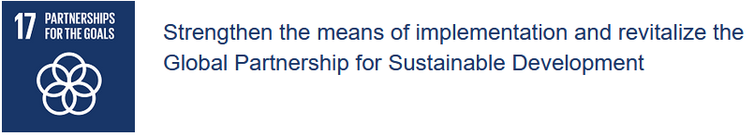



24 Indicators
Areas
Finance
Technology
Capacity Development
Trade
Systemic Issues
19 Targets
What is the current status of progress towards this goal?
What does and what does not work for effective interventions and progress under key areas?
What needs to change in order to accelerate progress before and post 2030?
Notes:
The first synthesis pilar we are starting in November to present to the 2023 HLPF and will be of the Partnerships pillar as we concluded that this pillar potentially offers fewer credible sources of evidence as you saw from the previous map and it is composed of only 1 goal, although it is one that covers 5 areas, 19 targets and 24 indicators, so plenty to analyse. The other 4 syntheses we hope to present in the 2024 HLPF

Slide 7
Next Steps
Broadening partnerships and mobilizing resources
Explore evidence, time, and resource contributions from knowledge partners and financial donors
Establish scope priorities
Identifying key syntheses questions with development partners, and external expertise
Preparing evidence for each pillars
Expanding the evidence base, tagging, mapping the SDG connections
Establishing a Governance structure for the synthesis
Appointing a steering committee and management reference groups
Notes:
In terms of next steps we are in the process of broadening partnerships and mobilizing resources to explore additional evidence sources, time and resource contributions from partners and financial donors.
Preparing evidence for each pillar and seeing whether to expand or not the evidence base
working with partners on tagging and mapping the SDG connections
establishing scope priorities, identifying key syntheses questions with development partners and external expertise
and finally establishing a governance structure with one steering committee for all 5 syntheses, specific management reference groups for each pilar, and identifying key experts and institutions for a technical advisory panel to quality assure the work.

Slide 8

THANK YOU
Ana.soares@undp.org
Notes:
I look forward to answering any questions about the initiative and welcome additional partners, donors and guidance on sources / databases of evidence especially of credible national and sub-national evaluations and how to prioritize the synthesizing of such a large amount of evidence most efficiently as the idea is to have all pilar syntheses completed by 2025.
Thank you .

