Slide 1
Lessons from Learning-Oriented Real-Time Impact Assessment (LORTA) Programme
Dr Anastasia Aladysheva, Independent Evaluation Unit, Green Climate Fund
NEC Session 4: What Can We Learn from Sectoral Evaluation Systems?

Slide 2
What is LORTA?
Demand-driven capacity-building programme in impact evaluations of GCF investments, started in 2018 at IEU
Produce evidence, informing GCF investments and decisions to measure attributable change on the ground effectively and efficiently
22 country projects in the portfolio spanning different continents and results areas
Currently, we have 5 projects with only baseline data (Rwanda, Guatemala, Zambia, Madagascar, Georgia*) and 2 projects with endline data (Malawi and Bangladesh*)
  * to be collected by the end of 2022

Slide 3
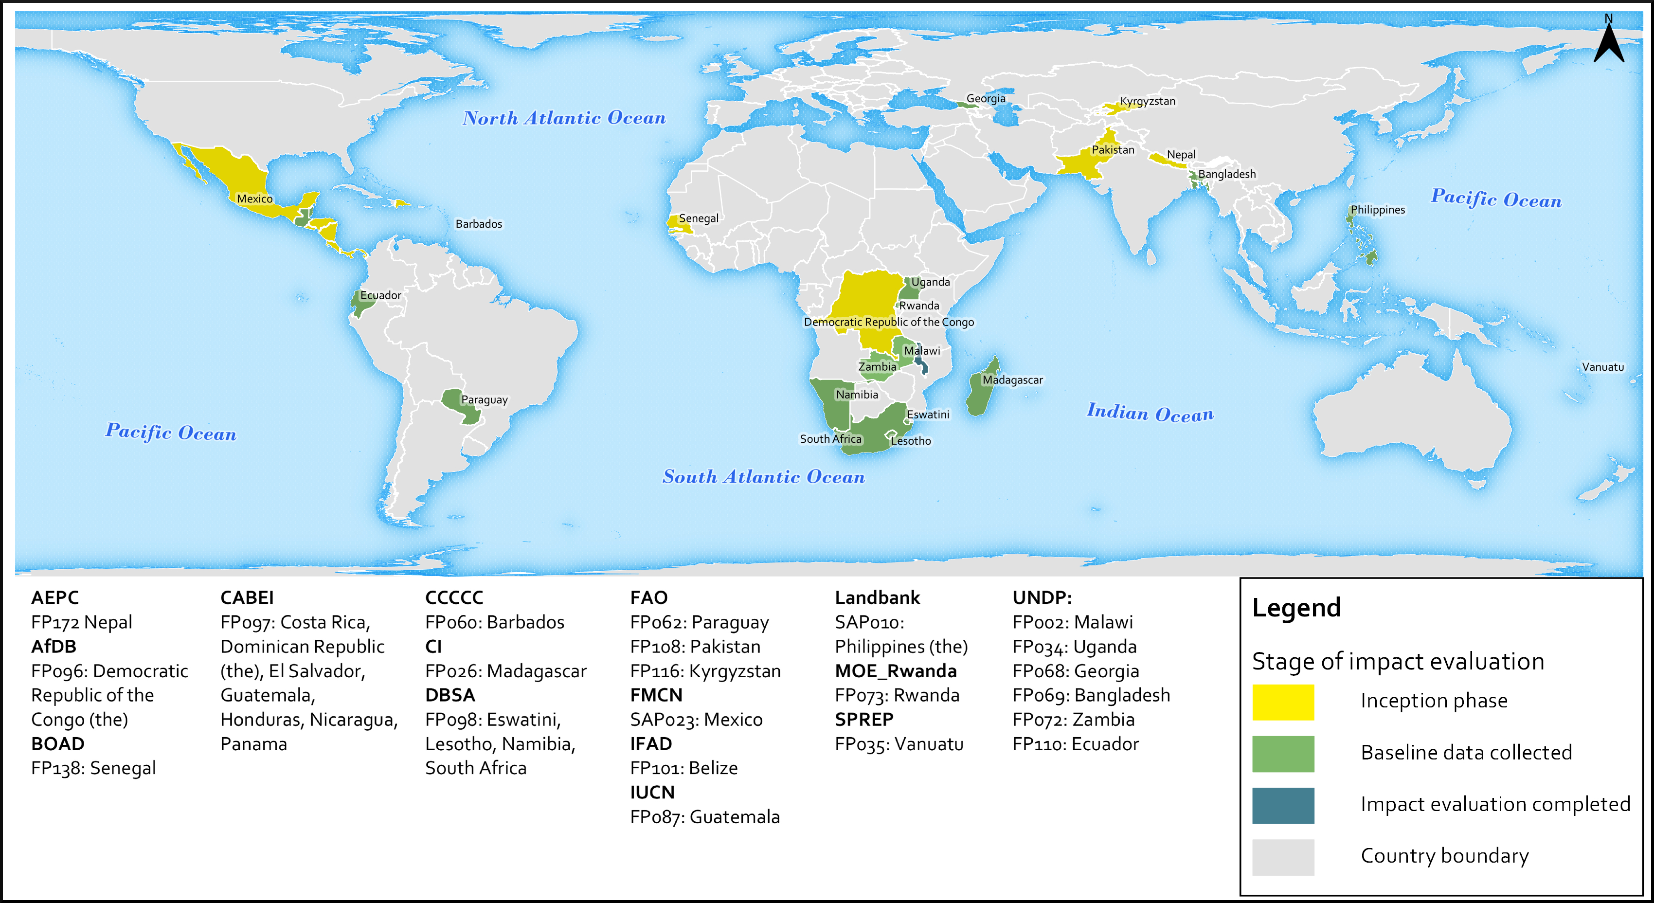
LORTA Portfolio

Slide 4
LESSONS: Implementation of IEs
Engagement: provide and receive timely feedback and make sure there is enough time to properly revise all necessary components of a project for IE
Flexibility: accommodate project needs, procurement schedules and changes to the project that may lead to an immediate revision of the evaluation strategy
Design: several methodologies are proposed to give project teams a choice over the most feasible id strategy and realistic commitments
Technical support: data analysis and report writing (if needed) to project teams to allocate more budget to the data collection while continuing local capacity building
Continuity: capacity building for data collection firms, newly joined staff to PMU, new government representatives to keep the buy-in

Slide 5
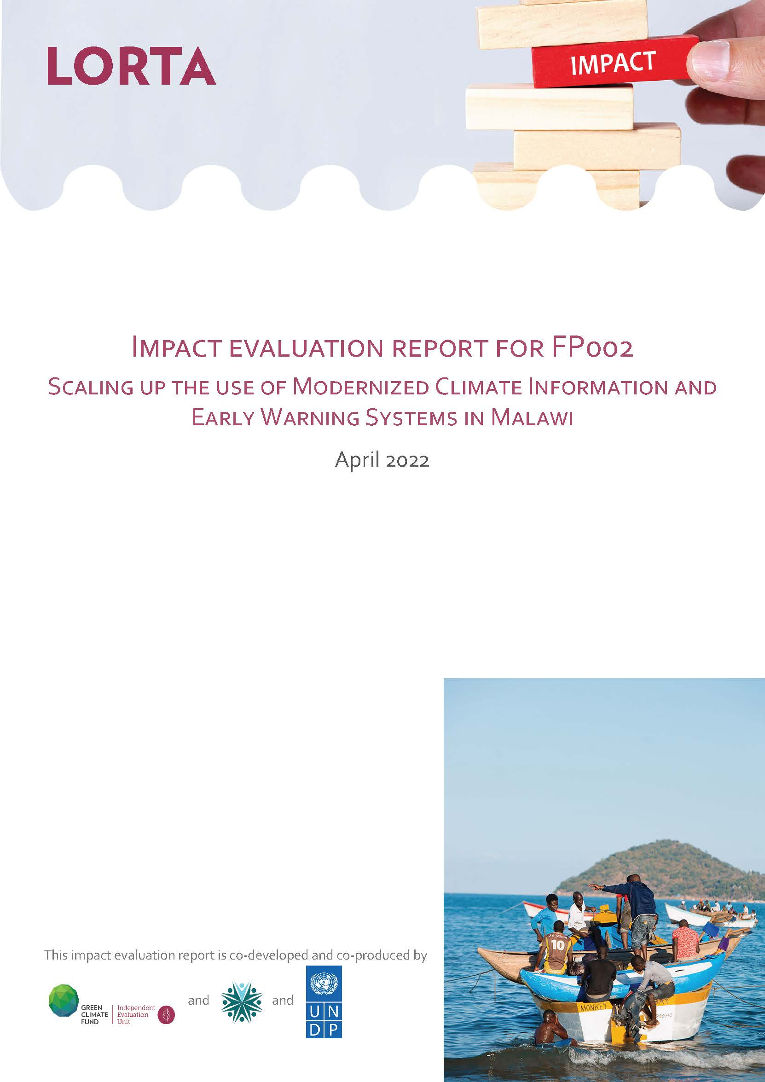
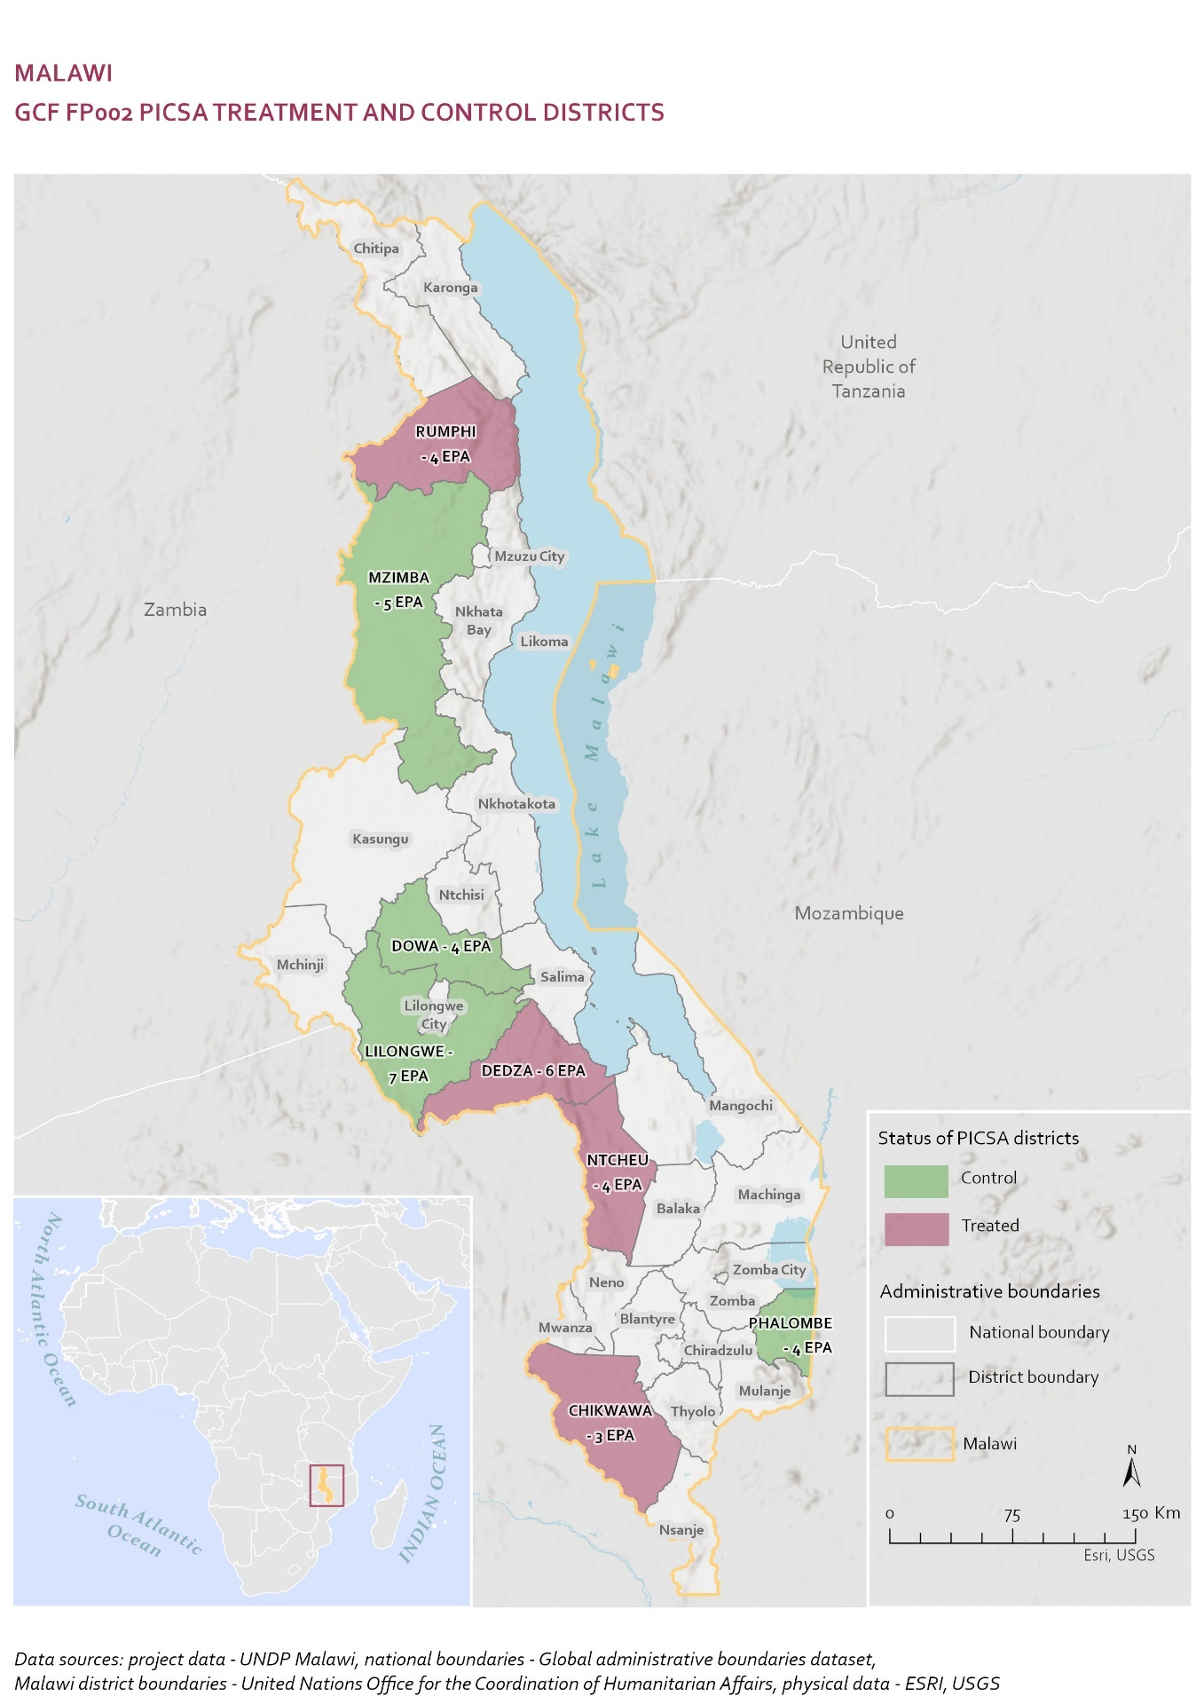
LESSONS: Scaling Up the Use of Modernized Climate Information and Early Warning Systems in Malawi, GCF and UNDP
Lifespan of 6 years (to be completed in 2023), over 12 mln investment from GCF
Result areas: health, water and food security and improved livelihoods
Improving access to climate information, forecasts, building weather stations, etc.
Participatory Integrated Approach to Agriculture (PICSA) component in providing climate information improved awareness, decision-making and agricultural yields, no impacts on food security.

Slide 6



THANK YOU

