Slide 1
Ethics for evaluation in sustainable development
Nicoletta Stame
NEC 2022
D4: Ethics and evaluation: from guidance to practice

Slide 2
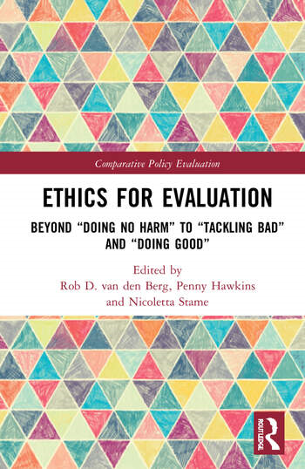

Slide 3
A traditional view of ethical guidelines
Ethics as a norm of right behavior
The program
- Linearity, regularity, time bound
- Isolated
- Change as expected
The evaluator
- Expert
- Value-neutral
Ethics principle
doing no harm, avoiding conflict of interest

Slide 4
New guidelines, old and new practice
Guidance: Ethics as helping make good decisions in an uncertain world
The program
Complexity, uniqueness, conflict of values
Long term, sustainability
Change also happens in un-expected ways
The evaluator
Reflective practitioner
Value critical
Ethics principles
New items: wrongdoing, interests and values, context, culture
Doing no harm, preventing bad, doing good

Slide 5
A large area of evaluation
Ethics for evaluator: ethical values concerning the professional conduct of the evaluator
What it means to be a democratic professional who is concerned with the public good
Ethics for evaluations: ethical values relevant for determining the acceptability and optimality of objectives and strategies
What it means to act when alternatives are open to the various stakeholders (decision-makers, commissioners of evaluation, implementers, local agents)

Slide 6
Areas of ethics in evaluation
 | Tackling bad | Doing no harm | Doing good
Ethics for evaluator | Potential action: personal integrity in situations where the evaluation would be influenced | Potential action: identifying "unintended impact" and including this in the evaluation | Potential action: ensuring stakeholders are treated with respect and dignity
Ethics for evaluations | Potential action: considering "planned suffering" affecting the evaluand | Potential action: considering "collateral damage", social & environmental safeguards, etc. | Potential action: empowering the voice of stakeholders, acknowledging their social innovations

Slide 7
Doing no harm
Evaluator: identifying “unintended impact" on evaluee
privacy, tactfulness in asking questions, no exposure of wrongdoing
Avoid conflict of interest
Evaluation: considering «collateral damage»
social & environmental safeguards
>> Considering risks

Slide 8
Preventing bad
Evaluator: personal integrity in situations where the evaluation would be influenced by vested interests
Evaluation: Considering “planned suffering” affecting the evaluand
identify and correct negative situations. Example: dams and resettlement: “improve or at least restore” livelihoods and living standards, in real terms, to pre-displacement levels (…): no development
>> Adverse un-intended consequences

Slide 9
Doing good
Evaluator: treat stakeholders with respect and dignity
Evaluation: How the evaluation can benefit society and the target population
discovering and supporting positive and innovative solutions to serious problems
empowering the voice of stakeholders
acknowledging their social innovations: : sustain creativity
>> Positive un-intended consequences

Slide 10
THANK YOU

