Slide 1
Case studies of evaluations in fragile settings : SRHR in West and Southeast Africa and The 2022 CSO National Voluntary Report for Mali
Sory Ibrahima Monekata, Ph.D.

Slide 2
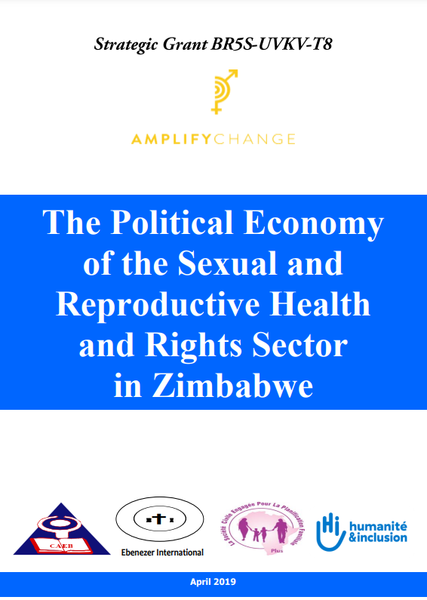
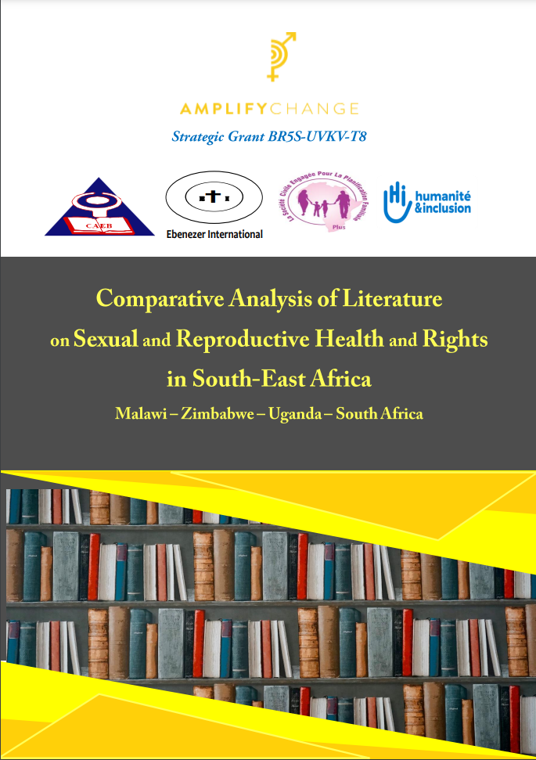
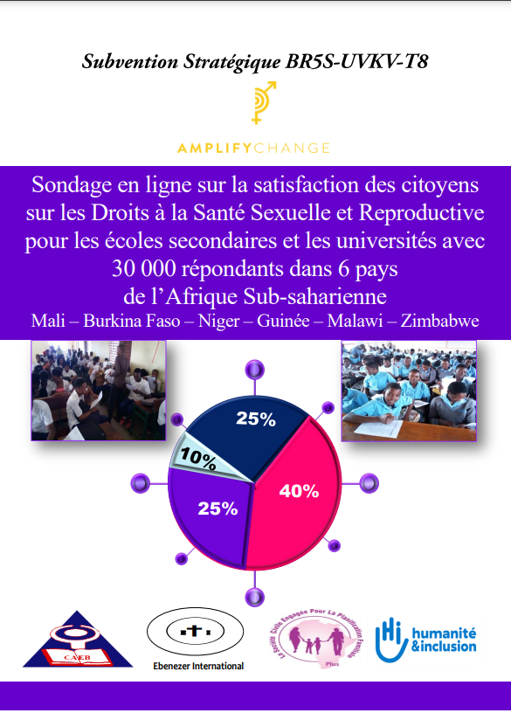
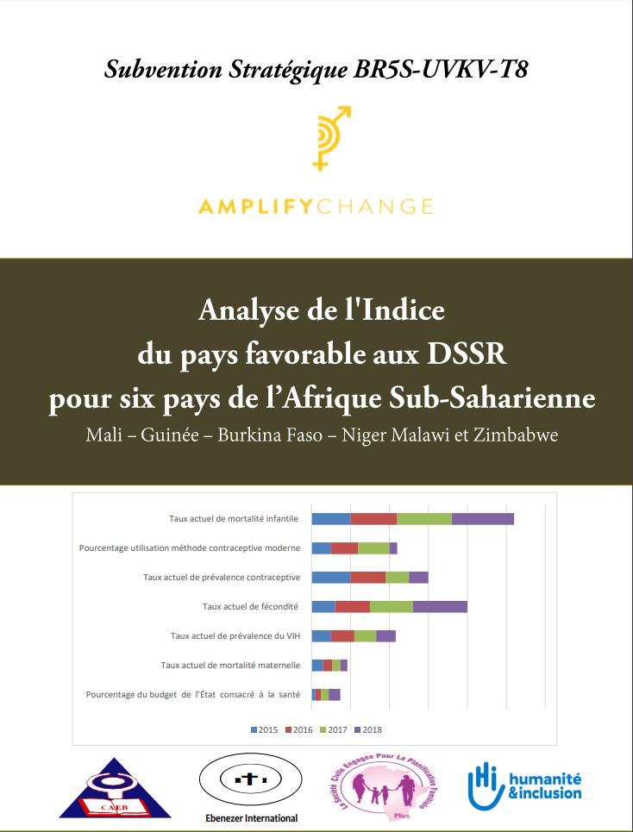
Conducting and using SRHR evaluations in fragile settings: 10 studies in 2 regions and 8 countries
West Africa : Mali, Guinée, Burkina Faso, Niger
Southeast Africa : Malawi, Zimbawe, Uganda, South Africa
6 studies, 6 countries
2 studies, 8 countries
1 studies, 6 countries
1 study, 6 countries

Slide 3
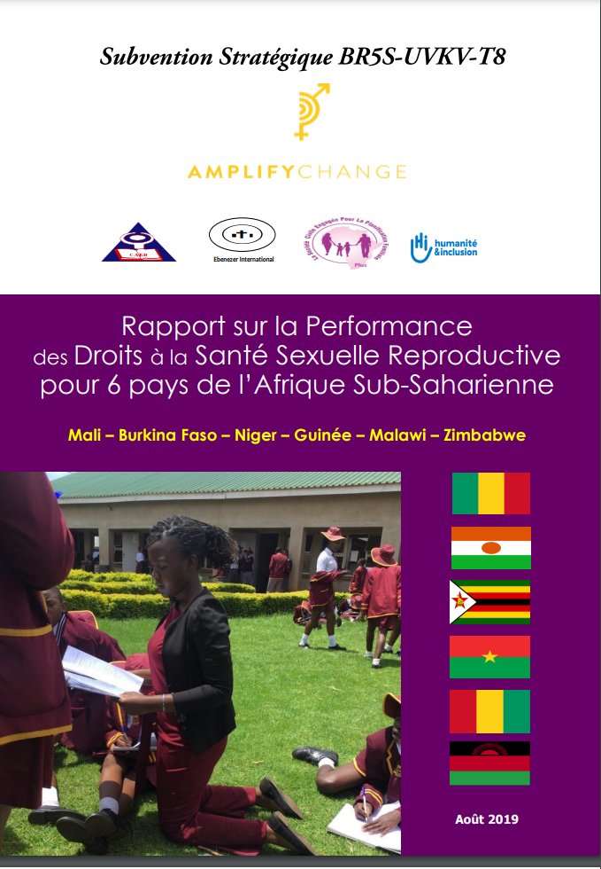
Who is using the reports, where and how ?
CSO coalitions working on SRHR
9 Ouagadougou Partnership Countries
Advocacy & Lobbying
Awareness raising
Resource mobilization

Slide 4
Developing the Mali Civil Society VNR 2022
Who ? CNSC, FOSC, FONGI
What ? CSO Evaluation of SDGs
Where ? 10 regions in Mali, West Africa
When? April, Mai, June 2022
How ? Evaluation team, CSO Steering Committee, Expert Panel, National Validation Workshop
Why ? Need to hear citizens’ voices in the VNR process

Slide 5
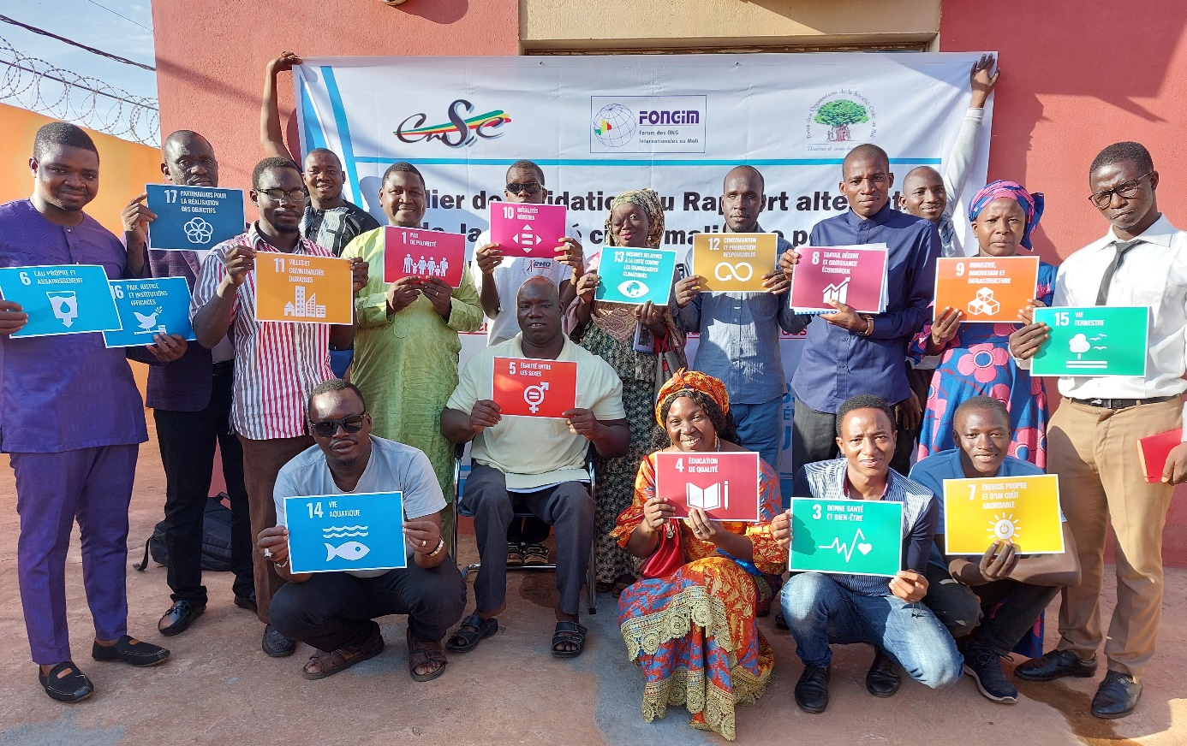
AW
NI
CE!

