Slide 1
Digital Innovations In Evaluation
The need for a cloud-based all-in-one M&E system

Slide 2
Progress Made In Developing A Solution
Demo video on e-Campus platform

Slide 3
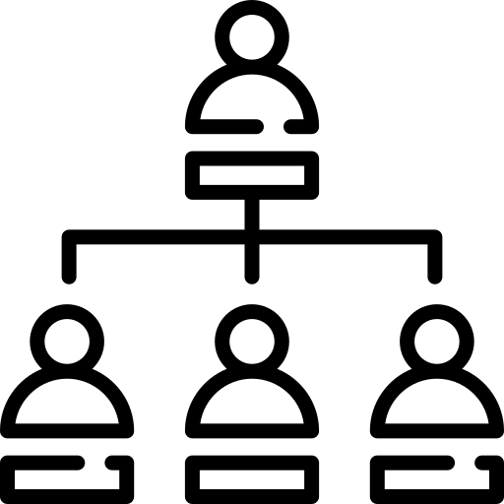
Adoption Case Study
Evaluation Consultants
Nampula, Mozambique
Globalmoz
Name
Org Type
Location
Remote mobile data collection through WhatsApp since March 2022
Easy to use and download data for on premise database in near-real-time
Training materials needed in local language on how to use and adopt digital tools
Use
Likes
Challenges

Slide 4
Contact Us
https://kpilens.com/
nodumo@kpilens.com or alfred@kpilens.com
KPI Lens

Slide 5
THANK YOU

