Slide 1



Triangulating Methods for Evaluation and Learning: Example of an Early Evaluation of the World Bank’s COVID-19 Response
Session C4: Approaches to evaluation during the pandemic.
2022 National Evaluation Capacities Conference: Resilient National Evaluation Systems for Sustainable Development.
Santiago Ramirez Rodriguez
October 27, 2022

Slide 2
Evaluation Design
Purpose
Early assessment of the quality of the World Bank’s COVID-19 health and social response.
Draw lessons to inform ongoing and future support for crisis preparedness and response.
Scope
Period: First 15 months of the COVID-19 pandemic in vulnerable countries.
Evaluation Questions:
Quality of the response in countries?
  Relevance to addressing needs?
  Factors facilitating or hindering implementation?
  How well did operational policies and partnerships work to provide support?

Slide 3
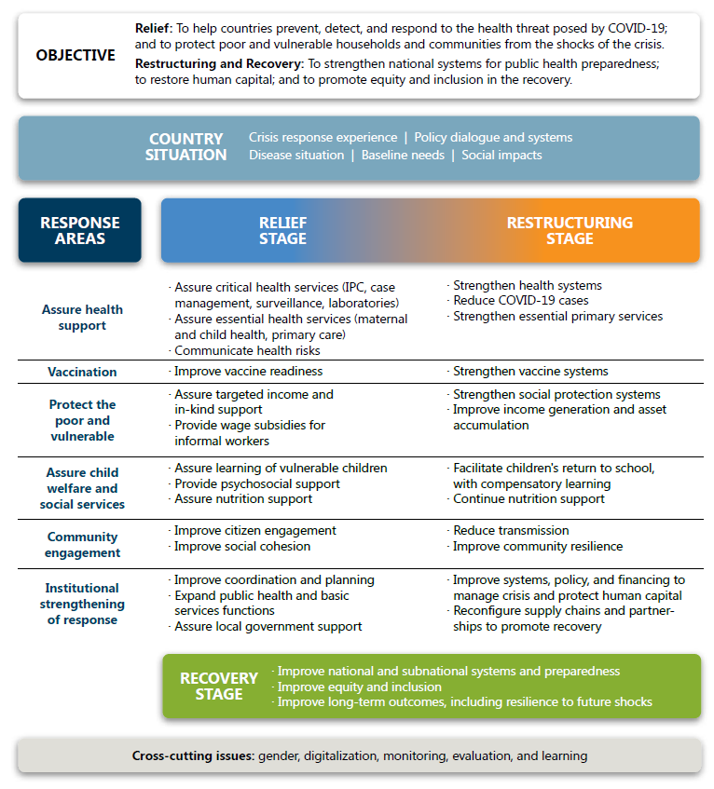
Conceptual Framework
(thematic areas and stages of support)

Slide 4
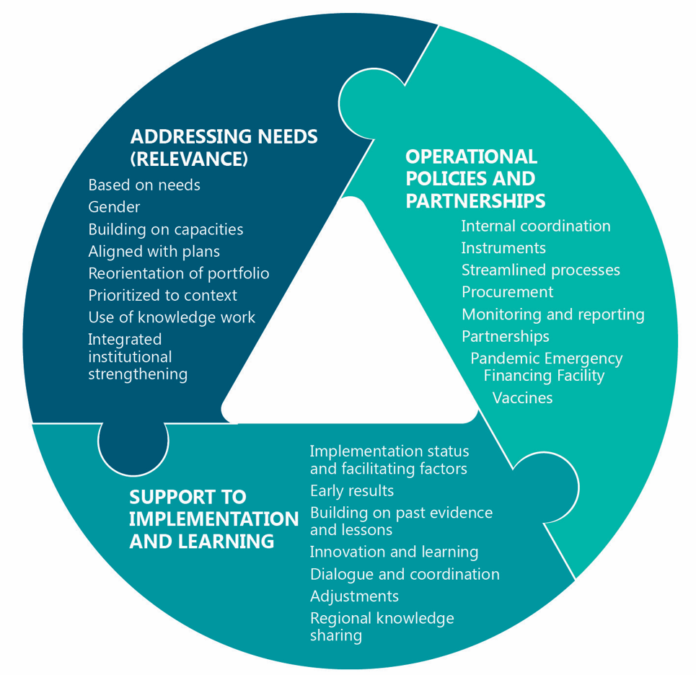
Theory of Action
(dimensions for the assessment)

Slide 5
Evaluation Design Matrix
Component
Method
Evaluation Question
Case-based analysis
8 Country case studies
Relevance to addressing needs?
Review of country needs
Heat map and clustering analysis of country data
Country
level
Benchmarking of evidence and lessons from the literature
Evidence and past lessons of crises
Learning on regional support
Regional project review
Stocktaking of innovations
Inventory of innovations
Factors facilitating or hindering implementation?
Portfolio
level
Portfolio analysis
Review of World Bank financing and knowledge products
How well did operational policies, and partnerships, work to provide support?
Corporate
level
Interviews with management and partners
Corporate and partnership review

Slide 6
Triangulation of findings
What was the quality of the response?
Question 1—Relevance to addressing needs?
Heat map shows unmet response areas for needs of countries – e.g., essential health services, gender, community. Portfolio analysis reinforced the same finding.
Clustering analysis showed countries had different needs.
Crowdsourcing survey showed many innovations, but these did not address all need areas.
Question 2—Factors facilitating or hindering implementation?
Case studies showed implementation was adaptive.
Case studies also showed that cross-sector coordination was difficult.
Portfolio analysis and case studies show the limited use of data to inform decisions.
Question 3—How well did operational policies, and partnerships, work to provide support?
Regional analysis showed the benefits of these projects.
Portfolio analysis and case studies showed the benefits of mixing financing instruments to respond quickly.
Interviews showed that pre-established partnerships facilitated the response by countries.

Slide 7



Lessons Learnt
a. Challenges
The dynamic nature of the COVID-19 situation and the overlap between the evaluation and the ongoing response created a challenge to inform the target audience on findings before the evaluation was completed.
The restrictions on empirical data collection created by the pandemic can result in delays and potential selection bias in the data.
Notes:
This was helpful to understand needs.
5. This was important to assess a dynamic response. E.g., IEG shared the results of the regional project review, of the innovations, and of the case studies, before the evaluation was concluded.

Slide 8
Lessons Learnt
b. Successes
  Challenges created opportunities and uncovered new useful ways of implementing methods.
  Triangulation of existing and new methods was key for understanding the complex situation created by COVID-19.
  Triangulating methods facilitated adapting evaluation purpose and scope to the needs of the target audience.
  Triangulation of methods warrants a more systematic approach in future early-stage evaluations.

