Slide 1
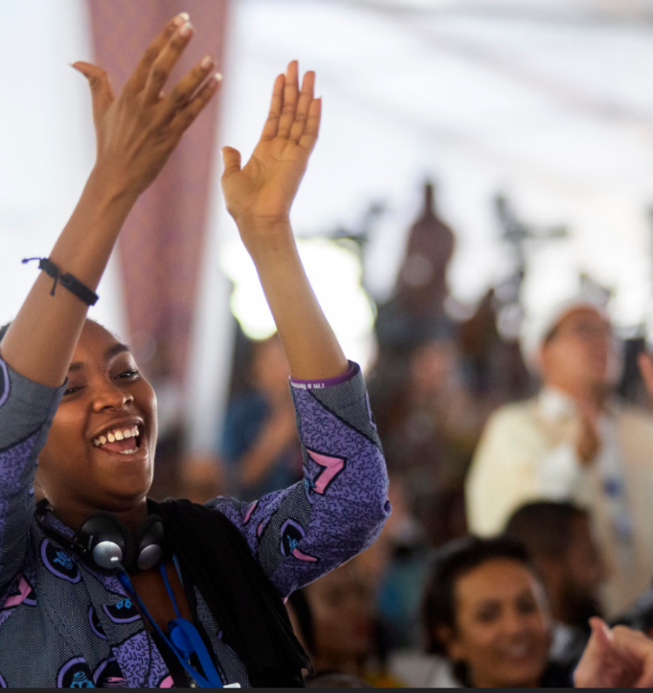
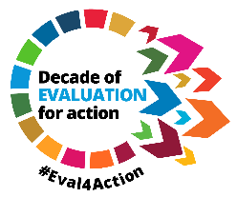


Meaningful engagement of Youth in Evaluation
Increasing the transformative power of evaluation to reach the furthest behind
Marco Segone
Director, UNFPA Evaluation Office
27 October 2022
NEC Conference, Turin
Notes:
Logo resolution

Slide 2
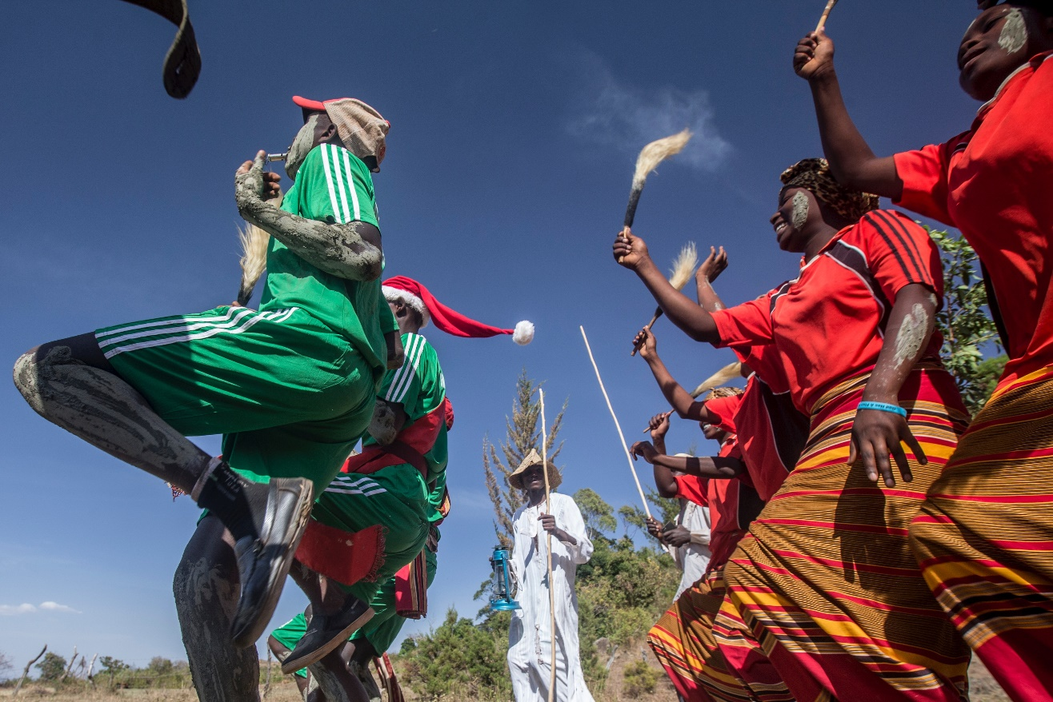
On 15 November 2022,
the global population is projected to reach 8 billion
Today 16% of the global population is aged 15-24
This will rise to 23% by 2030
This is a vital opportunity for the infinite possibilities of humanity to build the world we want
In parallel, the world faces great peril with complex interconnected challenges
World at
8 billion

Slide 3


United Nations Secretary-General’s
Our Common Agenda
Agenda of action to accelerate multilateralism and SDGs
Spotlights ‘listening to and working with youth’, prioritizing voice, learning, and prosperity of youth
Youth are already taking the lead in averting once-in-a-generation deep interconnected challenges: Conflicts, climate catastrophe, inequalities and division, rising poverty, energy crisis, financial crisis, unemployment, displacements, ongoing global pandemic
Across these areas youth is demanding action and space for meaningful engagement
Why is this vision important for evaluation and how do we apply it in the evaluation field?

Slide 4
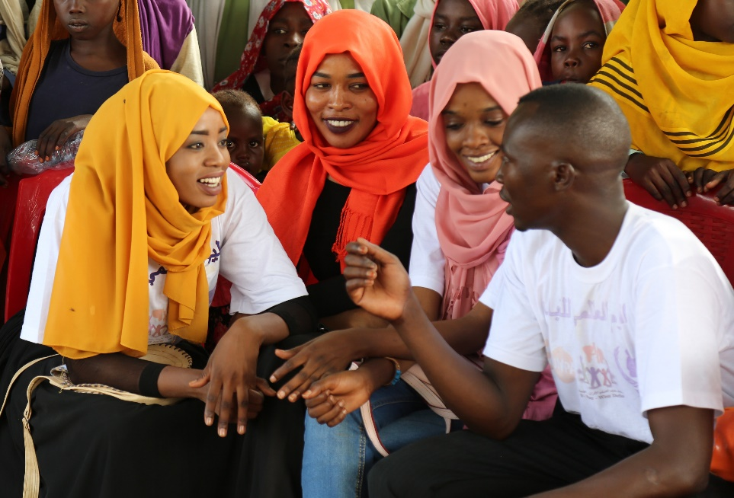
Benefits of engaging youth in evaluation are real
Engaging youth in evaluation
Improves relevance and quality of evaluation
Amplifies youth voice and agency
Enhances SDG implementation, monitoring and review, and holds governments accountable
Brings out-of-the-box solutions and perspectives, including for the global evaluation community
Multiplies the transformational power of evaluation

Slide 5
Systemic approach to enhance meaningful youth engagement in evaluation
Institutional Level
(policies, procedures, frameworks)
Enabling Environment
(policies, legislation, power relations, social norms)
Demand
Supply
Individual Level
(skills, knowledge, experience)
Tailored to the specific context of each country
Country leadership and ownership

Slide 6

Building an enabling environment
1. Evaluation advocacy movement with youth at the center
Aligned to the Decade of Action, Eval4Action is co-led by EvalYouth Global Network, Global Parliamentarians Forum for Evaluation, UNFPA Evaluation Office, with nearly 160 partners
7 regional Eval4Action consultations were co-led with young evaluators. At the regional level, communication hubs are primarily led by youth

Slide 7









Building an enabling environment
2. Youth in Evaluation
Multi-stakeholder and intergenerational call to action to commit to enhancing meaningful engagement of youth in evaluation
Today, there are nearly 500 signatories to the Youth in Evaluation manifesto globally, including 115 organizations
Everyone is invited to join Youth in Evaluation!

Slide 8

Building an enabling environment
3. Producing evidence on what works to meaningfully engage with youth
Meta-synthesis of lessons learned from youth evaluations to inform the implementation of United Nations Youth Strategy
Inter-agency knowledge collaboration, co-led by the UNFPA and UNICEF with EvalYouth, OSGEY, FAO, ILO, IOM, DPPA/PBSO, UNDP and UNIDO
Releasing soon: What works to amplify the rights and voices of youth in peace and resilience building?

Slide 9
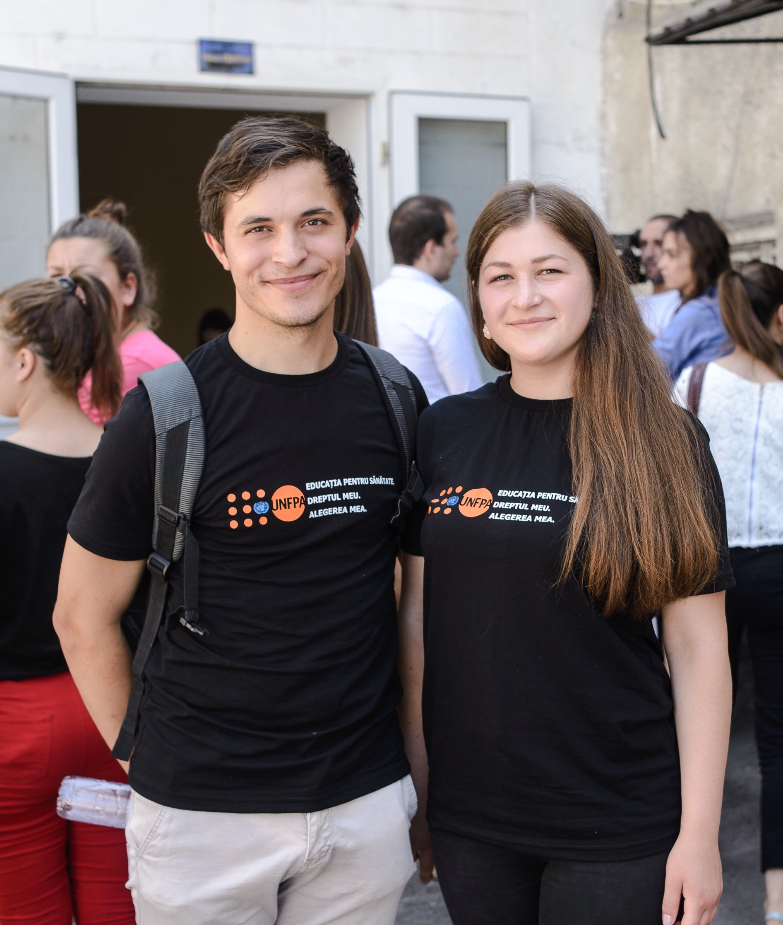
Strengthening institutional capacities for young evaluators
1. Co-creation of standards to step up the practice and accountability towards engaging youth in evaluation with various stakeholders
2. Strengthen EvalYouth Global Network and regional chapters
3. Enhance youth in leadership positions, for example, by supporting a boot camp on leading evaluation associations
4. Support the toolkit for evaluation associations, on increasing engagement of young evaluators in their activities, governance structures, and leadership
Notes:
Balance the numbers font

Slide 10
Strengthening individual capacities for young evaluators
Career development
Technical training
Facilitating access
to the labour market
Training package for youth’s career development in evaluation, led by a Youth Steering Committee, available in 6 languages
Support to peer-to-peer career advisory sessions for young evaluators
Support to EvalYouth Global Mentoring Programme
Bursaries for youth to attend capacity building events
Winter schools for young evaluators
Partnership with UNV and other agencies (UNDP, UNICEF, UN Women, WFP, DPKO, FAO) to provide young evaluation professionals access to the labour market, as UN Youth Volunteers
Notes:
Use pastel colors for the black boxes

Slide 11
Strengthening individual capacities for young evaluators
Innovative engagement of youth in the centralized evaluation of UNFPA support to adolescents and youth
Advisors/decision-makers
Conceptualize and guide the evaluation process together with the Evaluation Office, as members of the Youth Steering Committee
Active contributors
Provide inputs and feedback as members of the Evaluation Reference Group
Young evaluators
      Conduct the evaluation together with the broader evaluation team
Key informants
Act as critical sources of evidence and insight for the evaluation

Slide 12
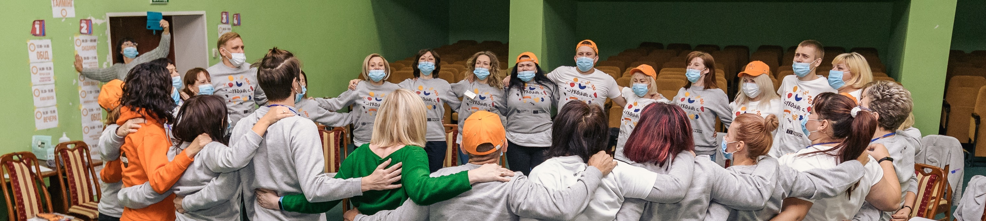
In the end..
Young evaluators are showing extraordinary leadership and innovation to build a global evaluation culture for SDG delivery
In the vision of Our Common Agenda,
Let’s commit to creating spaces and structures where youth can engage in evaluation meaningfully
Let’s together give a push to build evaluation capacities of youth on the ground
This intergenerational solidarity benefits us all

Slide 13

Join, endorse, and adopt the
Youth in Evaluation manifesto
eval4action.org
Notes:
Highlight the website

Slide 14
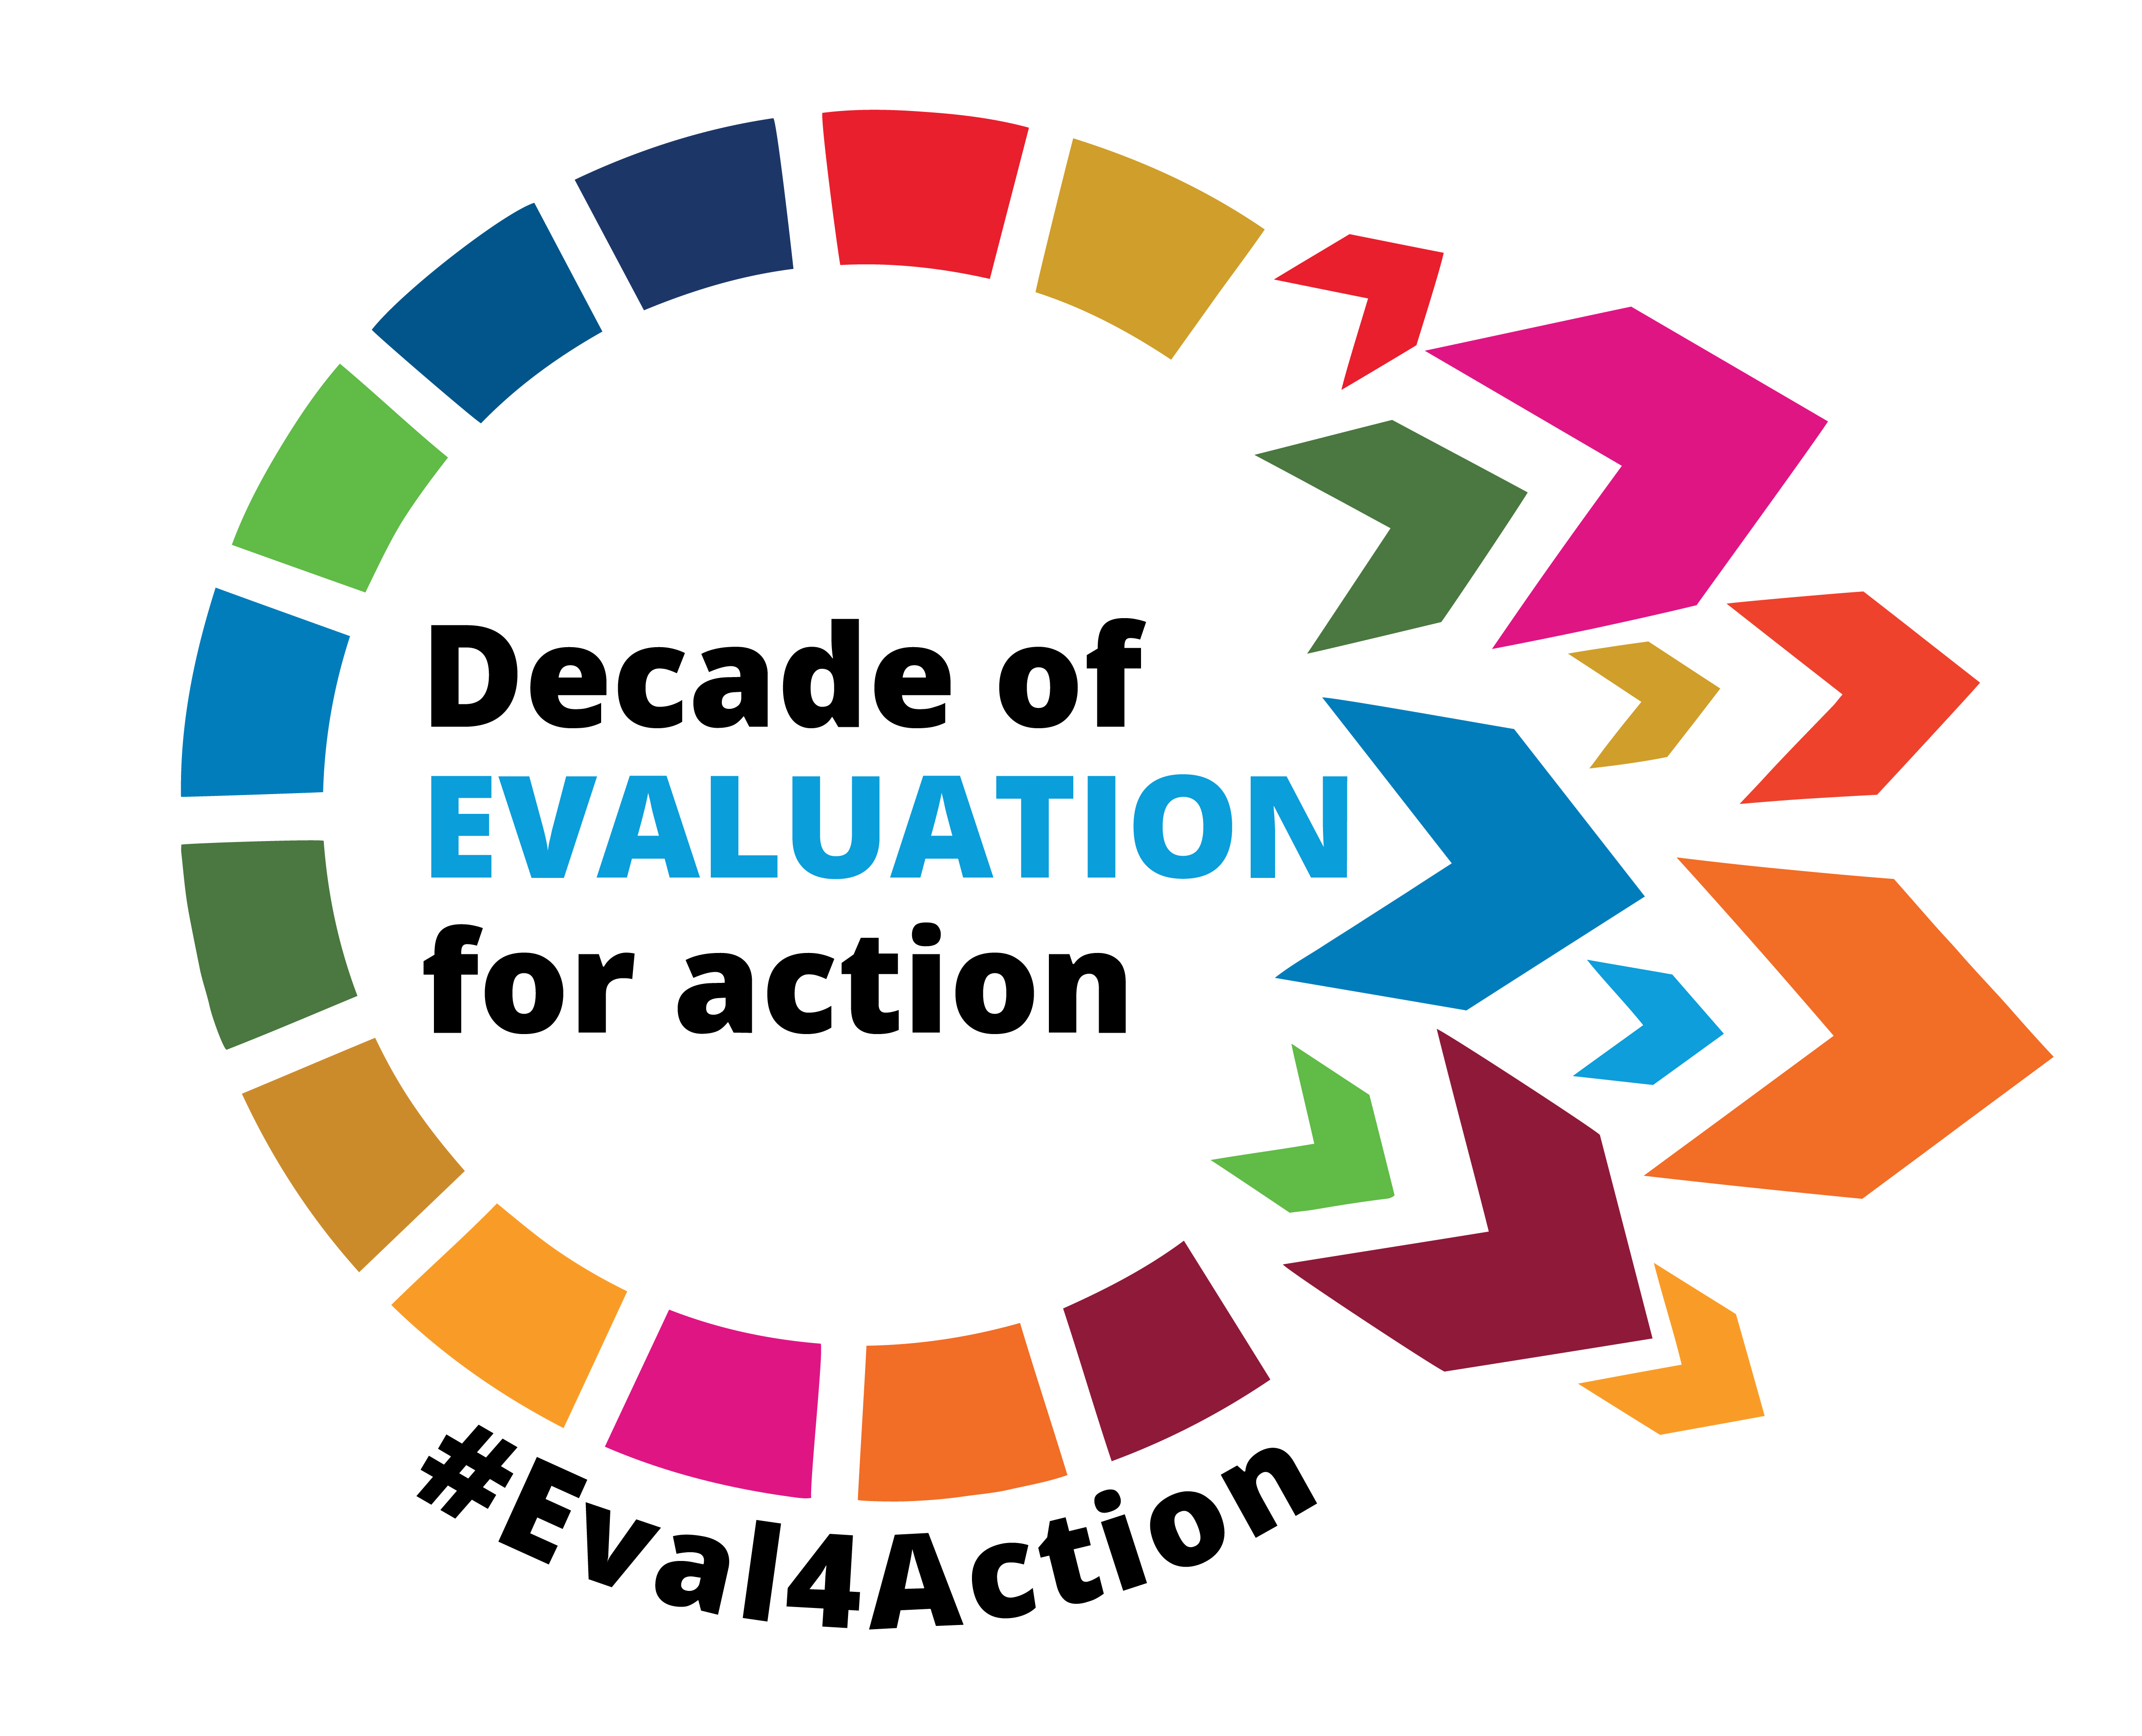


UNFPA Evaluation Office
#Eval4Action
evaluation.office@unfpa.org
contact@eval4action.org
unfpa.org/evaluation
eval4action.org
@unfpa_eval
Eval4Action Campaign
UNFPA Evaluation Office

