Slide 1
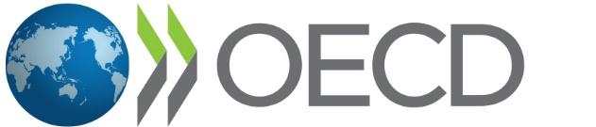
EVALUATING NATIONAL RESPONSES TO THE COVID-19 PANDEMIC
Megan G. Kennedy-Chouane & Jenna Smith-Kouassi (OECD)
National Evaluation Capacities Conference
26 October 2022
@OECD_EVALNET | @CovidEvaluation

Slide 2
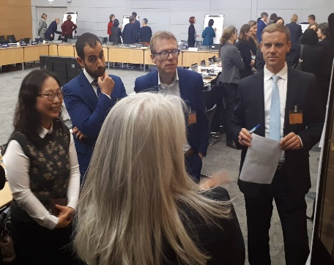
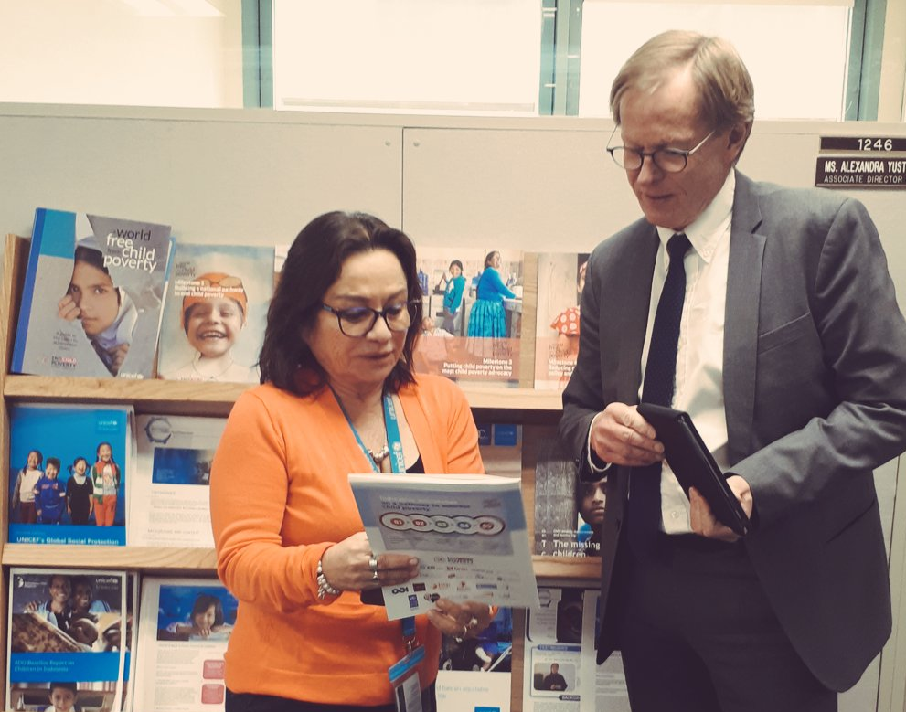
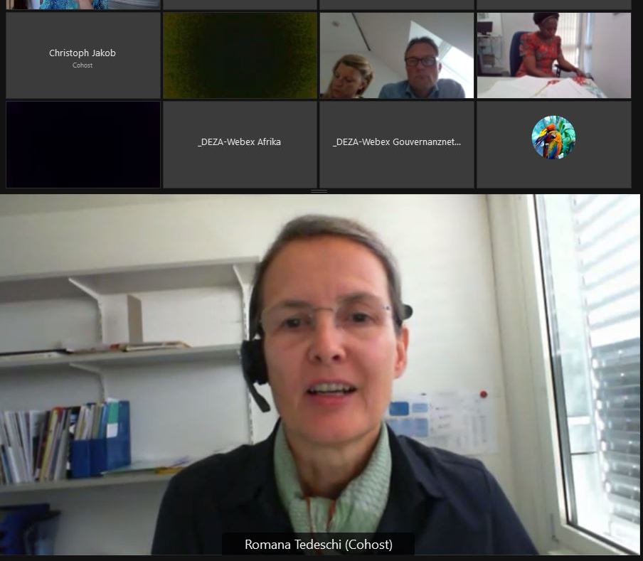

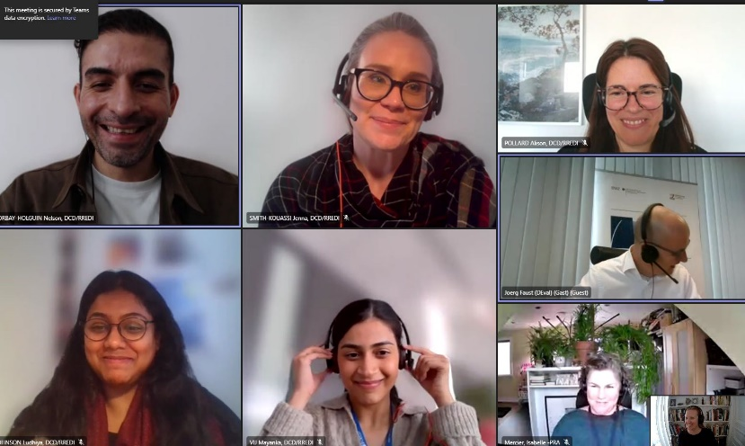
Who is EvalNet?
OECD DAC EvalNet is made up of the central and independent evaluation units of DAC countries + regional development banks, the World Bank IEG, the IMF, and the UNDP IEO.
Long history of partner engagement and capacity support for national evaluation systems.
Notes:
EvalNet members drive resources and evaluation demand.
While they have mandates for development assistance lots of work in of course inter connected with partner systems….
used on development co-opeariton, they are allies ….

Slide 3

Notes:
Missing element the full picture – it is never just about aid! Development cooperation is contributing to much larger social and economic and political change processes

Slide 4

COMMITMENTS TO STRENGTHEN NATIONAL SYSTEMS
For decades it has been widely agreed that development co-operation should be evaluated by countries themselves, via their own national systems.
Developing countries have committed to strengthening their systems, including evaluation systems, and donors have committed to using those systems to the maximum extent possible (Paris Declaration on Aid Effectiveness 2005)
In EvalNet: Rise of collaboration, joint evaluation and funding for evaluation capacity development + learning by doing
Notes:
Flatten the curve: from involving partner countries only as interviewees / consultants, to meaningful ownership as commissioners, managers, follo wup etc.
Mention Paris Declaration, Accra 2008 commitments…
The importance of a national evaluation systems that are coordinated, consolidated, and country led.
International development partners recognise that credible, effective evaluation systems are an important dimension of good governance. Evaluation can provide useful evidence to enhance our understanding of how development works and improve transparency and mutual accountability by demonstrating the results of aid. Evaluative evidence can help development partners manage programmes more effectively. Many development agencies have invested heavily in strengthening their own capacities to assess development results. Increasingly, donors are focusing on institutional and individual capacities for evaluation in partner countries, with the aims of strengthening domestic accountability, facilitating collaboration with partners and improving development effectiveness at the country level.
TOWARD OVERALL GOAL RELYING ON PARTNER COUNTRY SYSTEMS

Slide 5

REMAINING GAPS
And yet, in many countries, evaluation landscapes are still fragmented and donor dominated (check box reporting exercises not really supporting accountability nor learning)
High transaction costs overwhelm national governments’ capacity to plan, budget, manage, monitor, and evaluate
Policy and decision-making relies insufficiently on local monitoring and evaluation systems, negatively impacting effectiveness
The existing landscape results in missed opportunities for
“learning by doing” and capacity strengthening
External partners can both help and hurt!
Notes:
It is hard for evaluation to be owned if development cooperation itself is not… .ownership and accountability must go throughout.

Slide 6


COVID-19 Pandemic
Already in 2015 Agenda 2030: Universal goals
Emergence of GEI, etc.
Pandemic brought into stark relief how all governments struggle using evidence effectively, evaluating quickly, maintaining public trust, etc.
Created openness to new approaches (beginners mind-set), increased demand for evidence
Common cause among evaluators everywhere?
Notes:
COVID pandemic confirming the universality of evidence and evaluation challenges faced by all governments, all people.
Evaluation systems as part of good governance, democratic process.

Slide 7
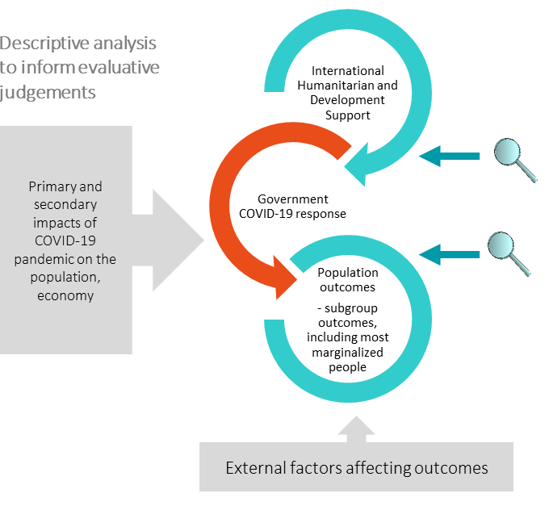

Notes:
COVID pandemic confirming the universality of evidence and evaluation challenges faced by all governments, all people.
Evaluation systems as part of good governance, democratic process.

Slide 8

THE COVID-19 GLOBAL EVALUATION COALITION
The evaluation units of national governments, UN agencies, multilateral banks, and INGOS working in sustainable development and humanitarian assistance
Who?
An independent, voluntary, collaborative project that that supports high quality, credible evaluations of the (non-clinical) COVID-19 response and recovery efforts in developing countries
What?
Why?
Facilitate shared learning, better quality evaluations, greater reach and influence, a broadened scope, and increased efficiency
Through overarching evaluation tools and approaches, peer learning, synthesis, technical and joint evaluative work, and increased opportunities to reach policy and decision-makers
How?
Notes:
Introduce the COVID-19 Global Evaluation Coalition generally, focusing on who, what, why and how. Touch on membership – OECD and non-OECD countries, etc., and the benefits of the diverse membership

Slide 9
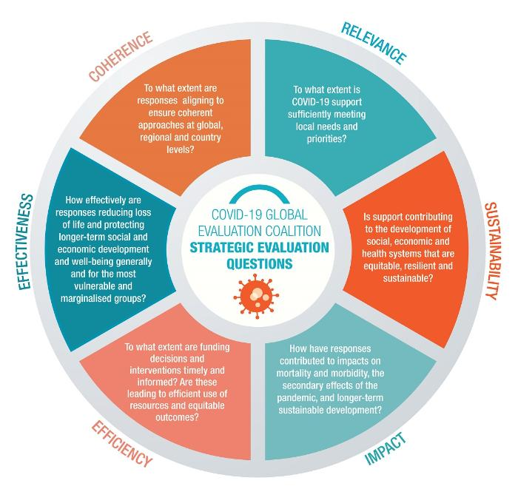
Notes:
Value add: Generating evidence around common questions – some evaluations together, some individual…

Slide 10




COUNTRY-LED EVALUATIONS
Lessons for future Global Crises
Building Government Capacity
Collaboration of national/international partners to reduce evaluation burden
Informing Policy
Notes:
Country-led evaluations of COVID response are providing accountability, while also strengthening national systems.
Open to all evaluation entities interested in credible evaluation of COVID response.
Provide credible, useful insights and valuable lessons Improve collaboration among financing and implementing partners
Support mutual or multidirectional accountability: between governments and their people, as well as between governments and development and humanitarian partners
Provide useful lessons for other countries and contribute to our overall understanding of the collective global response.
Help strengthen national agencies’ capacities to lead, conduct and co-ordinate evaluative work, while also contributing to the long-term resilience of national coping systems.
The COVID-19 Global Evaluation Coalition, in partnership with the Global Evaluation Initiative (GEI), supports governments with an interest in evaluating their national responses to COVID-19, including the extent to which humanitarian and development co-operation effectively supported those responses.
. Identifying and mobilizing local capacities
Supporting “learning by doing”
Donor co-ordination to avoid unnecessary demands on partner systems that overwhelm local capacities and pull evaluation expertise away from partner country systems. D
Inform policy makers and implementers to support a more effective (collective) response to and recovery from the COVID-19 pandemic.
Generate lessons and good practices, and facilitate learning for future crises.
Provide a basis for accountability of development partners, including the provision of information to the public.
Proposals to mitigate the barriers/challenges that inhibit the use and effectiveness of the evaluation and its findings.
Discussions around how National (within-country) M&E systems (e.g. at sectoral or cross-sectoral levels) can be strengthened, through increased coordination and collaboration with a range of national and international actors.
Introduction to the GEI-Coalition partnership
Impetus for this joint initiative
Purpose:
Lessons for future Global Crises: To provide valuable lessons for future global crises around the implementation of complex, multi-sectoral, policy responses
Building Government Capacity : To contribute to the development of evaluation capacities in national counterparts
Collaboration of national/International partners: To improve collaboration among financing and implementing partners to support collective learning and optimize the use of evaluative evidence
Informing Policy: To generate evaluative evidence on the performance and results of COVID-19 policy interventions to inform decision-making processes and program design

Slide 11




THANK YOU
Join the Coalition!
www.covid19-evaluation-coalition.org
COVID19evaluation@oecd.org
Notes:
COVID pandemic confirming the universality of evidence and evaluation challenges faced by all governments, all people.
Evaluation systems as part of good governance, democratic process.

