Slide 1
NATIONAL DATA FRAMEWORK
FOR MEASURING PROGRESS TOWARDS SDGs
Elena Kukharevich
National Statistical Committee of the Republic of Belarus

Slide 2
National list of SDG indicators
101 are proxy indicators that reflect the country's national availability is almost 90 priorities
267 indicators
166 coincide with the global indicators
25 data providers
101 are proxy indicators that reflect
the country's national development priorities
The data availability is almost 90%
Belstat
(106 indicators)

Slide 3
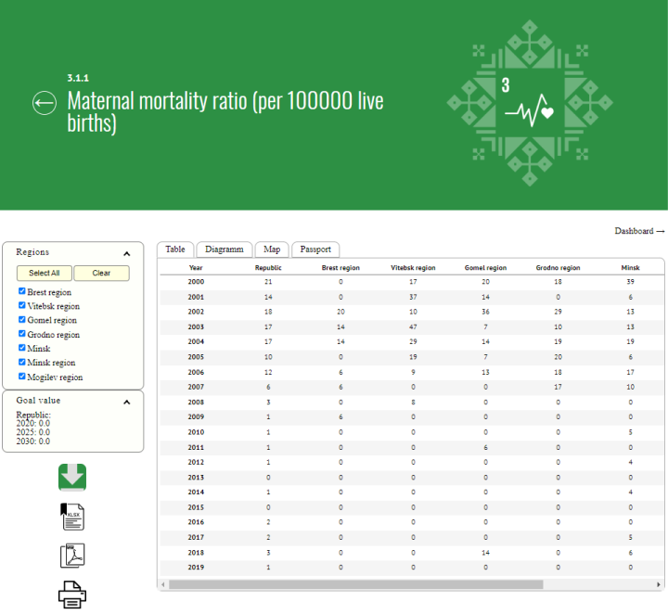
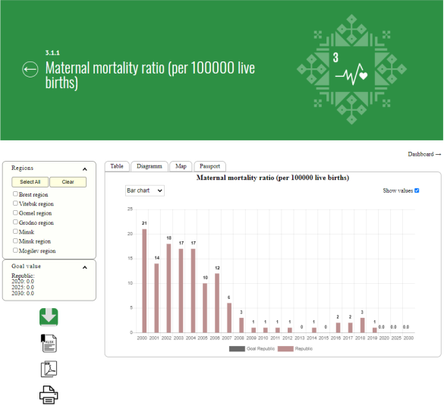
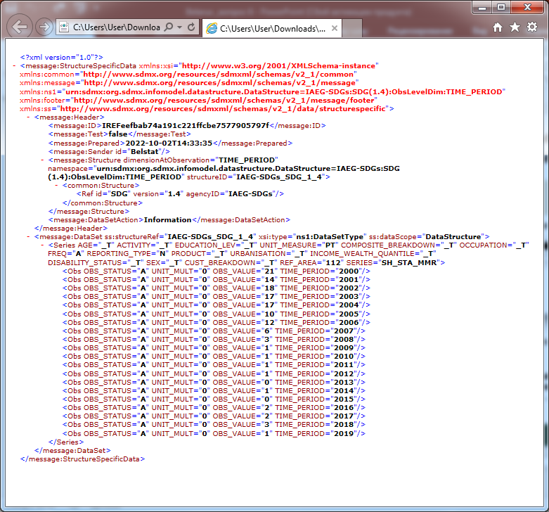
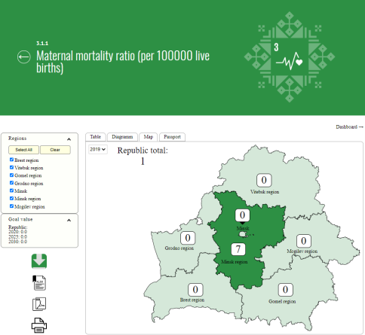
National platform for reporting indicators of Sustainable Development Goals
Three main purposes:
a portal for data collection
a tool for dissemination
of up-to-date information
interaction with custodial agencies
of the United Nations system
http://sdgplatform.belstat.gov.by/en

Slide 4
Quality monitoring of the SDGs
Household sample survey programmes
have been supplemented
Comprehensive survey of persons
with disabilities was conducted
lifelong learning for adults and youth,
economic activity of persons with disabilities,
to create a barrier-free environment for this category of citizens,
to improve accessibility of the services demanded by disabled persons,
to implement other measures
multidimensional poverty,
level of moderate or severe food insecurity,
satisfaction with government services
Multiple Indicator Cluster Survey to assess
the situation of children and women (MICS 6) was conducted
Geospatial data was implemented
21 SDG indicators
access to basic services,
health care,
use of contraception,
enrolment in quality education,
prevalence of child marriages,
discrimination and violence,
gender equality
9 indicators for

Slide 5
Measuring progress
Current state
Significant progress
Progress
The Eurostat approach was used to assess the current state of all indicators and progress in the absence of a target value
The UNESCAP approach was used to assess progress in the presence of target value
80%
62%
progressing towards
the targets
target values have been achieved or will be achieved at current levels of effort

Slide 6
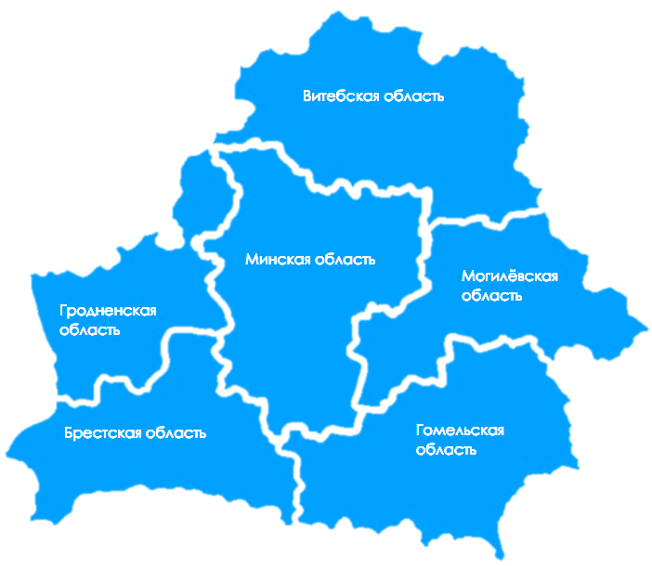
Localization of the SDGs
Unified regional list of SDG indicators
covers all 17 Goals and 75 targets
covers
17 Goals
75 targets
145 indicators
85 correspond to the indicators
from the national list
26 reflect specifics of regional
development
Regional reporting platform

Slide 7
THANK YOU
Elena Kukharevich
National Statistical Committee of the Republic of Belarus
https://www.belstat.gov.by/en
http://sdgplatform.belstat.gov.by/en
intcoop@belstat.gov.by

