Slide 1
Eritrea And The 2030 Agenda NEC 25-28, 2022 Turin, Italy

Slide 2
Credible national data system for evaluating progress towards the SDGs.
Introduction
Eritrea prepared its first Voluntary National Review (VNR) report aiming to assess implementation of the 2030 agenda for Sustainable Development. The VNR briefly touches upon the status of the progress of all the SDGs relevant to Eritrea. However, due to the limited data availability and their close interlinkages with other goals, special emphasis was given to SDG3 &13.
The purpose of this presentation is to share the country’s experience, including its successes, gaps, challenges, and support needed.

Slide 3
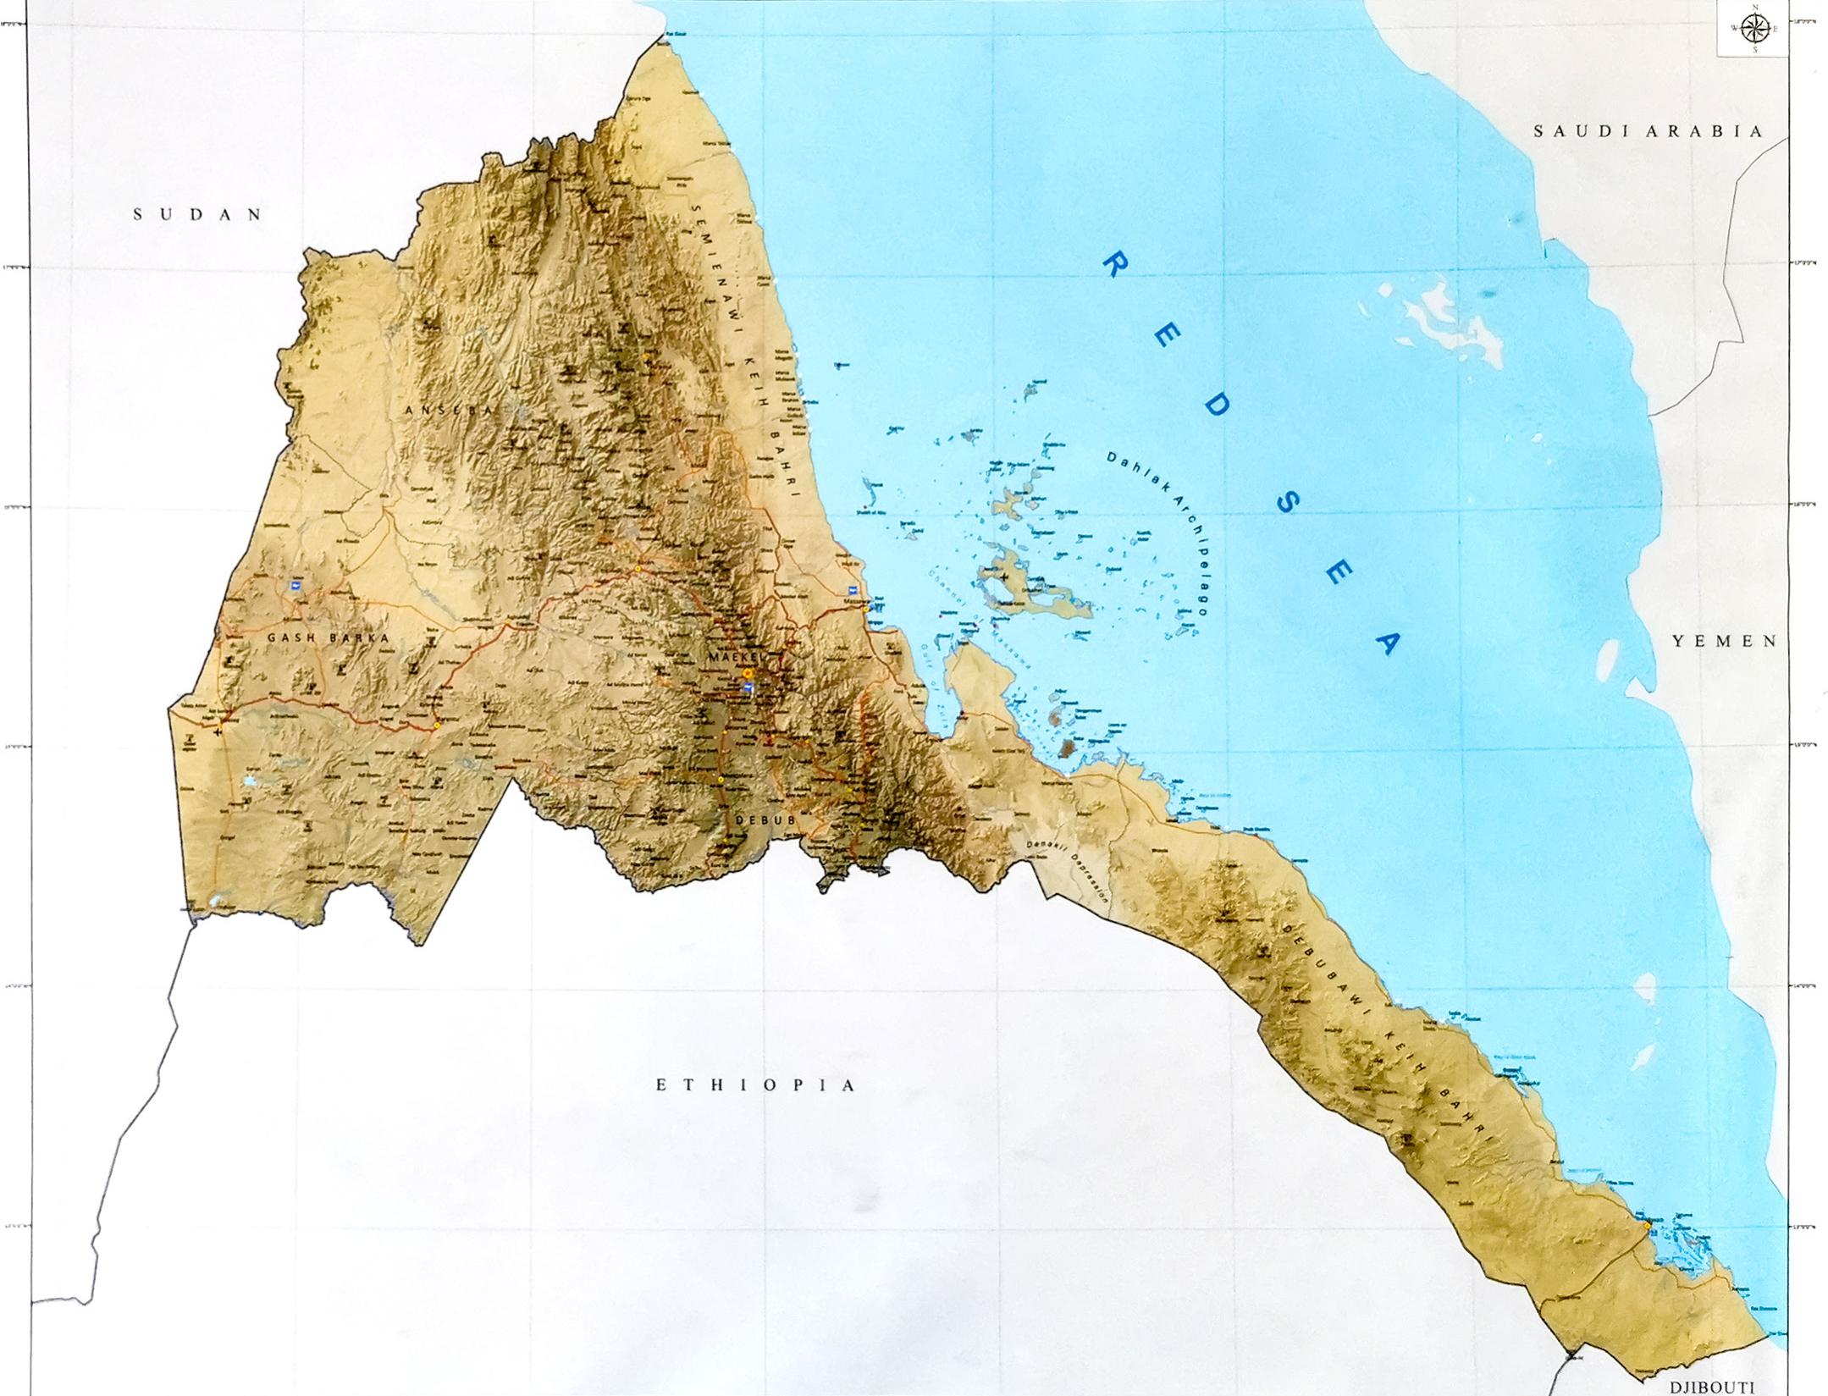
1. COUNTRY PROFILE
Achieved its independence in 1991.
Total land area is approximately 124,320 km2 with coastline 3,150 km including 350 islands
Population 3.475 million (2019)
The population comprises nine ethnolinguistic groups

Slide 4
2.1 Process Of Preparation Of The Review
Eritrea’s inaugural VNR process formally with its expression of interest to the UN
SDG 3 & 13 were selected for 2022 Eritrea’s VNR
A multi-institutional National SDGs Taskforce(NST) was established
NST was composed of focal points from Ministry of Finance and National Development, Ministry of Health & Ministry of Land water & Environment, along with representatives from the UN in Eritrea
The NST prepared and approved a comprehensive concept note, roadmap and detailed work plan, the terms of reference, outlines of the report

Slide 5
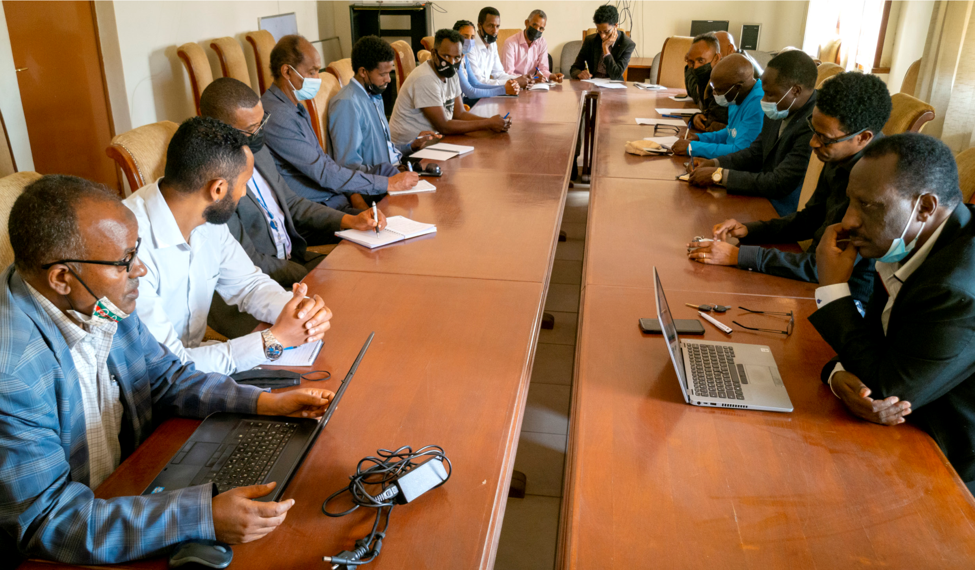
METHODOLOGY AND PREPARATION OF THE REVIEW

Slide 6
2.2 Data And Scope
Established two thematic working groups, headed by senior experts from MoH & MLWE, and comprising members from a total of 23 stakeholders
The process of the review was a participatory and all-inclusive exercise.
Preliminary assessments were conducted during multi-stakeholders consultations convened by the NST and working groups.

Slide 7
3. PROGRESS TOWARDS ACHIEVING THE SDG
3.1 SDG 3
In SDG3, progress is being registered toward achievement UHC
Health services are heavily subsidized
Maternal mortality ratio dropped from 998 per 100,000 live births in 1990 to 228 in 2015, and 184 in 2019
Between 1990 and 2020 neonatal mortality rate was reduced from 35 deaths per 1000 live births to 18, while under-five mortality rate was reduced from 153 to 39.
The country is transitioning from pre-elimination toward elimination of malaria.
More than 95% of children fully immunized for their age

Slide 8
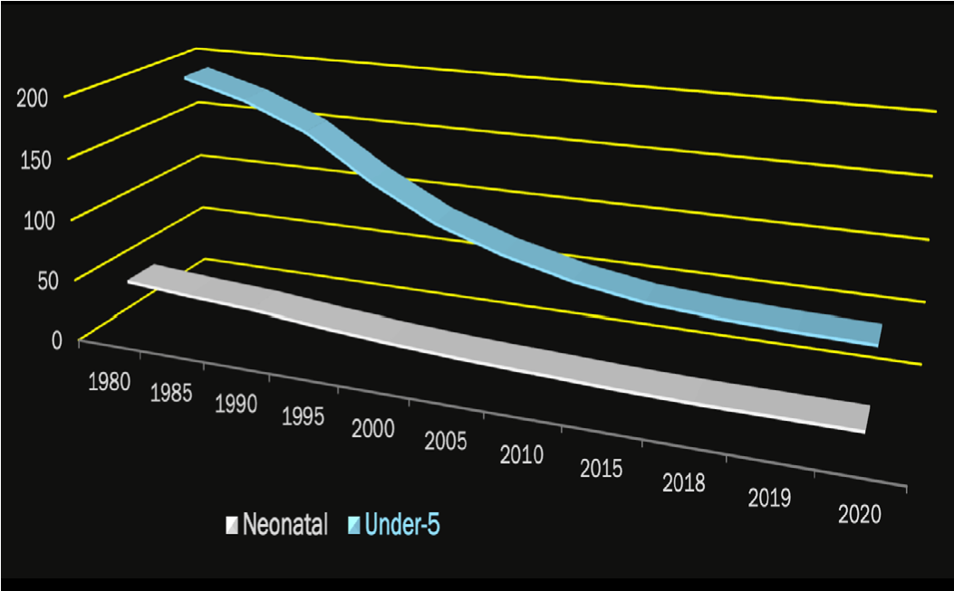
Neonatal and under-five mortality ratee

Slide 9
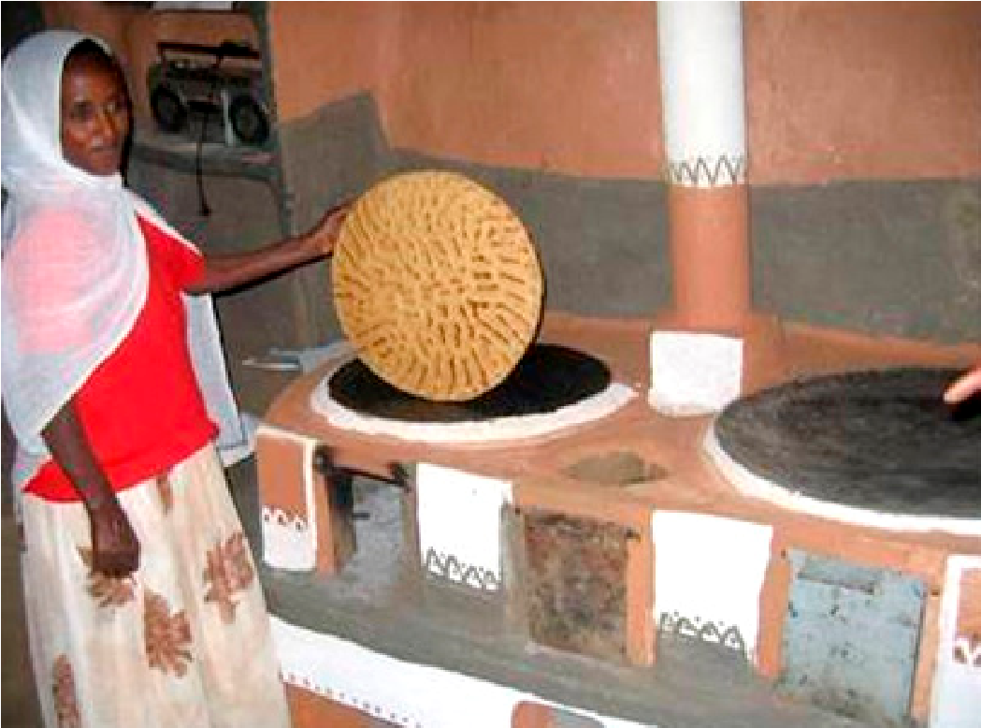
3.2 SDG 13 “
Number of persons affected by disasters increases from 26 per 100,000 in 2015 to 551 per 100,000 in 2021.
Climate change mitigation and adaptation focusing on the area of energy, forestry, and waste has been underway
A number of projects in place to conserve, restore, and enhance natural areas, including regular nationwide afforestation campaigns
Adhanet” energy efficient and safe stove

Slide 10
4. CHALLENGES
5. SUPPORT IN NEED
Need to strengthen the national and sub-national level SDG database
Technical capacity building in data collection, compilation, generation, analysis, and dissemination for National Statistics Office and other Government departments.
Lack or limited data availability
Limited stakeholder engagement in person due to COVID-19
Lack of national and sub-national level SDG databases

Slide 11
THANK YOU

