Slide 1
Cabo Verde experience on SDG Governance, SDGs Data centralization and dissemination
National Institute of Statistics - 25/10/2022

Slide 2
Why a Single Statistical Report?
INE already produced the statistical reports for the two agendas separately;
The African Union (AU) and the United Nations Economic Commission for Africa (UNECA) have aligned the objectives of the two agendas;
Countries recommended the production of a single statistical report from the two agendas;
Responding to the challenge of the AU and UNECA;
Facilitate consultation of users of statistical information.

Slide 3
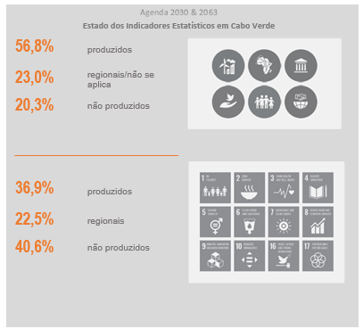
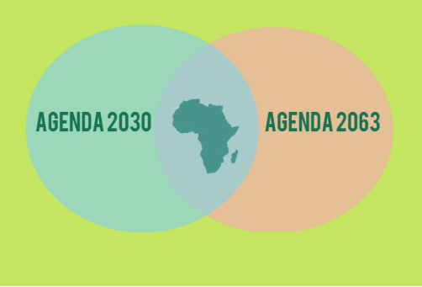
Alignment between Agendas 2063 (African) and 2030 (World):

Slide 4
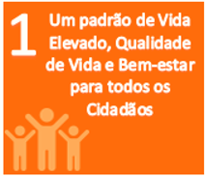
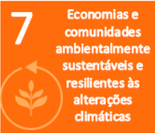
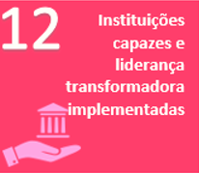
Alignment between Agendas 2063 (African) and 2030 (World):
Goals

Slide 5
INE CONTRIBUTION
INE-CV, as the central executive body of the Cabo Verde Statistical System, took on this responsibility of coordinating, compiling and producing statistical reports on these two agendas, which supports the production of the country's VNRs in compliance with the agendas, as well as making its contribution to the production and availability of indicators.
56,76%
67,57 %

Slide 6
Steps in preparing the Statistical Report
Alignment of the goals of the two agendas, respecting what was done by the AU and UNECA;
Collection of internal and external data, to update the SDG indicators inventoried in 2017 and at the same time the completion of the 2063 indicator questionnaire sent by the African Union;
Definition and harmonization of data series (2015 to 2019) for the indicators that have data available;
Verification of data in detail;
Internal discussion, improvement and validation process;
Publication of the report online (INE website) and paper version with sending to the producing agencies and other partners)
External data
Producing bodies of the National Statics System;
Internal Data
INE's production departments
National entities with statistical production capacity

Slide 7
CONTRAINTS / PERSPECTIVES
PERSPECTIVES
Increased data Disaggregation ;
Reduction of publication time, with greater engagement of sectors;
Better use of administrative data;
Increased coverage of indicators (with the execution of the RGPH-Censo, scheduled for June 2021.
Constraints / Difficulties:
Insufficiency of statisticians, in some sectors, for the adequate treatment of data and consequently the production of indicators;
Difficulty communicating with those responsible for some sectors;
Outdated data;
It takes some indicators to send to INE.

Slide 8
Contribution of the Handbook on Governance Statistics Governance Statistics to the implementation of the SDGs
The Handbook on Governance Statistics takes stock of existing practices in governance data collection and proposes guidelines for the improved production and compilation of governance, peace, security, human rights and rule of law indicators.
The Handbook outlines existing standards, emerging good practices and provides guidance on how to measure many aspects of SDG 16 based on 8 dimensions: Non discrimination and equality, Participation, Openness, Access to and quality of justice, Responsiveness, Absence of corruption, Trust, and Safety and security.
http://ine.cv/praiagroup/handbook/handbook_governance_statistics.pdf

Slide 9
Recommended SDG 16 indicators (1/2)
Non discrimination and equality
Participation
Openness
Access to and quality of justice
SDG 16.b.1 Proportion of population reporting having personally felt discriminated against or harassed in the previous 12 months on the basis of a ground of discrimination prohibited under international human rights law
SDG 16.7.1 Proportions of positions in national and local institutions, including (a) the legislatures; (b) the public service; and (c) the judiciary, compared to national distributions, by sex, age, persons with disabilities and population groups
SDG 16.7.2 Proportion of population who believe decision-making is inclusive and responsive, by sex, age, disability and population group *
SDG 16.10.1 Number of verified cases of killing, kidnapping, enforced disappearance, arbitrary detention and torture of journalists, associated media personnel, trade unionists and human rights advocates in the previous 12 months
SDG 16.10.2 Number of countries that adopt and implement constitutional, statutory and/or policy guarantees for public access to information
SDG 16.3.1 Proportion of victims of violence in the previous 12 months who reported their victimization to competent authorities or other officially recognized conflict resolution mechanisms
SDG 16.3.2 Unsentenced detainees as a proportion of overall prison population
Note: * Discussed also on Responsiveness chapter

Slide 10
Recommended SDG 16 indicators (2/2)
Responsiveness
Absence of corruption
Safety and security
SDG 16.6.2 Proportion of population satisfied with their last experience of public services
SDG 16.7.2 Proportion of population who believe decision-making is inclusive and responsive, by sex, age, disability and population group
SDG 16.5.1 Proportion of persons who had at least one contact with a public official and who paid a bribe to a public official, or were asked for a bribe by those public officials, during the previous 12 months
SDG 16.5.2 Proportion of businesses that had at least one contact with a public official and that paid a bribe to a public official, or were asked for a bribe by those public officials, during the previous 12 months
SDG 16.1.1 Number of victims of intentional homicide per 100,000 population, by sex and age
SDG 16.1.2 Conflict-related deaths per 100,000 population, by sex, age and cause
SDG 16.1.3 Proportion of population subjected to (a) physical violence, (b) psychological violence and (c) sexual violence in the previous 12 months
SDG 16.1.4 Proportion of population that feel safe walking alone around the area they live
SDG 16.2.1 Proportion of children aged 1–17 years who experienced any physical punishment and/or psychological aggression by caregivers in the past month
SDG 16.2.2 Number of victims of human trafficking per 100,000 population, by sex, age and form of exploitation
SDG 16.2.3 Proportion of young women and men aged 18–29 years who experienced sexual violence by age 18
SDG 16.4.2 Proportion of seized, found or surrendered arms whose illicit origin or context has been traced or established by a competent authority in line with international instruments
SDG 16.7.1c Proportions of positions in national and local institutions in the judiciary, compared to national distributions, by sex, age, persons with disabilities and population groups*
Note: * Discussed also on Participation chapter

Slide 11
Thank you for your attention!
https://ine.cv/ods/#agenda_2030_ods_agenda_2063
João Cardoso

