Slide 1
Sampling Techniques for Development Evaluation
National Evaluation Capacities (NEC) Conference 2019
No One Left Behind
Hurghada, Egypt
October 20-24, 2019.
Bassirou Chitou, Ph. D.

Slide 2
Presentation Outline
Workshop Objectives
Module I: Basic Sampling Concepts
Module II: Types of Random Sampling
Module III: Multi-Stage Sampling

Slide 3
Part I: Basic sampling concepts

Slide 4
General Objectives of this training
Point out potential roadblocks or challenges to a successful evaluation;
provide you with tools and ideas to deal with them;
open your curiosity and wet your appetite to learn more.

Slide 5
Specific Objectives of this training
Correct common misconceptions;
Understanding various types of random;
Skills in drawing several types of samples;
Skills in drawing multi-stage household samples;
Skills in using several web-based and MS Excel tools.

Slide 6
Myth 1 and Myth 2
Myth 1
Sampling NOT important to the validity of an evaluation if data collection is very well done . WRONG !
Myth 2
Studies based on a sample are inherently inferior to those based on a census. WRONG !

Slide 7
Key Terms in Sampling
Unit of Analysis
Population (Universe)
Sampling Frame (Frame)
Census
Sample
Sampling Error
Response Rate
Data Availability

Slide 8
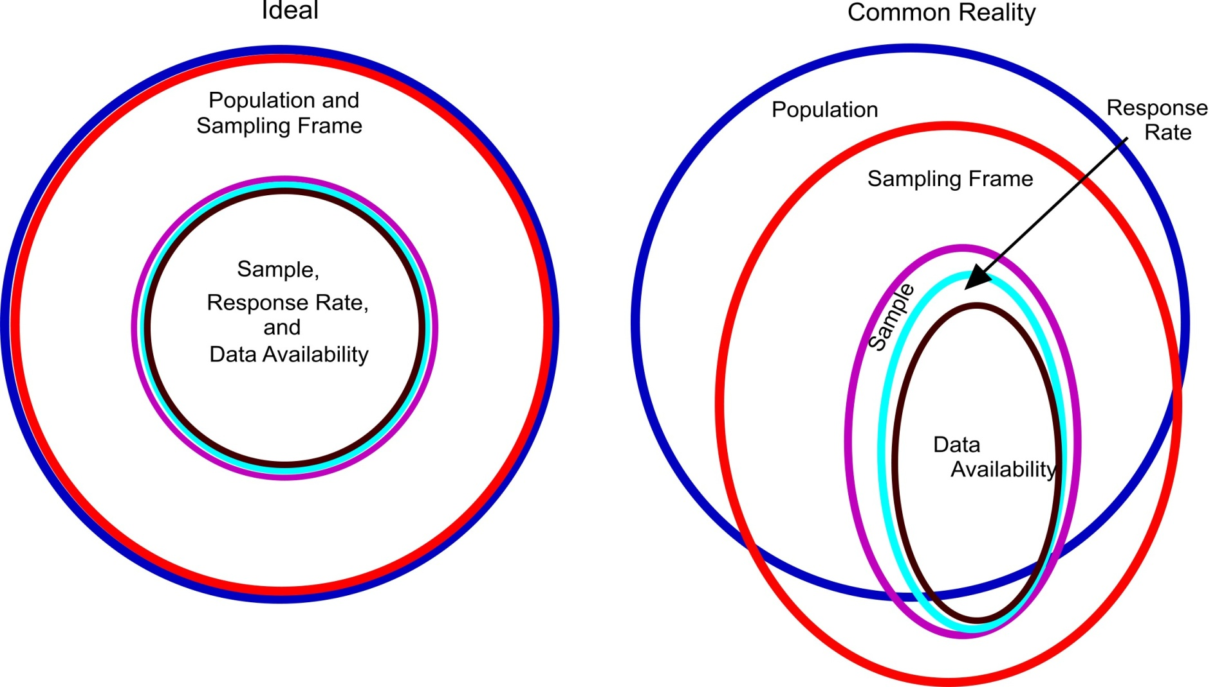
Relationship among Key Sampling Terms

Slide 9
Myth 3:
Non-response can be solved by over-sampling or by follow-up sampling, to achieve desired sample size.
WRONG!

Slide 10
Part II: Type of Random Sampling Pg. xx – pg. xx

Slide 11
Types of Random Samples
Simple random sample
Equal probability systematic sample (SYS)
Random interval sample
Stratified random sample
Random cluster sample
Multistage random sample
Notes:
Study, in an integrated manner, trends in sexual behavior and HIV prevalence among FSWs

Slide 12
Myth 4:
Random samples are always representative of the population from which they are drawn.
WRONG!

Slide 13
Myth 5:
Random sampling can rarely be used in development evaluations because resources usually allow only small samples and we need to assure that the sample includes units from small sectors, regions, and/or minority groups.
WRONG!

Slide 14
Appendix A: World Bank Funded Operations
Show Appendix A

Slide 15
Myth 6:
In development evaluation work, usually our only option is to collect data from the units convenient to the evaluator.
WRONG!

Slide 16
Myth 7:
If I draw a purposeful sample to be representative of the population, I can use statistical significance and confidence intervals.
WRONG!

Slide 17
Table 1: Random Sample Selection Guide
Your Objective | Generally Best Type of Random Sample
Generalize to the population
Can afford a large sample | Simple random sample
Can only afford a small sample | Stratified random sample—proportional
Expensive to access scattered units | Multi-stage random sample, starting with a random cluster sample
Sampling frame hard to enumerate | Systematic Sampling
Compare groups of unequal size in the population. | Stratified random sample-disproportional (draw the same number from each group)

Slide 18
Myth 8:
You should always draw the largest sample that is feasible.
WRONG!

Slide 19
Myth 9
If the evaluation is an important one, people will cooperate and provide the needed data.
WRONG!

Slide 20
SIX STRATEGIES FOR MAXIMIZING RESPONSE RATES
Requested information will contribute to something that the respondents value—for themselves, their families, or their communities;
Provide credible promises of confidentiality for the responses;
Use people of influence to help solicit participation;
Minimize the inconvenience and burden on respondents;
Offer incentives;
Be persistent.

Slide 21
Part III: Multi-Stage Sampling

Slide 22
Two Reasons for Multi-Stage Sampling
Units scattered over a large geographical area, making it time-consuming and expensive to take a simple random or stratified random sample of the units;
there is no up-to-date sampling frame for the units of analysis but there is an up-to-date sampling frame for naturally occurring clusters of these units.

Slide 23
Some popular clusters
Purpose | 1st stage sampling unit: Cluster | 2nd stage sampling unit: | 3rd stage sampling unit
Condition of bridges rated at 5 tons or greater load | Province or state | Bridges rated at 5 tons or greater load | N/A
Condom use among Female Sex Workers | Brothel, massage parlor, bar, city block | Female Sex Workers | N/A
Mechanization by small manufacturing facilities | City, town | Manufacturing facilities with less than ten employees | N/A
Youth Knowledge of HIV and Sexual Behaviors | School, household, locations where “street children” gather | Youth | N/A
Student’s aspirations for secondary education | Primary schools | Fifth grade classrooms | Students
Cell phone use by street vendors | Cities | Marketplaces | Vendors

Slide 24
How to conduct a two-stage cluster sampling
Stage 1: Selection of clusters
Clusters selected using PPS
Listing and mapping of all SSU in each selected
Stage 2: Selection of secondary sampling units using SYS

Slide 25
Advantages of two-stage cluster samples
Two stages sampling usually offers considerable efficiency with only moderate increases in sampling errors;
The use of residential households as the second-stage sampling unit guarantees the best coverage of the target population;
A household listing procedure, after the selection of the first stage and before the actual data collection, provides an up-to-date sampling frame for household selection in the second stage;
It guarantees a representative sample of the target population when there is a list of all clusters to be sampled but not a list of all target individuals within each cluster

Slide 26
Procedures for PPS sampling (1)
Step 1: Prepare a list of clusters with corresponding mos for each;
Step 2: Starting at the top of the list, calculate the cumulative mos and enter these figures in a column next to the measure of size for each unit;
Step 3: Determine the range corresponding to each unit. The lower limit of the range is the previous row’s upper limit of the range plus one. The upper limit is the – cumulative mos. Record the range in the column to the right of mos;
Step 4: Calculate the sampling interval (SI) by dividing the total cumulative mos, by the number of units to be selected , that is:
SI = mos/number of unit to be selected

Slide 27
Procedures for PPS sampling (2)
Step 5: Select a random number (r) between 1 and (SI). The r may be a decimal number. If it is, it is a good practice to retain 2 digits after the decimal;
Step 6: Compute subsequent random numbers. These are obtained by adding the sampling interval (SI) to r; that is:
r; r + SI; r + 2SI; …; r + (a-1)SI
Step 7: Select each cluster whose range contains the number obtained in step 6;
Note: In selecting clusters, the SI decimal points MUST be retained and the following rule is applied. When the decimal part of the sample selection number is less than 5, the lower numbered cluster is chosen, and when the decimal part of the sample selection number is 5 or greater, the higher numbered cluster is chosen.

Slide 28
Table 11.4.3: Selection of four Villages (clusters) using PPS
Cluster Num | mos: # HH listed | Cumulative mos | Range | Sample Selection # | Cluster Selected
1 | 163 | 163 | 1 - 163 | 22 | *
2 | 250 | 413 | 164 - 413
3 | 110 | 523 | 414 - 523
4 | 210 | 733 | 524 - 733 | 638 | *
5 | 207 | 940 | 734 - 940
6 | 160 | 1100 | 941 - 1100
7 | 165 | 1265 | 1101 - 1265 | 1254 | *
8 | 180 | 1445 | 1266 - 1445
9 | 140 | 1585 | 1446 - 1585
10 | 309 | 1894 | 1586 - 1894 | 1870 | *
11 | 245 | 2139 | 1895 - 2139
12 | 325 | 2464 | 2140 - 2464
Number of clusters to be selected = 4 ; SI = 2464 / 4 = 616; r = 22
* = Selected clusters

Slide 29
EXERCISE: PPS to select a sample of two villages (Part 1)
Village ID | Number of Households in Each Village | Cumulative mos | Range | Sample Selection Number
1 | 50
2 | 30
3 | 10
4 | 20
5 | 40
6 | 30

Slide 30
EXERCISE: PPS to select a sample of two villages (Part 2)
Village ID | Number of Households in Each Village | Cumulative mos | Range | Sample Selection Number
1 | 50 | 50 | 1 - 50
2 | 30 | 80 | 51 - 80 | *
3 | 10 | 90 | 81 - 90
4 | 20 | 110 | 91 – 110
5 | 40 | 150 | 111 - 150 | *
6 | 30 | 180 | 151 - 180

Slide 31
Advantage of systematic sampling at the second stage
The selected households come from throughout the cluster, rather than being concentrated in one or two areas, which could happen by chance if a simple random sample is used;
If necessary or desirable, the actual sampling can be done easily in the field with a minimum of training of the field staff;
It allows for easy verification of fieldwork, walking a specified pattern and checking the selected SSUs.

Slide 32
Kish Grid for selecting one respondent from several eligible within a household

