Slide 1

WORKSHOP ON NATIONAL EVALUATION DIAGNOSTICS AND STRATEGIZING

Slide 2

Workshop Agenda
08:00 – 09:00 Registration
9-9.30 | Introductions and workshop agenda
9.30-10.30 | About the Tool and discussion
10:30 – 11:00 Coffee/tea break
11.00-12.00 | Senegal Evaluation Diagnosis and Strategizing using the Tool Discussion
12.00 to 13.00 | Group discussion- Country specific requirements
13:00 – 14:00 Lunch break
14:00 – 15:30 | Going through the Tool individually /small groups
15:30 – 16:00 Coffee/tea break
16:00 – 17:00 | Group discussion and key takeaways
17:00-17:30 | Way forward and conclusion of the workshop

Slide 3

Quick introductions
Name, Organization, Country

Slide 4
NATIONAL EVALUATION IN THE SDG ERA
ONLINE SELF-ASSESSMENT TOOL FOR DIAGNOSING NATIONAL EVALUATION STRATEGY OPTIONS
Vijayalakshmi Vadivelu, Senior Evaluation Advisor

Slide 5

Presentation covers
1. What does strengthening national evaluation capacity mean in practice?
2. What does the ‘Online Self-assessment Tool For National Evaluation Diagnostics’ offer?

Slide 6
What does strengthening national evaluation capacity mean in reality?

Slide 7

A quick look at the key aspects of Agenda 2030 that have salience for national evaluations
Country-led evaluations that are integrated into national systems
Integrated view of institutions & development
Inclusive and participatory development processes –focus on the poorest, most vulnerable –Leave No One Behind
Support public policy
Data informed public policy

Slide 8
A majority of countries represent evolving and emergent capacities
Evaluation capacity is evolving but the pace is slow

Slide 9



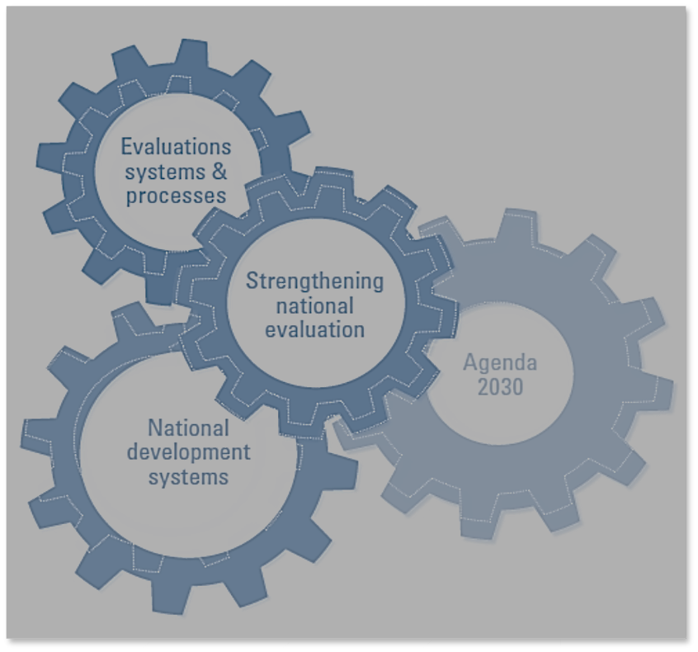





There are several pressing factors that undermine SDG/national development evaluations
Data and analysis gaps
Constraints in the use of evaluations
Evaluation
capacity challenges
Evolving accountability mechanisms
Weak institutional
capacities
Lack of enabling political environment
Limited budget for evaluations
Human resource
challenges
Less demand from policy processes

Slide 10
What does the ‘Online Self-assessment Tool For National Evaluation Diagnostics’ offer?

Slide 11
Using a non prescriptive approach, the Tool aims to facilitate institutional self-assessment of evaluation
Enables UNPACKING of national evaluation requirements
OUTLINES a series of steps to assess key evaluation bottlenecks and needs
Enables a systematic approach to DETERMINE PATHWAYS for Strengthening national evaluation
FLEXIBLE to use at different level of government

Slide 12
Tool will facilitate diagnostics of enabling environment and organizational capacity
Development of national evaluation capacities entails efforts to integrate, strengthen, and connect three interlocking elements — National systems of government, Agenda 2030, and evaluation

Slide 13
Modules recognize the complexity of national evaluations; address key areas of national evaluation capacities
Access the Online Tool at:
https://nec.undp.org/
http://web.undp.org/evaluation/national-evaluation-diagnostics/
Notes:
The Modules are self-explanatory and need limited technical expertise to use them.
The Modules are based on the recognition that the need for structured evaluation practice cannot be universally assumed

Slide 14



Module 1 facilitates understanding and building enabling environment for national evaluation systems
Take stock of existing national evaluation policies and institutional arrangements
Assess the need for evaluation
Map needs of the stakeholders
Identify paths that would facilitate and accelerate national evaluation capacities
Build constituencies and partnerships
Collaborate with constituencies with comparable objectives
Notes:
© Copyright PresentationGo.com – The free PowerPoint template library

Slide 15





Module 2 enables taking stock of links between national systems, evaluations, and the SDGs
Mainstreaming the SDGs into entities at national and subnational levels
Explore coordination mechanisms and their links to national evaluation systems
Take stock of national prioritization of SDGs
Identify areas of convergence national and sectoral development objectives
Notes:
© Copyright PresentationGO.com – The free PowerPoint template library

Slide 16
Module 3 provides instruments for strengthening and institutionalising evaluation capacities
Updating mandates and policies
Assigning responsibilities and resources for evaluation
Mainstreaming evaluation at the ministerial, sector and subnational level
Assigning responsibilities and resources for evaluation capacity development, use, follow-up of evaluation
Promoting core development values in evaluations
Strengthening data and statistics
Notes:
© Copyright PresentationGO.com – The free PowerPoint template library

Slide 17




Module 4 measures needed to integrate SDG principles and approaches in evaluations
Endorsing and promoting SDG approaches
Forming partnerships for performance data
Evaluating horizontal and vertical policy coherence
Establishing systems to manage intersectoral/joint evaluations
Establishing multi-stakeholder and multi-institutional approaches
Promoting inclusiveness and equity

Slide 18
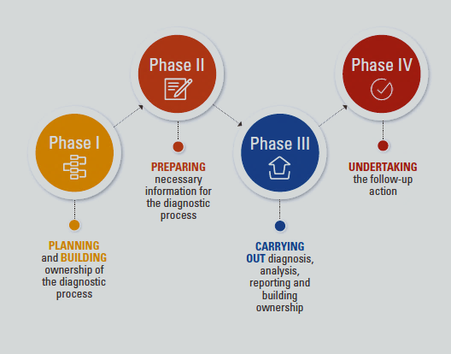
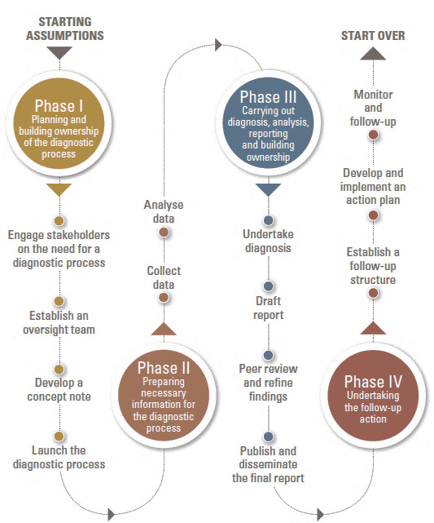
Commitment at the highest level in the government/ institution(s) is critical during the diagnosis and setting evaluation milestones

Slide 19
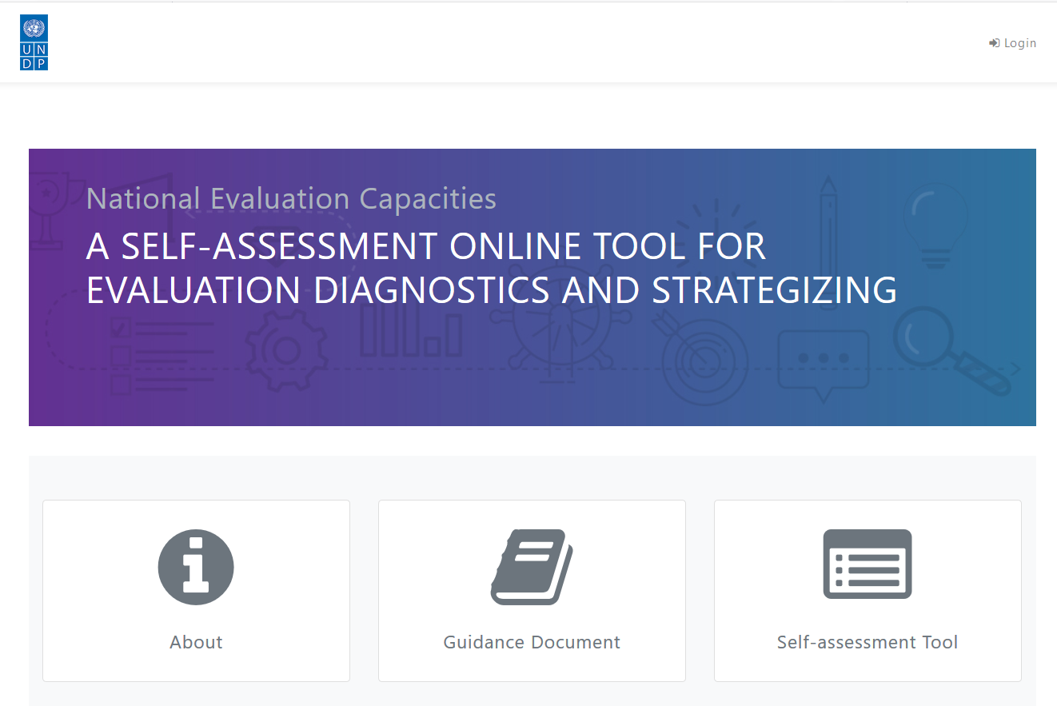
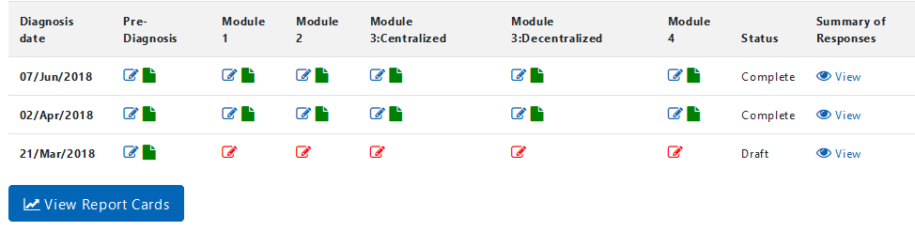
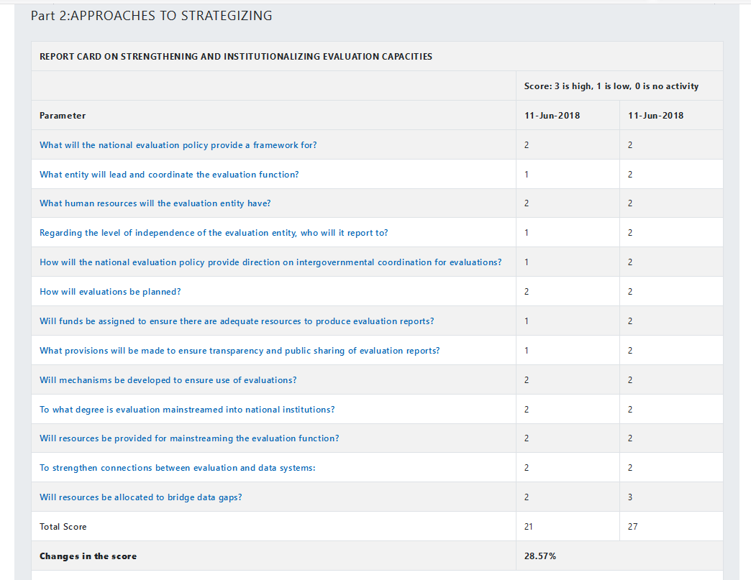
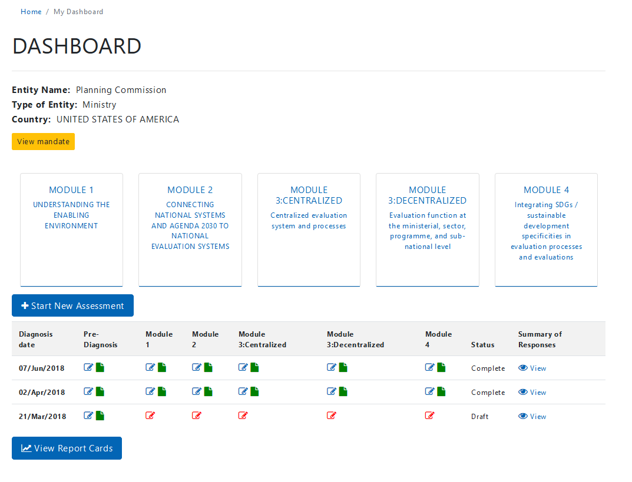
National Evaluation Diagnostics Online Tool
Report card comprises of two components:
Diagnostics
Approaches and strategizing
.

Slide 20


Access the Online Tool at:
http://web.undp.org/evaluation/national-evaluation-diagnostics/
https://nec.undp.org/
Vijayalakshmi Vadivelu
Senior Evaluation Advisor
1 UN Plaza, 20th floor
New York, NY 10017
www.undp.org/evaluation
Vijaya.vadielu@undp.org
@undp_evaluation
#NECdev

Slide 21
DIAGNOSING NATIONAL EVALUATION STRATEGY OPTIONS
Senegalese experience
Madina Tall, Government of Senegal

Slide 22
Context
Senegal is one of the pilot countries selected by the PNUD to test the online self-assessment tool for national evaluation diagnosis .
Senegal is one of the pilot countries selected by the PNUD to test the online self-assessment tool for national evaluation diagnosis .
Share the Senegalese process for diagnosis and elaborating a national evaluation policy using the online self assessment tool

Slide 23
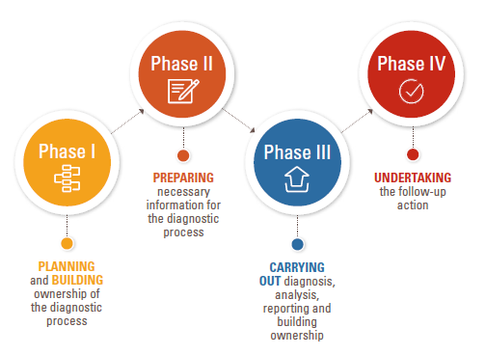
Senegalese process
The process was based on the 4 phases recommended by the online tool
Starting assumptions : The BPE has conducted a readiness assessment for evaluation capacity diagnosis and concluded it can be proceed

Slide 24
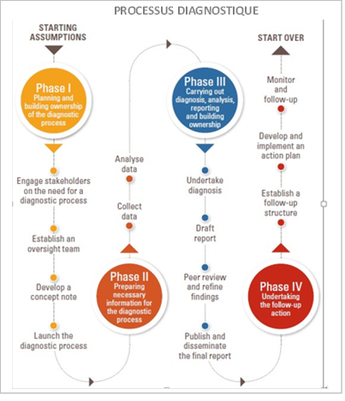
Phase I : steps 1&2
BPE organized a national workshop to launch the process of diagnosis with the main stakeholders:
Introducing the tool
Collecting the stakeholder's opinion on the approach
Setting up a steering committee for monitoring the work plan and validating the reports

Slide 25
Phase I: steps 3 &4
Step 3: Developing and Presenting a Concept Note on Objectives, Methods and Resources Needed
Step 4: Launch the diagnostic process:
quantitative and qualitative surveys : (Questionnaires and interview with key actors).

Slide 26
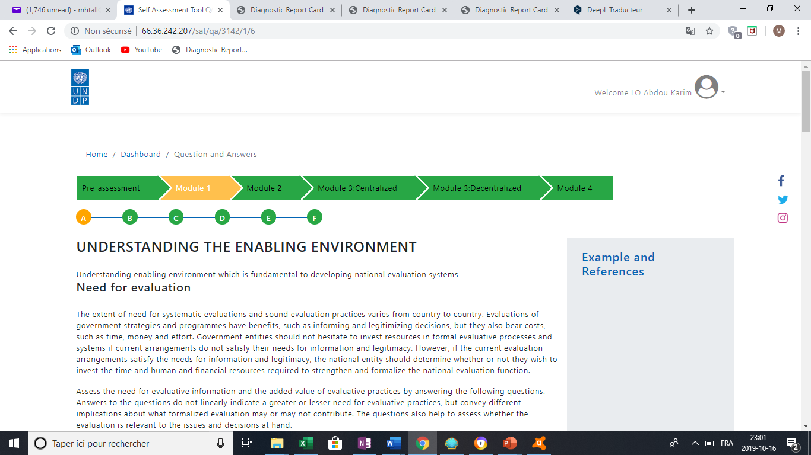
Phase II step 1: collect data
Step 1: Collect data. : our questionnaire was based on the different questions of the 4 modules of the online self assessment tool

Slide 27
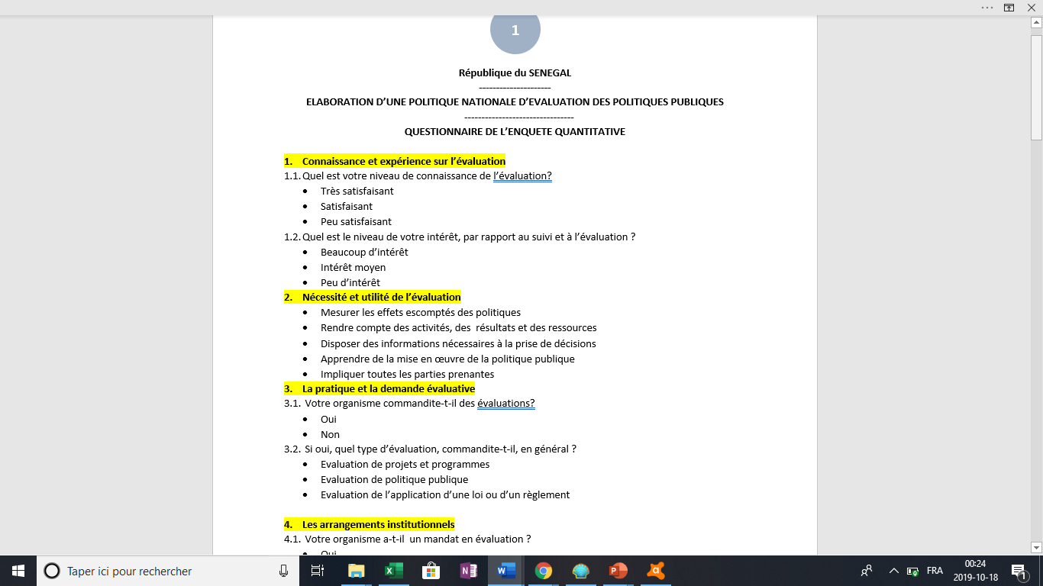
Phase II step 1: collect data
Module 1 : Understanding the enabling environnement
Need for an evaluation
Identify the evaluation needs of key stakeholders
Demand for evaluation
National evaluation policies and institutional arrangements

Slide 28
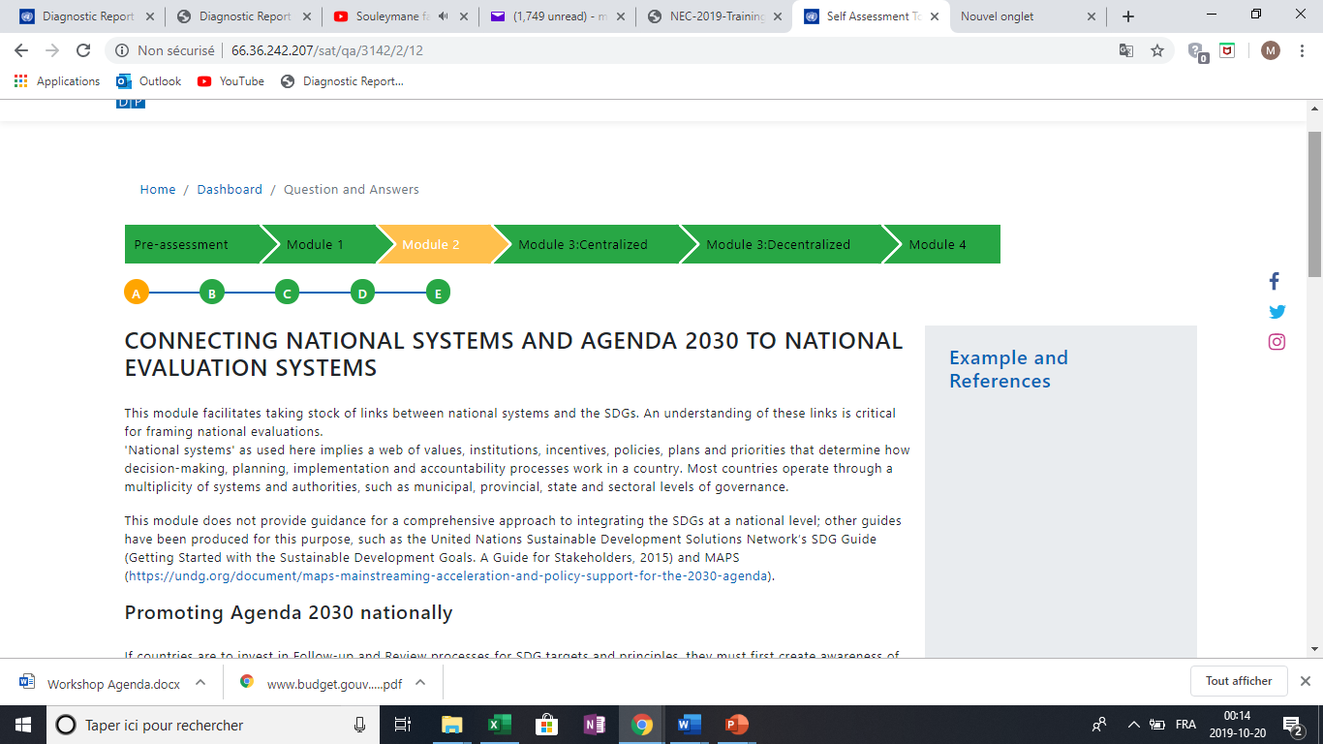
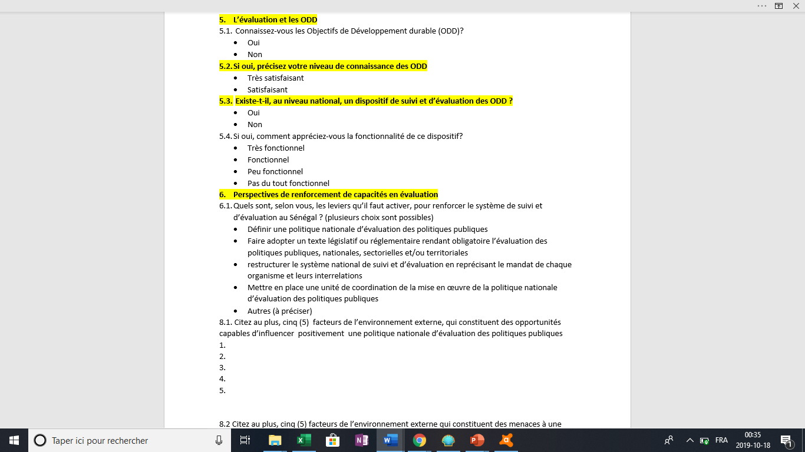
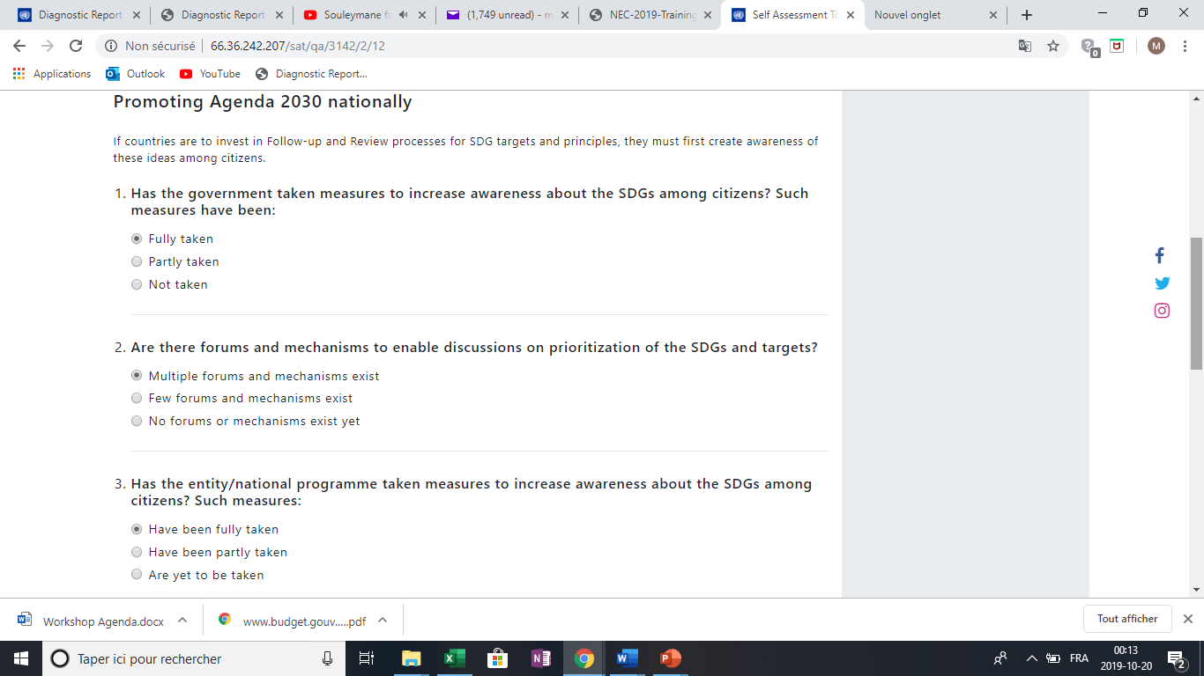
Phase II step 1: collect data

Slide 29
Phase II step 2: analyse data
Step 2: analyze the data : administer the survey to various stakeholders ( Public administration, local authorities , TFP , etc.

Slide 30
Phase III : undertake diagnosis
Diagnosis of evaluation capacities was done by using the four modules of the online tool

Slide 31
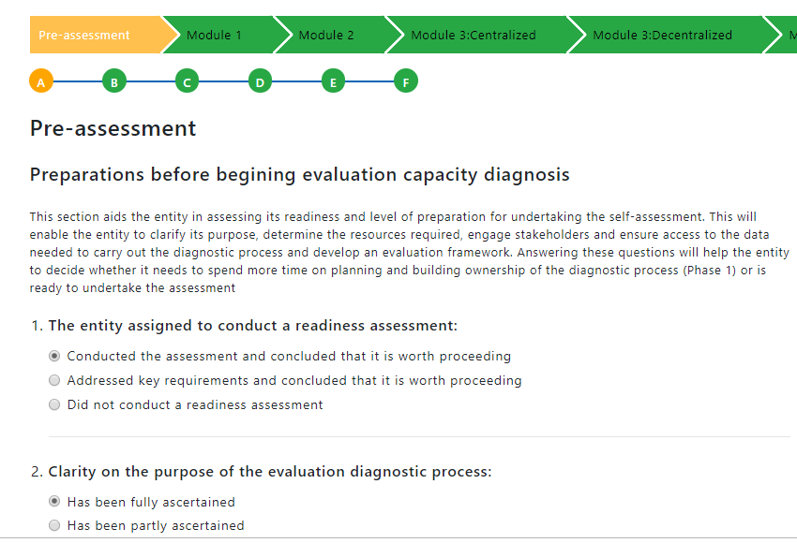
Phase III : undertake diagnosis

Slide 32
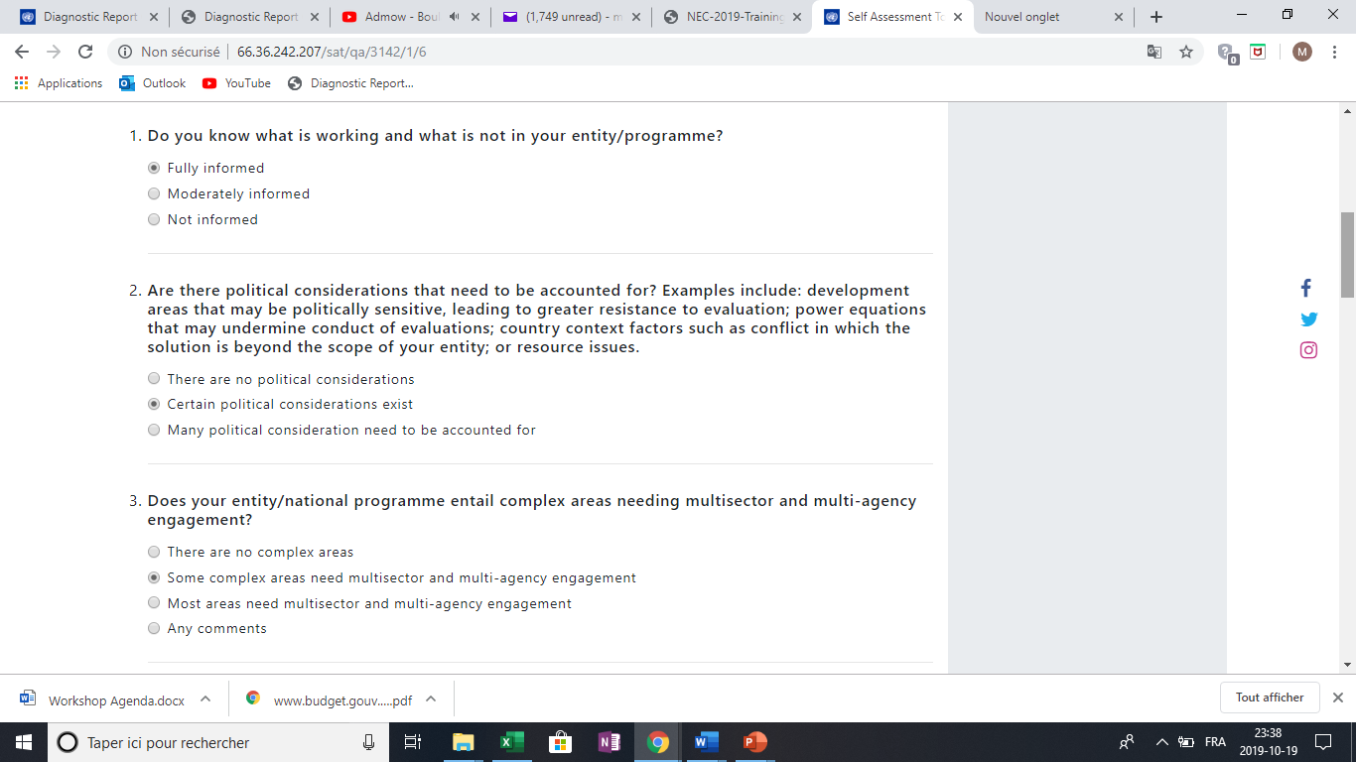
Phase III : undertake diagnosis

Slide 33
Phase III : undertake diagnosis

Slide 34
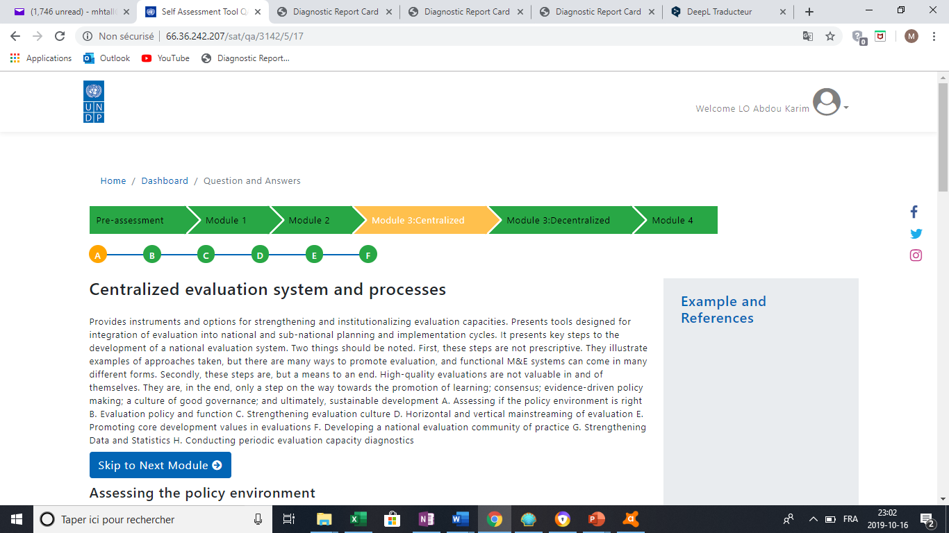
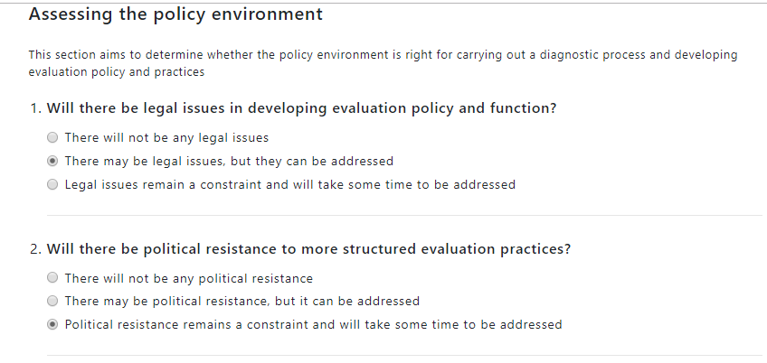
Phase III : undertake diagnosis

Slide 35
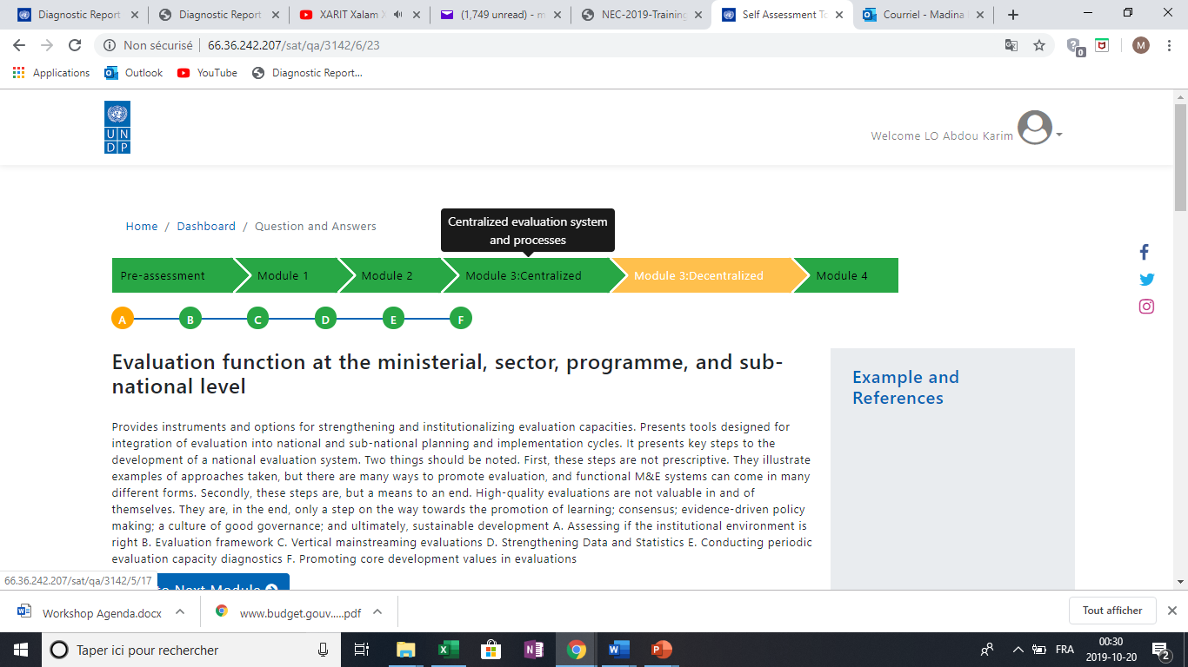
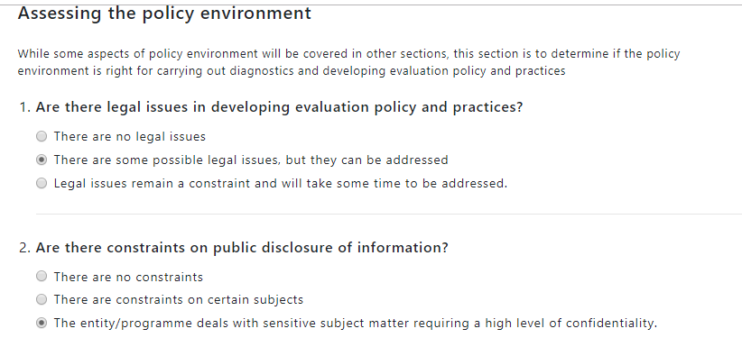
Phase III : undertake diagnosis

Slide 36
Phase III : elaborate the draft report
A combination of the reports generated by the online tool and the data collected by the survey.

Slide 37
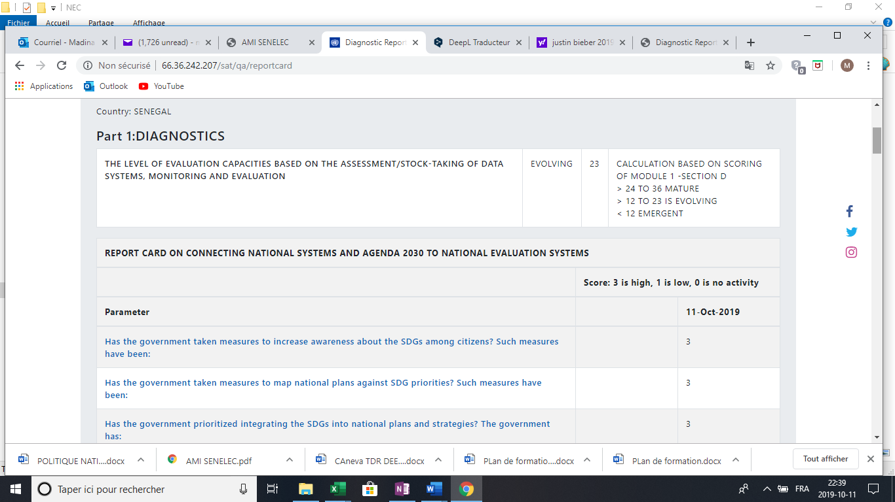
Phase III : the online tool ‘s report
Report Card : Diagnostics
Scoring 23
Evolving level of evaluation capacities

Slide 38
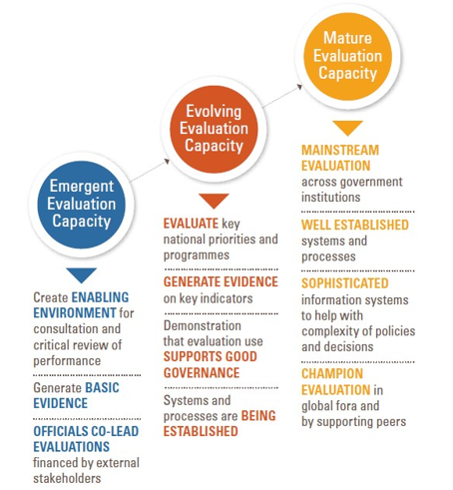
Phase III : the online tool ‘s report
Report Card : Diagnostics
Programmes financed by technical and financial partners are evaluated
No national evaluation policy
Confusion between auditing, inspection, control and evaluation
Absence of budget line dedicated to evaluation
Ex ante evaluation is widely used, as a prerequisite for the inclusion of projects in the investment budget

Slide 39
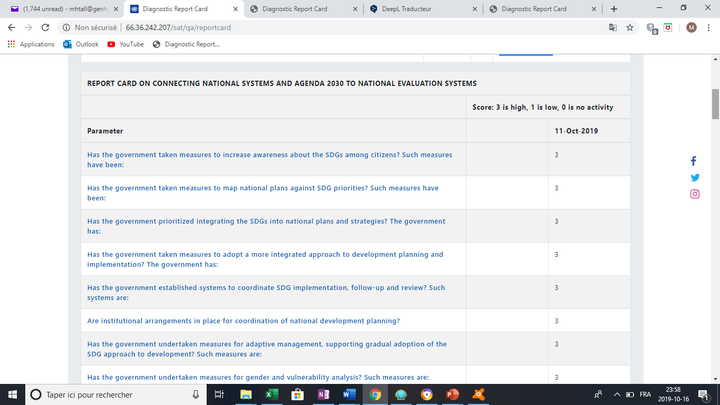
Phase III : the online tool ‘s report
Report Card Module 2: Connecting National Systems and the 2030 Agenda to National Assessment Systems
Integration of the SDGs in the emerging Senegal Plan and into some sectoral policies of the ministries
Annual report on the SDGs implementation
National SDG Committee with strong participation of civil society
Low communication to publicize the SDGs to the public and evaluation actors
lack of dissemination of the SDG follow-up report

Slide 40
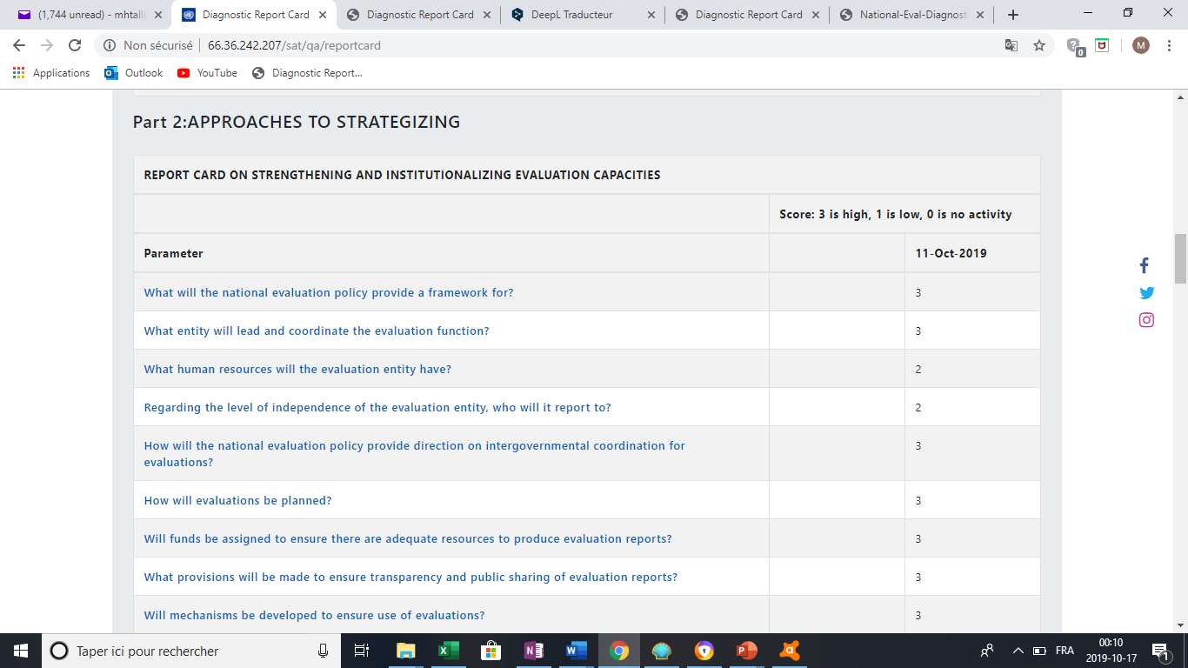
Phase III : the online tool’s report
Report Card Module 3: strengthening and institutionalizing evaluation capacities
Creation of the BOS (Operational office for monitoring and evaluation projects and flagship reforms)
Creation of the BPE to ensure the conduct of public policy evaluations
Setting up monitoring and evaluation units in all ministries
Creation of the Commission for Monitoring and Evaluation of Public Policies and Programs hosted by the Presidency.

Slide 41
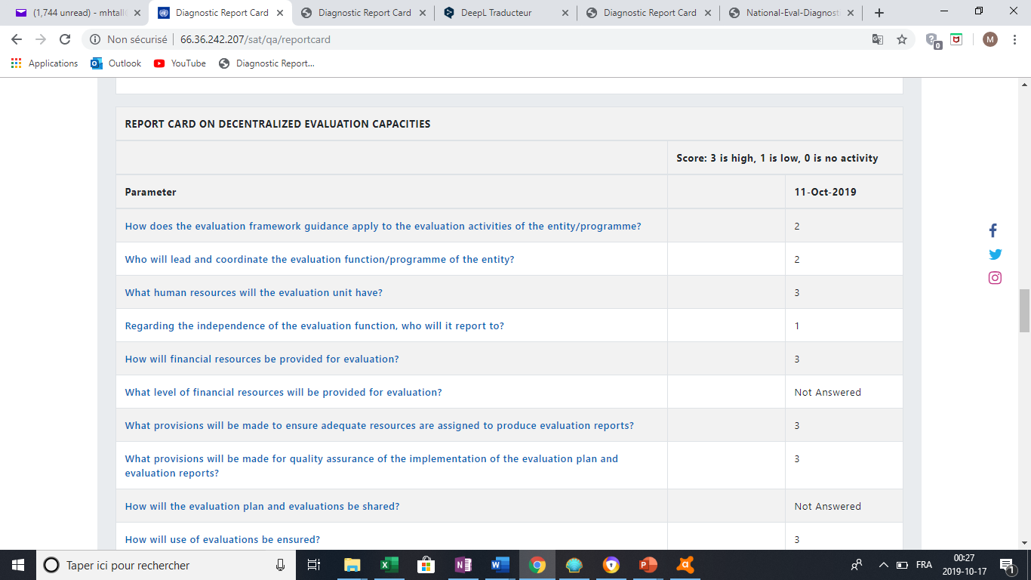
Phase III : the online tool’s report
Report for module 3: Decentralize the evaluation function at ministerial, sectoral, programmatic and sub-national level
Setting up monitoring and evaluation units in all ministries
Setting up sectoral policy letter for all ministries
Creating monitoring office evaluation in all agencies and programs
Quarterly review of indicators for all ministries
Annuel review performance for all ministries according their targeted SDG

Slide 42
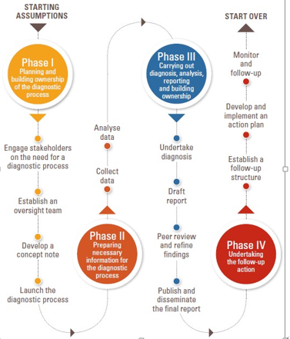
Phase IV: undertaking the follow-up actions
Workshop scheduled on November 05 to move forward on these steps
Steering committee have to the clarify roles and responsibilities of different actors
Finalise and adopt the draft of national policy evaluation

Slide 43
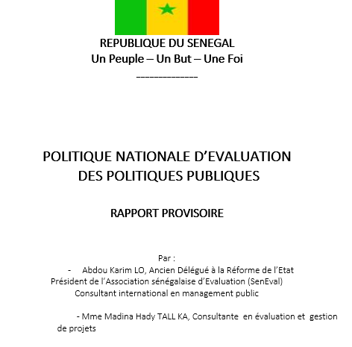
Phase IV: undertaking the follow-up actions
Validate and adopt the national evaluation policy

Slide 44
An action plan will be elaborated in collaboration with the stakeholders for a better appropriation and to facilitate its implementation
RESULTATS | INDICATEURS | ACTIVITES | DESCRIPTIONS | RESPONSABLES | COUTS PREVISIONNELS (en millions de F CFA) |  |  |  |  | TOTAUX
 |  |  |  |  | 2020 | 2021 | 2022 | 2023 | 2024
Extrant 1.1 : |  | A1.1.1. :
 |  | A1.1.2. :
 |  | A1.1.3. :
TOTAL E1.1.
Extrant 1.2 : |  | A1.2.1. :
 |  | A1.2.2. :
 |  | A1.2.3. :
 |  | A1.2.4. :
TOTAL E1.2.
Extrant 1.3 : |  | A1.3.1. :
 |  | A1.3.2. :
 |  | A1.3.3. :
 |  | A1.3.4. :

Slide 45
Conclusion
The tool allowed us to have a structured approach to assess evaluative capacities, link with the ODDs and develop a draft national evaluation policy
A Translation of the tool was carried out for the stakeholders
The steering committee will be train in the tool after the UNDP workshop and the validation of the final report
A second evaluation will be made after the adoption of the national policy and implementation in order to see the evolution of the results after the baseline situation (evaluation level)

Slide 46
GROUP DISCUSSION
What are the key country specific requirements?

Slide 47
Key questions for the discussion
What are the key contextual factors that need consideration while developing national evaluation framework?
At which level evaluation capacity should be prioritized?
What are the SDG specificities national evaluation should prioritize?

Slide 48
NAVIGATING THE TOOL

Slide 49
National Evaluation Diagnostics: Online Tool
To start diagnostic:
Click on ‘Self-assessment Tool’
→ Create Profile
Access the Online Tool at: http://web.undp.org/evaluation/national-evaluation-diagnostics/

Slide 50
Dashboard will be accessible through login. Dashboard enables:
Starting new diagnostics
Access ongoing or past diagnostics
Access Summary Report of each Module
Access Report Cards
Click here to start new diagnostic
Click here view complete summary of responses
Click here view comparative report

Slide 51
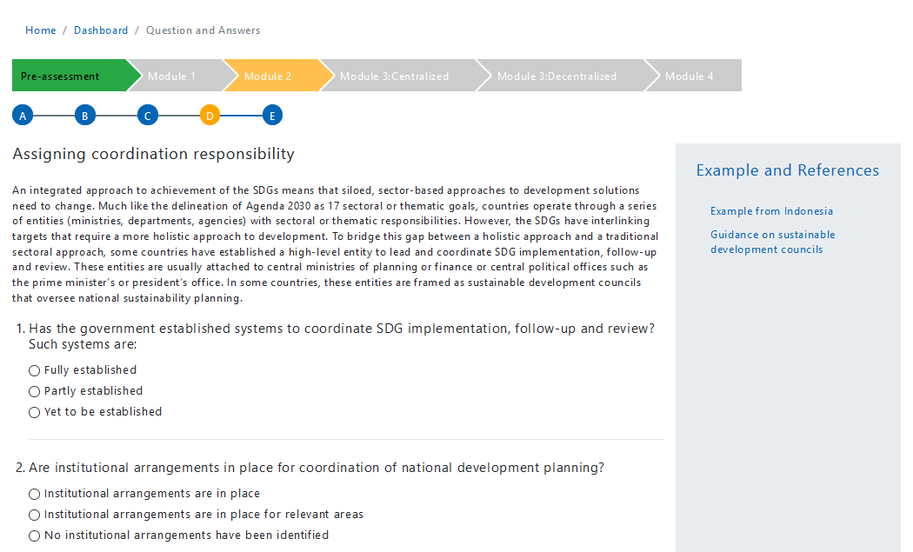
Diagnostic process is comprised of 4 Modules
Navigation tool bar allows you to move between Modules
Navigation bar is color coded to show status of completion: green (complete), grey (incomplete) and orange (current)
Some of the sections within each Modules have pop-up links to examples for your reference

Slide 52
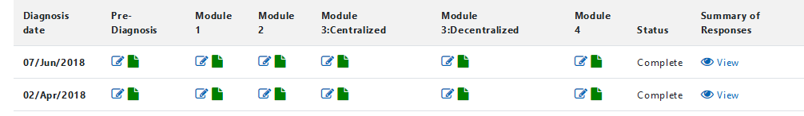
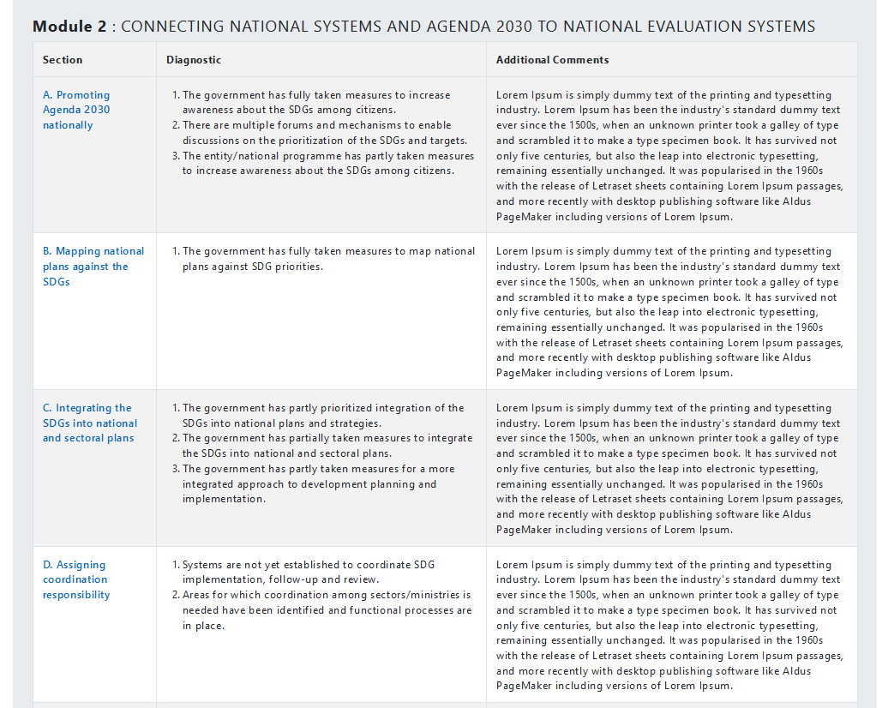
SUMMARY OF RESPONSES
Each Module will produce a Summary of Responses
Provides your responses to each individual parameter and additional comments provided per section within each Module
The user can click on the section title in the Summary Report to navigate back to the section to update/revise response

Slide 53


Report card enables to track progress in national evaluation capacities over a period of time
Diagnostics Report Card
Provides a bench mark on the enabling environment, capacities, and resources assigned for evaluation
An assessment of the development data and statistics available
Strategizing Report Card
Enables to set realistic targets for assessment of progress
The targets are intended to reflect the policy, institutional and resource realities
Enabled follow up progress made

Slide 54
REPORT CARD
Report card is comprised of two components:
  Diagnostics
  Approaches and strategizing
You are view the weighted scores received per component for each diagnostic assessment
If there are more than one diagnostic available, it also provides percentage change from last to current diagnostic

Slide 55
GROUP DISCUSSION

Slide 56
What are the big messages to address evaluation capacity challenges?

Slide 57
WAY FORWARD

Slide 58






Pilot rollout has been encouraging, particularly commitment of the government champions
Pilot rollout and engaging governments
Senegal, Uganda, Nepal. Country rollouts will be pursued
2018-2019
Dissemination initiatives
Engaging UN agencies and other international agencies in reaching out to national institutions
Partnerships with UN evaluation offices will be concretized. Specific efforts being taken to promote the tool among UN agencies and other international and bilateral agencies to increase government reach out
Engaging evaluation networks
Rollout to be pursued through evaluation networks
Twining with UN/ UNDP SDG related strategizing /monitoring initiatives
Synergies of the Tool and UN SDGs Mainstream, Acceleration and Policy Support (MAPS) pursued through twining efforts to provide more holistic support on SDG mainstreaming and analytics including evaluation
Training and
networking
Training workshops and setting up communities of practice

