Slide 1


Knowledge
Brokers
www.knowledgebrokers.edu.pl
Notes:
Desola preise -

Slide 2
CHALLENGE

Slide 3
MISSION OF PUBLIC INTERVENTIONS
Create favorable environment for development
Deliver the services that fulfill needs of the citizens
Guide citizens towards socially desirable behaviors

Slide 4
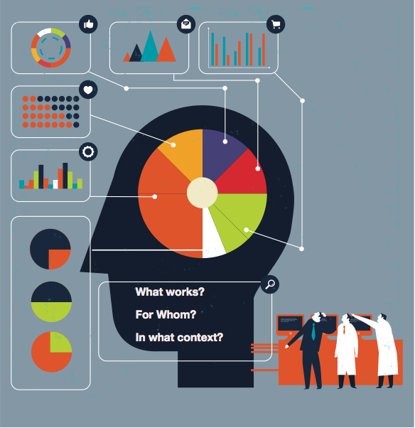

Slide 5
Notes:
KNOWLEDGE DELIVERY PROCESS: The independent Evaluation Department
The core objective of evaluation is to contribute to the Bank’s legitimacy, relevance and to superior institutional performance. To achieve its core objective, the Evaluation Department fulfills two primary functions:
It provides a critical instrument of accountability through objective, evidence based performance assessment of outputs and outcomes relative to targets; and
It contributes to institutional learning for future operations by presenting operationally useful findings.
KTO JEST STAKEHOLDEREM: państwa partycypujące w budżecie EBOiR + EBI +UE
The EBRD is owned by 65 countries from five continents, as well as the European Union and the European Investment Bank. These shareholders have each made a capital contribution, which forms our core funding. Each shareholder is represented individually on the Board of Governors of the EBRD which has overall authority over the Bank.
The Board of Governors delegates most powers to the Board of Directors, which is responsible for the EBRD's strategic direction.
PROPONUJĘ ZADAĆ GRUPIE PYTANIE: CO W PRZYPADKU DZIAŁALNOŚCI EBRD JEST SUKCESEM?
W POLITYCE EWALUACJI MAJĄ ZAPIS: “foster transition towards open market-oriented economies and to promote private and entrepreneurial initiative in… countries committed to and applying the principles of multiparty democracy, pluralism and market economics” – ale to bardziej misja. Pytanie co dla nich oznacza (i jak badać) sukces na poziomie projektów czy inicjatyw (np. wsparcie zabezpieczeń w handlu międzynarodowym) – każdy projekt jest u nich inny. The ultimate and essential focus of evaluation must be on results—outcomes that flow from inputs provided. CZY OPŁACALNOŚĆ FINANSOWA, NAWET JEŚLI TO POŻYCZKI JEST GŁÓWNYM KRYTERIUM?

Slide 6


Slide 7
"One of the diseases of this age is the
multiplicity of books: they both so overcharge
the world that it is not able to
digest the abundance of idle matter that
is everyday hatched and brought forth
into the world ."
Notes:
Derek de Solla Price, quotes
the following statement. attributed to Barnaby
Rich. in the year 1613 A.D.:

Slide 8
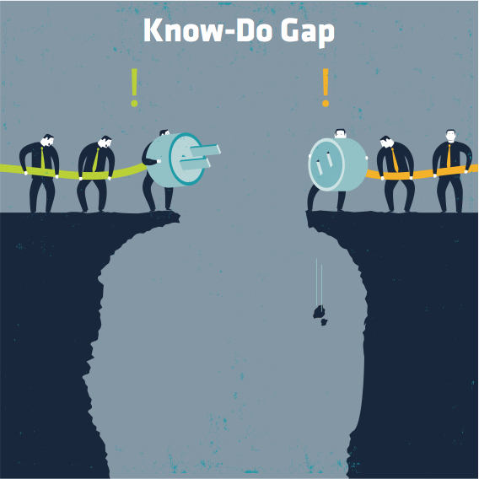
Notes:
Szkorbut – a cytrusy
W 1617 r. chirurg-generał John Woodall raportował, że cytrusy zapobiegają szkorbutowi (SCURVY)
Po 136 latach dr James Lind potwierdził to eksperymentem (1753 r.)
Po 42 latach decyzja brytyjskiej admiralicji o obowiązkowych cytrusach na statkach (1795 r.)
W sumie zajęło to brytyjskiej flocie 178 lat.
James Lind is remembered as the man who helped to conquer a killer disease. His reported experiment on board a naval ship in 1747 showed that oranges and lemons were a cure for scurvy. But why did the Royal Navy, which celebrates the tercentenary of Lind's birth on 4 October 2016, take nearly half a century to act on his findings?
The explorer Sir Richard Hawkins recorded in 1622 that "sower lemons and oranges" were "most fruitful... I wish that some learned man would write of it".
More than a century later, a learned man fulfilled that wish, with a text which earned him a place in scientific history.
James Lind was the son of an Edinburgh merchant and became a medical apprentice in the city before joining the Royal Navy as a surgeon's mate in the late 1730s.
His service allowed him to observe the effects of scurvy at first hand.
In 1747, on board HMS Salisbury, he carried out one of the first controlled clinical trials recorded in medical science.
He took 12 men suffering from similar symptoms of scurvy, divided them into six pairs and treated them with remedies suggested by previous writers:
a quart of cider a day
25 drops of elixir of vitriol, three times a day
half a pint of sea-water a day
a nutmeg-sized paste of garlic, mustard seed, horse-radish, balsam of Peru, and gum myrrh three times a day
two spoonfuls of vinegar, three times a day
two oranges and one lemon a day
By the end of the week, those on citrus fruits were well enough to nurse the others.
Dr Lind's "Treatise of the Scurvy", containing a celebrated review of literature on the disease, appeared in 1753, by which time he was a practising physician in Edinburgh.
He prided himself that he had conquered a condition which "during the last war, proved a more destructive enemy, and cut off more valuable lives, than the united efforts of the French and Spanish arms".
But it was not until 42 years later that the Admiralty first issued an order for the distribution of lemon juice to sailors. Historians still debate why it did not act upon Dr Lind's discovery earlier.
http://www.jameslindlibrary.org/illustrating/articles/who-was-james-lind-and-what-exactly-did-he-achieve

Slide 9
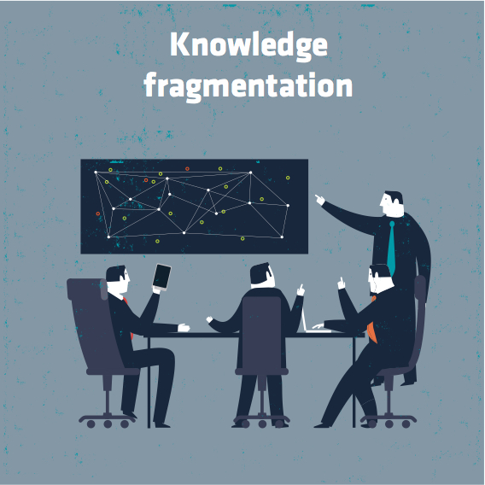
Notes:
huge numeber of reports on the same issue: each scientist, think thank, research center use different perspective, focus on different issues. Let’s take the extensive wave of migration that became a problem once the war in syria became more intensive. You may find reports concetrated solely on women abuse problem, cultural differences, people traffic ect. The purpose as well as the adresse of studies really matters and shape therir content (you may have sociological perspective, health care, children protection, economic perspective etc.). Also the reports’ content differs in terms of language used, data provision (big data analyses vs case studies or ethographical observation)

Slide 10
SOLUTION

Slide 11
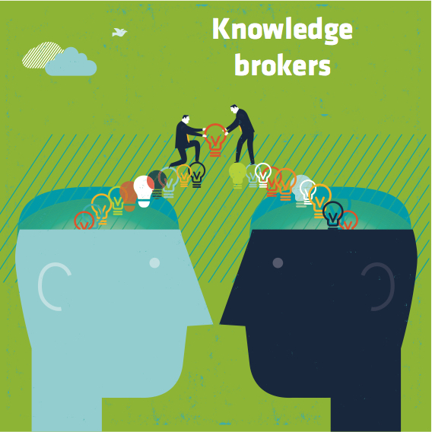
Notes:
A knowledge broker is an intermediary (an organization or a person), that aims to develop relationships and networks with, among, and between producers and users of knowledge by providing linkages, knowledge sources, and in some cases knowledge itself, (e.g. technical know-how, market insights, research evidence) to organizations in its network.
While the exact role and function of knowledge brokers are conceptualized and operationalized differently in various sectors and settings, a key feature appears to be the facilitation of knowledge exchange or sharing between and among various stakeholders, including researchers, practitioners, and policy makers.
A knowledge broker may operate in multiple markets and technology domains. ^{[1]} The concept of knowledge brokers is closely related to the concept of knowledge spillovers.
In the fields of public health, applied health services research, and social sciences, knowledge brokers are often referred to as bridges or intermediaries ^{[2]} ^{[3]} ^{[4]} ^{[5]} that link producers of research evidence to users of research evidence as a means of facilitating collaboration to identify issues, solve problems ,^{[6]} and promote evidence-informed decision making (EIDM), which is the process of critically appraising and incorporating the best available research evidence, along with evidence from multiple other sources into policy and practice decisions ^{[7]} ^{[8]} ^{[9]} ^{[10]} ^{[11]} ^{[12]} .^{[13]} Using a knowledge broker to facilitate the exchange of knowledge and the adoption of insights is one strategy in the broader field of Knowledge Management.
Knowledge brokers facilitate the transfer and exchange of knowledge from where it is abundant to where it is needed, thereby supporting co-development and improving the innovative capability of organizations in their network. In the field of public health, knowledge brokers facilitate the appropriate use of the best available research evidence in decision making processes, enhancing individual and organizational capacity to participate effectively in evidence-informed decision making. In this setting, knowledge brokers promote research use. ^{[7]} ^{[14]}
Knowledge brokers are typically involved in the following activities below:^{[1]}
Assessing barriers and establishing access to knowledge (i.e. screening and recognizing valuable knowledge across organizations and industries)
Learning (e.g. internalizing experiences from a diverse range of perspectives including those of industry, technology or health disciplines)
Linking of separate knowledge pools (e.g. through joint research, consulting services, and developing a mutual understanding of goals and cultures
Supporting knowledge and skill development
Facilitating individual/organizational capacity development for knowledge use (e.g., assessing current knowledge use, absorptive and receptive capacity, and readiness for change)
Implementing knowledge in new settings (e.g. combining existing knowledge in new ways)

Slide 12
ACTIVITIES of BROKERS
Identifying knowledge needs of users
Acquiring credible knowledge
Feeding knowledge to users
Accumulating knowledge over time
Building networks with producers and users of knowledge
Promoting evidence-based culture
Managing time and resources
How to learn those skills in practice BUT without bearing the costs of mistakes that are part of the learning process?

Slide 13
LEARNING

Slide 14
LEARNING CYCLE
Experience
Reflection
Theory
Application
Source: Kolb (1984)
Notes:
1. Concrete Experience - (a new experience of situation is encountered, or a reinterpretation of existing experience).
2. Reflective Observation (of the new experience. Of particular importance are any inconsistencies between experience and understanding).
3. Abstract Conceptualization (Reflection gives rise to a new idea, or a modification of an existing abstract concept).
4. Active Experimentation (the learner applies them to the world around them to see what results).
Effective learning is seen when a person progresses through a cycle of four stages: of (1) having a concrete experience followed by (2) observation of and reflection on that experience which leads to (3) the formation of abstract concepts (analysis) and generalizations (conclusions) which are then (4) used to test hypothesis in future situations, resulting in new experiences.
Learning Styles
Kolb's learning theory (1974) sets out four distinct learning styles, which are based on a four-stage learning cycle (see above). Kolb explains that different people naturally prefer a certain single different learning style. Various factors influence a person's preferred style. For example, social environment, educational experiences, or the basic cognitive structure of the individual.
Whatever influences the choice of style, the learning style preference itself is actually the product of two pairs of variables, or two separate 'choices' that we make, which Kolb presented as lines of axis, each with 'conflicting' modes at either end:
A typical presentation of Kolb's two continuums is that the east-west axis is called the Processing Continuum (how we approach a task), and the north-south axis is called the Perception Continuum (our emotional response, or how we think or feel about it).

Slide 15
GAME

Slide 16
GAME in a NUTSHELL
You manage an evaluation unit in a region for twelve months.
During that time, four different public interventions are implemented in your region.
At different stages of those interventions, different decision-makers express different knowledge needs.
Your mission is to provide credible knowledge, to the key user, on the right moment and in an accessible way.
Notes:
Wziąć z tłumaczenia gry!!!!

