Slide 1
Navigating Spectacular Ambitions: The Importance of Thinking Evaluatively in Challenging the Sustainable Development Goals of “No One Left Behind” UNDP National Evaluation Capacity Conference 2019 October 20th 2019
Sanjeev Sridharan
Bill and Melinda Gates Foundation
April Nakaima
University of Toronto

Slide 2
Thinking of complexity
Four Stories: Rethinking the role of evaluation
No person left behind
Planning for sustainability/
Planning an evaluation
Looking forward

Slide 3
Organisation
An Example from India
Questions to focus attention to evaluating No one left behind
Evaluation Stories: Moving beyond impacts
Planning for sustainability
No one left behind: Evaluation’s role
Thinking about your interventions
/Exercises
Scope

Slide 4
1. Scope of class
Clarify what is different about evaluating SDGs
How can evaluations help enhance the success of SDGs: locating evaluations in SDG space
Identify the navigational function of evaluation
Identify new concepts that are needed to evaluate SDGs
Rethink your intervention in light of the ideas discussed in the class

Slide 5
2. No one left behind
“This Agenda is a plan of action for people, planet and prosperity…... As we embark on this collective journey, we pledge that no one will be left behind.”
“Endeavour to reach the furthest behind first”.

Slide 6
No one left behind: Evaluation’s role
What is the evaluation community’s role in ensuring that there is substance to such a claim?
Potential of evaluation to play a navigational role

Slide 8
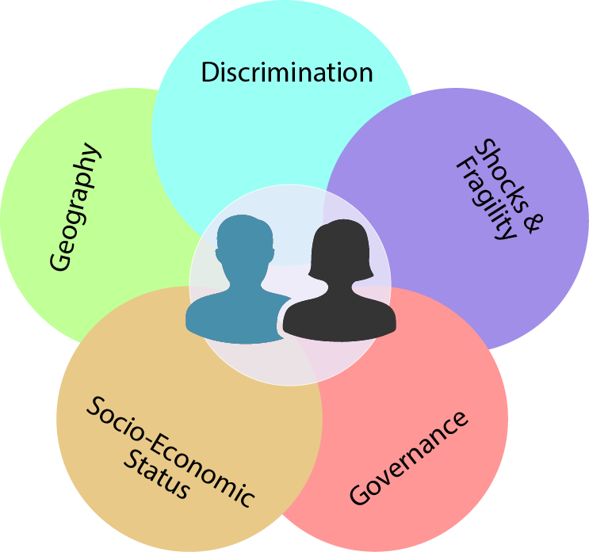
Dimensions that contribute to the problem
People at the intersection of these factors face reinforcing and compounding disadvantage and deprivation, making them likely among the furthest behind.

Slide 9
Thinking about intersectionalities
“Available data across 16 countries found that the most likely to be left behind are women and girls in group rural areas who are born to poor families and belong to a minority ethnic.
This population has had the fewest years of education, the highest under-five child mortality rates and the least progress in human development over the last few decades. In this case, three factors intersect to generate reinforcing deprivations and disadvantages: geography (rural), socio-economic status (income poor families) and identity/discrimination (gender and ethnic minority).
“The more severe the poverty and inequities people experience, the more tightly interwoven and enduring such barriers become and the more vulnerable people become to exploitation and human rights abuses.”

Slide 10
Moving towards solutions: The UNDP View
Examine
Empower
Enact

Slide 11
Examine
“Undertaking integrated “leave no one behind assessments”
Strengthening national capacities to gather, analyze and use disaggregated data and evidence
Working with governments, national human rights institutions and civil society to institutionalize community feedback mechanisms and collect people-centred data;
Enabling the use of all available evidence to better understand and track the SDG progress of the furthest behind and most vulnerable, relative to others;
Mobilizing all levels of government, marginalized communities, stakeholders and partners to fill gaps in disaggregated data with improved surveys and registries, new techniques and technologies, perception surveys, practitioner know-how, participatory mechanisms etc.”

Slide 12
Empower
“Facilitating a rights-based approach to programming that is conducive to meaningful participation….and hold government to account to realize their rights;
Supporting governments to ensure SDG reporting, follow-up and review are people-centred, gender-sensitive, respect human rights and focus on the most vulnerable and furthest behind;
Expanding opportunities for local civil society, national human rights institutions and community networks to engage decision makers, including to build consensus on the policies required to address gaps in SDG progress….;
Strengthening the capacities of civil society actors, and expanding and protecting spaces for people’s participation in political and public life;
Building capacities of national and local authorities to be inclusive, responsive and accountable to their populations, with a special focus on the furthest behind people and places;
Promoting and supporting women and young people’s political participation in parliamentary and electoral processes as candidates and voters.”

Slide 13
Enact
“Integrating the pledge to leave no one behind in SDG strategies, plans and budgets through equity focused and rights-based approaches;
Promoting equity-focused and rights-based laws, policies, public information campaigns and frameworks to address stigma and discrimination;
Encouraging SDG localization to understand and address divergent rates of progress, establish SDG support mechanisms and capacities at central, regional and local levels;
Building accountable, responsive and inclusive local governance systems to reduce inequalities and exclusion;
Supporting governments and other stakeholders to identify, embed and report effectively on locally achieveable and ambitious SDG targets essential to leave no one behind;
Promoting, supporting and learning from policies and interventions to improve the opportunities and capabilities of the furthest behind people, groups and communities, and respective governments; and
Assessing options to finance leave no one behind policies and interventions”

Slide 14
Some obvious evaluation questions
What are tell-tales sign of a system of intervention in which there is a focus on ‘no one is left behind’?
Are the complex set of ‘unmet needs’ being met?
Are intersections of risk categories being considered?
What are we evaluating? “We should not be in the business of selling solutions but in the business of solving problems”

Slide 15
Challenges
The problem of voice
The problem of adaptation
The problem of space to understand unmet need
The problem of lack of design space
The problem of time
The problem of commissioning
The problem of evaluation roles

Slide 16
Leaving ‘no one behind’: What is evaluation’s role in being serious about this?
Evaluating Program Proposals/Program Planning
Implementation heterogeneity
Developmental role
Measurement and studying change

Slide 17
3. QUESTIONS TO SHARPEN EVALUATION’S ROLE IN ‘NO PERSON LEFT BEHIND’

Slide 18
a) Theory of change vs. Framework of equities
What is a minimally sufficient description of an intervention that is serious about impacting equities? What is a good enough program theory focused on addressing equities?
What is the level of description that promotes action?
Segmentation of actions
Real-time progress markers

Slide 19
b) Integrating evaluation with monitoring
Rules for prioritizing evaluations
A strategic approach to evaluation
What is a learning framework that can help guide such an integration?

Slide 20
c) Understanding the realism of goals
Timelines and trajectories
Relationship between the goals
Towards an ecology of indicators: What is the relationship between the domains of indicators? Which indicators matter (drivers) in which contexts?

Slide 21
d) Understanding variations in trajectories of outcomes across contexts
Contexts, mechanisms and outcomes
Anticipated heterogeneous trajectories across contexts: How can we learn from the variations in trajectories of indicators across contexts?

Slide 22
e) Towards a knowledge ecosystem of what works under what contexts
How can there be a process of being more explicit on the areas in which there are uncertainties in achieving the goals? How can there be learning over time?
The role of developmental evaluation
A realist framework: what works under what conditions?
Building a knowledge infrastructure

Slide 23
f) Building capacities to address inequities
What are examples of successful experiments that have built capacities to be responsive to be gender and equity?
Program of work for capacity building
Being specific of the types of capacities that need to be built to address inequities

Slide 24
We need to go beyond a product view of what matters in building capacities
“Existing methodological guidelines (like the one published by UNEG, UN Women and UNICEF) or new country-specific ones to be developed should be disseminated widely within countries to ensure that appropriate EFGR methodologies are used and that evaluation staff are trained in their use.

Slide 25
g) The challenge of intersectionality
What can an international agency really change (on their own) given the challenges of intersectionality? The challenges of social determinants of health
Building a culture of joint and shared ownership.
Leverage of an intervention

Slide 26
h) What does it mean to be equity focused and gender responsive?
What does it mean to be equity focused and gender responsive? How do we actually know if evaluations have achieved this?
What does it mean to be complexity-responsive?

Slide 27
Implications
Commissioning
Multiple phases
Project Proposals
Intersectionalities
Heterogeneous mechanisms
Reductions in gaps
Clarification of roles
Role of Evaluation
Developmental
Navigational
Testing

Slide 28
Activity 1
Please work with a partner (ideally not an evaluator from the same organization)
Briefly discuss a program that you are presently evaluating
Does the program plan to impact inequities?
What do short and long term success mean for this program?
How will results of the program be assessed?
How will you know if your program is successful?
What data do you plan to collect?
28

Slide 29
4. Evaluation Stories: Moving beyond impact evaluations

Slide 30
Purposes of evaluation
Assessing merit and worth
Causal questions
Programme and organizational improvement
Formative evaluation
Oversight and compliance
Knowledge development
Neglected purpose of many evaluations

Slide 31
The Roles of Evaluation
Navigational
Exploration
Theorizing
Improvement
Moving beyond impacts to navigation
An alternative path to learning

Slide 32
One definition of impact evaluation: The search for ‘hard evidence’
Unlike general evaluations, which can answer many types of questions, impact evaluations are structured around one particular type of question: What is the impact (or causal effect) of a program on an outcome of interest?
This basic question incorporates an important causal dimension: we are interested only in the impact of the program, that is, the effect on outcomes that the program directly causes. An impact evaluation looks for the changes in outcome that are directly attributable to the program.
Gertler et al, 2007, World Bank Publication

Slide 33
Why ‘one’ and ‘only’ may not cut it?
“The “hard evidence” from the randomized evaluation has to be supplemented with lots of soft evidence before it becomes usable”
(Rodrik, 2008)

Slide 34
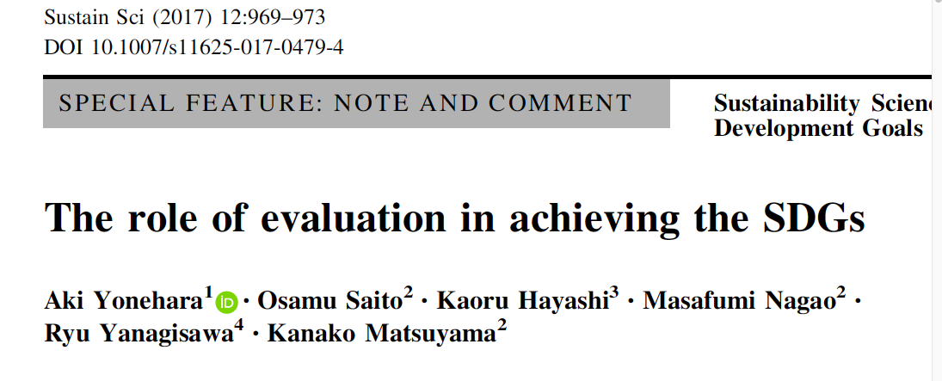
Recommendations

Slide 35
“The SDGs’ 15-year time frame can helpfully be divided into three 5-year phases: a planning phase driven by proactive evaluation and evaluability assessment, an improvement phase characterized by formative evaluation and monitoring, and a completion phase involving outcome and impact evaluations.”
“Under these phases, in order not to miss the SDGs’ fundamental philosophy of ‘‘no one left behind,’’ local relevance must be considered when evaluating SDG programs, particularly to capture the overarching concepts applicable across the 17 goals, such as educational dynamics and resilience.”

Slide 36
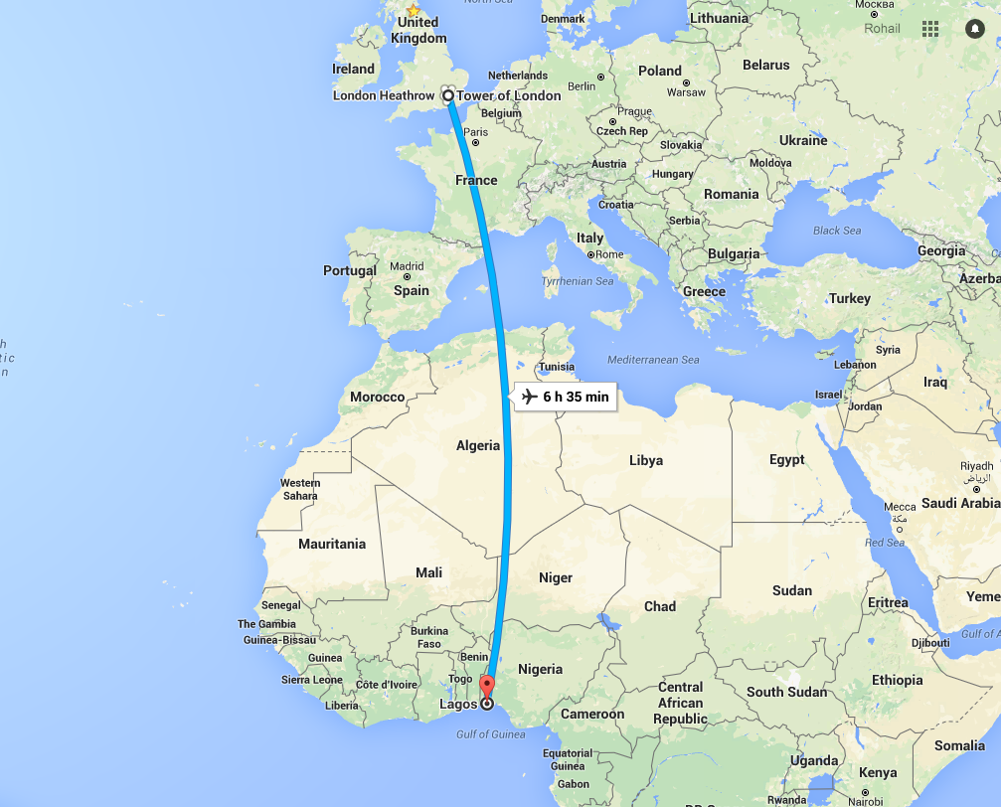
SO WHAT IS THE PROBLEM HERE? THE NEED TO MOVE BEYOND A NARROW FIXATION WITH DATA
The Lagos-London problem

Slide 37
Some Stories on Impacts

Slide 38
1. LESSONS FROM AN EVALUATION OF A MEDIA CAMPAIGN
On love and propensity scoring models

Slide 39
LESSONS
It is never about just about a single method
Methods are fallible
Theory matters
The need to move beyond being an accidental tourist

Slide 40
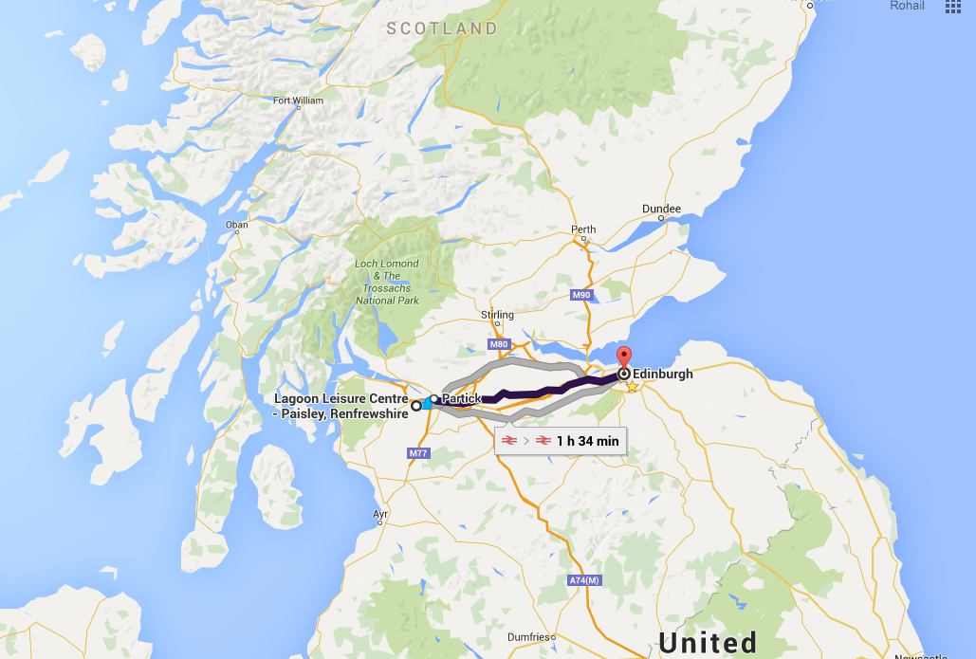
2. LESSONS FROM HAVE A HEART PAISLEY

Slide 41
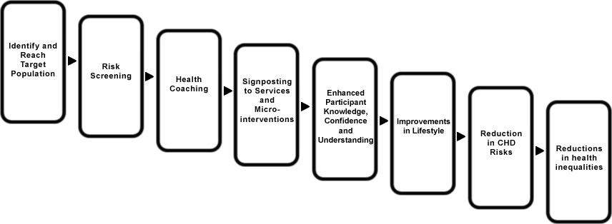
AN EXAMPLE: PRIMARY PREVENTION HAVE A HEART PAISLEY

Slide 42
LESSONS
Adaptation matters
Going beyond protocols and experiments
Dynamics of interventions
Incompleteness of knowledge at the outset

Slide 43
3. LESSONS FROM DANCING WITH PARKINSON’S

Slide 44
LESSONS
Support structures matter
Mechanisms
Heterogeneity is not noise
Scaling up

Slide 45
4. EXPERIENCES WITH THE WHO

Slide 46
LESSONS
The importance of understanding the nature of connections
Issues of power
The attribution/contribution problem
The inequity problem

Slide 47
What does it mean to think of Evaluation’s role for navigating interventions?
Accountability towards learning: learning about what specifically?
Be clear about the multiple roles of evaluation and the need to make transitions
The developmental role of evaluation
Understanding of processes that create change
Measurement needs to incorporate focus on inequities
Plan for sustainable impacts
Take inequities seriously in the theorizing
Understand the absorption capacity of systems
Embed interventions in systems for sustainability
Rethinking the theory of change

Slide 48
Activity 2
Briefly describe the theory of change for an intervention you are evaluating? Is there clarity on how the program will impact health inequalities?
What are some of the underlying contexts that might be conducive for the program to work?
Which disadvantaged groups are targeted by the program?
What mechanisms are needed for the program to reach and impact such groups? Did the program incorporate knowledge of such mechanisms in its design?
48

Slide 49
5. An Example from Uttar Pradesh, India

Slide 50
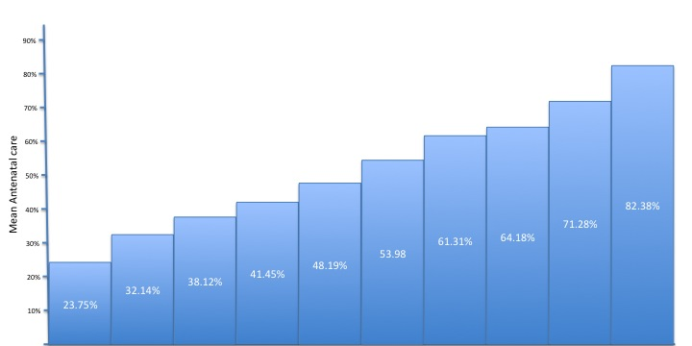
Segments of utilization: An intersectionality analysis
Read Write = No
Own House = no
Read Write = No
Own House = yes
Proportion female <=46.83
Read Write = Yes
Wealth index <=4.48
Own House = yes
Read Write = No
Own House = yes
Proportion female <=46.83
Age >24.5
Proportion female >47.65
Read Write = Yes
Wealth index <=4.84
Own House = yes
Proportion female <=47.62
Wealth index <=0.74
Read Write = No
Own House = yes
Proportion female <=46.83
Age >24.5
Proportion female >47.65
Read Write = No
Own House = yes
Proportion female > 46.83
Age at interview <= 24.5
Read Write = Yes
Wealth index <= 4.84
Own House = yes
Proportion female > 47.62
Wealth index > 0.74
Read Write = Yes
Wealth index <= 4.84
Own House = yes
Proportion female <=47.62
Read Write = Yes
Wealth index <=4.48

Slide 51
Rethinking evaluative focus
How do you assess implementation heterogeneity?
Are key segments being reached?
Are the unmet needs of key segments being addressed?
What is a good enough theory of change?
Heterogeneous mechanisms
Consideration of intersectionalities
How do you measure progress?
Developmental Trajectories
Extreme value statistics

Slide 52
A few realities about interventions
Incompleteness
Support structures needed unclear
Adaptation to context: often opportunistic
Capacities needed unclear at outset

Slide 53
A Case Study of a Maternal, Newborn and Child Health Intervention
India
Uttar Pradesh (Population > 200 million)
Components of the intervention
Technical Support Unit
Nurse Mentoring
First Referral Units
Support for Community Workers
Micro-planning
Health Systems Strengthening

Slide 54
The Challenge
Very different timescales for each component
Impact time frame does not match the evaluation timeframe
Process as outcomes
Learning for action

Slide 55
Measurement, Learning and Evaluation Framework
UTTAR PRADESH – TECHNICAL SUPPORT UNIT, PHASE-2
What are the impacts of the UP-TSU interventions?
Impact Evaluation
Have key processes been implemented with quality? What types of feedback help with course-correction?
How can the MLE for Phase 2 help inform future course of action?
Process Evaluation
Learnings for Action

Slide 56
A learning system for the evaluation of UPTSU Phase 2
Theory of Change
Assumptions
Data
Knowledge Domains
Timeline for decisions and evidence
Impacts
Process
Learning from actions

Slide 57
Theory of influence
TSU
Enhanced capacity
Impacts
Sustained impacts
Individual capacities
Organisational capacities
Improved processes
Building partnerships
with the state
Sustainability processes

Slide 58
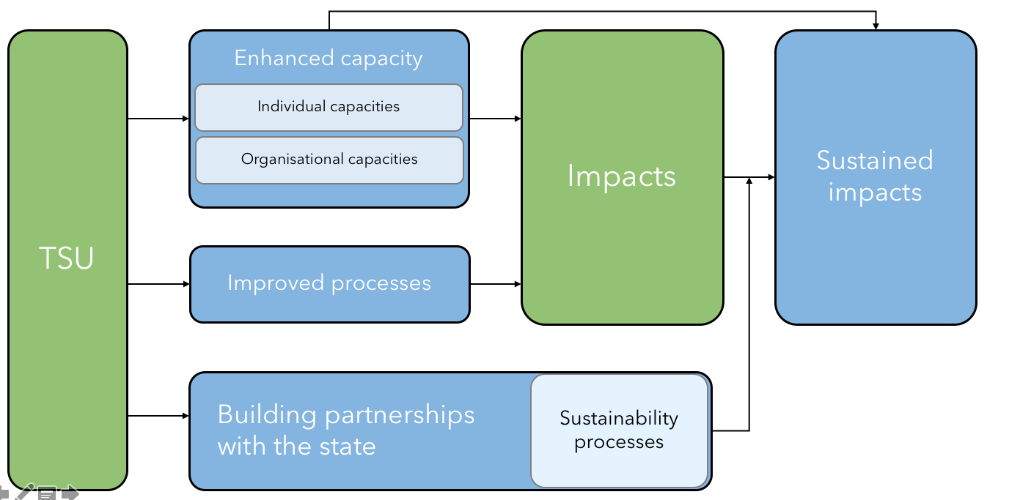
Assumptions
The initial increases of capacities can be sustained even after the TSU has ended
The state would take responsibility of sustaining the gains from the TSU
Enhanced processes can lead to enhanced impacts

Slide 59
Domains
Evidence
generated
TSU
Impacts
month 1
month 30
Decision point
Process
Capacities
Sustainability
Knowledge development

Slide 60
Data
NMR study (June 2019)
Household study (June 2019)
Quality of Care study at facilities (June 2019)
Qualitative study with FLWs (June 2019)
CBTS Rounds (TSU)
Rolling Facility Survey at Facilities (TSU)
TSU
Impacts
Process Evaluation study (Mar 2019, Sep 2019, Mar 2020, Sep 2020)
Continuum of Care study (April 2019, Sep 2019, April 2019)
TSU Program Monitoring Data (Mar 2019, Sep 2019, Mar 2020, Sep 2020)
Process
Capacities
Health System Assessment study (June 2019)
Process Evaluation studies (Mar 2019, Sep 2019, Mar 2020, Sep 2020)
Sustainability
Process Evaluation studies (Mar 2019, Sep 2019, Mar 2020, Sep 2020)
Knowledge development
Synthesis of learnings for action from Process and Summative evaluation studies; RFPs (April 2019, October 2019, April 2020, October 2020)

Slide 61
Navigating learning
Organization of the knowledge domains moving away from one team
Competitive learning — mixed methods
Frequency of interaction//design needs to meet learning needs
Role of web
Sustainability and Spread vs Impact
Rethinking theories of change

Slide 62
Activity 3
Returning back to the program you are evaluating:
How does learning take place about the program processes?
How will you learn about program impacts?
Does the implemented design provide you information on impacts on inequities?
Is there sufficient time for the impacts to be observed?
62

Slide 63
6. The problems of complex interventions: Beginning to locate your intervention in complexity space

Slide 64
What makes an intervention complex? What are the implications for impact evaluation?
A hypothesis: Idealized views of ‘best’ or even ‘appropriate’ evaluation approaches might depend on the complexity of the intervention

Slide 65
Evaluation Approach
Complexity of Intervention

Slide 66
Approach to Evaluation
Community Intervention
System-level Intervention
Clinical Intervention
Complexity of Intervention

Slide 67
Working definition of complex interventions
DYNAMIC:
An intervention that changes over time (both in response to changing context and learnings over time)
HETEROGENOUS, CONTEXT shaped:
Is constrained and shaped by the context (the same intervention will look very different in very different contexts)
COMPLEX INTERVENTIONS ARE:
MULTIPLE INTERACTING COMPONENTS:
These multiple interacting components has the potential of changing the overall intervention over time

Slide 68
QUESTIONS TO DESCRIBE COMPLEX INTERVENTIONS
How hard is it to describe?
How hard is it to create?
What is its degree of organization?

Slide 69
Formative
Developmental
Summative

Slide 70
FEATURES OF COMPLEX INTERVENTIONS (PAWSON ET AL., 2004)
The intervention is a theory or theories
The intervention involves the actions of people.
The intervention consists of a chain of steps
These chains of steps or processes are often not linear, and involve negotiation and feedback at each stage.
Interventions are embedded in social systems and how they work is shaped by this context.
Interventions are prone to modification as they are implemented.
Interventions are open systems and change through learning as stakeholders come to understand them.

Slide 71
SYSTEM DYNAMIC APPROACHES (STERMAN, 2006)
Constantly changing;
Governed by feedback;
Non-linear, History-dependent;
Adaptive and evolving;
Characterized by trade-offs;
Policy resistance: “The result is policy resistance, the tendency for interventions to be defeated by the system’s response to the intervention itself.”

Slide 72
An Intriguing Problem of Complex Interventions: Surprising Anticipated Trajectories of Impacts

Slide 73
Notes:
Ditch e and f

Slide 74
The reality of our understanding of trajectories
“Specifically, I will argue that, in virtually all sectors, the development community has a weak (or at best implicit or assumed) understanding of the shape of the impact trajectories associated with its projects, and even less understanding of how these trajectories vary for different kinds of projects operating in different contexts, at different scales and with varying degrees of implementation effectiveness; more forcefully, I argue that the weakness of this knowledge greatly compromises our capacity to make accurate statements about project impacts, irrespective of whether they are inspired by ‘demand’ or ‘supply’ side imperatives, and even if they have been subject to the most deftly implemented randomised trial.”

Slide 75
Temporary-Gradual
Permanent-Gradual
Temporary-Abrupt
Permanent-Abrupt

Slide 76
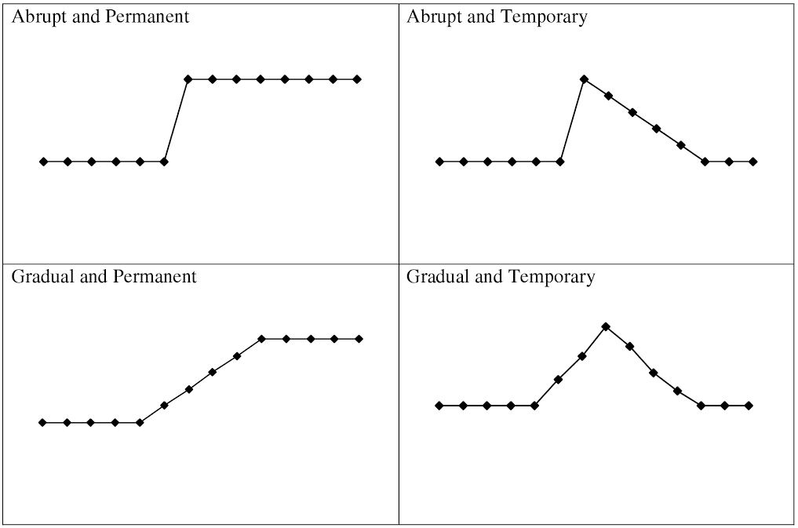

Slide 77
A STRANGE PARADOX: THE LOGIC OF AN EVOLUTIONARY STRATEGY
Box et al (1978, p. 303):
... the best time to design an experiment is after it is finished, the converse is that the worst time is the beginning, when least is known. If the entire experiment was designed at the outset, the following would have to be assumed as known: (1) which variables were the most important, (2) over what ranges the variables should be studied... The experimenter is least able to answer such questions at the outset of an investigation but gradually becomes more able to do so as a program evolves. (p. 303)

Slide 78
WHY DOES DIVERSITY MATTER IN CONDUCTING EVALUATIONs?
LEARNING:
Very different learning needs of different stakeholders
VIEWS of SUCCESS:
Differing views of what constitutes success
DIVERSITY of QUESTIONS:
Heterogeneity of relevant evaluation questions
COMPLEXITY of the INTERVENTION:
Might be hard to focus on all aspects of the intervention. What to focus might depend on what stakeholders value
MIXTURES of DESIGNS:
Varieties of designs need to be integrated to answer the relevant evaluation questions
DIVERSITY of MEASUREMENT:
Diversity in views of what constitute the most important measures

Slide 79
LOOKING FORWARD: EMBRACING COMPLEXITY GENTLY
Heterogeneity is not noise
The need for an evolutionary strategy
Ecology of Evidence
Culture
Context
Incompleteness of knowledge
Dynamics: timeline. trajectories
What is a stable-enough intervention?
Causal Structure of Connections

Slide 80
7. Planning for Sustainability
Sridharan, S. & Nakaima, A. (2019). Till Time (and Poor Planning) Do Us Part: Programs as Dynamic Systems—Incorporating Planning of Sustainability into Theories of Change.
Canadian Journal of Program Evaluation / La Revue canadienne d’évaluation de programme 33.3 (Special Issue / Numéro special), 375–394.

Slide 81
Sustainability can be thought of in three ways:
Sustaining components of the intervention,
Sustaining impacts after the program ends,
Mainstreaming or incorporating active ingredients of the intervention into other programs.

Slide 82
Multiple definitions of sustainability
Five distinct classes of definitions (Lennox, Maher, and Reed 2018):
Continued program activities
Continued benefits
Capacity building
Further adaptation
Recovering costs

Slide 83
The COM-B Theory of Change Model
Developed by John Mayne (2015, 2017)
COM-B = Capabilities, Opportunities, Motivation, Behaviour
Model “postulates that behaviour (B) occurs as the result of interaction between three necessary conditions, capabilities (C), opportunities (O), and motivation (M)” (Mayne, 2017)
Research suggests that the causal package for behaviour change needs to include each of the components: knowledge, skills, aspirations, attitudes, and opportunities. (Mayne, 2015)

Slide 84
The COM-B Theory of Change Model
Improved Wellbeing
Unanticipated Results
Wellbeing
Assumptions
Direct Benefits
Direct Benefits
Assumptions
External Influences
Behaviour Change
Supporting Activities
to help bring about the assumptions, including the enabling environment
Behaviour Change
Assumptions
Capacity Change
Motivation
Capability
Opportunity
Capacity Change
Assumptions
Reach & Reaction
Timeline
Reach
Assumptions
Goods & Services
/Activities

Slide 85
But is this a good enough model of how change actually happens?
There is a pretense that the change can happen during the life of the intervention. Change is often more complex

Slide 86
The “impact journey” typically encountered by a client rarely takes the form of a linear trajectory but is one of a “rugged landscape” in which there are multiple hills to climb and descend

Slide 87
Knowledge of timeline of impact and heterogeneous nature of impact journeys for different clients
Despite the short length of some interventions, they need to incorporate some planning for sustainability (Sridharan, Go, Zinzow, Gray, & Gutierrez Barrett, 2007) that integrates knowledge of the timeline of the impact journeys and the heterogeneous nature of the impact journeys of different clients.
Providing support at different stages of the impact journey, which involves “multiple hills” that need to be traversed, is part of the successful implementation of complex interventions.
The evaluator’s challenge in exploring this impact journey is further compounded by the fact that impacts might occur well after the time frame of the evaluation (Sridharan, Campbell, & Zinzow, 2006).

Slide 88
Decisions about sustainability often need to be made well before the evaluation provides evidence of impacts.
Why?
Because realistic timelines of impacts often are not considered in planning evaluations (Cook, 2000) and
Because decision-making cycles by policymakers may not be aligned with the timing of evaluation results (Leviton & Hughes, 1981).
Hence, planning for sustainability needs to happen much earlier

Slide 89
Planning for sustainability should be an integral part of what we consider to be a useful theory of change.
This is important because incorporating planning for sustainability can change the nature of the program itself (Sridharan & Gillespie, 2004).

Slide 90
Developing the Theory of Change
Our theories of change need to be driven by knowledge of such heterogeneous impact journeys and what context of supports, capacities, opportunities, and motivational incentives clients might need after the program ends.
Planners and policymakers should envision what needs to be in place (perhaps at the system level) to at least maintain the gains achieved and then to plan and take steps toward, for example, partnerships with other agencies that have the capacity to carry on, or equipping participants with needed capabilities and resources to carry on themselves.

Slide 91
Organizational capacities needed
There must be an active focus both on the heterogeneous needs of clients and the required capacities of staff to address such a diversity of needs

Slide 92
Key questions that need to guide the thinking in planning for sustainability to make the journey include the following:
Is there an appreciation of the heterogeneous needs of clients? Are the planned activities able to address such needs?
Do the program and the organization have the capacities to address the heterogeneous needs of clients?
What resources are available from the program’s organization to help clients with their impact journeys? Is the funding enough to bring about change? If not, what is the role of the evaluator in helping bring realism to what impacts can be expected?
What plans are in place to provide supports to the clients after the funding for the program ends? Will partnering organizations be able to provide such supports after the program’s funding runs out?

Slide 93
Areas of initial uncertainties that need to be made explicit in developing the theory of change
Taking Stock of the Intervention Theory of Change
Map the uncertainties in the theory of change
Map the connections between the intervention and the rest of the organizational system
Explore the heterogeneities of client-level needs
Explore key barriers that individuals will face in the intended impact journey
Explore if the program resources are consistent with the resources required to make the impact journey
Explore the potential timelines of impact
Explore the dynamic supports needed both during and post-funding stages to assist with capabilities, motivation, and opportunities
Explore role of boundary partners in enhancing organization capacities and provide dynamic supports over time

Slide 94
Other aspects that needed greater attention:
a) a greater focus on mapping individuals and understanding needs;
b) more deliberate processes to better understand the heterogeneities of impact journeys;
c) a better understanding of the dynamics of supports needed;
d) a better understanding of the sequencing needed for the multiple interventions targeting capacity, motivation, and opportunities;
e) a better upfront understanding of the resources needed to make the impact journey;
f) a clearer role of partners: a single organization might not have the capacity to facilitate opportunities for clients -- the theory of change needs to explicitly recognize the importance of building partnerships to enhance opportunities for clients.

Slide 95
Incorporating a dynamic support perspective into the theory of change: A conceptual illustrative model

Slide 96
Activity 4
Is planning for sustainability built into the theory of change?
Is there a clear plan to sustain the program?
What are the decisions on sustainability of the program based on? What types of evidence do you need to make such a decision?
96

Slide 97
8. Planning your evaluation

Slide 98
Questions to Assist With a Common-Sense Perspective to Results
What is the program?
What are the outcomes? How will the program impact outcomes?
How will the program impact inequities?
What are the key assumptions made by the program?
What is it about the program that brings about the change in outcomes?
How long will it take for the program to impact outcomes? Impact inequities?
How will the process and outcomes be measured? How will inequities be measured?
How will the results data be collected? Who will be collecting the results data?
How will the data be analyzed? Who will be analyzing the data?
98

Slide 99
Communicate results and refine the TOC over time
10
Implement a design to understand whether the program is having an impact
9
Identify what performance information can support accountability and learning along the TOC
8
Link evaluation questions to the TOC
7
Develop clear expectations of the timelines for expected results
6
Ten
Steps
to
Conducting
a Theory- Based
Evaluation for SDGs
Incorporate planning for sustainability into the Theory of Change
5
Incorporate Inequities into the Theory of Change
4
TOC: Clarify mechanisms, assumptions and risks underlying the program logic
Step 4:
Step 5
3
Develop an initial program logic: link program activities to outcomes
2
Describe the elements of the program
1

Slide 100
The multiple functions of evaluation
1. The Stock-taking function
3. The Testing function
2. The Navigational Function;
4. The Spread Function

Slide 101
1) Mapping the problem
2) Clarifying roles
3) Learning framework
4) Intervention mapping, planning, implementation and theory of change: setting dynamic expectations
5) Incorporating Inequities and intersectionalities: exploration and theorizing; contexts and mechanisms
6) Developmental role: Planning for sustainability, integrating with systems
7) Design, Data and Methods
8) Revise, reshape and reform interventions: Learning spaces

Slide 102
1) Mapping the problem
Exploring time series of key indicators
Understanding drivers
Reviewing literature to respond to the problem;
Exploring data and understanding intersectionalities
Identifying key disadvantaged groups

Slide 103
2. Clarifying roles
Specific roles of the evaluation
Map actions to multiple functions: Stock-taking, navigational, testing and spread
Map roles to the timeline of intervention implementation and evaluation timeline;
Develop clear plans for changes in such roles

Slide 104
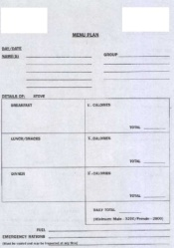
What kind of evaluation will you be doing?
Formative
Developmental
Summative

Slide 105
3. Learning frameworks
What needs to be learned;
Who needs to learn’
What is the timeframe of decision making;
Learning about the intervention or about the spread strategy.

Slide 106
Evaluation and Learning
Context & Support Structures
Implementation
Risk Landscape of Clients
Impacts
Impact on Scale
Ecology of Interventions
System-level Contexts & Supports
Organizational
Planning for Sustainability
Heterogeneity of System Needs
System-level Sustainability
Process/ Mechanisms
PROJECTS
Policy
SPREAD

Slide 107
A few thoughts on learning
Evaluation ≠Learning
Learning is an:
Intentional Act
Needs structure (but also nimbleness)
Needs clarity of questions
Needs a process
Need to move evaluation’s preoccupation with products towards a process

Slide 108
4. Intervention mapping/Theories of change
Pathways
Context
Mechanisms
Heterogeneity
Leverage
Timeline and Trajectories

Slide 109
Basic Questions
How complete is our knowledge of how interventions are intended to work?
Do we have clarity on the timeline of impacts?
How do we ensure that we don’t get caught up in the ‘activity space’ of such initiatives?
How do we align metrics to provide incentives to focus on the outcomes?

Slide 110
Some Challenges
INCOMPLETENESS; LIMITED SPHERE OF CONTROL
REPRESENTING SUSTAINABILTY
THE TIMELINE PROBLEM
UNDERSTANDING MECHANISMS

Slide 111
5. Incorporating Inequities and Intersectionalities
Exploration of data: identify intersections of categories
Sharpen the theory of change: refocus from average impacts to impacting inequities
Sharpen knowledge of key contexts/groups/populations that need disproportionate focus
Sharpen program strategies to impact these groups

Slide 112
The nature of mechanisms
“In fact, it is not programmes that work but the resources they offer to enable their subjects to make them work. This process of how subjects interpret and act upon the intervention stratagem is known as the programme ‘mechanism’ and it is the pivot around which realist research revolves. Realist evaluation begins with the researcher positing the potential processes through which a programme may work as a prelude to testing them.”

Slide 113
Deeper dive into Contexts
i) Individuals – the characteristics and capacities of the various stakeholders in the programme.
ii) Interpersonal relations – the stakeholder relationships that carry the programme.
iii) Institutional settings – the rules, norms and customs local to the programme.
iv) Infrastructure – the wider social, economic and cultural setting of the programme.

Slide 114
6. Developmental role for evaluation
Planning for sustainability
Mapping needed capacities
Understanding absorptive capacities of systems
Work with program to embed interventions within existing/routine systems

Slide 115
7. Design, Data and Measures
What data will be collected to measure key processes? Immediate, Intermediate and long-term impacts? Inequities? Capacities?
What types of designs will be used to measure change over time? Will the time series be analyzed? Will there be a comparison group?
How will changes be analyzed over time? Will time series be analyzed?
How will the differential impacts of the intervention be analyzed across groups/contexts?
How will impacts on processes be explored?
What types of capacities need to help sustain the progress?
Are the capacities in place for the initial progress to continue?
How will the acceleration of change caused by the intervention be analyzed?
Will key assumptions in the theory of change be tested?
How does the timeline of impact/anticipated influence the findings of the analysis?

Slide 116
8. Revise, Reshape and Reform Interventions
Learnings about the theory of change: problems and challenges with assumptions
Learnings about inequity: how should the reach assumptions be modified
Based on system capacities, how should the interventions be modified to promote sustainability
What else needs to happen to accelerate progress for specific groups

Slide 117
Questions to improve reporting of Evaluations from a sustainability perspective

Slide 118
Describe the Intervention--Leverage
Was there a discussion of the evidence informing the program? Was there a discussion on timelines?
What was the Setting? What was the Context? What were other boundary partners?
Challenges of adaptation to specific setting? program plan for sustainability?
Is the program a pilot?
Duration of the intervention?
Were there changes in the intervention over time? How did the evaluation explore this?
Was the theory of change described? Sustainability? Did it change over time?
Discussion on timelines and trajectories of impacts?

Slide 119
How were impacts studied; what design were implemented to study dynamic impacts?
What was the Intervention Planners’ view of success? Relationship to sustainability?
Was there a Formal process of describing how the impacts can be sustained?
Was the program a success? Unintended outcomes? Differential impacts for different groups?
Were there formal structures to learn and modify the program over time?
Was there a discussion of what can be spread as part of learnings from the evaluation?
Did the evaluation help with decisions about sustainability? How?
Was the organizational structure of the intervention described?

Slide 120
Looking ahead

Slide 121
A QUICK Story: OnValues and China

Slide 122
My Grand Challenge(s)
How can it be ensured that a proposed intervention is consistent with the values of the individuals who are supposed to benefit from it?
How does an intervention respect and respond to the diversity of values within a specific population?
Are there methods of telling if a proposed solution is based on an understanding of the context of a problem?

Slide 123
Ecology of Evidence
Models of Causation
(Successionist vs. Generative Models of Causation)
Program Theory and Incompleteness
Capacity Building for Addressing Inequities
Integrating Knowledge Translation with evaluation: Dynamic theories
Time Horizons and Functional forms
Developmental evaluation in Complex Dynamic Settings
Spread, Scaling up and Generalization
Portfolio of designs
and approaches

