Slide 1
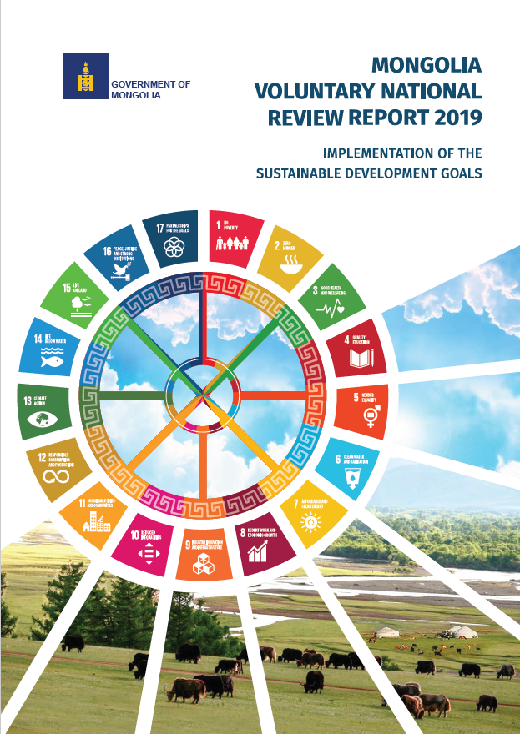
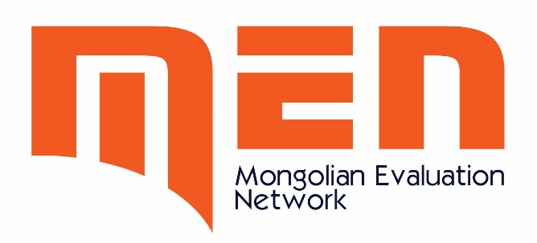
Mongolia for Agenda 2030:
Mongolian Evaluation Network
Buyandelger U.
UNDP, Mongolia
Notes:
Good morning to you all.
Congratulations to the participants who came here to unite your efforts for better future through strengthening the national evaluation capacities!

Slide 2
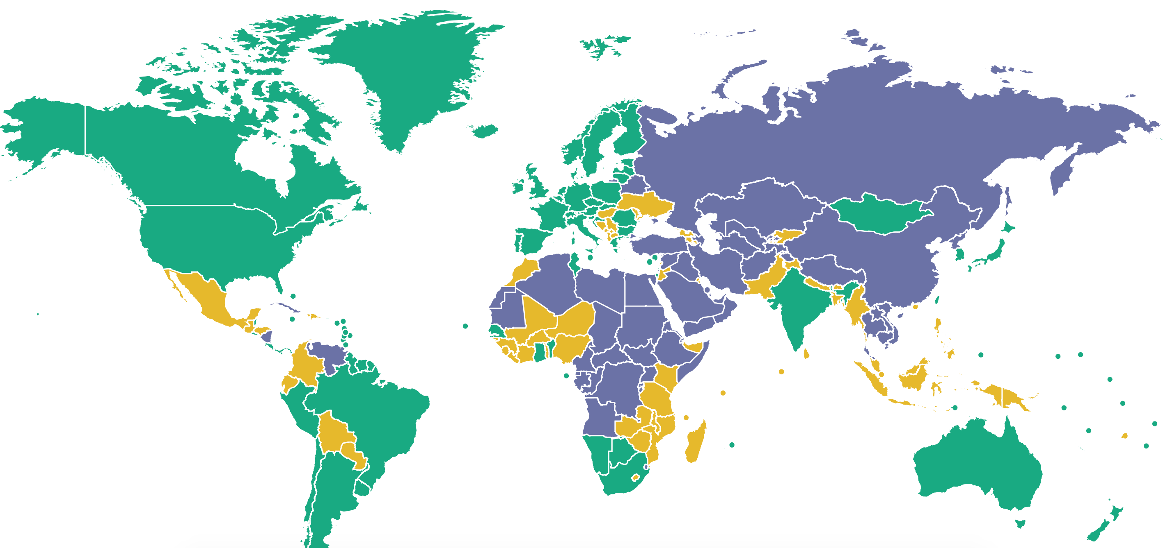
Mongolia
www.freedomhouse.org
Notes:
Mongolia has a relatively well established legal and policy environment supporting freedom, human rights and democracy
According to the Freedom in the World 2019 report and Freedom House Index – Mongolia scored 85/100 – 100 being most free and 0 being least free - Political Rights and civil liberties.
As such, the democracy provides an enabling environment for the institutionalization of evaluation and to promote an evaluation culture.

Slide 3
Integrating the 2030 Agenda – Building Blocks
Mongolia case
Aligning strategies and plans with 2030 Agenda
Setting up institutional arrangements for horizontal/ vertical coordination and policy coherence
Integrating 2030 Agenda into budgets
Assessing data availability and capacities of data systems to monitor and evaluate progress, adapting/ establishing M&E Systems
From planning to action: prioritizing and sequencing – identifying SDG ‘accelerator interventions’
Financing for sustainable development

Slide 4
Key stakeholders in evaluation:
Formal (National Evaluation Policy) | No NEP however, there is legal basis for outcome assessment
Key state actors and institutions | Parliament Secretariat Cabinet Secretariat Ministry of Finance National Development Agency National Statistics Office National Audit Office
Key non-state actors and institutions | National Academy of Governance A wide array of NGOs Mongolian Evaluation Network International organizations (IFIs; iNGOs )
Notes:
operating in silos
Lack of national actors in participating
Currently, there is no dedicated national evaluation policy (NEP) in Mongolia, rather it is infused in key development policies and laws.
Law on Development Policy and Planning (2016)
Budget Law
Law on Government
Sustainable Development Vision of Mongolia

Slide 5
Demand for partnership and participation of non-government actors
CabSec
Parliament
NDA
MOF
Citizens
Professional associations
NGOs
Media
Private sector
International organizations
Line ministries / specialists
Government agencies
Local governments
Notes:
Weak coordination between the government organizations themselves
Weak participation of non-government stakeholders
Therefore, MEN works for filling in the gap aiming to strengthen the following areas (next slide)

Slide 6
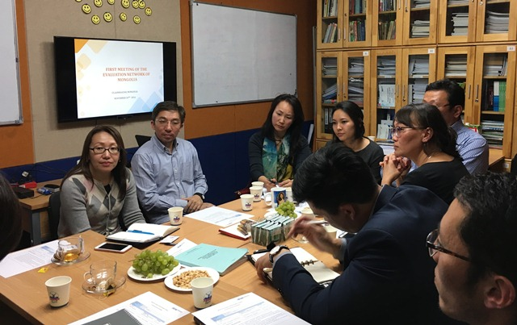
VOPE in Mongolia
Established in 2016/2017
Encouragement from APEA and IOCE
Informal network
Demand driven – wide demand from the public sector to use M&E
Timely
Locally-driven
Multi-sectoral and multi-disciplinary
Notes:
In Mongolia, there was an earlier attempt to build the VOPE – ‘Mongolian Evaluation Society’ in 2011? However, now it is not active and a new community of practice ‘Mongolian Evaluation Network’ has been newly formed since 2016.
Established in response to demand for network/platform connecting evaluation professionals and enthusiasts in different sectors
Demand driven – wide demand from the public sector to use M&E
Timely – SDGs; Mongolian Sustainable Development Vision, new laws and regulations
The pioneer members of the network consist of a diverse group of evaluation professionals and non-professionals inside and outside the government, consisting of around 12 active members and 15 inactive members. Members work at government - MoF, Cabinet Secretariat and NDA; members from academia – National University of Mongolia and National Academy of Governance; members from NGOs – IRIM and WorldLearning; members from international organisations – UNICEF, UNDP, World Bank and Swiss Agency for Development and Cooperation. Currently, IRIM is serving as its secretariat role (paying membership fees, providing coordination and writing meeting minutes etc.) Through the IOCE P2P project in 2017, the network translated the ASEAN region evaluation standards into Mongolian and shared it among the relevant stakeholders. VOPES from Vietnam, Malaysia and Laos collaborated on this project. The tasks, building relationship between the network and the government and forming sustainable financing mechanism remain to be done in the near future.

Slide 7
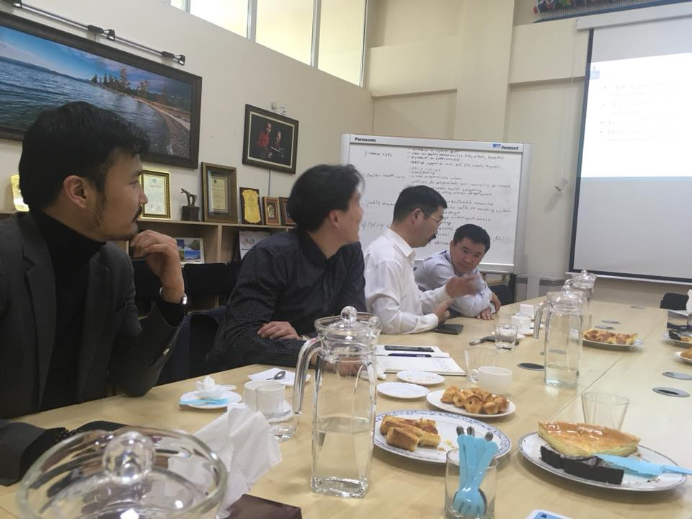
Notable outputs:
Mongolian Evaluation Standard (draft) – P2P with MES, VNME and LES
National Evaluation Capacity Assessment – UNICEF, UNDP and IRIM
Roadmap for strengthening National Evaluation System in discussion with NDA and Cabinet Secretariat
Inputs for the revision of Government M&E revisions.
MEN is a member of (since 2016):
Notes:
The history of MEN:
Individuals in Mongolia started talking about a network – but not clear action.
UNDP – NEC conference – meeting with Asela, Jim and Rom
APEA conference in 2016 – joined APEA
Having a secretariat and a main body to support
Currently 38 members - 12 active members
Email group and Facebook group

Slide 8
Professional Network for:
Enabling environment
Institutional capacity
Individual capacity
Notes:
Enabling environment:
Demonstrate strong political commitment towards the 2030 Agenda and evaluation.
Increasing demand from citizens, and mechanisms facilitating citizen engagement in evaluation and the 2030 Agenda; the corresponding openness of government is mixed but growing overall.
Evaluative thinking and learning culture limitations.
Legalistic culture that places greater emphasis on compliance
Prevailing negative association with evaluation
Dedicated resources for evaluation are not sufficient.
Limited proportion of financial resources dedicated to evaluation as compared to national development plan implementation.
Feedback loops promoting uptake and use of evaluations are limited.
2. Institutional capacity:
Key institutional structures and mechanisms for NES are in place
Harmonization and coordination of various NES efforts are limited.
Data quality assurance mechanisms are insufficient
Progress on promoting equity focused and gender responsive (EFGR) practices and evaluations is variable.
3. Individual capacity:
Overall, individual capacity for evaluation is limited and uneven.
capacity often highly concentrated among a few
capacity for evaluation among relevant actors is limited.
most public projects evaluators are not professional evaluators
High rotation in the public sector adversely affects capacity
Disconnect between individual capacities related to the 2030 Agenda and those related to evaluation
for practical, hands-on evaluation training and on-the-job learning scarse
Opportunities for professional evaluation capacity development are limited but increasing.

Slide 9
National Network
-
Objectives
To promote evaluation culture
To liaise and unite evaluation professionals
To raise public and decision-makers’ awareness
To influence policy through evaluation results
Notes:
Further promote evaluative thinking and a learning culture.
Strengthen the alignment between the principles and aspirations of the 2030 Agenda and the role and value of evaluation.
Improve horizontal and vertical harmonization and coordination of NES efforts.
Strengthen feedback loops to better promote the use and uptake of evaluation findings.

Slide 10
National Network
-
Activities
Provide a platform of evaluation knowledge and information
Exchange practices and information related to evaluation – nationally and internationally
Translation of materials into Mongolian and to translate key evaluation terms
Prepare for the professionalization of evaluation - Provide training and capacity building (certified evaluators)
Conduct advocacy activities
Internal institutionalization - Transform into a formal evaluation association – once members are ready.
Notes:
In order to fulfill the above mentioned objectives, MEN is running these activities.
Our approach has been to not formalize quickly and grow organically – taking things easy.
A joint proposal through UNICEF/UNDP on HazeGazer: a public eye on air pollution interventions.

