Slide 1
Quantitative Data Analysis For Development Evaluatation
National Evaluation Capacities (NEC) Conference 2019
No One Left Behind
Hurghada, Egypt
October 20-24, 2019.
Bassirou Chitou, Ph. D.

Slide 2
Module I: Basic Concepts
Module II: Summary Statistics Essentials
Presentation Outline
Module III: Bivariate Analysis and Hypothesis Testing
Module IV: Data Visualization Basics

Slide 3
Module I
Basic Concepts and Dummy Tables

Slide 4
Basic concepts
What are the evaluation questions (EQ)?
What are the evaluation hypothesis (EH)?
What is the main outcome (s) ?
What are the covariates?

Slide 5
Dummy Table: Definition and Example
Definition
Example
“blank mock tables”, or “blank table shells”;
variable names;
labels of statistical measures;
absolutely NO data;
constructed before data collection
Table I: Participants Sociodemographic Traits
Sociodemographic Characteristics | n | Percent (%)
Gender
Male
Total

Slide 6
How Useful Are Dummy Tables?
True Merits of Dummy Tables
Template for systematic steps in the analysis
Ensure correct data were collected
help to visualize the data in relationship to the evaluation overall goal
help you test the evaluation hypotheses
help you stay focused on relevant analyses
powerful communication tool
Advance planning tool for various analysis
centralized record of analyses, results, and decisions

Slide 7
Basic Types of Dummy Tables
Table of participants’ baseline socio-demographic characteristics;
Table of bi-variate analysis of main outcome and key covariate(s);
Table of subgroup analysis, for example, male vs. female;
Table of regression analysis or other models building.

Slide 8
https://d.docs.live.net/43296abb124de8a9/Documents/UNDP_Egypt/workshop/word/nss_sam_dummy_tables_oct_21_2019.docx
Go to

Slide 9
How Do We Analyze Data Effectively?
Data Analysis Steps
Step 1: Prepare the data
Step 2: Describe your sample
Step 3: Assess “Difference” and “ Significance”
Step 4: Explore relationships
Step 5: Built meaningful models
Step 6: Organize and Present Findings
Step 7: Validate Findings with Key
Stakeholders

Slide 10
Data Analysis Planning Worksheet (DAP)
DAP Worksheet Template
DAP Features
Resources | What you have | What you need | How to get what you need or work within resources limitation
Funding
Time
Staff
Materials and equipment
good communication tool;
help secure the necessary resources;
ensure your accountability.

Slide 11
Module II
Descriptive Analysis: Summary Statistics

Slide 12
Level Of Measurement
Definition
Six Types of Level Of Measurement
scale that defines and identifies a given variable;
determines the appropriateness and the use of a certain statistical method.
Binary;
Nominal;
Ordinal;
Interval;
Ratio;
Likert scale

Slide 13
Binary and Nominal Variable
Binary
Nominal
2 unique values or categories;
Puts each unit in one and only category
Sex: male / female
Did you eat today: yes / no
2 or more distinct categories or classes;
puts each unit in one and only one category;
marital status: single / married /separated/divorced/widowed

Slide 14
Interval and Ratio
Interval
Ratio
“difference” or “interval” makes sense;
“division” or “ratio” does NOT;
“0” does NOT mean “Absence”;
Example: Temperature
BOTH “difference” and “ratio” make perfect sense;
“0” = “ABSENCE;
Example: Age, height, income, revenue.

Slide 15
Likert Scales
Agreement Scale
Rating / Ranking
Measure respondent’s opinion on a particular topic;
Extent to which participant “agrees” or “disagrees”;
Extent of which a respondent is “satisfied” or “dissatisfied”;
Ask participant to rate or rank a particular statement;
“On a scale of 1 to 5 how would you rate the WFP Food Assistance you received in the past 3 months”

Slide 16
Importance of Level of Scale
The scale of measurement determines
the correct statistical analysis;
The inferences or conclusions that may or not be drawn

Slide 17
Measure of Central Tendency
Single value describes center of the data;
Characterizes typical behavior of the data;
facilitates comparisons between data.

Slide 18
Measures of Central Tendency
Central Tendency Measures
Mean:
Arithmetic average;
Easy to use;
Most popular.
Symmetric distribution
Affected by extreme values: NOT robust
Mode:
Most Frequent value;
Highest Frequency value;
Skewed distribution
Robust against extreme values
Median:
Ordered data;
Middle value
Skewed distribution.
Robust against extreme values

Slide 19
Measure of Variation
Describes the extent to which the data is spread out, stretched or squeezed around the central tendency value.
Characterizes dispersion of the data;
Help understand how individual scores or values behaves;
enhances comparisons between data.

Slide 20
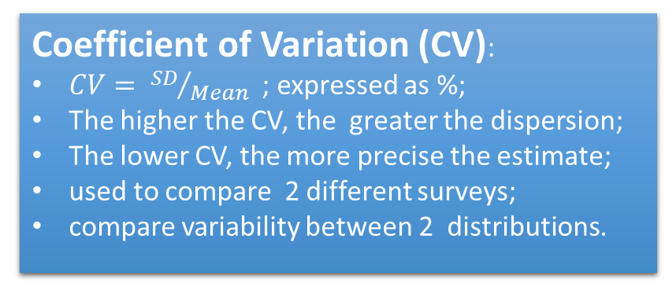
Measures of Central Tendency
Measures
Of
Variation
Standard Deviation (SD):
Describes how far or close a value is from the mean;
Square root of the variance;
Small is good; Large is of concern
Interquartile Range (IQR):
Difference between Third Quartile (Q3) and First Quartile Q1;
Contains approximately 50% of the data.
Coefficient of Variation (CV):
$CV= {SD}/{Mean}$; expressed as %;
The higher the CV, the greater the dispersion;
The lower CV, the more precise the estimate;
used to compare 2 different surveys;
compare variability between 2 distributions.

Slide 21
Module III
Bivariate Analysis & Hypothesis Testing

Slide 22
https://d.docs.live.net/43296abb124de8a9/Documents/UNDP_Egypt/workshop/word/intro_to_quant_anal_undp_nec_2019_sept_26_2019.docx
Go to

Slide 23
Module IV
Bivariate Analysis & Hypothesis Testing

Slide 24
https://d.docs.live.net/43296abb124de8a9/Documents/UNDP_Egypt/workshop/word/intro_to_quant_anal_undp_nec_2019_sept_26_2019.docx
Go to

Slide 25
Thank You A Million

