Slide 1
ARCHITECTURE FOR EVALUATION EFFECTIVENESS
Indran Naidoo, Director, Independent Evaluation Office, UNDP, and UNEG Vice Chair
@undp_evaluation
#NECdev

Slide 2
About IEO

Slide 3
Independent Evaluation Office
Functionally Independent
Report directly to and is accountable to the EB
Guided by the UNDP Evaluation Policy
Directorate
Country Programme Section
Corporate / Thematic Evaluation Section
Capacity Development Section
Operations Section
MANDATE
The core function of the Independent Evaluation Office is to:
Conduct independent thematic and programmatic evaluations.
Prepare the Annual Report on Evaluation
Set standards and guidelines on evaluation, monitor compliance on evaluation and share lessons for improved programming.
Report directly to EB with oversight from AEAC and QA by EAP
10.2 Million USD in 2019 budget, equivalent to 0.2% of UNDP total spend
32 Staff members from 23 Nationalities, speaking 26 languages

Slide 4
PRIMARY EMPHASIS OF IEO STRATEGY IS ACCOUNTABILITY AND LEARNING FOR RESULTS
Evaluation system and processes
Increasing evaluation coverage
Evaluation for a Stronger UNDP
Strengthening the decentralized evaluation function
National evaluation capacity to advance the SDGs
Ensuring the use of evaluations

Slide 5
Evaluation Policy

Slide 6
Evaluation Policy Evolution
UNDP’s evaluation policy adopted in 2006
2010- Review of UNDP evaluation policy
2010- Adoption of new UNDP evaluation policy
2014- Review of UNDP evaluation policy
2016- Adoption of new UNDP evaluation Policy
2019 – Adoption of the Revised Evaluation Policy
Enhanced independence of UNDP’s evaluation function
Committed budget allocation for UNDP’s evaluation function (1% vs. 0.2%)
Expanded reporting & tracking of management responses, including IEO spot-checking
New Audit and Evaluation Advisory Committee (AEAC)
Expanded services of IEO’s evaluation advisory panel to include support to UNDP at headquarter & regional levels
Director of the IEO reports to the Executive Board and is limited to a single five year term at UNDP
Increase in the percentage of resources reserved for the work of the Independent Evaluation Office from 0.2% to 0.3%

Slide 7
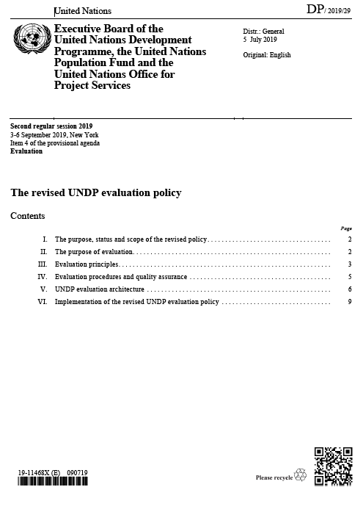
The Revised Evaluation Policy
The Executive Board adopted decision 2019/19 on the revised evaluation policy
Most significant Changes
Increases in IEO resources from 0.2% to 0.3% of UNDP combined resources
stipulates establishment of IEO offices in the regions
IEO oversight of the decentralized evaluation under the Revised Evaluation Policy
Assessment of regional and country offices
Participation in the recruitment of independent evaluators
Assess the quality and utility of evaluations commissioned;
Support capacity building on evaluation

Slide 8
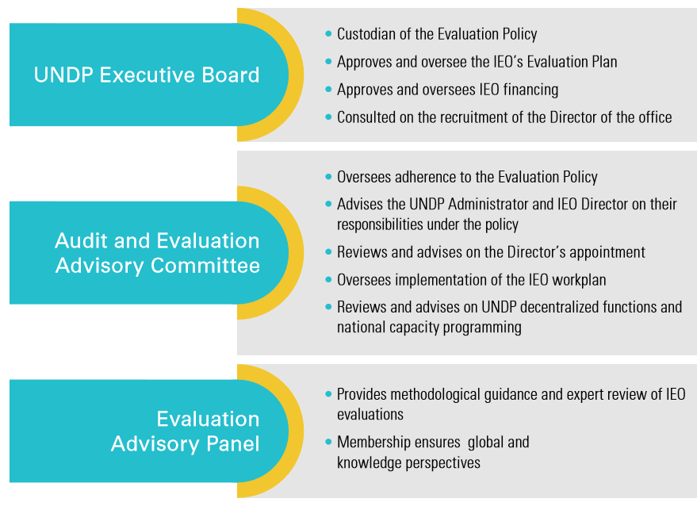
Oversight of UNDP evaluation function
To ensure conformity with the evaluation policy and quality of evaluation products

Slide 9
Evaluation Coverage

Slide 10
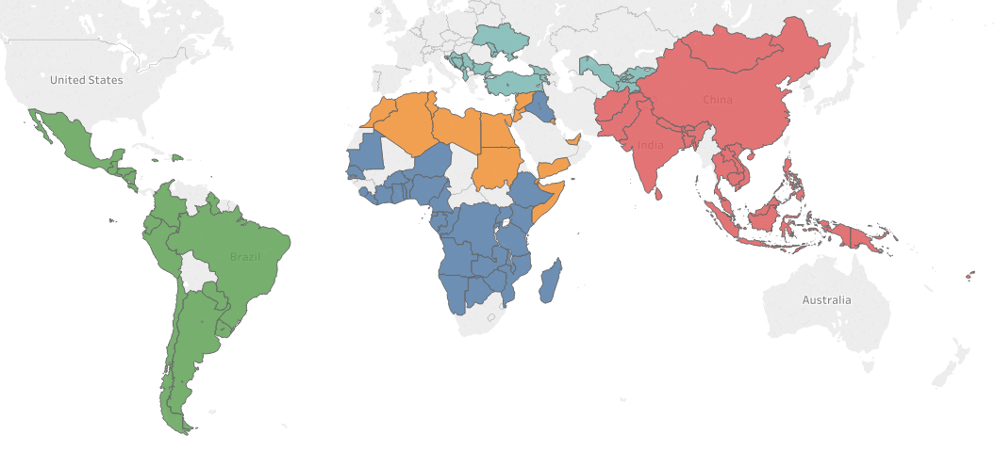
Independent Country Programme Evaluation 2002-2018
114 ICPEs conducted
1185 Recommendations made
2516 Keys actions planned
1728 Keys action completed

Slide 11
ICPE Coverage 2018-2019
2018
14 countries
2019
40
countries
Total UNDP Expenditure over 4 years Evaluated by 54 ICPEs:
7.1 Billion

Slide 12
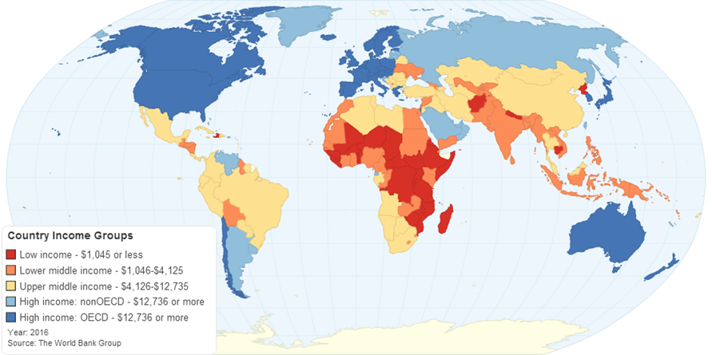
Increased coverage of corporate / thematic evaluations of UNDP framed by the 2018-2021 Strategic Plan
Board Submission Dates for Evaluations: 2018 -2021
Support to LDCs for poverty reduction (1/2019)
UNDP Evaluation Policy review (6/2019)
Disaster risk reduction & climate change adaptation (9/2020)
Support to middle income countries
(9/2020)
Leveraging private sector finance and engagement (2021)
UNDP Strategic Plan (2021)
UNDP, UNICEF,UNFPA and UN Women: Common Chapter (2021)
Conflict prevention and recovery & human migration (2021)
UNDP/GEF Small Grants Programme (2021)
Interagency pooled financing services (9/2018
Interagency operational services (9/2018)
Scope of evaluation aligned with development settings defined in UNDP’s strategic plan
Coverage of key strategic areas for UNDP in light of UNDS reform and SDGs
ICPE and thematic evaluations as building blocks to a comprehensive evaluation of the UNDP strategic plan

Slide 13
Evaluation Quality

Slide 14
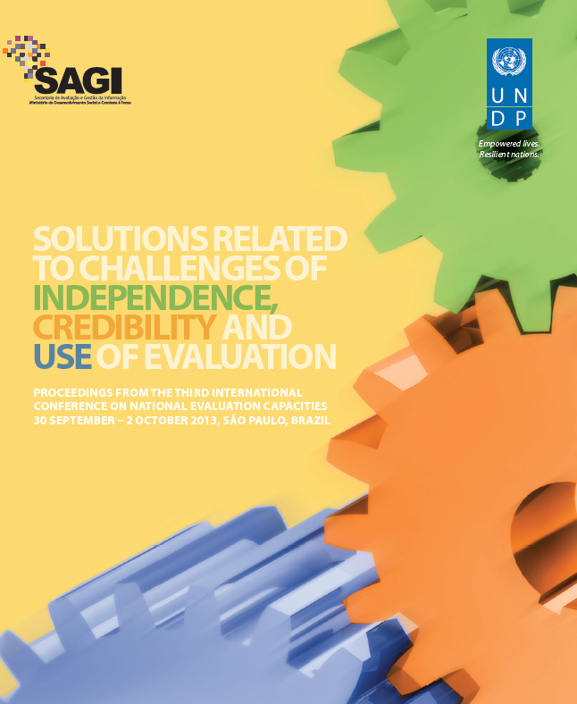
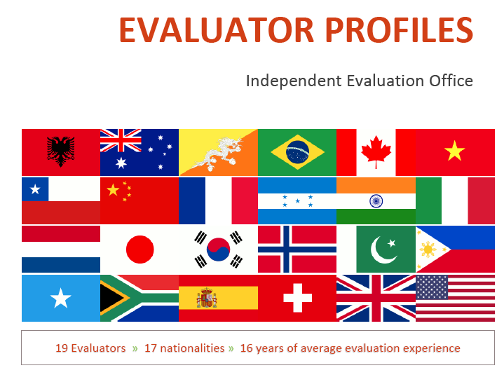
Evaluation leadership to ensure quality
Entrenched independence, enhanced credibility and engaged more for learning
Moved from EO to IEO
Model-change from consultant led to professional led
Move to full coverage of all CPDs
Bringing together IEO and UNDP – needed in the context of UN reform
42 ADRs completed since 2012
6 ADRs completed in 2016
8 ADRs completed in 2017
14 ICPEs ongoing in 2018 (88% of new CDPs)
40 ICPEs planned for 2019 (100% of new CPDs)

Slide 15
Vision for IEO
Advice on strategic directions
A new vision for the IEO
Independence
Advice on independence, draft policy
Model Change: from contracting to conducting evaluations
Amplified “independence message” through critical evaluations
International visibility
Greater engagement with global evaluation networks and platforms
Advice and contributions to IEO thinking on strategic issues
NEC Conferences expanded
Revised Evaluation Policy
Quality Assurance
IEO-led ADRs/ICPEs and thematic evaluations
Advice on methodology; quality assurance of evaluation reports
QUALITY ASSURANCE: VISION AND EAP RESPONSE
VISION
EAP contributions
IEO implementation

Slide 16
18 HIGH LEVEL EVENTS
6 EAP Annual Meetings
2 IEO workshops
5 NEC conferences
2 UN HLPFs
3 external conferences
165 INPUTS TO EVALUATIONS
62 ICPE inputs
42 corporate inputs
20 capacity development inputs
41 strategic inputs
SEVERAL OTHER PROJECTS AND INITIATIVES
NEC diagnostic tool
Multi-year evaluation plan, AREs
Executive Board and UNDP Management engagement
6 years of IEO-EAP Synergy

Slide 17
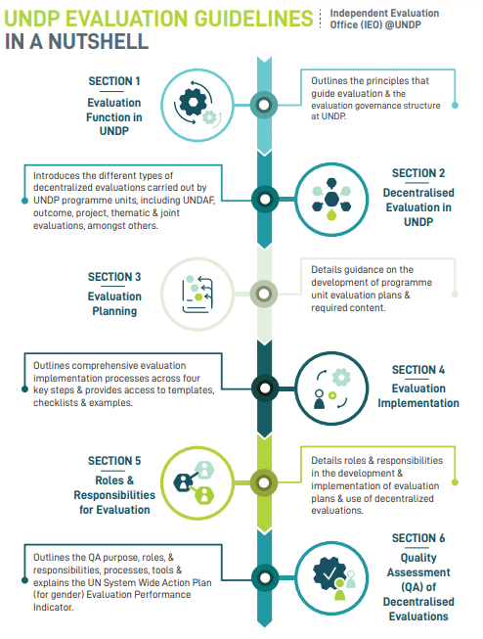
UNDP’s Evaluation Guidelines
New guidelines launched in Jan 2019
Available in English, French and Spanish
Outlines 6 sections to strengthen UNDP’s decentralized evaluation function
IEO is organizing trainings and webinars

Slide 18
Evaluation Communication

Slide 19
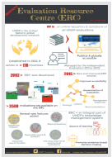
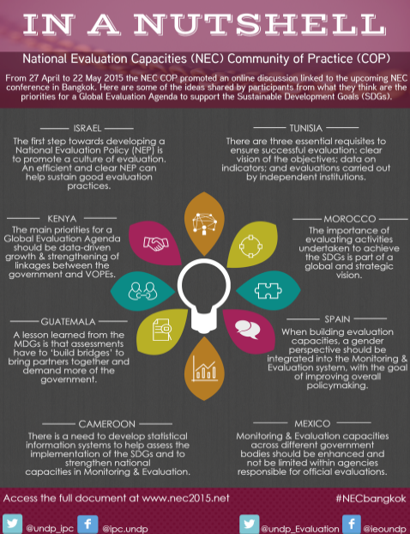
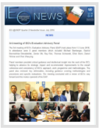
IEO Outreach & Products
Annual Report (Illustrated)
Videos
Infographics/Data Visualizations
Newsletters
Social Media
Evaluation Reports
2018 >>>>>> 11,000 followers
2018 >>>>>> 2000 followers

Slide 20
RESOURCES
Indran Naidoo, 2018. IPDET Graduation Speech: https://undp.sharepoint.com/:b:/r/teams/IEO/directorate/Shared%20Documents/IEO%20and%20SDG/Keynotes/201807_Indran%20Naidoo%20speech%20-%20IPDET.pdf?csf=1&e=4e4Hh3
Indran Naidoo, 2019. Audit and Evaluation: Working Collaboratively to Support Accountability, EES Conference paper. http://web.undp.org/evaluation/papers/papers-articles.shtml
Indran Naidoo, 2018. Revisiting independence, objectivity and the critically reflective role of evaluation for the SDG Era. http://web.undp.org/evaluation/papers/papers-articles.shtml
UNDP IEO, 2018. Annual Report on Evaluation. http://web.undp.org/evaluation/annual-report/are-2018.shtml
UNEG Norms and Standards, 2016, http://www.unevaluation.org/document/detail/1914
Evaluation Advisory Panel Deliberations 2019, http://web.undp.org/evaluation/directors-desk.shtml
UNDP Evaluation Policies, 2016 & 2019, http://web.undp.org/evaluation/policy.shtml
Guidance on how to develop national policies and systems available for download at: https://www.evalpartners.org/library/selected-books

Slide 21
MULTIMEDIA AND MEDIA RESOURCES
Video of Srini Pillay, M.D., CEO and Founder of NeuroBusiness Group; Assistant Professor (Part-time), Harvard Medical School, https://drive.google.com/file/d/1qlvGAQb23JFXUIsdtjGjJEoqpG3pI2Dr/view?ts=5dad633e
Some books from Srini Pillay:
https://thriveglobal.com/stories/there-should-be-a-generational-approach-to-handling-workplace-anxiety/
https://www.fastcompany.com/90382424/how-to-build-emotional-intelligence-at-work
https://www.forbes.com/sites/forbescoachescouncil/2019/08/05/five-brain-based-methods-to-lead-organizational-change/#6117f4f02154
https://hbr.org/2017/05/your-brain-can-only-take-so-much-focus
https://hbr.org/2016/03/the-science-behind-how-leaders-connect-with-their-teams

Slide 22
@undp_evaluation
#NECdev

