Slide 1
Measuring global progress in the implementation of the Sendai Framework for Disaster Risk Reduction 2015-2030 & 2030 Agenda for Sustainable Development
Ms. Magda Stepanyan, Founder & CEO at Risk Society
www.risk-society.com

Slide 2
Monitoring progress under the Hyogo Framework for Action (HFA Monitor) : 2005-2015
22 Core indicators in 5 Priorities for Action:
Ensure that disaster risk reduction is a national and a local priority with a strong institutional basis for implementation.
Identify, assess and monitor disaster risks and enhance early warning.
Use knowledge, innovation and education to build a culture of safety and resilience at all levels.
Reduce the underlying risk factors.
Strengthen disaster preparedness for effective response at all levels.
Monitoring progress:
HFA Monitor – on-line, self-assessment monitoring and reporting tool
61 countries (2007-2009); 133 countries (2009-2011);
113 countries (2011-2013); 96 countries (2013-2015).
Peer review process – Africa, Americas, Europe.
Global repository:
Single largest repository of the worldwide state of play in DRR: http://www.preventionweb.net/english/hyogo/hfa-monitoring/?pid:223&pil:1
www.risk-society.com

Slide 3
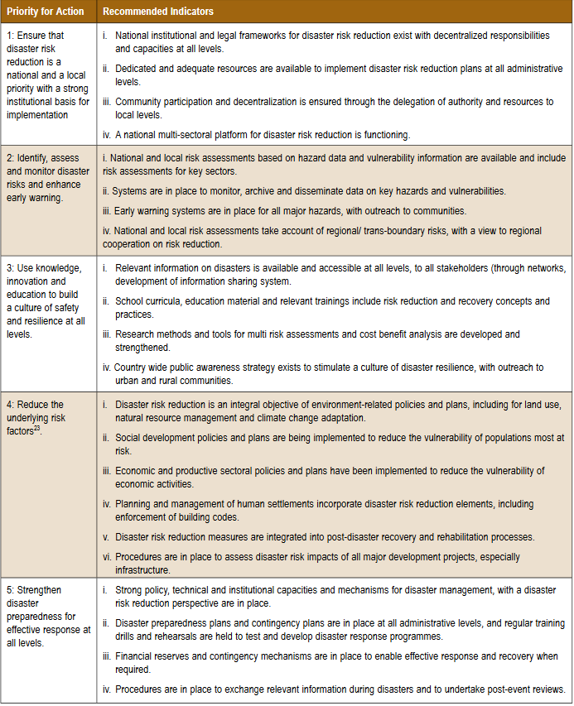
22 Core indicators for National HFA Monitor

Slide 4
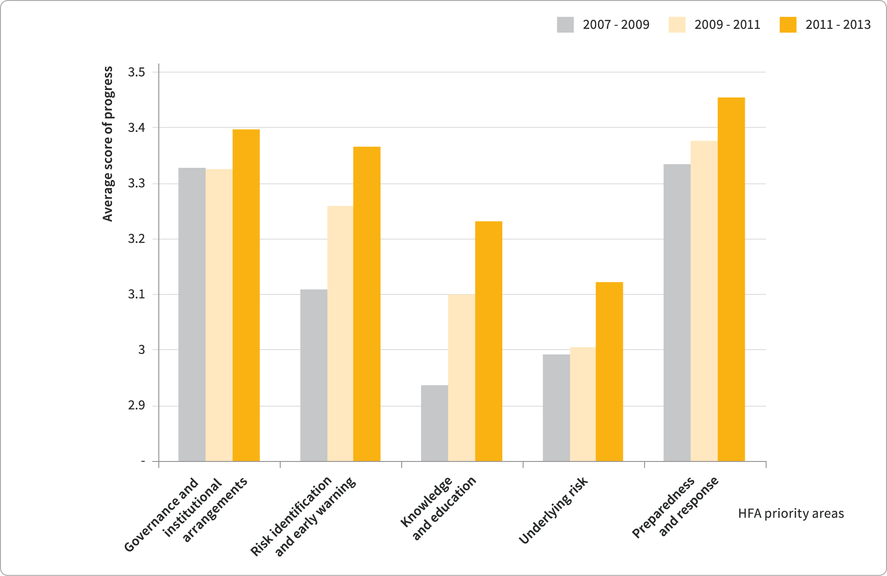
Conflicting evidence on progress
Increasing physical damage and economic loss
www.risk-society.com
Gradual progress across all Priorities for Action

Slide 5
Monitoring the HFA: issues encountered
Core indicators were input rather than output or outcome focused
Focused on reducing existing risks rather than on the generation of new risks or resilience .
Subjective, not allowing international benchmarking
Core indicators relate to multiple policies and stakeholders: Unclear responsibility and accountability
No clear link to Millennium Development Goals and UNFCCC
www.risk-society.com

Slide 6
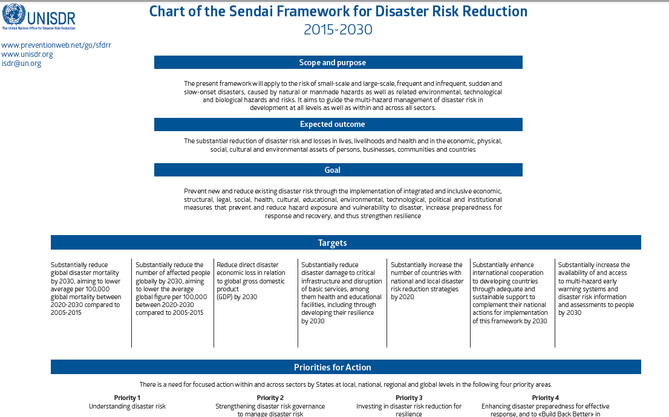

Slide 7
Sendai Framework for Disaster Risk Reduction: 2015-2030 (A/RES/69/283 - June 2015)
Seven Global Targets, four of which are outcome focused
Goal focuses not only on reducing existing risks also on preventing new risks and strengthening resilience
The reduction of disaster losses is assessed relative to the size of a country’s population and economy
Outcome Targets are objective and measurable allowing international benchmarking of progress relative to a quantitative baseline 2005-2015
Input Targets include national and local DRR strategies, international cooperation, MHEWS and disaster risk assessments
Priorities for Action refer to specific public policies for disaster risk management
Explicit links to the 2030 Agenda for Sustainable Development and to the Paris Agreement (UN Framework Convention on Climate Change)
www.risk-society.com

Slide 8
Open-ended intergovernmental expert working group on indicators and terminology relating to disaster risk reduction (OIEWG) (A/RES/69/284 - June 2015)
Comprised of experts nominated by States, for the development of a set of possible indicators and terminology to measure global progress in the implementation of Sendai Framework in coherence with the work of the Inter-Agency and Expert Group on SDG Indicators (IAEG-SDGs). OIEWG recommendations in Report A/71/644 (Dec 2016)
Developed INDICATORS to measure global progress in the implementation of the Sendai Framework
Updated of TERMINOLOGY on disaster risk reduction
UNISDR’s technical follow-up to support Member States in monitoring
The work of the working group completed by December 2016 and its report submitted to the General Assembly for consideration. General Assembly endorsed OIEWG report in UNGA Resolution A/RES/71/276 (Feb 2017 )
www.risk-society.com

Slide 9
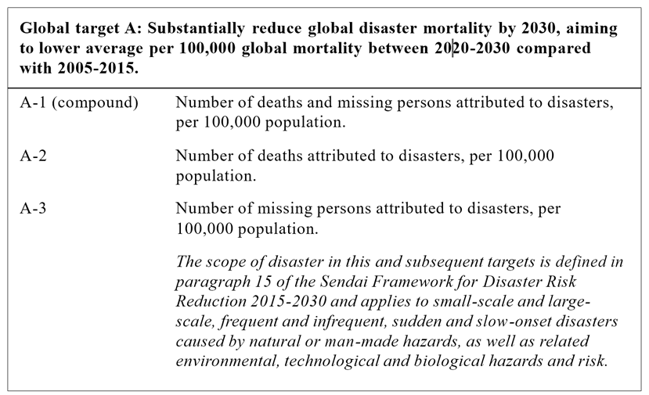
Target A

Slide 10
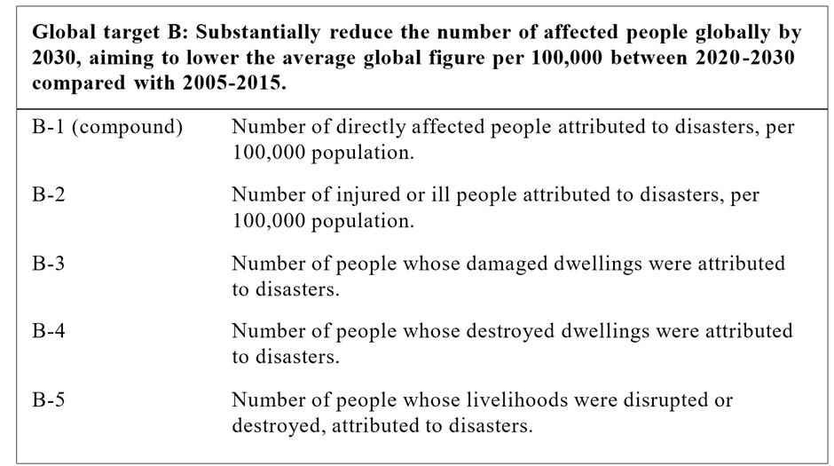
Target B

Slide 11
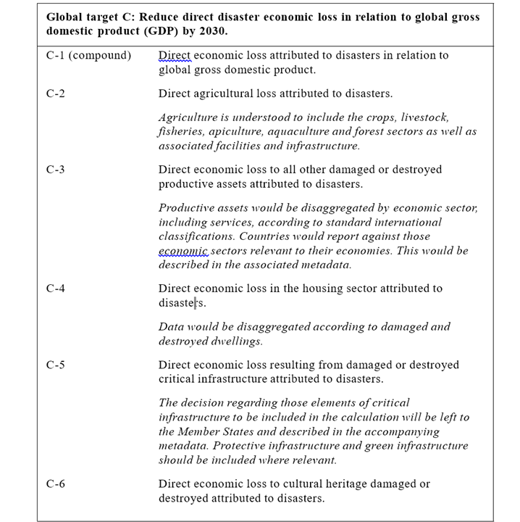
Target C

Slide 12
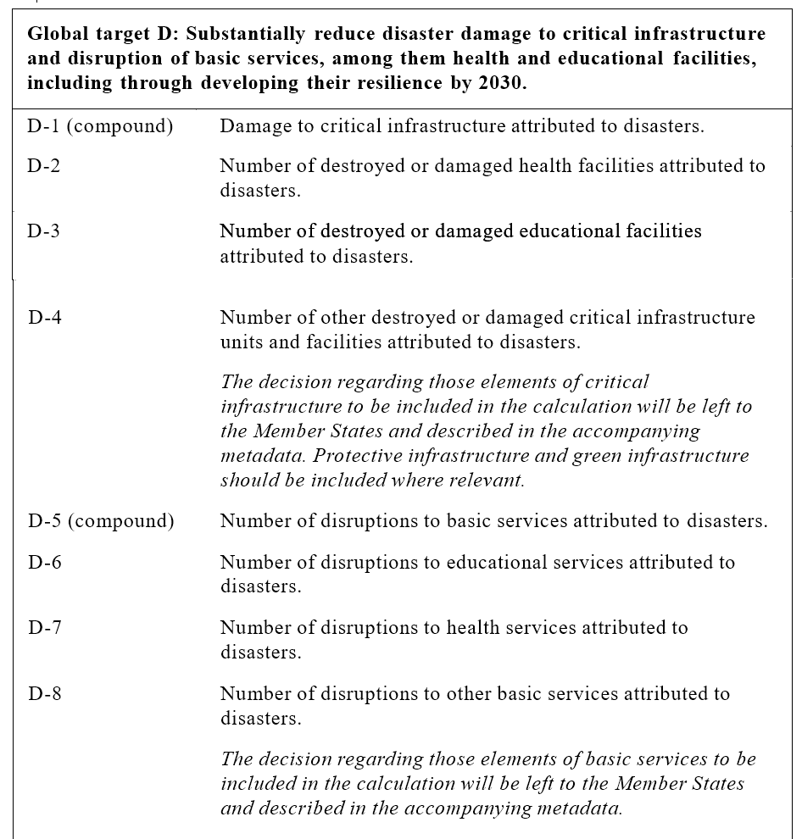
Target D

Slide 13
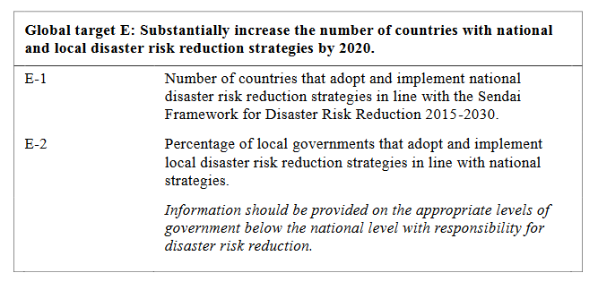
Target E

Slide 14
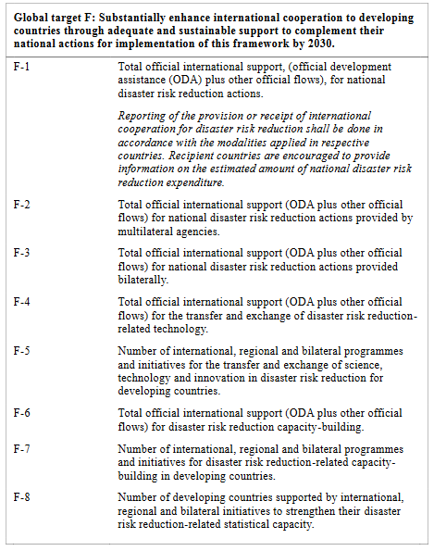
Target F

Slide 15
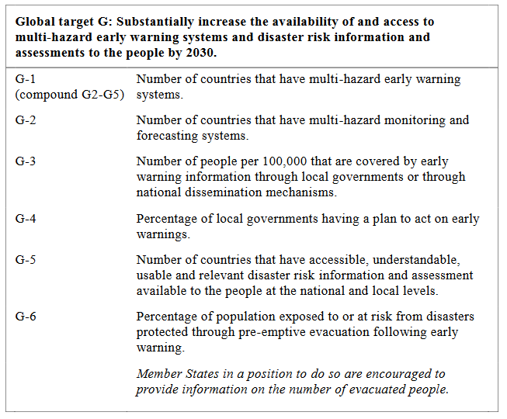
Target G

Slide 16
7 TARGETS
DISASTER MORTALIY BY 2030 B. # of AFFECTED PEOPLE BY 2030 C. ECONOMIC LOSS BY 2030 D. INFRASTRUCTURE DAMAGE BY 2030 | E. DRR NATIONAL/LOCAL STRATEGIES BY 2020 F. INTERNATIONAL COOPERATION BY 2030 G. MULTIHAZARD EWS + RISK ASSESSMENTS BY 2030

Slide 17
Architecture of the Sendai Framework Monitoring System at National Level
Sendai Framework Outcome
The substantial reduction of disaster risk and losses in lives, livelihoods and health and in the economic, physical, social, cultural and environmental assets of persons, businesses, communities and countries
Process
Data
Outcome Level Globally comparable and objective indicators defined by the OEIWG | Sendai Framework Global Targets | Disaster loss data (Targets A – D) National assessment (Targets E – G) ODA and STI data (Target F)
Output Level Nationally defined targets and indicators embedded in national strategies and plans | Sendai Framework Goal Reduce existing Prevent Strengthen social and risk new risk economic resilience Underlying Risk Drivers Urban Environmental Social Governance Climate Change | SDG indicators Paris agreement Risk metrics
Input Level Nationally appropriate public policy indicators | Sendai Framework Priorities for Action Priority 1 Priority 2 Priority 3 Priority 4 Understanding Strengthening Investing Enhancing preparedness for risk governance in DRR effective response, BBB | National self- assessment (Custom indicators)
A
B
C
D
E
F
G
C
D
E
F
A1-A3
B1-B8
C1-C15
D1-D15
E1-E13
F1-F20
G1-G14
Drop down menu of national targets and indicators

Slide 18
Disaster risk reduction indicators in measuring the 2030 Agenda for Sustainable Development
Inter-agency Expert Group on SDG Indicators (IAEG-SDGs) recognizes the OIEWG works and identifies UNISDR as custodian agency (December 2015)
5 of the key indicators recommended by the OIEWG being used to measure the global targets of both the Sendai Framework AND the SDGs.
www.risk-society.com

Slide 19
Target
Goal / Target
A
Number of deaths, missing persons and directly affected persons attributed to disasters per 100,000 population
Goal 1.
Target 1.5
B
Direct economic loss attributed to disasters in relation to global gross domestic product (GDP)
C
Goal 11.
Target 11.5
Direct economic loss in relation to global GDP, damage to critical infrastructure and number of disruptions of basic services, attributed to disasters
D
Number of countries that adopt and implement national disaster risk reduction strategies in line with the Sendai Framework for Disaster Risk Reduction 2015-2030
Goal 11.
Target 11.b
E
F
Proportion of local governments that adopt and implement local disaster risk reduction strategies in line with national disaster risk reduction strategies.
Goal 13.
Target 13.1
G
Notes:
□ 3 SDGs:
□ Goal 1. End poverty in all its forms everywhere
□ Goal 11. Make cities and human settlements inclusive, safe, resilient and sustainable.
□ Goal 13. Take urgent action to combat climate change and its impacts

Slide 20
Monitoring and reporting
Progress in implementing the Sendai Framework will be assessed biennially by UNISDR at Regional Platforms.
Analysis and trends will be presented in the Sendai Framework Progress Report (covering the period from January of the first year, to December of the second year of the biennium) and validated at successive Global Platforms.
Key outcomes of the Global Platforms can contribute to the review undertaken by the High-Level Political Forum for Sustainable Development (HLPF) for which countries are expected to collect data and report on an annual basis.
As from January 2018, countries will be able to report against the indicators for measuring the global targets of the Sendai Framework, and disaster risk reduction-related indicators of the SDGs, using the online Sendai Framework Monitor. The first Sendai Framework Progress Report is expected in 2019 and will, on an exceptional basis, cover trends in implementation for the two biennial cycles 2015-2016 and 2017-2018.
www.risk-society.com

Slide 21
Sendai Framework Data Readiness Review
UNISDR conducted the Sendai Framework Data Readiness Review and presented its findings at the Fifth Global Platform for Disaster Risk Reduction held from 22 to 26 May 2017 in Cancun, Mexico.
Findings:
Most countries collect a critical mass of disaster loss data required to measure Sendai Targets A to D and SDGs 1 (End poverty in all its forms everywhere) and 11 (Make cities and human settlements inclusive, safe, resilient and sustainable), while greater gaps in data availability exist for Targets E, F and G.
Gaps in data must be addressed by March 2019, for all countries to be able to report in the first official reporting cycle of the Sendai Framework and build the 2005-2015 baselines required for measurement.
www.risk-society.com

Slide 22
While the monitoring system of the Sendai Framework is deemed to measure the progress towards the realization of the Framework, is it also sufficient and useful system to evaluate or measure resilience?
www.risk-society.com

Slide 23
THANK YOU!
www.risk-society.com

