Slide 1
Behavioural Insights: Applications for Sustainability and Sustainable Development
Toby Park
Senior Advisor, Head of Energy & Sustainability
20th October 2017

Slide 2

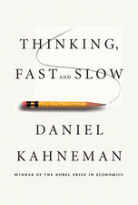

The dual process model of cognition
System 1
Fast thinking/Automatic
intuitive, effortless
2x2
Taking your daily commute
Picking up groceries on auto-pilot
System 2
Slow thinking/Reflective
deliberate, analytic
24x17
Planning a trip overseas
Planning a new meal you’ve never cooked before
“It turns out that the environmental effects on behavior are a lot stronger than most people expect”
Daniel Kahneman, Nobel Laureate, 2002

Slide 3
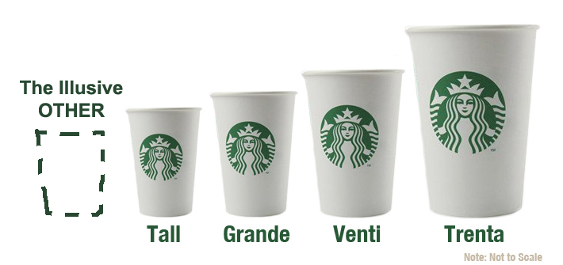
‘environmental effects on behaviour’…
Small changes to our environment, to the way choices are presented and services are designed, can have a big impact on our behaviour
Notes:
Cinemas use this to get you to buy bigger, more expensive popcorn,
Why can’t we use it to sell more efficient lightbulbs? Super efficient LED bulbs could increase sales of quite efficient fluorescent bulbs?

Slide 4
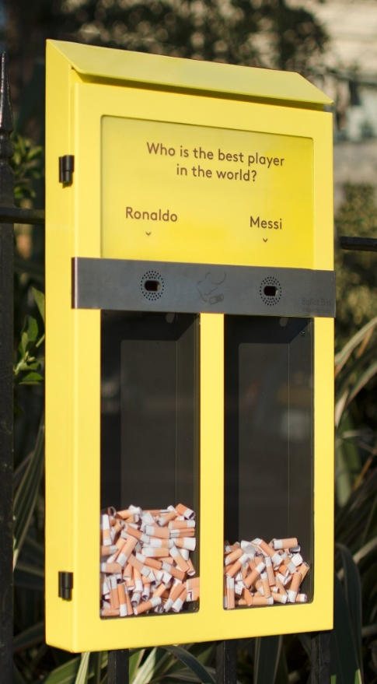
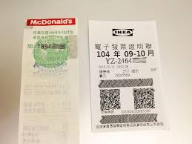
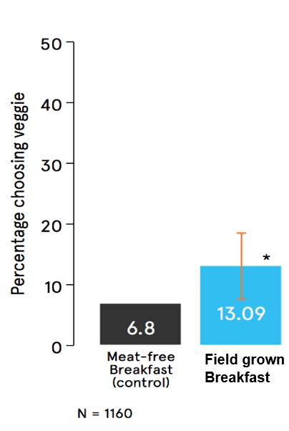
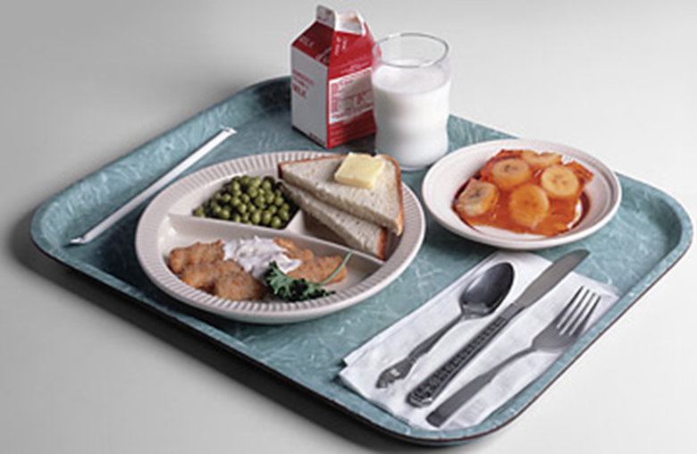
Some less trivial examples…
Reduce tax avoidance by putting lottery tickets on receipts
(behaviourally-informed incentives)
Encourage sustainable diets by changing dish names (framing)
Reduce littering by making it fun (gamification)
(Hubbub)
Reduce food waste (~40%) by removing the tray (friction costs)
Notes:
Litter – hubbub
Lottery tickets – Chinese authorities mandating receipt machines, could not be tampered with. But businesses just didn’t use them. Classic last-mile problem. Just in early experimental phase, lottery winnings were $5m, additional tax revenue $150m.
Food waste – 36% reduction solid, 44% reduction liquid.
Vegetarian dishes – BIT/World Resources Institute

Slide 5
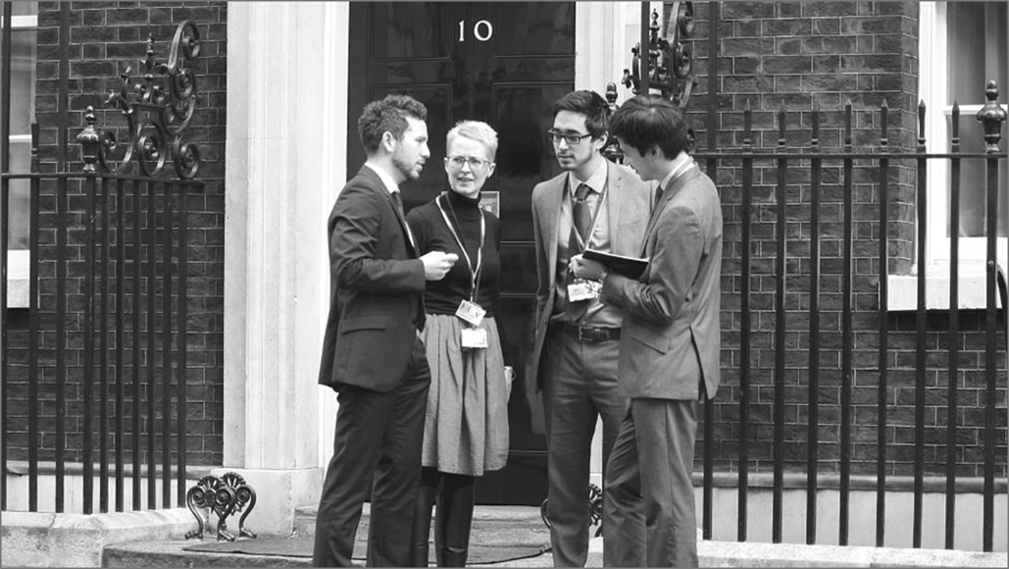
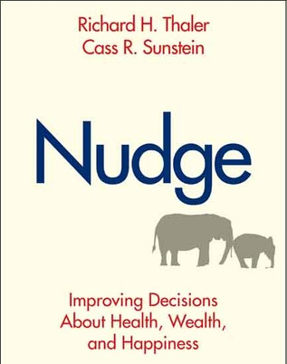


How can we use behavioural insights?
‘Nudging’
Regulation
Incentives
Information
Changes the ‘choice architecture’ to influence behaviour while maintaining freedom of choice
Limits choice by force (of law)
Limit choice by economic cost & reward
Maintains choice. Informs & persuades
Understanding how people behave ‘in the real world’ to make better policy and pubic services
Behavioural Insights
Notes:
2017 Nobel prize – Richard Thaler.
Applying this to ‘health, wealth and happiness’

Slide 6
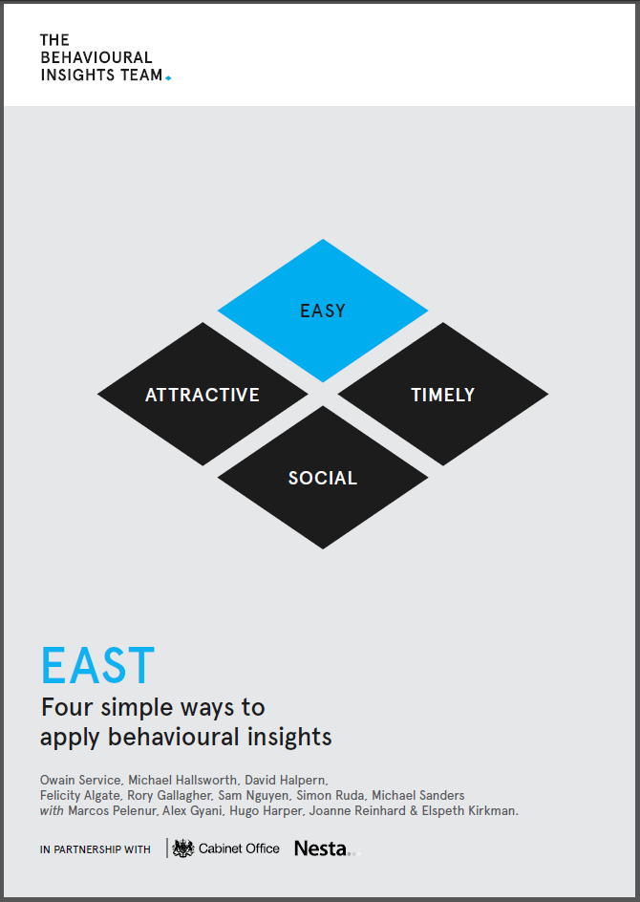
The EAST
Framework
Download at: www.behaviouralinsights.co.uk

Slide 7
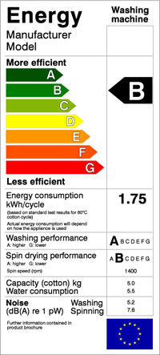
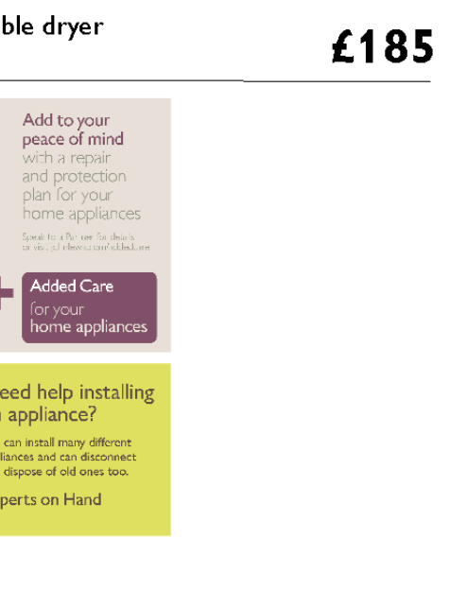

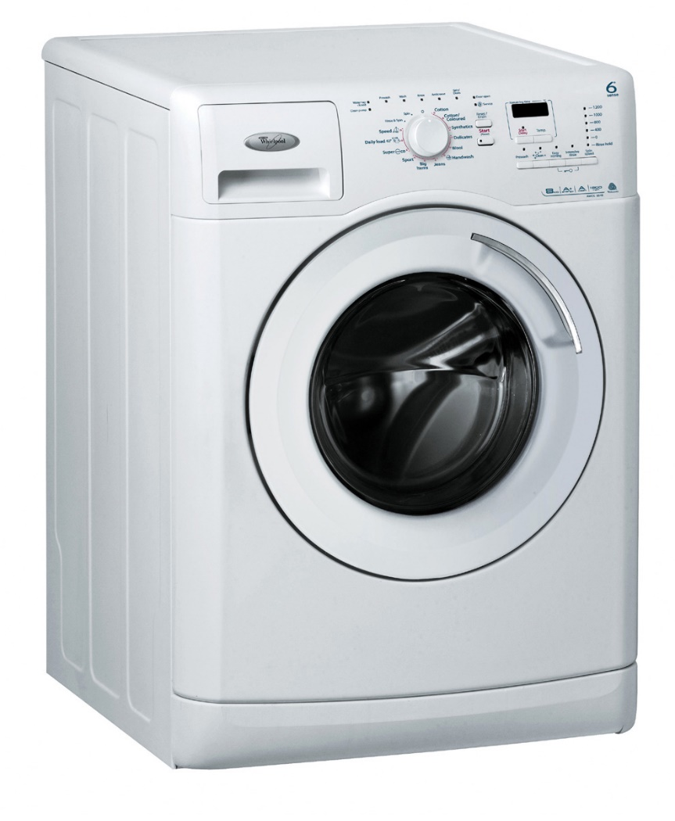
Using a better understanding of heuristics and biases to encourage action
Lifetime electricity running cost £551
Notes:
EAST, p. 41 FUTURE DISCOUNTING – making long-term running costs of appliances more salient on labels.
More expensive (more efficient) units tend to be cheaper in the long run. Requiring people to overcome higher up-front cost for long-term gain.
We had very little scope to make changes to the John Lewis Labels – added the tony black box.

Slide 8
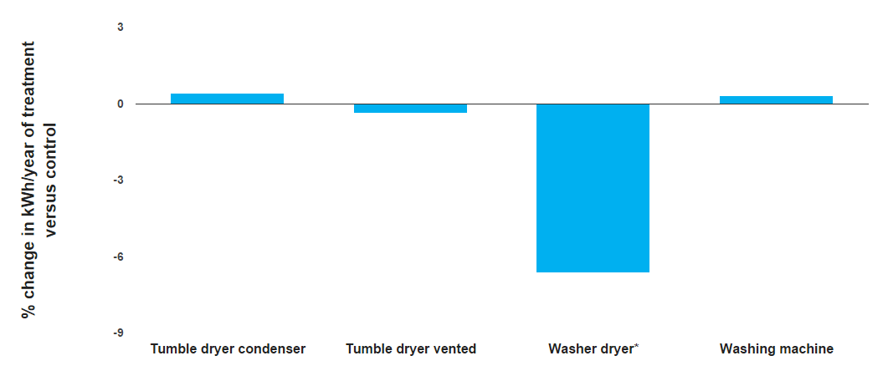
Consumers who saw the new labels were overall buying more efficient washer dryers
The washer dryers sold in intervention stores consumed an average of 6.64 kwh/year less energy than the appliances sold in control stores.
Notes:
EAST, p. 41 positive impact only on combined washer-driers (which use way more electricity than other categories and so the lifetime running cost was most significanrt, reltive to the product cost).
Chart shows the reduction in average kWh energy use of the products bought, i.e. more efficient washer-dryers were being bought.

Slide 9
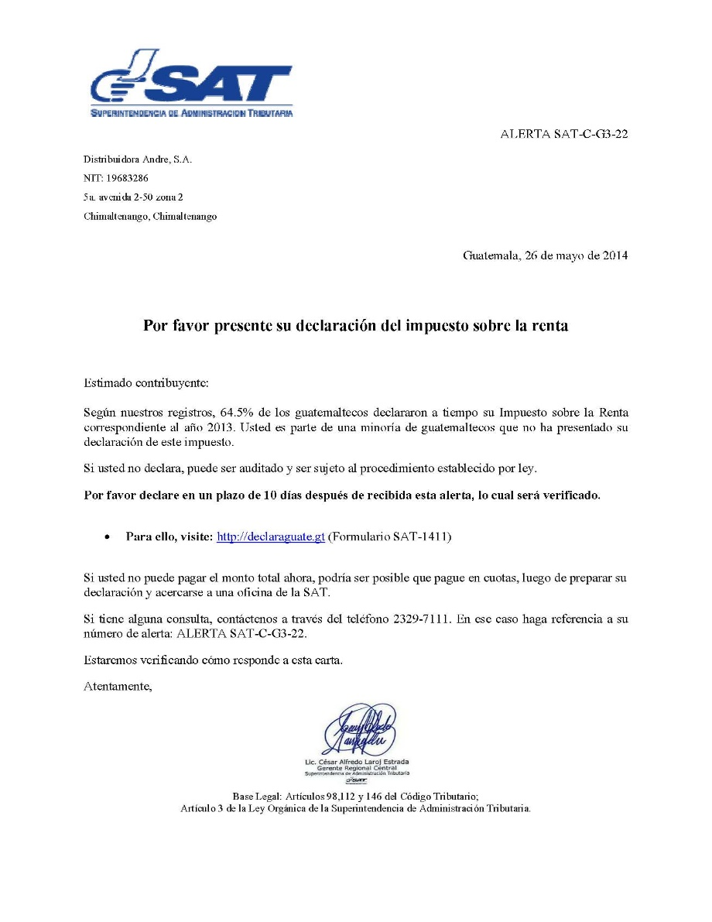
Guatemala tax collection: Behavioural letters
“According to our records, 64.5% of Guatemalans declared their income tax for the year 2013 on time. You are part of the minority of Guatemalans who are yet to declare for this tax”
“Previously we have considered your failure to declare an oversight. However, if you don’t declare now we will consider it an active choice. You may therefore be audited and could face the procedure established by law.”
Notes:
The deliberate choice message is aimed at removing inaction as a strategy to avoid blame and thereby remove the tendency to remain with the status quo of inaction.

Slide 10
Guatemala: 2013 tax year (n=43,387)
US$850,000
Notes:
We tested behaviourally-informed variants to the tax authority’s standard letter to citizens who were late paying income tax. The two best performing letters were the social norms and deliberate choice letters. These letters increased the rate of payment as well as the average amount paid. The trial only took 3 months, cost virtually nothing (as letters were being sent anyway), and we were able to measure our impact with actual tax payments to government.
We estimate that if sent to all taxpayers with a debt, the deliberate choice letter would have generated an additional US $850,000; Forty times the cost of sending the letters.

Slide 11
Key points
Our decisions are made quickly, with limited information and cognitive bandwidth, and are subject to cognitive biases, habit, social influence
Much of what we do is on ‘auto-pilot’ – greatly influenced by ‘trivial’ aspects of our environment. Small details can = big impact.
Policy and services should be designed to reflect human nature
Not just about ‘nudging’, but about applying behavioural insights to all policy tools (regulation, incentives, information campaigns)
No ‘silver bullets’ or ‘one size fits all’ – we need to understand the specific behavioural barriers & opportunities – do your homework!

Slide 12
Thank You
Notes:
Introduce BIT

